Slide 1
Welcome to Fall 2022
From the Accreditation Core Team!

Slide 2

Your Accreditation Core Team
Kelly Fowler
Lianne Greenlee
Michelle Sampat
Barbara Mezaki
Allie Frickert
Patty Quiñones
Vice President of Instruction; Accreditation Liaison Officer
Assistant Dean of Accreditation & Planning
Acting Dean of Arts
Director of Research and Institutional Effectiveness
Professor of American Language; Faculty Accreditation Coordinator
Professor of History; Faculty Assistant Accreditation Coordinator
Laura Martinez
Executive Assistant to the Vice President of Instruction
Notes:
Barbara

Slide 3
Thank you to 2021-22 Students
Standard I
Standard II
Standard III
Standard IV
Carlos Romero
Amber Nuno
Matthew Sosa
Eric Claudino
Courtney Larrabee
Chloe Kim
Gavin Ong
Susan Ramuco-Elicerio
Carlos Romero
Arturo Nava
Rebecca Contreras
Janet Ceja
John Uy
Angi Zhao
An Ha
Valerie Menna
An Ha
Juan Mendoza

Slide 4

What is Accreditation ?
Accreditation is a practice of academic quality control
  Promotes institutional excellence through application of standards
  Advances meaningful and effective student learning and achievement
  Provides assurance to students, the general public, & others about the quality of educational offerings
  Completed through peer review
Notes:
Kelly
Note: In many other countries, colleges and universities are recognized by a government education agency, such as the Ministry of Education

Slide 5

Why Bother?
  Access to Federal Student Aid
  Assure quality to the public and students
  Credibility for degrees and credentials (transfer & employment)
  Stimulates institutional innovation and improvement
  Provides assurance to students, the public, and other institutions that you are achieving your mission
Notes:
Lianne

Slide 6
Four Interconnected Standards of Institutional Practice
Standard I
Standard II
Standard III
Standard IV
Mission
Instructional Programs
Human Resources
Decision-Making Roles & Processes
Physical Resources
Chief Executive Officer
Assuring Academic Quality & Institutional Effectiveness
Library & Learning Support Services
Technology Resources
Governing Board
Institutional Integrity
Student Support Services
Financial Resources
Multi-College Districts
Notes:
Purpose—define Standards of Good Practice; to provide guidance on what makes a quality institution
All parts of institution – institutional review (not micro program level)

Slide 7
Developing the College Report
Our college report is called an ISER (Institution Self-Evaluation Report)
Collaborative Partnership
Multiple groups and perspectives working together!

Slide 8

The Essential Questions of Accreditation are:
How do we know that we are doing well in our work?
How do we reflect on what we are doing in order to improve?
How do we use the data that we have to aid our reflection?

Slide 9
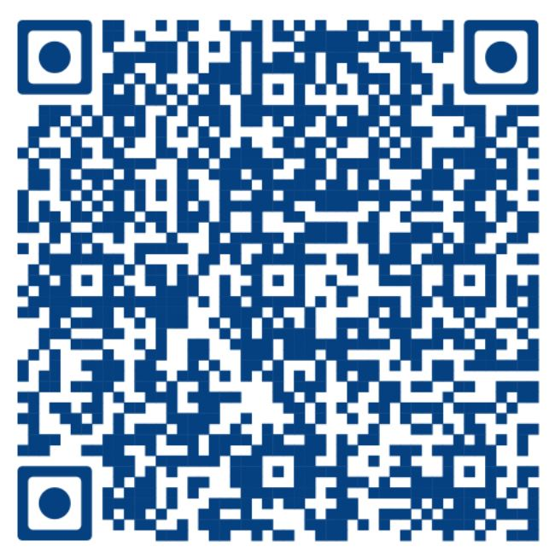
Finishing Teams
Choose
Choose an area of expertise or interest – YOUR SUPERPOWER
Attend
Attend a 1-hour Zoom training September 16th at 3 pm
Read
Read a short excerpt from a Weaving Team, review evidence, give input based on a rubric
Meet
Meet with your Finishing Team to compare notes and discuss next steps
Submit
Submit Finishing Team input to the Accreditation Steering Committee
Accept
Accept our thanks and add accreditation experience to your resume!
Notes:
Michelle

Slide 10
Why get involved?
Build your resume!
Build relationships at the College (Possible letters of recommendation)
Have your voice heard!
Free swag & sometimes food

Slide 11

Seeking Campus Input
Campus Review
Paced release of all ISER elements
Anonymous responses
Listening Tour
Notes:
Barbara

Slide 12

Overall Timeline
Summer 2022 – Review of process effectiveness
Fall 2022
  Resource/review teams
  Finishing teams
  Friday Fall Forums – 9/16; 10/21; 11/18
Spring 2023 – Roll out to the campus and Board of Trustees
Summer 2023 – Submit the ISER
Fall 2023 – Formative review by ACCJC Peer Team
Spring 2024 – ACCJC Focused Site Visit
Summer 2024 – Celebrate!

Slide 13
Thank you so much for your time!
For more information, please go to the Accreditation webpage
Link: https://www.mtsac.edu/accreditation/college_accreditation/2024/index.html

