Slide 1
Accreditation
Weaving Our Stories

Slide 2
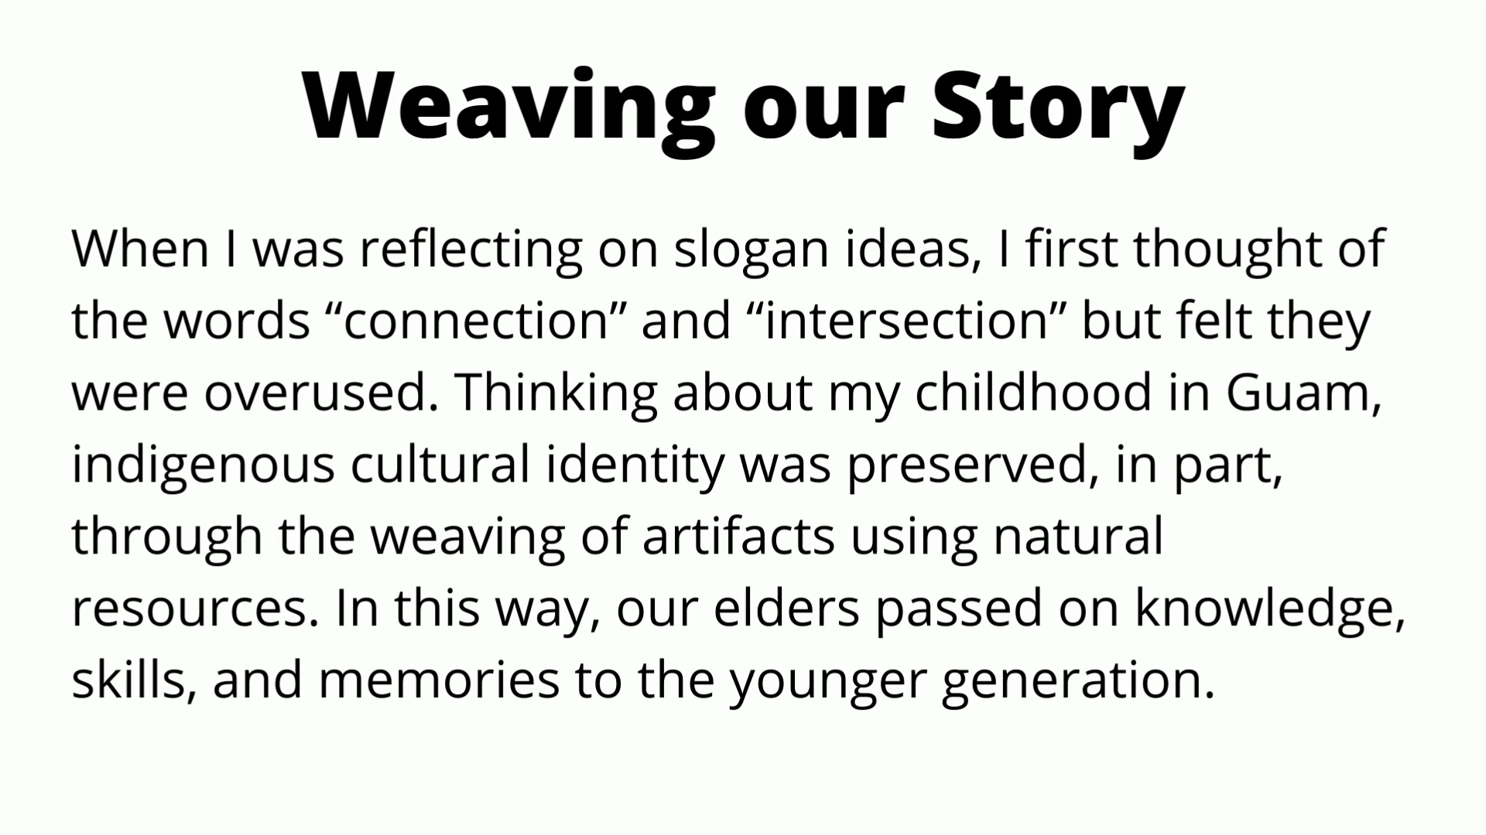
Weaving Our Stories
Introduction to the Video: Aida Cuenza-Uvas
Notes:
Hi, I'm Allie Frickert-Murashige from the History department and I'm the assistant faculty Accreditation coordinator. Last October at our big kickoff we revealed the winning slogan submission "Weaving our Story." Today we have a logo to show you! Our logo and slogan are perhaps unusual in guiding not only our abstract philosophical approach to Accreditation, but in the concrete application of the concept of "weaving" into our practical approaches for this cycle. Before we show the logo, I would like to share the context for the inspiration of both slogan and logo from the slogan winner, my friend and colleague Aida Cuenza-Uvas, who is the director of Arise (our AAPI equity center) and who guided the many years of our Aanapisi federal grants. As part of the grants, Arise created "Digital Stories" a form of autobiographical oral history with roots in indigenous practices, in which Arise students share and record their stories, a small clip you are about to see.
Here is Aida!

Slide 3

The Accreditation Logo
Notes:
Barbara

Slide 4
Accreditation Core Team
Accreditation Liaison Officer/ VP Instruction | Kelly Fowler
Faculty Accreditation Coordinator | Barbara Mezaki
Faculty Accreditation Co-Coordinator | Allie Frickert
Director, Research and Institutional Effectiveness​ | Patty Quinones
Director, Professional Organizational Development​ | Lianne Greenlee
Executive Assistant to the VP Instruction | Laura Martinez
Associate Dean, Arts Division | Michelle Sampat
Notes:
Lianne

Slide 5
Accreditation Steering Committee
Accreditation Liaison Officer/ Vice President, Instruction (Co-Chair) | Kelly Fowler | Ongoing
Faculty Accreditation Coordinator (Co-Chair) (appointed by Academic Senate) | Barbara Mezaki | Ongoing
Faculty Accreditation Assistant Co-Coordinator (appointed by Academic Senate) | Allie Frickert | Ongoing
Director, Research and Institutional Effectiveness | Patty Quinones | Ongoing
Director, Professional Organizational Development | Lianne Greenlee | Ongoing
Associate Vice President, School of Continuing Education or Designee | Liza Becker | Ongoing
Associate Vice President, Instruction | Meghan Chen | Ongoing
Management from Student Services | Audrey Yamagata-Noji | 2019-2022
Management from Administrative Services | Michael Carr | 2018-2021
Management from Human Resources | Sokha Song | 2019-2021
Academic Senate President or Designee | Chisa Uyeki | 2021-2024
Faculty Association President or Designee | Elizabeta Meyer | 2019-2022
Classified Senate President or Designee | Diana Dzib | 2021-2024
CSEA 262 President or Designee | Robert Stubbe | 2019-2022
CSEA 651 President or Designee | Kimberly Butler | 2021-2024
Students (Appointed by the Associated Students) | Matthew Sosa/Amber Nuno | 2021-2022
Outcomes Coordinator | Kim-Leiloni Nguyen | Ongoing
Faculty Noncredit Member (Appointed by Academic Senate) | L.E. Foisia | 2020-2023
Faculty Member (Appointed by Academic Senate) | Michelle Shear | 2020-2024
Notes:
Lianne

Slide 6
The Old Story..
What the ACCJC Accreditation Process was...
Lengthy -- many meetings over two years.
Big campus-wide writing teams.
Long, repetitive ISER (Institutional Self-Evaluation Report), 500-600 pages (!)
Inclusion of ALL possible evidence relating to the standards.
A weeklong site visit from the site team.
High pressure, stressful situation with visiting team.
Visiting team could request information to clarify any gaps.
Deficit-minded approach (visiting team looking for "mistakes")
Notes:
Kelly

Slide 7
The Process still is...
Important Components of the Process that remain:
Inclusive
Reflective
Inquiry-based
Evidence-driven
Growth and improvement
Opportunity for collaboration, celebration, and community
Notes:
Michelle

Slide 8
The New Story…
What the ACCJC Accreditation Process is now...
Streamlined ISER (approximately 200 pages).
Best evidence -- not all evidence.
Growth mindset approach to the process.
It is a formative – summative process.
Process happens over three semesters, Spring, Fall, Spring.
The new process is meant to eliminate the "Gotcha!" And surprise.
Core inquiries inform the triangulation of evidence for reviewers.
A small visiting team will conduct a Focused Site Visit on Core Inquiries.
Notes:
Barbara

Slide 9
The Next Steps…
As we follow the new ACCJC process, we will also weave in the “Lessons Learned” from our 2017 Accreditation:
“Identify an expert lead writer and an effective facilitator for each Standard. “
“Minimize writing by committee.”
“Engage all constituencies.”
The Accreditation Core team response:
Small "weaving" teams.
Inclusion of faculty, staff, students, and administrators on teams, where possible.
Committee chairs with expertise relevant to specific areas.
Core team liaisons who will assist with drafting, evidence location, and evidence cross-referencing.
Notes:
Allie

Slide 10
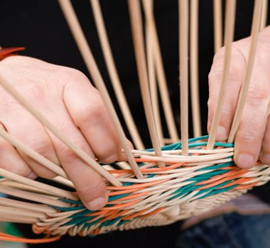
The Next Steps… The new process will be easier for each team!
No more "writing teams" with large groups working from scratch and needing to compile exhaustive evidence.
The ASC Core group will assist and support “Weaving Teams" with preliminary outline content, strategies for identifying representative (best) evidence, as well as strategic triangulation of evidence across different standards.
These ”Weaving Teams” will represent the campus committees and work groups with expertise pertaining to each standard.
Teams will have faculty, classified, administrative, and student representation whenever possible, in order to include diverse voices and perspectives.
Notes:
Michelle

Slide 11
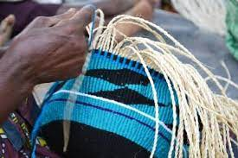
What will "Weaving Teams" do?
Engage in discussions about the representative samples of evidence
Identify evidence after reading the preliminary outline drafted by the Core Team
Freely modify and revise the preliminary outline
Provide additional representative samples of excellence as needed
Identify areas for improvement
Notes:
Kelly

Slide 12
Upcoming Training and Your Role…
The ASC Core Team will provide training for the chairs of the key committees that will be providing evidence for the standards.
Faculty input and participation is vital to the Accreditation process.
We need your help on our writing teams!
Notes:
Lianne

Slide 13
Do you want more information about how to get involved?
Email us!
Barbara Mezaki and Allie Frickert, Faculty Accreditation Coordinators
Bmezaki@mtsac.edu AND Africkert@mtsac.edu
Office Hours!
Office hours provide an opportunity to speak with the members of the Accreditation Core committee.
Kelly Fowler (Mt. SAC ALO/VPI)
First Friday of the month 8 am – 9 am
Barbara and Allie (Faculty Coordinators)
Fridays from 1:00 – 2:00 pm on Zoom
Patty Quiñones (Director of Research and Institutional Effectiveness ) will join the above Coordinator office hours periodically.
Notes:
Barbara, Allie

