Slide 1
Accreditation
Weaving Our Stories

Slide 2
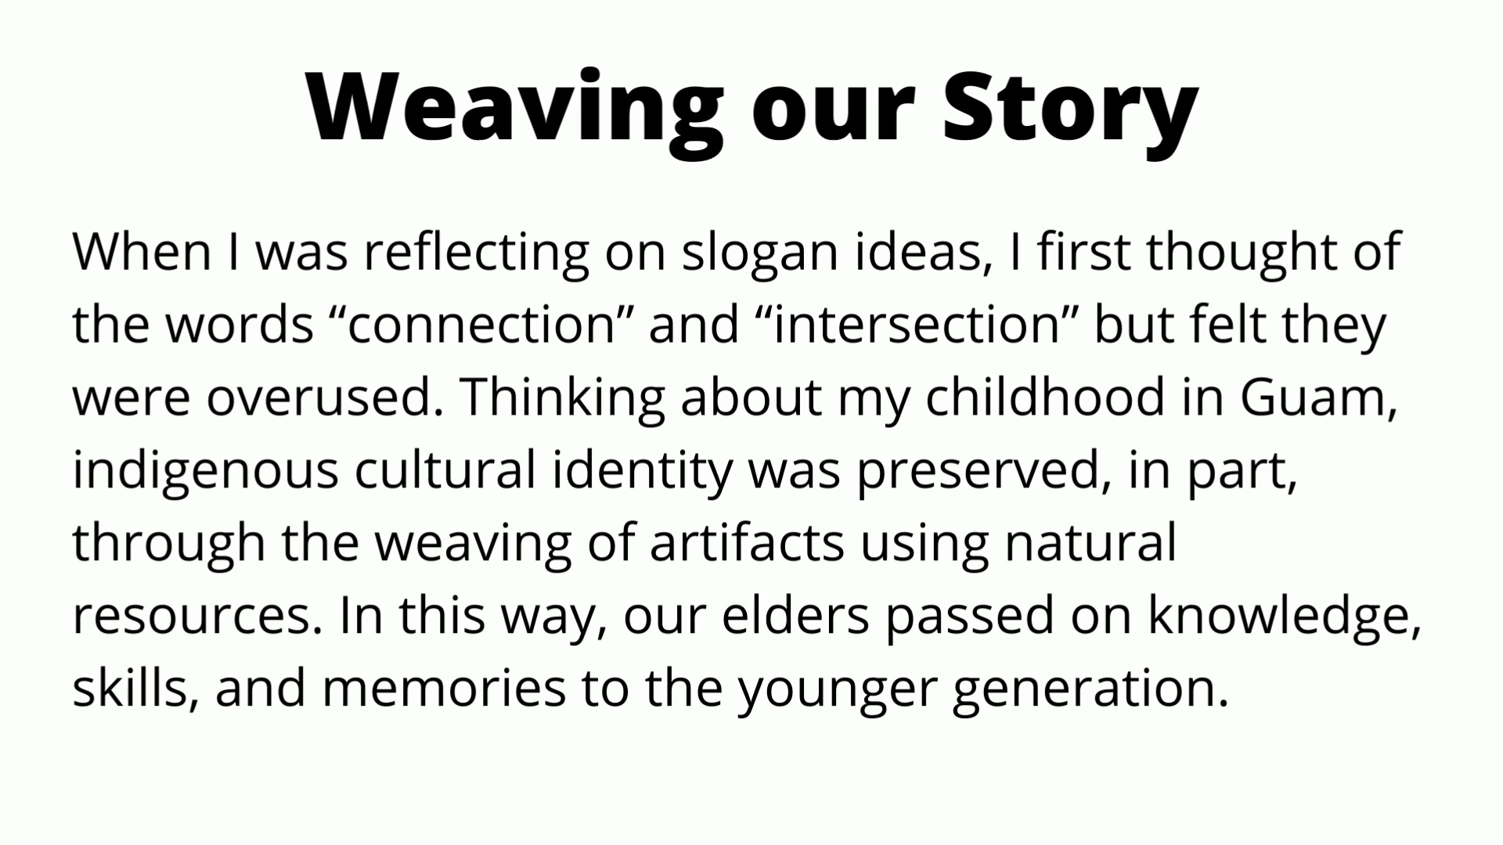
Weaving Our Stories
Introduction to the Video: Aida Cuenza-Uvas
Notes:
Hi, I'm Allie Frickert-Murashige from the History department and I'm the assistant faculty Accreditation coordinator. Last October at our big kickoff we revealed the winning slogan submission "Weaving our Story." Today we have a logo to show you! Our logo and slogan are perhaps unusual in guiding not only our abstract philosophical approach to Accreditation, but in the concrete application of the concept of "weaving" into our practical approaches for this cycle. Before we show the logo, I would like to share the context for the inspiration of both slogan and logo from the slogan winner, my friend and colleague Aida Cuenza-Uvas, who is the director of Arise (our AAPI equity center) and who guided the many years of our Aanapisi federal grants. As part of the grants, Arise created "Digital Stories" a form of autobiographical oral history with roots in indigenous practices, in which Arise students share and record their stories, a small clip you are about to see.
Here is Aida!

Slide 3

The Accreditation Logo
Notes:
Barbara

Slide 4
The Old Story..
What the ACCJC Accreditation Process was...
  Lengthy -- many meetings over two years.
  Big campus-wide writing teams.
  Long, repetitive ISER (Institutional Self-Evaluation Report), 500-600 pages (!)
  Inclusion of ALL possible evidence relating to the standards.
  A weeklong site visit from the site team.
High pressure, stressful situation with visiting team.
      Visiting team could request information to clarify any gaps.
Deficit-minded approach (visiting team looking for "mistakes")
Notes:
Kelly

Slide 5
The Process still is...
Important Components of the Process that remain:
Inclusive
Reflective
Inquiry-based
Evidence-driven
Growth and improvement
Opportunity for collaboration, celebration, and community
Notes:
Michelle

Slide 6
The New Story…
What the ACCJC Accreditation Process is now...
Streamlined ISER (approximately 200 pages).
Best evidence -- not all evidence.
Growth mindset approach to the process.
It is a formative – summative process.
Process happens over three semesters, Spring, Fall, Spring.
The new process is meant to eliminate the "Gotcha!" And surprise.
Core inquiries inform the triangulation of evidence for reviewers.
A small visting team will conduct a Focused Site Visit on Core Inquiries.
Notes:
Barbara

Slide 7
The Next Steps…
As we follow the new ACCJC process, we will also weave in the “Lessons Learned” from our 2017 Accreditation:
“Identify an expert lead writer and an effective facilitator for each Standard. “
“Minimize writing by committee.”
“Engage all constituencies.”
The Accreditation Core team response:
Small "weaving" teams.
Inclusion of faculty, staff, students, and administrators on teams, where possible.
Committee chairs with expertise relevant to specific areas.
Core team liaisons who will assist with drafting, evidence location, and evidence cross-referencing.
Notes:
Allie

Slide 8
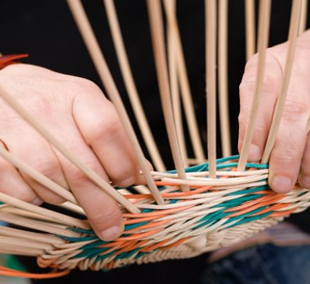
The Next Steps… The new process will be easier for each team!
No more "writing teams" with large groups working from scratch and needing to compile exhaustive evidence.
The ASC Core group will assist and support “Weaving Teams" with preliminary outline content, strategies for identifying representative (best) evidence, as well as strategic triangulation of evidence across different standards.
      These ”Weaving Teams” will represent the campus committees and work groups with expertise pertaining to each standard.
      Teams will have faculty, classified, administrative, and student representation whenever possible, in order to include diverse voices and perspectives.
Notes:
Michelle

Slide 9
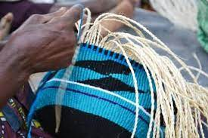
What will "Weaving Teams" do?
      Engage in discussions about the representative samples of evidence
      Identify evidence after reading the preliminary outline drafted by the Core Team
      Freely modify and revise the preliminary outline
      Provide additional representative samples of excellence as needed
      Identify areas for improvement
Notes:
Kelly

Slide 10
Weaving Team Training
Evidence Gathering for the ISER

Slide 11
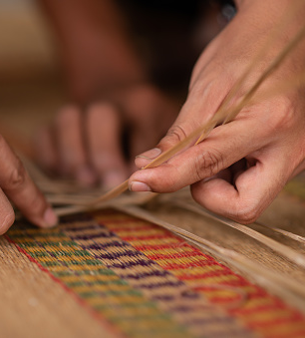

The ACCJC Accreditation Review Team will be looking for:
Process
Procedures
Practices
This means that your Weaving Team wants to explain the process that the College uses, the procedures in that process, and how that works in practice. add text

Slide 12
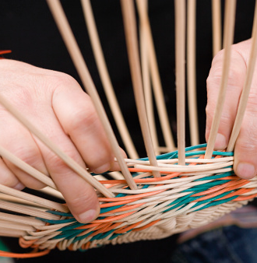
Step 1:
Set up a “Weaving Team” of your committee or group

Slide 13
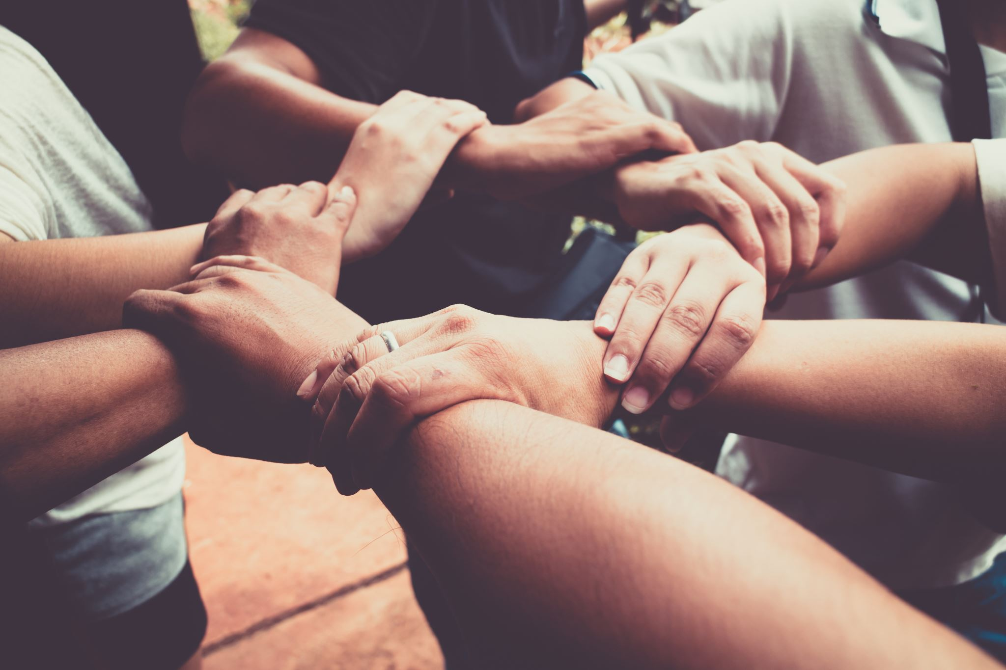
Step 2: the Weaving Team should have representation from constituent groups (manager, faculty, classified, student) to ensure inclusion.

Slide 14

Step 3: Set up the Roles for the Weaving Team:
Planner - facilitates meetings, sets agendas, communicates updates, and is the point of contact for the liaison.
Investigator - quality control with evidence gathering, formatting, ensuring evidence is recent and relevant, and matching the narrative text to the evidence.
Documenter - compiles info, supplements and/or revises draft responses to the standards, is the primary editor.
Standards Supporters - (optional) a specific lead assigned to each sub section of the standard.
*NOTE- one person can hold multiple roles (as decided by the team)

Slide 15
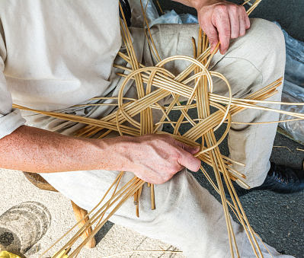
The ASC Core Group recognizes that every committee has a different “culture” that we want to respect.

Slide 16
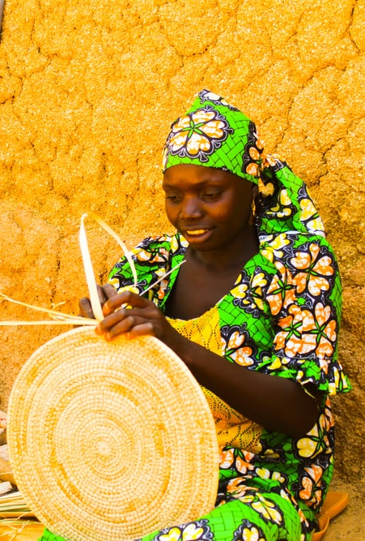
The Accreditation Standards are assigned to a primary team
But…
Each Weaving Team will have access to “Resources,” which are other committees or groups that will be able to augment the evidence of your Weaving Team.
These committees and groups have been notified that your primary team will be contacting them.

Slide 17
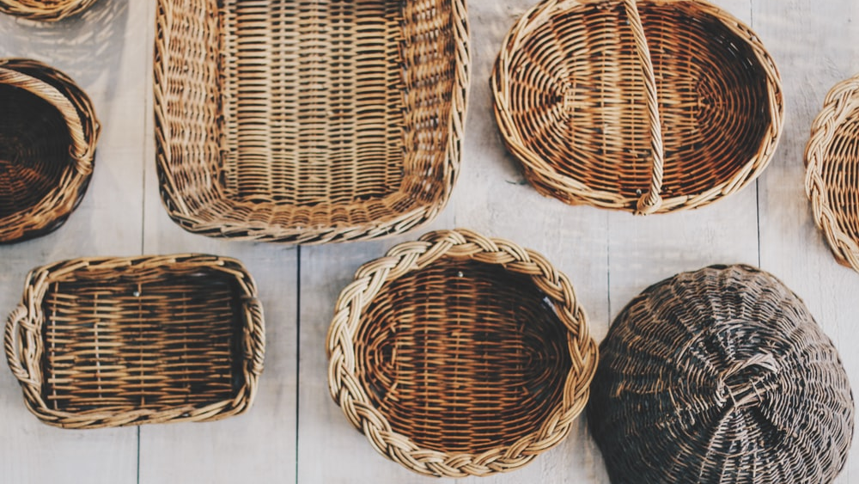
There are many ways to “weave.”
Your Weaving Team might make arrangements to speak to members of the Resource Teams – one of the liaisons can help facilitate this conversation if necessary.

Slide 18
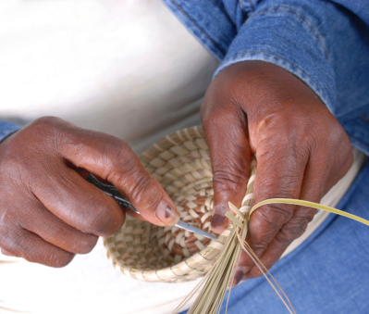
There is a Liaison assigned to each Weaving Team.
Core Team Liaisons:
Kelly Fowler
Allie Frickert
Barbara Mezaki
Lianne Maldonado-Greenlee
Patty Quiñones
Michelle Sampat

Slide 19
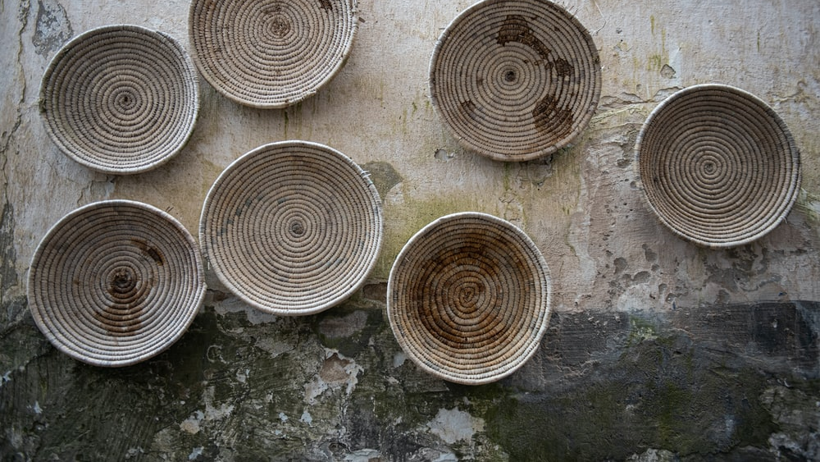
Your Weaving Team’s Charge:
Read and familiarize yourself with the Standards/Eligibility Requirements and the “review criteria” from the ACCJC
Backward plan your Weaving Team’s necessary meetings and completion date based on the timeline
Review the draft and suggested evidence provided to your Weaving Team
Gather relevant evidence – contact the Resources Committees as needed
Evaluate the narrative and edit as necessary by adding, deleting or modifying to support the Standards

Slide 20
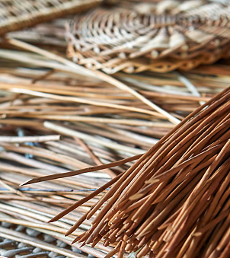
Consider the evidence your Weaving Team already has :
What evidence does the team have to show that the college meets the standard?
Does the team need additional evidence?
Do you have a request for data?
→ Send these requests to the core team liaison.

Slide 21
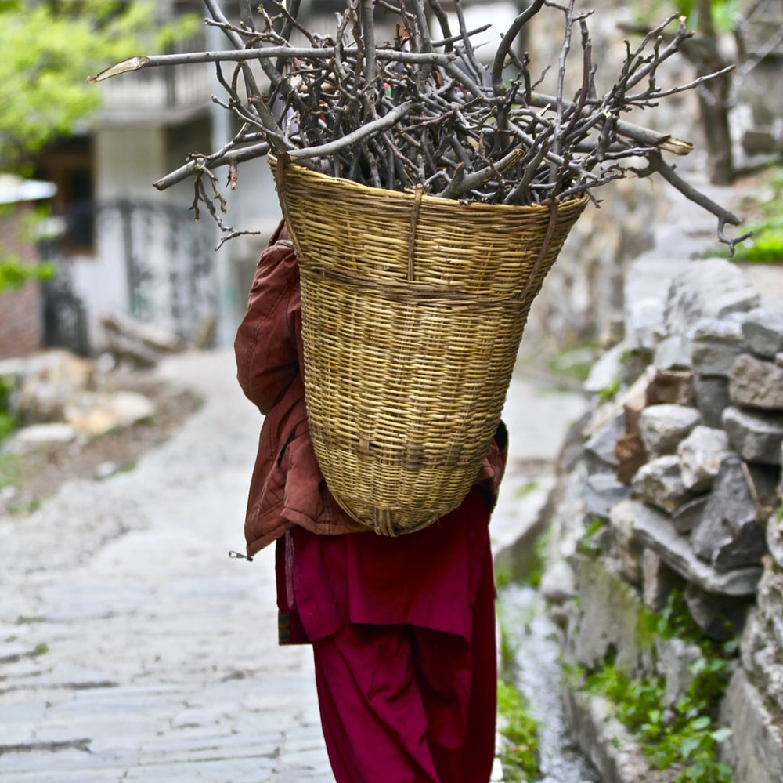
Once your Weaving Team has the evidence:
Please contact your Core Team Liaison about how and where to upload the evidence.

Slide 22
Do you want more information about how to get involved?
Email us!
Barbara Mezaki and Allie Frickert, Faculty Accreditation Coordinators
Bmezaki@mtsac.edu AND Africkert@mtsac.edu
Office Hours!
Office hours provide an opportunity to speak with the members of the Accreditation Core committee.
  Kelly Fowler (Mt. SAC ALO/VPI)
  First Friday of the month 8 am – 9 am
  Barbara and Allie (Faculty Coordinators)
  Fridays from 1:00 – 2:00 pm on Zoom
  Patty Quiñones (Director of Research and Institutional Effectiveness ) will join the above Coordinator office hours periodically.
Notes:
Barbara, Allie

