Slide 1

Advanced ISER Training: The Accreditation 4-1-1 August 26, 2022
With special guest ACCJC Liaison
Dr. Gohar Momjian
Vice President, ACCJC
Notes:
Kelly

Slide 2
Outcomes for Today:
Understand what to expect during the ACCJC Formative/Summative review process
Be familiar with the School of Continuing Education ASC WASC accreditation process
Celebrate accreditation work completed
Recognize accreditation in action during Fall 2022
Know about upcoming Key events
Notes:
Lianne

Slide 3
Your Accreditation Core Team
Kelly Fowler
Lianne Greenlee
Michelle Sampat
Barbara Mezaki
Allie Frickert
Patty Quiñones
Vice President of Instruction; Accreditation Liaison Officer
Assistant Dean of Accreditation
Associate Dean of Arts; Core Team member
Director of Research and Institutional Effectiveness
Professor of American Language; Faculty Accreditation Coordinator
Professor of History; Faculty Assistant Accreditation Coordinator
Laura Martinez
Executive Assistant to the Vice President of Instruction
Notes:
Barbara

Slide 4
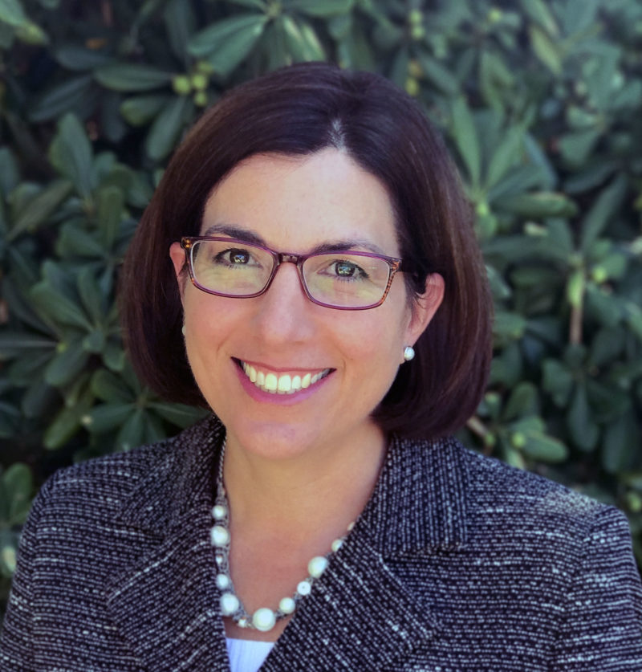
Dr. Gohar Momjian
Vice President at Accrediting Commission for Community and Junior Colleges (ACCJC) with more than 25 years of experience working in higher education and specialize in leading institutional change processes, strengthening organizational infrastructure, and securing resources to support innovative programs to enhance student access and success.
Notes:
Kelly

Slide 5
Welcome and Today’s Topics
The ISER: Good Practices & Tips
Overview of the Comprehensive Review Process
Questions Emerging from Your Process

Slide 6
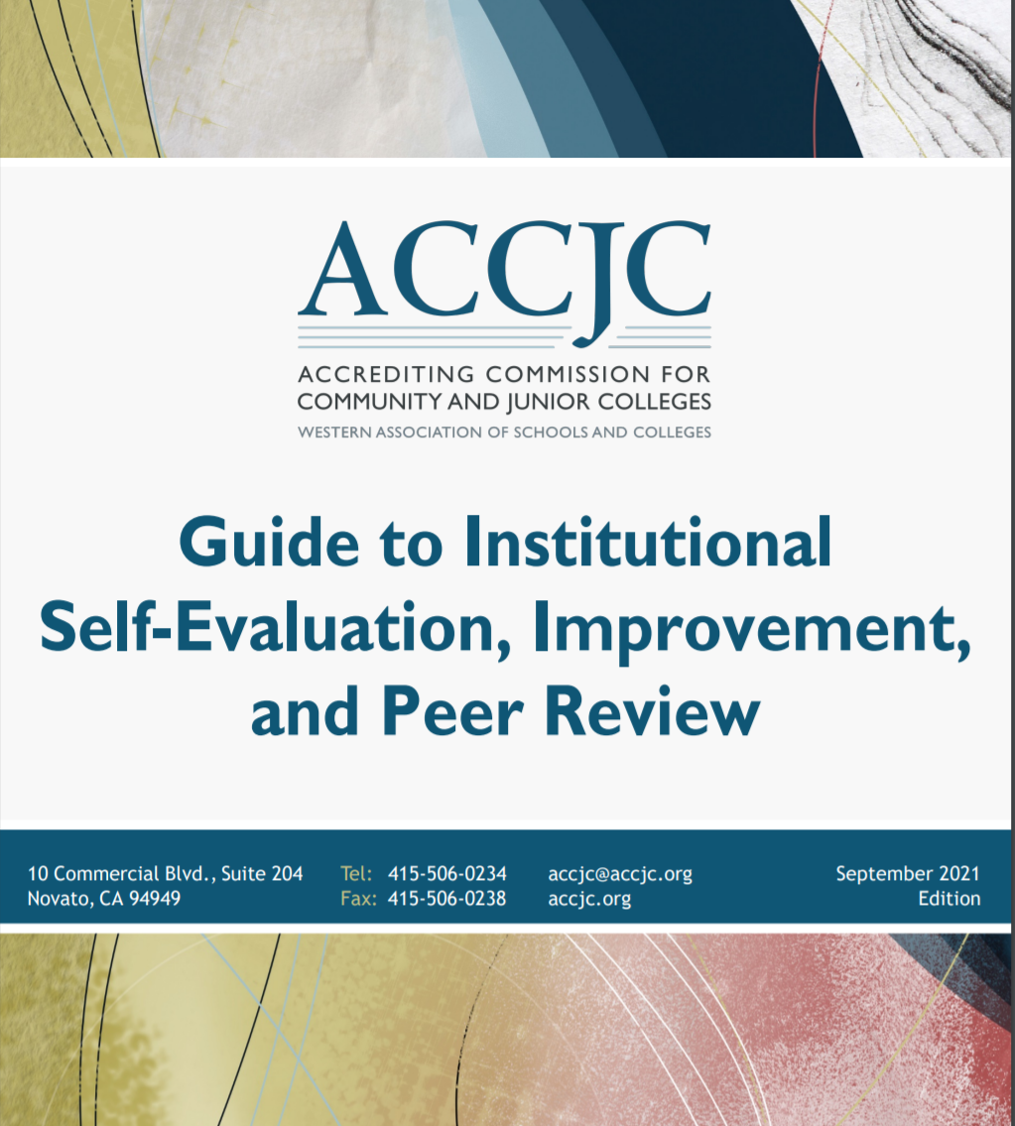
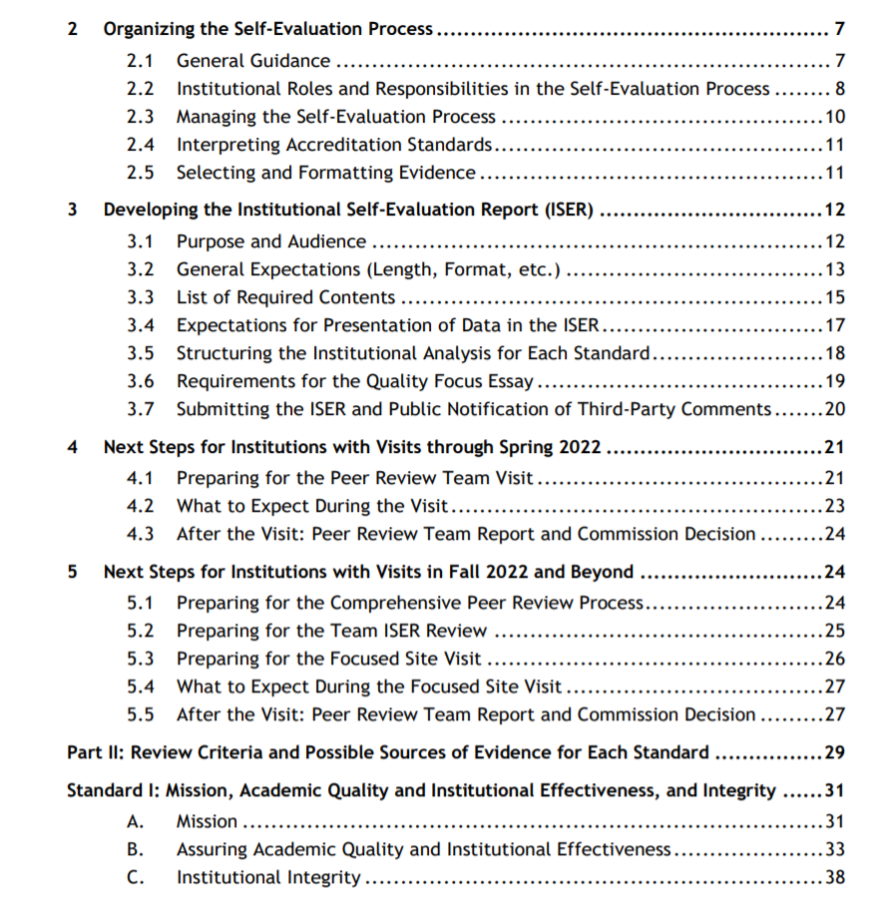
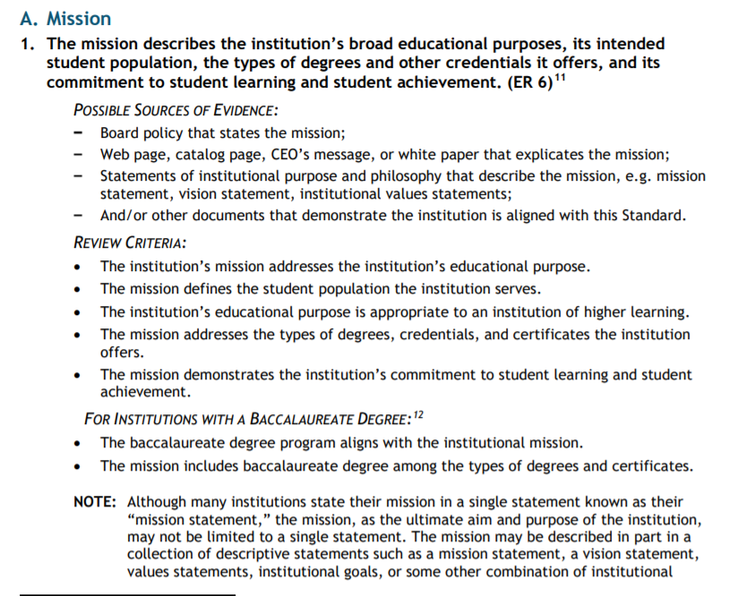
My Northstar
Notes:
•We have some writing teams that didn't notice "regardless of location or means of delivery" in some Standards.
•Many writing teams didn't notice when the last sentence in a Standard states "and uses the results for improvement".

Slide 7
Structure of the Institutional Analysis
Evidence of Meeting the Standard
Indicates WHAT specific evidence demonstrates alignment with the Standard
Briefly describes the evidence in its context to explain WHY it is relevant
Analysis and Evaluation
Indicates HOW the evidence demonstrates alignment with the Standard
Evaluates the effectiveness of the policy, procedure, or practice
May include improvement plans emerging from analysis and evaluation
Conclusions on Standard X (at the end of each major section)
Summarizes the effectiveness of the College’s efforts towards Standard
Includes improvements the College determines would strengthen alignment
Notes:
The goal of this structure is to demonstrate your collective reflection on how well your practice aligns with the Standard and help your readers see how you align.
You do not need to include a statement indicating that you meet the Standard.
Be judicious in selecting evidence - more is not always better.
If you find gaps in alignment with Standards, you have an opportunity to discuss improvement processes that have begun (and do begin improvements! You do not have to wait until after the team leaves to get started. If you see something, do something!)
We had a rich dialogue here around the idea of whether it is “safe” to acknowledge areas for institutional improvement. We acknowledged that in the past, there was a different approach to evaluation and there is lingering fear from living through those experiences. ACCJC is now training its Peer Review Teams to approach the process much differently – to come in with a growth mindset, and to practice appreciative inquiry techniques throughout the process. We’re asking them to think of themselves as a thoughtful friend, who cares enough to offer honest, constructive feedback to help you reach your potential as an institution.. Also remember: I will be with your peer review team throughout the process, in order to help them stay focused on interpreting the Standards in the context of your mission and culture.

Slide 8

Powerful Framework for Ongoing Improvement
Power of Self-Reflection
Power of Peer Review
Power of Accredited Status

Slide 9
Reflect & Self-Assess as You Go
Questions to consider as you review your drafts:
Does each response flow from appropriate evidence?
Does the evidence sufficiently demonstrate how processes were followed? How processes led to improvements? Focus on outcomes in evidence.
Have we sufficiently addressed the Standard (subject, verb, direct object)?
Have we kept our response focused ONLY on the Standard?
How clearly do we demonstrate how the self-evaluation led to an understanding of strengths in alignment to Standards? Areas of improvement aligned to Standards?
Do we have action plans in place to address areas of improvement?
Do our relevant constituency groups understand the institutional processes described in the ISER?
Notes:
Examples and Case Studies – program review, and slo assessments – focus on results, show from result how process was used and led to improvement – mapping backwards
IIIA5– evaluations example
IVC7 – policy reviews, updates example

Slide 10
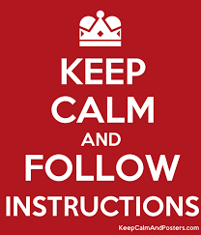
Other ISER Tips & Tricks
Always begin with relevant evidence
Focus on the core and language of the Standard
Use the ISER Template & Guide
Be concise – more is not necessarily better
Use simple, clear, business-style writing
Format as an electronic document from the start
Link to evidentiary documents with your readers in mind
“Freeze” any evidence from websites (PDF or Word)
Notes:
Approach the ISER as a technical report – not a presentation piece or descriptive paper. Write with clear, concise, business-style language.
There are suggested page lengths for each section in the Guide to Self-Evaluation, Improvement, & Peer Review -- try to stay at or near those limits!
Remember: the Peer Review Team is trained to approach your ISER and the visit with the assumption that you align with Standards. Write from that perspective, as well.
Outcomes focused examples!

Slide 11
Overview: The Accreditation Evaluation Process
Self-Reflection (ISER)
Peer Review (Team ISER Review & Focused Site Visit)
Affirmation (ACCJC Action)
Ongoing Commitment to Improvement & Educational Excellence
Notes:
-beginning of process not end test,
-Institutional Self Evaluation Report (ISER) say what ISER stands for– clean slate, you’re accredited, assume meet standards
-Peer Review (two semester approach) Formative and Summative Components: concluding in Team Report with Recommendations (for improvement or for compliance); Commendations;
-Commission action – accreditation status
-really always in cycle – always doing accreditation work (whether recognize it or not); focus on ongoing process – #accreditation365 - accreditation is part of everyday work

Slide 12
Comprehensive Peer Review
College
Self-Reflection
ISER
Team ISER Review
Standards Validation
Core Inquires
Off-Campus Site

Slide 13
Comprehensive Peer Review
College
Self-Reflection
ISER
Team ISER Review
Standards Validation
Core Inquires
Off-Campus Site
PEER REVIEW PROCESS
Focused Site Visit
Core Inquires
On-Campus Site
Team Report
Commission Action
(Affirmation)
College
Prep
College will have a few months from receipt of core inquires to prepare for focused site visit.

Slide 14
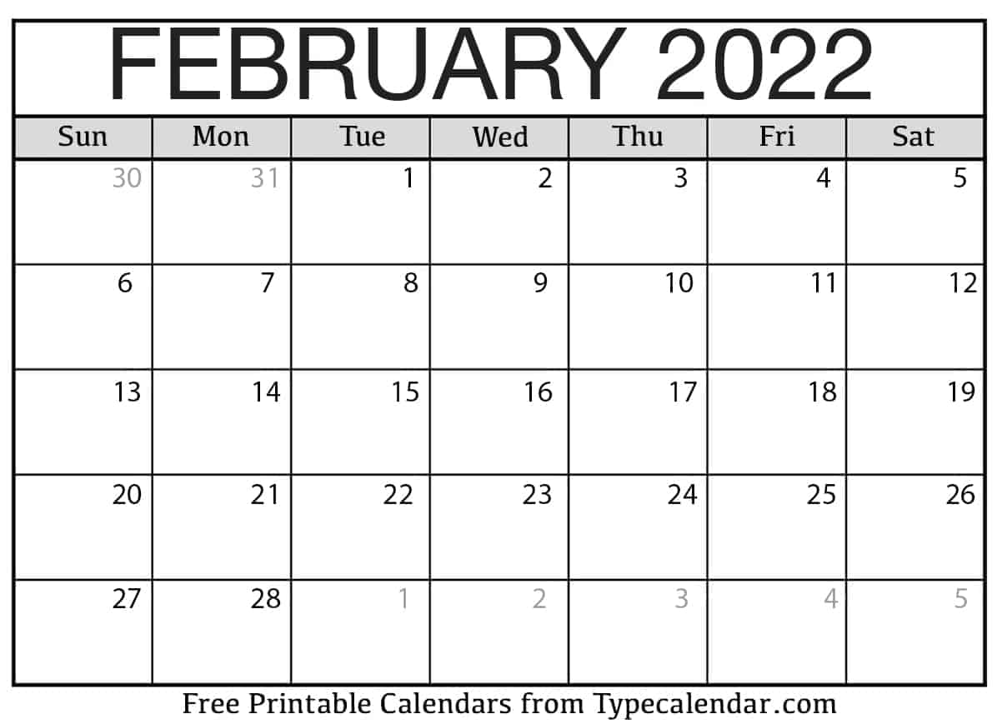
College Preparation: Team ISER Review & Focused Site Visit
Team ISER Review:
College responds with additional information or evidence as requested by team
College provides access to distance education courses (random sample from prior semester)
Hosts a virtual Meet & Greet
Hosts a virtual Open Forum
Receives “Core Inquiries” and reflects on them
Prepares for Focused Site Visit
Subsequent term (approx. 4 months)
Focused Site Visit - In-person (at college)
Provide brief narrative and add’l evidence in response to “Core Inquiries”
Host small team / short visit (logistics, hotel, workspace, interviews, meetings)
Host Open Forum and attend Exit report
Celebrate and Focus on ongoing improvement and excellence

Slide 15
Timeline for Comprehensive Review
Date | Activity
Fall 2021: | College began self-evaluation & ISER development
Aug. 1, 2023: | ISER due to ACCJC
Fall 2023: | Team ISER Review
Spring 2024: | Focused Site Visit
June 2024: | Commission Action

Slide 16
Formative/Summative Comprehensive Review Outcomes/Benefits
Reduce Fear
Eliminate
Surprise
Promote
Collegiality
Foster Trust
Increase
Transparency
Time to
consider team’s
Feedback
& plan
Emphasize
Improvement
Notes:
Eliminates surprises during Focused Site Visit
Reduces fear and anxiety
Allows you time to consider team’s feedback and make changes
Emphasizes institutional improvement and ongoing learning
Promotes collegiality between you and your peer review team
Increases transparency and trust
Reduces costs involved with the review process

Slide 17

Approach (mindset) for Review
Starts with trusting the ISER and evidence
Seek to understand the college in the context of its mission
Practice appreciative inquiry
Respect / Appreciate college processes, practices and culture
Validation and affirmation (alignment with Standards)
Not hunting for deficiencies (not playing gotcha game)
Not reviewing against other regulations or requirements of other groups/entities
Triangulate all evidence and findings
Goal: assist college with improving educational quality and student learning
Outcome: team report – help the college to improve, and celebrate good practice
Excerpted from Team Training materials, Fall 2022

Slide 18

Your questions… What additional information would be helpful?

Slide 19
School of Continuing Education
Madelyn Arballo
Minerva Avila
Provost, School of Continuing Education
Special Projects Manager
Notes:
Allie

Slide 20

Celebration of Teamwork
Weaving Teams
17 teams produced 13 drafts of 113 substandards
111 Faculty, staff, students, managers collaborated
Core Team
Met with and trained Weaving Teams
Reviewed and supported revisions for all drafts
Facilitated processes for ongoing work
Promoted campus engagement
Notes:
Michelle

Slide 21

Revised Mission/Vision/Values
Part of periodic review process
Led by Presidents Advisory Council Taskforce in 2021-22
Inclusive input from constituencies
Incorporates anticipated substantive changes
Timeline:
Spring 2022: Approved by constituencies & PAC
Summer 2022: 1st Review by Board of Trustees
September 2022: Anticipated Board of Trustees approval
Notes:
Barbara

Slide 22

Substantive Changes*
Requires ACCJC approval before it is included in the scope of the accreditation granted to the college
Application process:
Requires evidence of institutional planning
Includes resource commitment to the proposed change
Provides evidence that following the change, the College will continue to meet the Eligibility Requirements, Accreditation Standards and Commission policies
Anticipated submissions:
BA Histotechnology
Competency-Based Education (CBE)
*Any major change to the College Mission and programs
Notes:
Kelly

Slide 23

Strategic Plan in Development
Getting back on Track
Internal and external factors led to a short pause in revisions
Society for College & University Planning (SCUP) Training
Timeline:
2021-22 Campus engagement (ex: IEC listening tours)
September - October 2022: IEC and PAC review & finalize
November - December 2022: Review & approval by Board of Trustees
Notes:
Patty

Slide 24

Institutional Effectiveness Partnership Initiative (IEPI) Request
Colleagues-helping-colleagues model
Resource Team of experts assist the College in developing improvement strategies and timelines via an innovation and effectiveness plan
Letter of interest sent in Spring 2022 & Fall 2022
Mt. SAC's focus is on developing effective practices and structures to support, strengthen, and integrate outcomes, assessment, and the college’s Planning for Institutional Effectiveness (PIE) processes.
Notes:
Kelly

Slide 25
Self Reflection Results
Emerging Areas of Focus
Result from work of Weaving, Finishing, and Resource Teams
Self-Identified Improvement Plans (a.k.a. planning agenda)
Purpose: Plans to strengthen college’s alignment to specific standards
Quality Focus Essay (QFE)
Purpose: Long term plans to improve student learning and achievement
Identify outcomes, which are measurable and achievable
Notes:
Lianne

Slide 26
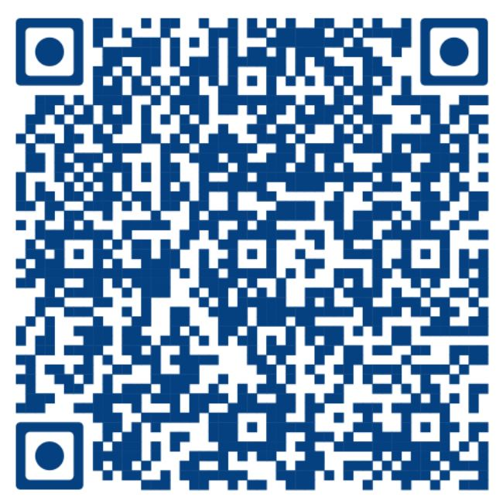
Finishing Teams
Choose
Choose an area of expertise or interest – YOUR SUPERPOWER
Attend
Attend a 1-hour convenient training at the September 16th Friday Forum at 3 pm
Read
Read a short excerpt from a Weaving Team, review evidence, give input based on a rubric
Meet
Meet with your Finishing Team to compare notes and discuss next steps
Submit
Submit Finishing Team input to the Accreditation Steering Committee
Accept
Accept our thanks and add accreditation experience to your resume!
Notes:
Michelle

Slide 27
Resource/Review Teams
College committees and councils identified by the Accreditation Steering Committee
Invited to give feedback on accreditation standards relating to their purpose/function
October – November 2022
Leverage expertise: “Does the ISER accurately reflect the policies, procedures, and practices related to the committee or council's work?”
Notes:
Allie

Slide 28


Mark Your Calendar!! Friday Online Fall Forums:
September 16th: Finishing Teams
October 21st: Distance Education/RSI
November 18th: The ISS and Data Coaching
Notes:
Patty
Watch your email for the fall accreditation newsletter and meme!

Slide 29

Seeking Campus Input
Campus Review
Paced release of all ISER elements
Anonymous responses
Listening Tour
Notes:
Barbara

Slide 30

Burning Questions
Notes:
Kelly

Slide 31
ASC & IEC Going Deeper August 26, 2022
With special guest ACCJC Liaison
Dr. Gohar Momjian
Vice President, ACCJC
Notes:
Kelly

Slide 32
Outcomes for Today:
Understand the intersection between accreditation & integrated planning
Define your leadership role in accreditation & integrated planning
Identify the College’s progress in developing the new Strategic Plan
Reflect on emerging ISER findings
Recognize your role in next steps for 2022-23
Notes:
Lianne

Slide 33

Chatfall
Chatfall:
Please type your answer into the chat …BUT DON’T HIT ENTER…YET!
What is your ultimate purpose at Mt. SAC?
Notes:
Barbara

Slide 34







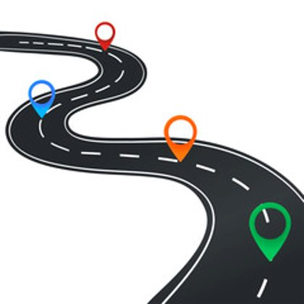

Collage of College Student Outcomes
Notes:
Barbara

Slide 35

Dr. Gohar Momjian
The intersection of accreditation & integrated planning
It’s more than Standard IB!
Notes:
Gohar

Slide 36

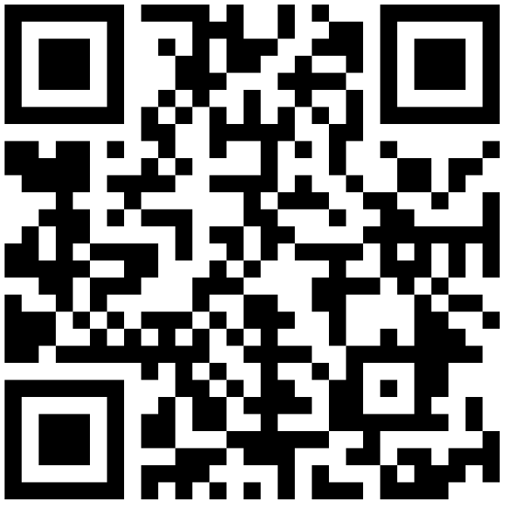
Essential Question:
As a campus leader, how do you see your role in accreditation and integrated planning?
Notes:
Allie
https://padlet.com/greenleelianne/gl8sbmpwu5430swg

Slide 37
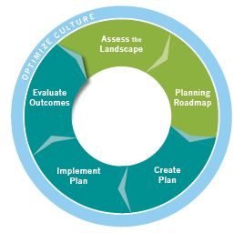
SCUP Model of Integrated Planning
Integrated planning: A sustainable approach to planning that builds relationships, aligns the organization, and emphasizes preparedness for change
Notes:
Patty

Slide 38
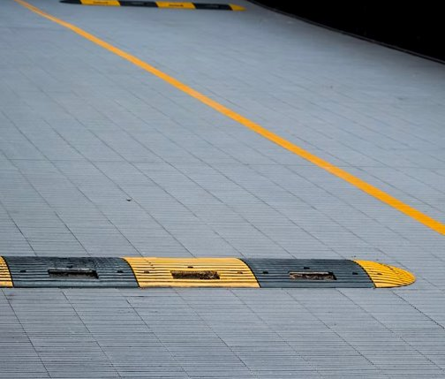
Speedbump
NOT because of accreditation
Accreditation = urgency to move forward
Notes:
Michelle

Slide 39
Process Thus Far
Fall 2020
Spring 2021
IEC and EPAC attendees worked on development of meta-level priorties.
Fall 2021
IEC co-chairs lead an EPAC training session on goals, objectives, strategies, and actions.
Spring 2022
IEC hosted six listening sessions & launched campus-wide survey
Fall 2022
IEC began the process of developing college priorities with a survey to committees
Coding of survey data generated 23 themes
IEC further synthesized meta-level priorites and developed 6 college priorties.
PAC approved 6 college priorities
RIE analyzed feedback data and generated themes
IEC used themes to develop goals, objectives, strategies, and actions.
EPAC engaged in a listening session of their own
IEC final revisions and approval of strategic plan.
IEC recommendation of strategic plan to PAC.
PAC approval of strategic plan
Campus leaders attended SCUP training
Mission/Vision/Values anticipated approval by Board of Trustees
Notes:
Kelly

Slide 40

Intersection of Strategic Plan with All Plans
Strategic Plan
Effectively coordinate human, physical, technology, and financial resources to improve student accessibility, growth, and academic success.
Develop and expand strategies for and communication about opportunities for students that support retention, persistence, and success.
Further develop, facilitate, and maintain a physically and emotionally safe and accessible campus environment.
Advance and foster an equitable, diverse, inclusive, just, and anti-racist campus culture that empowers our community to make positive change in society.
Embed environmental, social, and economic sustainability into the work and decision-making processes of all areas of campus
Ensure open and authentic communication and coordination among stakeholders to support achievement of college goals
Student Equity Plan
CA Adult Education Program (CAEP) Plan
Professional Development Plan
Information Technology Master Plan
EEO Plan
Workforce Innovation & Opportunity Act (WIOA) Plan
Climate Action Plan
Educational and Facilities Master Plan
Electronic Media Accessibility Plan
Notes:
Lianne

Slide 41

Definitions
Strategic Plan
Describes how goals will be achieved through the use of available resources.
Strategic Priority
Themes identified as broad campus objectives.
Goal
A broad statement of what an institution would like to accomplish or achieve. It is typically a big statement described in broad qualitative terms. Goals are supported by measurable objectives.
Objective
An objective is a specific outcome that defines a goal. Objectives are measurable and define how much improvement will take place. Objectives are described in specific quantitative metrics.
Strategy
A broad method or approach for achieving a goal. It provides a high-level plan the institution will follow to achieve a goal. Strategies answer the question “how do we accomplish our objectives”?
Action
An action is a specific activity or step that will be implemented to meet an objective and execute a strategy.
Notes:
Michelle

Slide 42
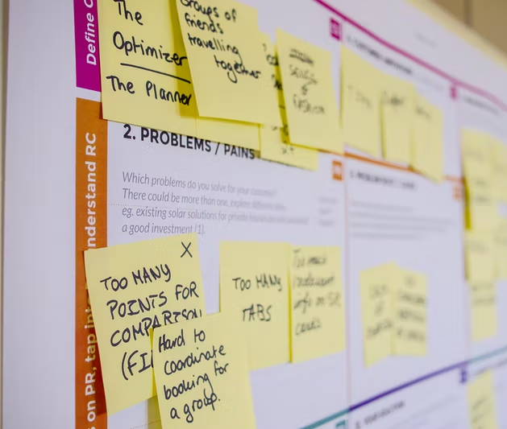
Anticipated Framework for Fall
IEC (September)
PAC & Governance Review (October)
Visual update for Planning Cycle (green monster)
Visual update for Integrated Planning & Budget Process Calendar (in collaboration with Budget Committee)
BoT (November)
Notes:
Allie

Slide 43

Connection between PIE and the Institution Set Standards (ISS)
Notes:
Patty

Slide 44

Institution-set Standards (ISS)
Cover metrics such as:
Successful course completion
Program completion (associate degrees and certificates)
Licensure exam pass rates
Job placement rates
The College establishes the standard goal and an aspirational (stretch) goal for each metric.
Notes:
Patty

Slide 45

Outcomes of ISER Reflection Process
Areas of excellence that the College should continue
Areas of potential improvement or change
An honest, evidence-based, and mission-focused self-evaluation
Ongoing institutional learning, and innovation and improvement in support of students’ success
Opportunity for deep, intentional reflection on current institutional conditions, achievements, and goals, and for thorough examination of the quality and effectiveness of programs, services, and institutional operations
--> Through the self-evaluation, institutions identify strengths and areas for further improvement.
Notes:
Barbara

Slide 46

Emerging Areas of Focus – How are these determined & next steps
Weaving Teams – Established the foundation for evidence review and drafts
Finishing Teams – Validate narrative and evidence
Resource Teams – Offer expert perspectives and “best evidence” check
Notes:
Lianne

Slide 47
Self Reflection Results
Improvement Plans
Purpose: Plans to strengthen college’s alignment to specific standards
Quality Focus Essay (QFE)
Purpose: Long term plans to improve student learning and achievement
Identify outcomes, which are measurable and achievable
Notes:
Michelle

Slide 48

Findings
Quality Focus Essay (QFE)
Integrated Planning Topic emerging as a result of current reflection process
Further Reflection to Strengthen Development of QFE
IEPI will provide feedback
IEC will have a major role in defining next steps
Notes:
Allie

Slide 49

Institutional Effectiveness Partnership Initiative (IEPI) Request
Mt. SAC's focus is on developing effective practices and structures to support, strengthen, and integrate outcomes, assessment, and the College’s Planning for Institutional Effectiveness (PIE) processes.
Notes:
Kelly

Slide 50

Critical areas of interest to be supported by an IEPI PRT Team
Review and reflect on progress around course, program, and institutional level outcomes.
Establish/re-establish an assessment cycle (regular and systematic) and timeline for course, program, and institutional level outcomes.
Leverage outcome data to help inform the college’s Planning for Institutional Effectiveness (PIE) processes.
Identify and implement course, program, and institutional outcomes through a DEISA (diversity, equity, inclusion, social justice, and antiracism) lens.
Implement a Professional Development Outcomes and Assessment (data-informed) Framework to support faculty, departments, and units in assessing and analyzing outcomes.
The proposed project to focus on outcomes and assessment helps to strengthen the meaning, impact and analysis of course outcomes, and leveraging these results for course, program, and institutional improvement
Notes:
Kelly

Slide 51

What would you like to share about the accreditation process, strategic planning, or any other topic from today's presentation?
On behalf of the Core Team, accept our thanks!
Notes:
Barbara

