Slide 1
DE/DL in Accreditation
Going the Distance with the New Federal DE Regulations.

Slide 2

Accreditation Core Team
Kelly Fowler
Lianne Greenlee
Michelle Sampat
Barbara Mezaki
Allie Frickert
Patty Quiñones
Vice President of Instruction; Accreditation Liaison Officer
Assistant Dean of Accreditation
Sangvan Thaysangkram
Associate Dean of Arts; Core Team member
Director of Research and Institutional Effectiveness
Professor of American Language; Faculty Accreditation Coordinator
Professor of History; Faculty Assistant Accreditation Coordinator
Special Assistant and Support
Laura Martinez
Executive Assistant to the Vice President of Instruction

Slide 3
DL Team Members
Dr. Romelia Salinas
Katie Datko
Carol Impara
Catherine McKee
Dean of Library and Learning Resources
Director of Distance Learning & Instructional Technology
Professor of Nutrition and Foods; Distance Learning Coordinator
Professor of Paralegal Studies; Assistant Distance Learning Coordinator

Slide 4
‘Weaving’ DL: A Few Key Terms
ACCJC
DL & DE
At Mt. SAC, we call it ‘Distance Learning’ (DL)
ACCJC calls it ‘Distance Education’ (DE)
Accrediting Commission for Community & Junior Colleges

Slide 5

Before starting, let's warm up with a Kahoot!
Open the Kahoot! app on your phone OR go to the URL: https://www.kahoot.it
Enter the game PIN 868 8022
Enter a USER NAME (Use an alias if you'd like!).
Notes:
Recommend Barbara present

Slide 6

‘Weaving’ DL: ‘Warp’ Threads
Warp: Vertical threads on the loom.
Foundational structure of cloth.
Accreditation ‘warp’ can be thought of as the following institutional requirements/processes*:
Mission
Shared Governance
Curriculum & Instruction
Academic Policies & Procedures
Faculty Contracts & Evaluations
Outcomes
*Standards I.C11, I.C.8, I.C.I, IIA.1, II.A.2, II.A.7, II.B.1, II.C.1, III.C.1 & Appendix C
Notes:
Katie

Slide 7
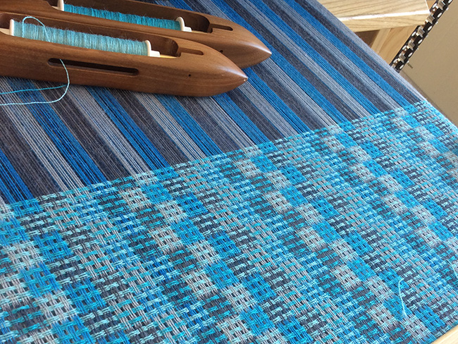
‘Weaving’ DL: ‘Weft’ Threads
Weft: Horizontal threads that intertwine with warp threads.
Pattern of the cloth can change.
In terms of accreditation & DL, the following can change or alter the makeup of the ‘cloth’ outside of institutional policies and processes:
Course quality
Course delivery
Notes:
Katie

Slide 8
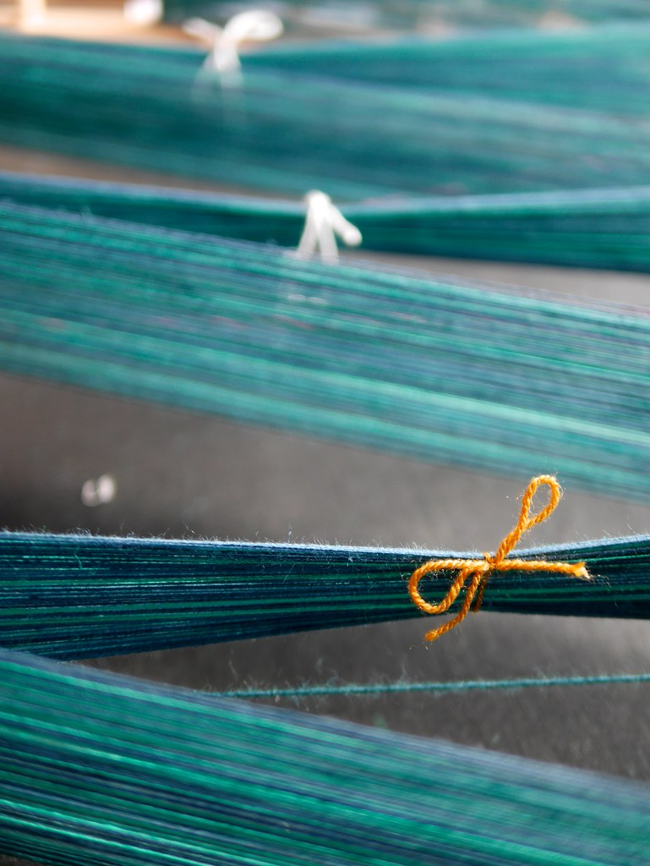
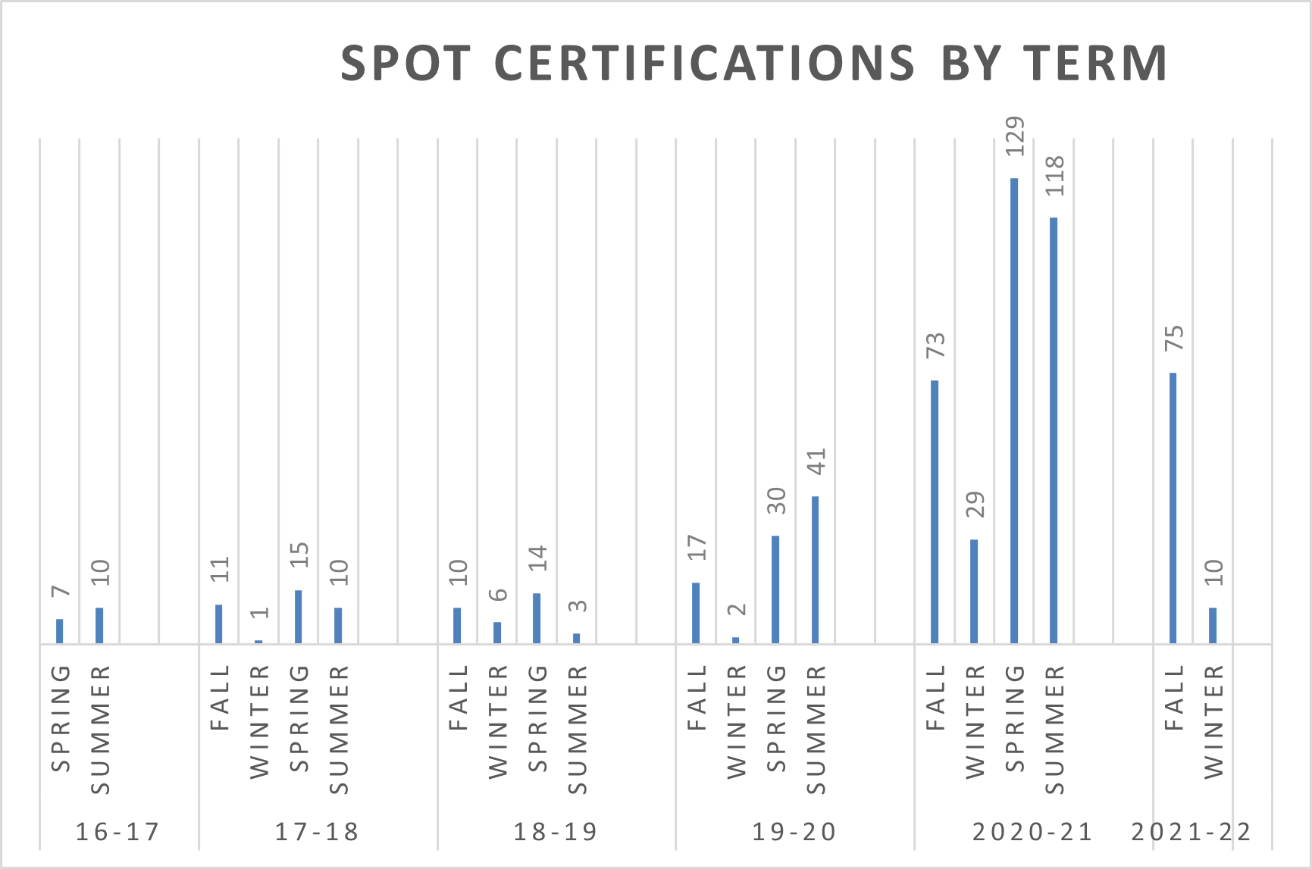
DLC Accomplishments (‘Warp’)
DLC Recommendations
Example: Camera & Privacy Use
DL AP 4015
Undergoing Update
Faculty Training (SPOT & SPOT Recertification)
Notes:
Carol
802 SPOT faculty total

Slide 9
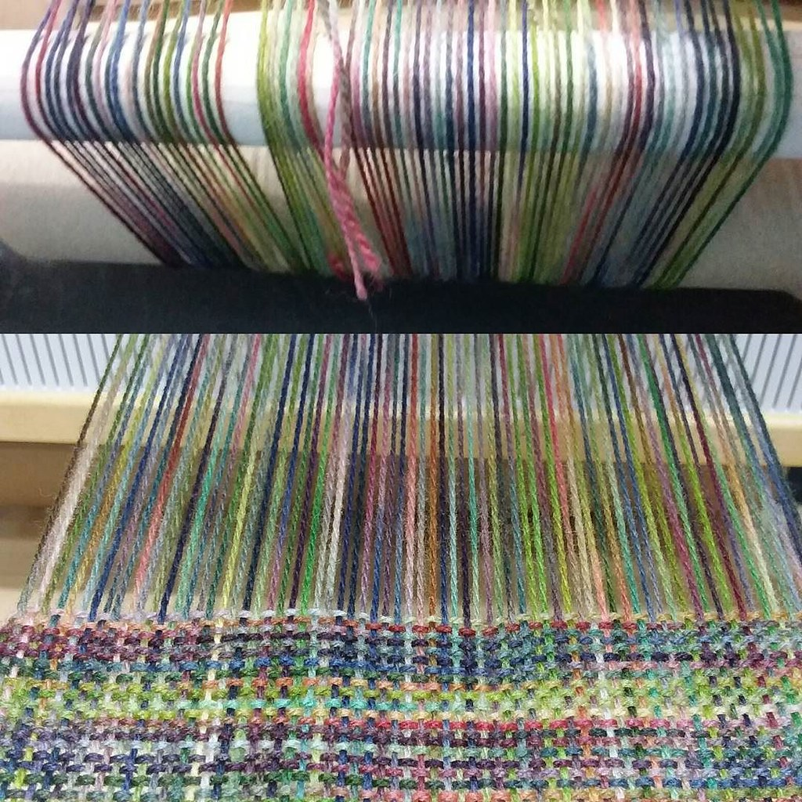
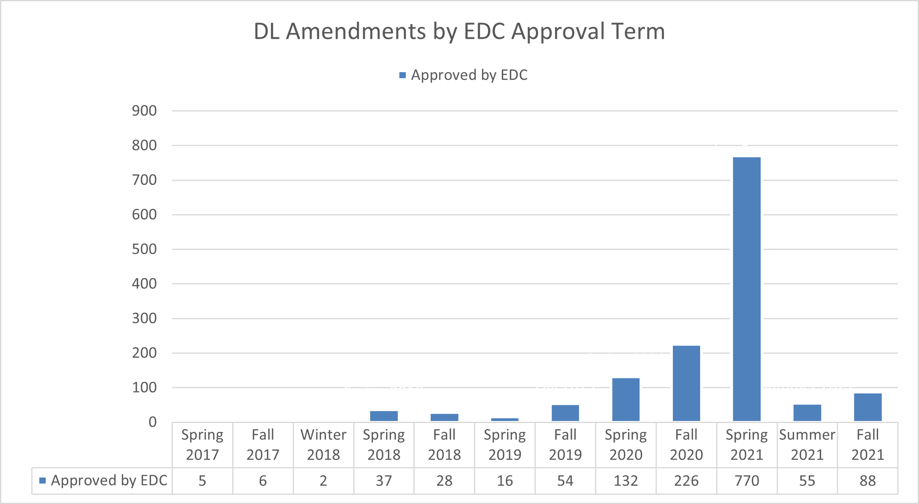
DLC & EDC Accomplishments (‘Warp’)
DL Addenda (DL Amendment Form)
All courses go through the full DL approval process
Notes:
Carol

Slide 10
DL Course Quality (‘Weft’)
The ACCJC has very specific requirements about Distance Education:
…all learning opportunities provided by accredited institutions must have equivalent quality, accountability, and focus on student outcomes, regardless of mode of delivery.
Policy on Distance Education & on Correspondence Education, June 2021.
Notes:
Recommend Accreditation Team Present

Slide 11
DL Course Delivery: Regular & Substantive Interaction (‘Weft’)
The ACCJC bases DL course delivery on 34 CFR § 602.3, which calls for Regular & Substantive Interaction (RSI).
Providing the opportunity for substantive interactions with the student on a predictable and scheduled basis commensurate with the length of time and the amount of content in the course or competency; and
Monitoring the student’s academic engagement and success and ensuring that an instructor is responsible for promptly and proactively engaging in substantive interaction with the student when needed, on the basis of such monitoring, or upon request by the student.
Notes:
Recommend Accreditation Team present

Slide 12
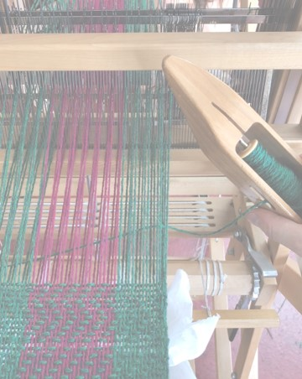
DL RSI Defined
The ACCJC bases DL course delivery on 34 CFR § 602.3
Policy on Distance Education & on Correspondence Education, June 2021.
…..substantive interaction is engaging students in teaching, learning, and assessment, consistent with the content under discussion, and also includes at least two of the following:
Providing direct instruction
Assessing or providing feedback on a student's coursework
Providing information or responding to questions about the content of a course or competency
Facilitating a group discussion regarding the content of a course or competency
Notes:
Carol

Slide 13

DL RSI Examples
Examples from Mt. SAC faculty of activities for RSI:
https://tinyurl.com/RSIexamples
Notes:
Carol

Slide 14
DL ACCJC ‘Weaving’ Process
The college should work with the team chair to provide a random sample of fully online distance education courses to observe. This sample should constitute 5% (not to exceed a maximum of 50) of the total number of distance education sections that were offered during the semester immediately preceding the semester of the comprehensive review.
Guide for Peer Review Team Members – November 2021, p. 27
Notes:
Recommend Accreditation Team present

Slide 15

Getting Started (Weaving Our First Few Rows)
DL Needs Assessment: https://tinyurl.com/MTSACDLNeedsassessment
Anonymous
Asks about
Course Structure
Regular & Substantive Interaction
Accessibility
Course Assessments
Fall RSI Trainings
Based on data from needs assessment
Academic Senate involvement
Notes:
Katie

Slide 16
Questions, Comments, Concerns?
Feel free to ask us questions and or provide feedback on this Padlet: https://tinyurl.com/DLForumQandA
For accreditation questions, please contact:
Lianne Greenlee
Barbara Mezaki
Allie Frickert
For DL questions, please contact:
Dr. Romelia Salinas
Katie Datko
Carol Impara

Slide 17
Resources
ACCJC DE Guidelines
Federal DE Guidelines
ACCJC Peer Review Process
Mt. SAC Accreditation Website
Mt. SAC DL Website
Mt. SAC DLC Website

