Slide 1

Accreditation Standards for the Governing Board Board Study Session November 12, 2022
Kelly Fowler, Vice President of Instruction and Accreditation Liaison Officer
Barbara Mezaki, Faculty Accreditation Coordinator
Lianne Greenlee, Assistant Dean, Accreditation & Planning
Patricia Quiñones, PhD, Director of Research and Institutional Effectiveness
Notes:
Kelly

Slide 2
Accreditation Core Team
Accreditation Liaison Officer / VP Instruction | Kelly Fowler
Faculty Accreditation Coordinator | Barbara Mezaki
Faculty Accreditation Co-Coordinator | Allie Frickert
Director, Research and Institutional Effectiveness | Patricia Quiñones, PhD
Assistant Dean, Accreditation and Planning | Lianne Greenlee
Acting Dean, Arts | Michelle Sampat, JD
Executive Assistant to the VP Instruction | Laura Martinez
Notes:
Lianne

Slide 3
What is Accreditation?
Accreditation is a practice of academic quality control.
Promotes institutional excellence through application of standards.
Advances meaningful and effective student learning and achievement.
In the United States we are fortunate that this is a peer-review driven process. In many other countries, colleges and universities are recognized by a government education agency, such as the Ministry of Education.
Notes:
Barbara

Slide 4
Benefits of Accreditation
Gives credibility to degrees and credentials awarded to students
Stimulates institutional innovation and improvement
Enables access to Title IV (Federal Student Aid)
Provides quality assurance to students, the public, and other institutions that your Colleges are achieving their missions
Other colleges accept our courses for transfer of credit because accreditation.
Notes:
Kelly

Slide 5
Elements of the Comprehensive Review
Self-Reflection (ISER)
Peer Review (Team ISER Review & Focused Site Visit)
Affirmation (ACCJC Action)
Ongoing Commitment to Improvement & Educational Excellence
Notes:
Lianne

Slide 6
Roles and Responsibilities of Trustees and Advice for Board Excellence
Notes:
Barbara

Slide 7
ACCJC Eligibility Requirement #7
Eligibility Requirement 7: Governing Board
The institution has a functioning governing board responsible for the academic quality, institutional integrity, and financial stability of the institution and for ensuring that the institution's mission is achieved. This board is ultimately responsible for ensuring that the financial resources of the institution are used to provide a sound educational program. Its membership is sufficient in size and composition to fulfill all board responsibilities. The governing board is an independent policy-making body capable of reflecting constituent and public interest in board activities and decisions. A majority of the board members have no employment, family, ownership, or other personal financial interest in the institution. The board adheres to a conflict of interest policy that assures that those interests are disclosed and that they do not interfere with the impartiality of governing body members or outweigh the greater duty to secure and ensure the academic and fiscal integrity of the institution. (Standard IV.C.1, IV.C.4, and IV.C.11)
Notes:
Barbara

Slide 8
ACCJC Actions on IV.C. Governing Board - January 2021 – June 2022
IV.C.1 (ER7): In order to meet the Standard, the Commission requires that the Board of Trustees assures the academic quality, integrity, and effectiveness of the student learning programs and services and the financial stability of the institution.
IV.C.2: In order to meet the Standard, the Commission requires that once the Board of Trustees reaches a decision, all board members act in support of board decisions.
IV.C.3: In order to meet the Standard, the Commission requires the Board adhere to their clearly defined policy for evaluating the CEO of the District.
IV.C.4 (ER7): In order to meet the Standard, the Commission requires the governing board functions as an independent, policy-making body that reflects the public interest in the institution’s educational quality.
IV.C.7: In order to meet the Standard, the Commission requires that the Board establish a formal process for regularly assessing its policies for effectiveness in fulfilling the District’s mission and revise them as necessary.
IV.C.11 (ER7): In order to meet the standard, the Commission requires the Governing Board uphold and adhere to their adopted code of ethics policy-BP 1010.
IV.C.12: In order to meet the standard, the Commission requires the Governing Board delegate full responsibility and authority to the Chancellor to implement and administer board policies without board interference and hold the Chancellor accountable for the operation of the District.
Notes:
Kelly

Slide 9
Fiduciary Responsibility: Representing the Public Trust
(B)oard members do not represent specific constituencies in the sense of taking board actions in favor of their interests. All governing board members, appointed or elected, have a fiduciary responsibility to the institution and are expected to bring to board deliberations a broad understanding of the college’s role in serving all students and the institution’s multiple stakeholders. There must be no implied obligation for any governing board member to serve the interests of a specific constituency over the interests of the broad mission of the college.
ACCJC Guide to Accreditation for Governing Boards, p. 7
Notes:
Lianne

Slide 10
Common Accreditor Concerns Regarding Boards
Is the Board:
Balancing the budget, planning for ongoing fiscal stability?
Staying at the “policy level” and not intruding into daily operations?
Acting as a collective entity, free from undue influence?
Acting consistently with its policies, bylaws, and code of ethics?
Delegating appropriately to the District CEO?
Remaining engaged in strategic, integrated planning?
Maintaining awareness and accountability for student success?
Notes:
Barbara

Slide 11
Institution-set Standards (ISS)
Cover metrics such as:
Successful course completion
Program completion (associate degrees and certificates)
Licensure exam pass rates
Job placement rates
The College establishes the standard goal and an aspirational (stretch) goal for each metric.
Notes:
Kelly

Slide 12
Institution-set Standards (ISS)
Notes:
Patty

Slide 13
Institution-set Standards (ISS)
Notes:
Patty

Slide 14

Questions?
Notes:
Lianne

Slide 15
School of Continuing Education ACS-WASC November 12, 2022
Madelyn Arballo, Provost, School of Continuing Education
Minerva Avila, Special Project Manager, School of Continuing Education

Slide 16
School of Continuing Education ACS-WASC November 12, 2022
Madelyn Arballo, Provost, School of Continuing Education
Minerva Avila, Special Project Manager, School of Continuing Education

Slide 17

Three WASC Commissions
SCE is seeking to reaffirm our accreditation status through ACS-WASC
The Western Association of Schools and Colleges (WASC) is one of six regional accrediting associations in the United States.
ACCREDITING COMMISSION FOR SCHOOLS (ACS)
ACCREDITING COMMISSION FOR COMMUNITY AND JUNIOR COLLEGES
ACCREDITING COMMISSION FOR SENIOR COLLEGES AND UNIVERSITIES
1
2
3
Post-secondary – Adult Education – ROP

Slide 18
ACS WASC Mission
ACS WASC Mission
ACS WASC advances and validates quality ongoing school improvement by supporting its private and public elementary, secondary, and postsecondary member institutions to engage in a rigorous and relevant self-evaluation and peer review process that focuses on student learning.
Source: https://www.acswasc.org/about/acs-wasc-overview/

Slide 19


Why Pursue Accreditation when Mt. SAC is already accredited through ACCJC
Why Pursue Accreditation when Mt. SAC is already accredited through ACCJC?
CERTIFIES TO THE PUBLIC THAT SCE IS A TRUSTWORTHY ADULT EDUCATION INSTITUTION OF LEARNING
UC/CSU approval of A-G requirements
Cal Grant and federal financial aid eligibility
Acceptance into the military
Transfer of HS credits to another HS program
Institutionalizes a cycle of improvement of SCE programs and operations to support student learning

Slide 20
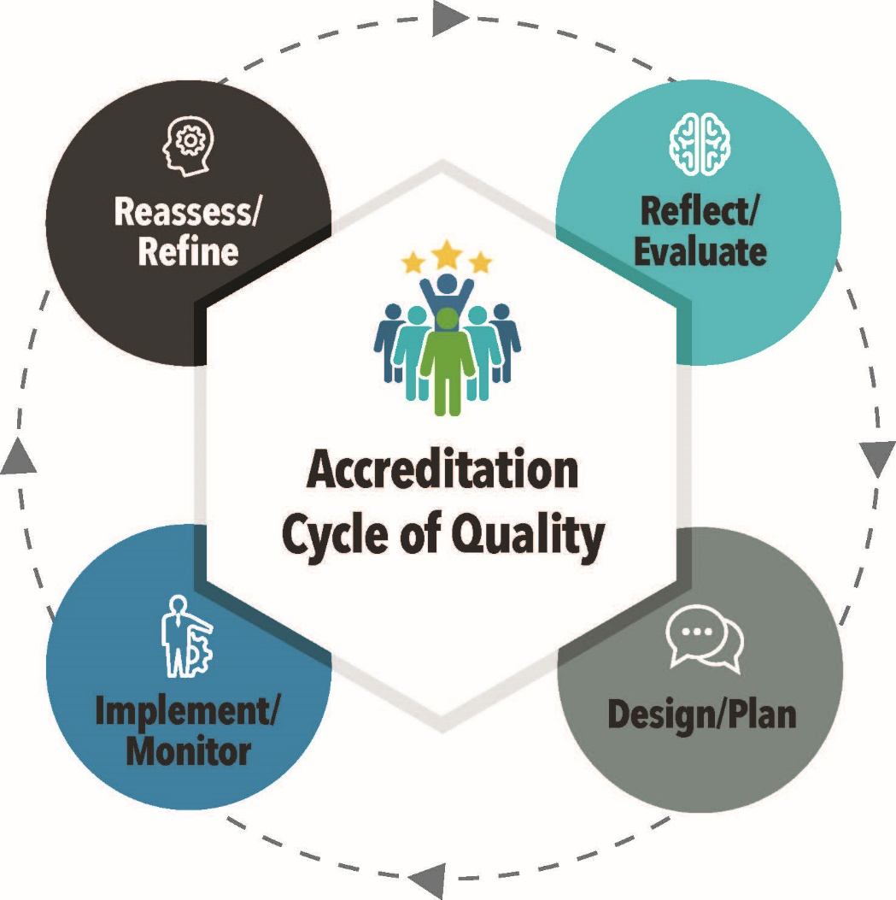
ACS WASC Process

Slide 21
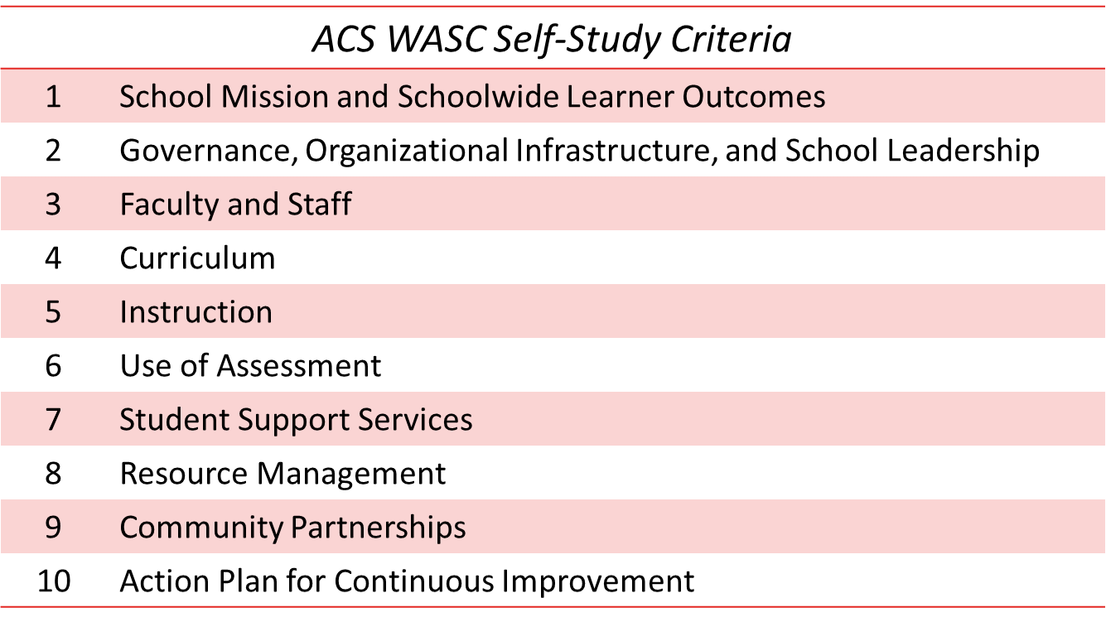
Ten Criteria Areas Guide the ACS Process

Slide 22
WASC: ACS & ACCJC COMPARISON
ACS WASC
ACCJC
6-year cycle
Mid-cycle report
Substantive change process
Eligibility requirements not included in self-study
Self-study process
Address 4 criteria by focus groups, and 6 additional criteria
Focused on student learning and the classroom
7-year cycle
Mid-cycle report
Substantive change process
Eligibility requirements addressed in the Institutional Self-Evaluation Report (ISER)
Self-evaluation process
Address 4 standards
Focused on the institution

Slide 23
Governing Board Responsibilities
Approval of mission statement, which is central to institutional planning and decision-making activities.
Enables the administration to implement policy and lead the school effectively.
Monitors regularly the annual review of the ACS WASC schoolwide Action Plan to ensure continuous improvement.
Review, provide input, and approve the self-study report submitted to ACS WASC

Slide 24
SCE’s ACS WASC Cycle Timeline
YEAR 1
2018-19
YEAR 2
2019-20
YEAR 3
2020-21(Mid-cycle Report)
YEAR 4
2021-22
YEAR 5
2022-23
2023-24 (Self-Study Report & ACS WASC visit)
YEAR 6

Slide 25
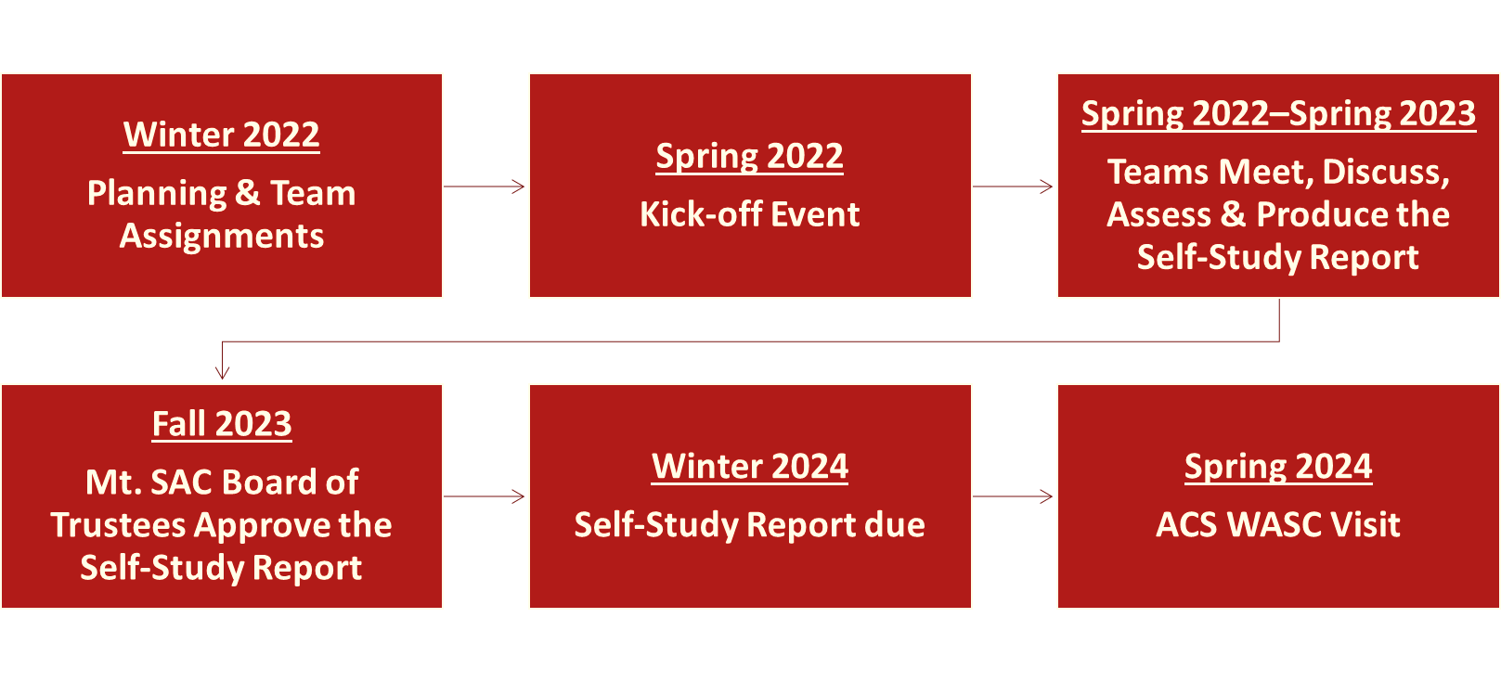
SCE’s ACS WASC Self-Study Timeline
Two-Year Process

Slide 26
Strategic Plan
Board Study Session
November 12, 2022
Kelly Fowler, Vice President of Instruction
Patricia Quiñones, PhD, Director of Research and Institutional Effectiveness
Notes:
Kelly

Slide 27
Overview of Strategic Plan
Strategic Plan contains six sections:
Introduction
Planning for Institutional Effectiveness (PIE) and Integrated Planning
Development of Strategic Plan
Alignment of Educational and Facilities Master Plan and Strategic Plan
College Priorities, Goals, Objectives, Strategies, and Actions
Implementation Plan
Notes:
Patty

Slide 28
I. Introduction
This section provides an overview of the college’s planning process and a brief overview of the plan’s contents. The following topics are addressed in this section:
Description of Board Policy 3250 on Institutional Planning
Role of Presidents Advisory Council (PAC)– assure the effectiveness of ongoing planning processes are periodically reviewed and to make recommendations on institutional plans, including Strategic Plan.
Role of Institutional Effectiveness Committee (IEC) – Evaluates the PIE process and gathers information on the status of the College’s Strategic Plan.
Notes:
Lianne

Slide 29
II. Planning for Institutional Effectiveness and Integrated Planning
This section provides a description of how PIE and the Strategic Plan are integrated and how both processes are used to evaluate accomplishment of the College’s Mission. The following topics are addressed in this section:
Description of the PIE process
IEC’s role in evaluating and assessing the PIE process
Integration of PIE with the College’s Strategic Plan and Mission.
College’s revised Mission, Vision, and Core Values
Notes:
Barbara

Slide 30
III. Development of the Strategic Plan
This section details the steps taken to develop the current Strategic Plan. The section provides an account of the work done by IEC, Expanded PAC, and PAC, dating back to Fall 2020, to get this Strategic Plan done. The following topics are addressed in this section:
Development of the Strategic Planning Priorities
Campus-wide data collection: Listening sessions and campus survey
Development of Goals, Objectives, Strategies, and Actions
Timeline of Strategic Plan Development
Notes:
Kelly

Slide 31
IV. Alignment of Educational and Facilities Master Plan and Strategic Plan
This section demonstrates the alignment between the Education and Facilities Master Plan (EFMP) and the Strategic Plan.
Given that the EFMP is the College’s long-term plan and serves as the foundation for other components of the College’s integrated planning process, it was important to highlight the alignment between the EFMP and the Strategic Plan.
This section includes a crosswalk between the EFMP Themes from PAC and Strategic Plan Priorities.
Notes:
Patty

Slide 32
V. College Priorities, Goals, Objectives, Strategies, and Actions
The main section of the Strategic Plan is devoted to the College goals, objectives, strategies, and actions. The goals, strategies, and actions were developed using campus-wide feedback collected during the listening sessions and campus survey. This section includes the following:
Goal, objectives, strategies, and actions for each College priority
Each College priority has a table of goals, objectives, strategies, and actions.
Notes:
Lianne

Slide 33
IV. Implementation of Strategic Plan
This section contains a description of how the Strategic Plan will be implemented. The implementation process described in previous Strategic Plans has been carried forward to this plan.
The implementation plan includes:
The role of PAC in prioritizing and identifying goals annually
PAC assigning actions to departments and committees
Integration of Strategic Plan actions into PIE
IEC’s role in evaluating progress on actions, the efficacy of planning practices, and recommendations to PAC.
Notes:
Barbara

Slide 34
Next Steps
PAC Review and Feedback
Cabinet Review and Feedback
Implementation Plan:
Alignment of Goals, Strategies, Objections, and Action Items
Timeline
Notes:
Kelly

Slide 35

Questions?
Notes:
Kelly

