Slide 1

Accreditation Welcome! Student Accreditation Orientation

Slide 2
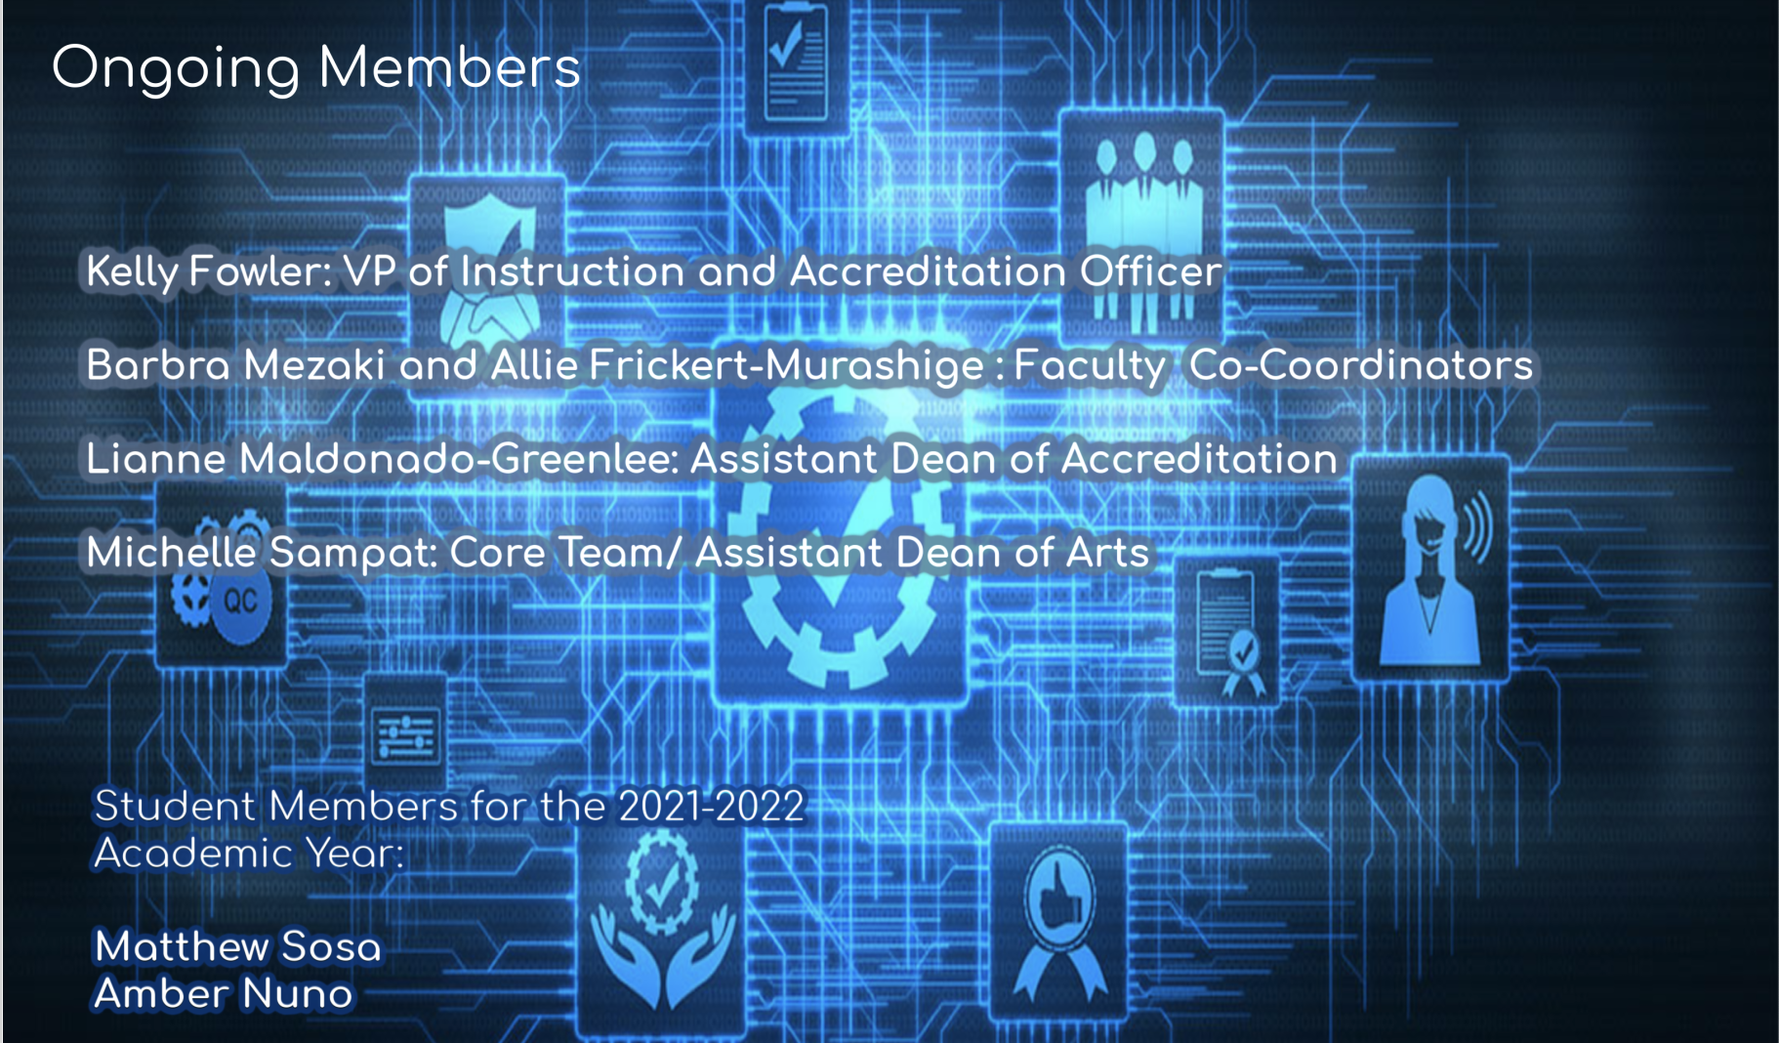
Ongoing Members

Slide 3

Introductions

Slide 4

The Purpose and Process of Accreditation

Slide 5
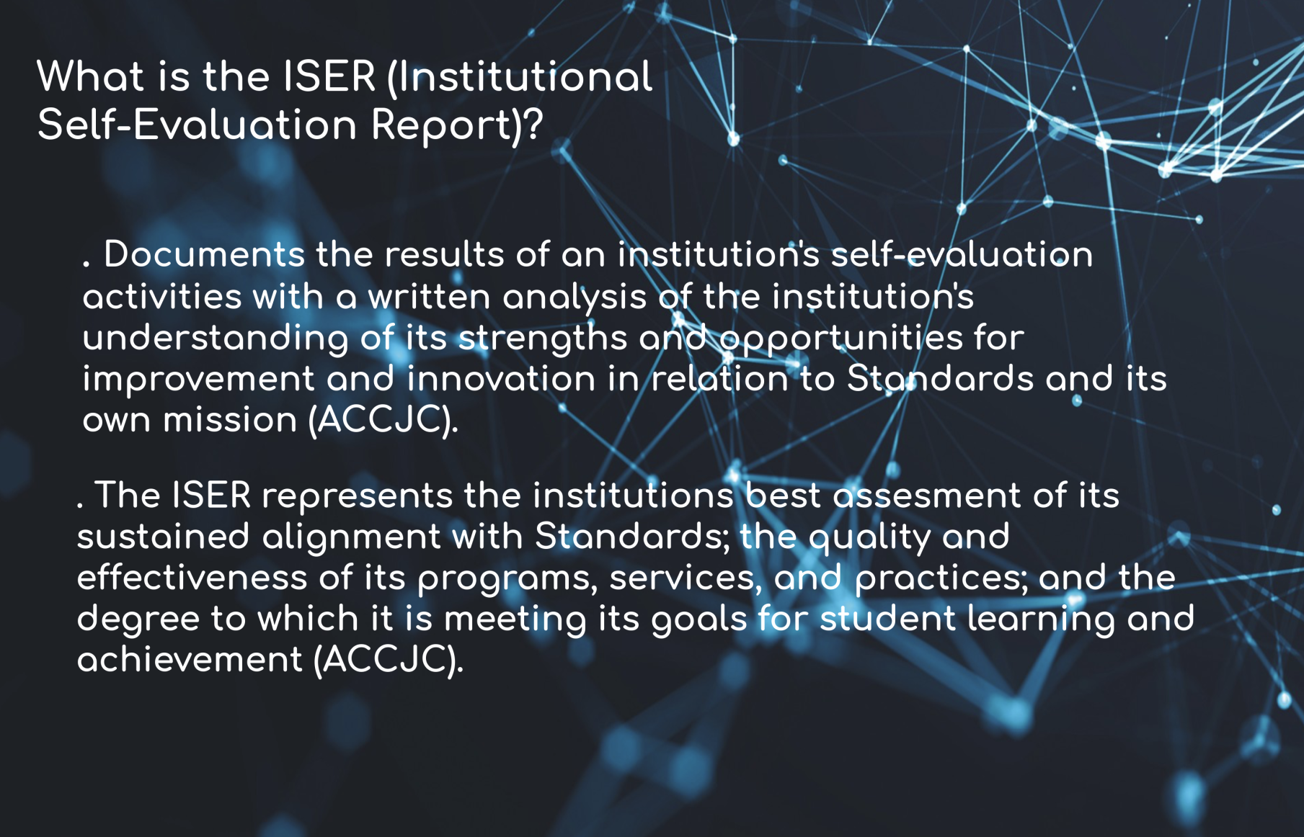
What is the ISER (Institutional Self-Evaluation Report)?

Slide 6
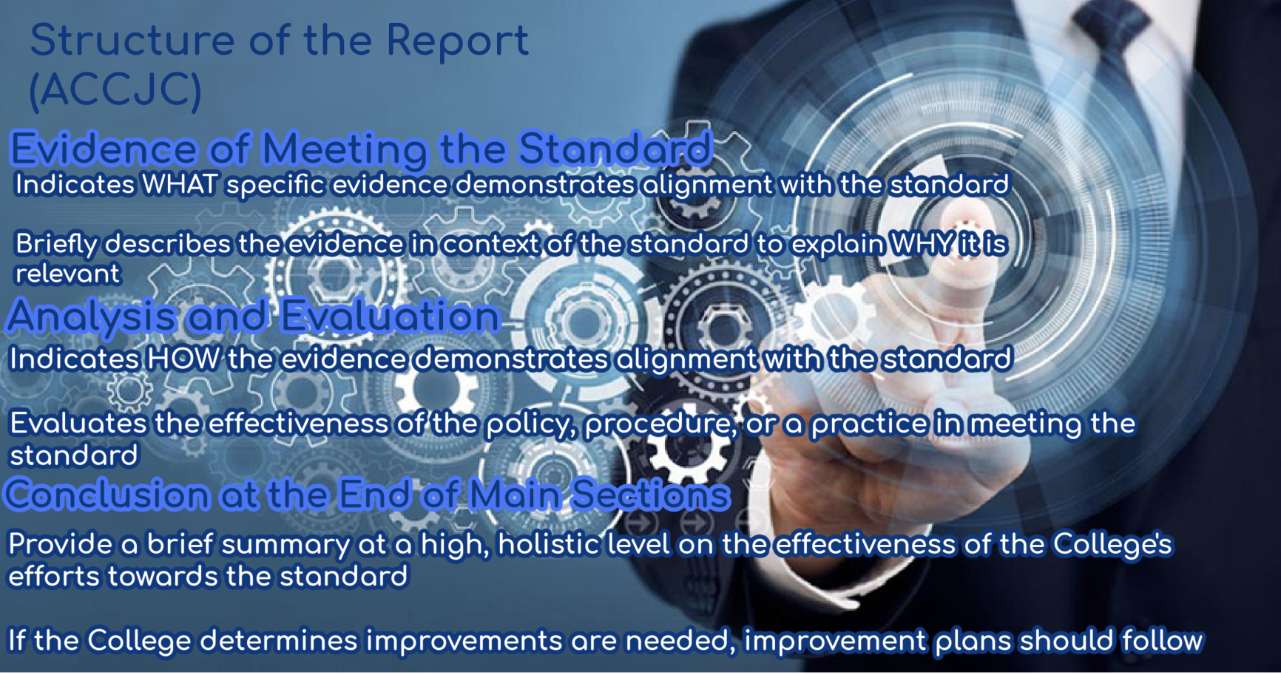
Structure of the Report

Slide 7
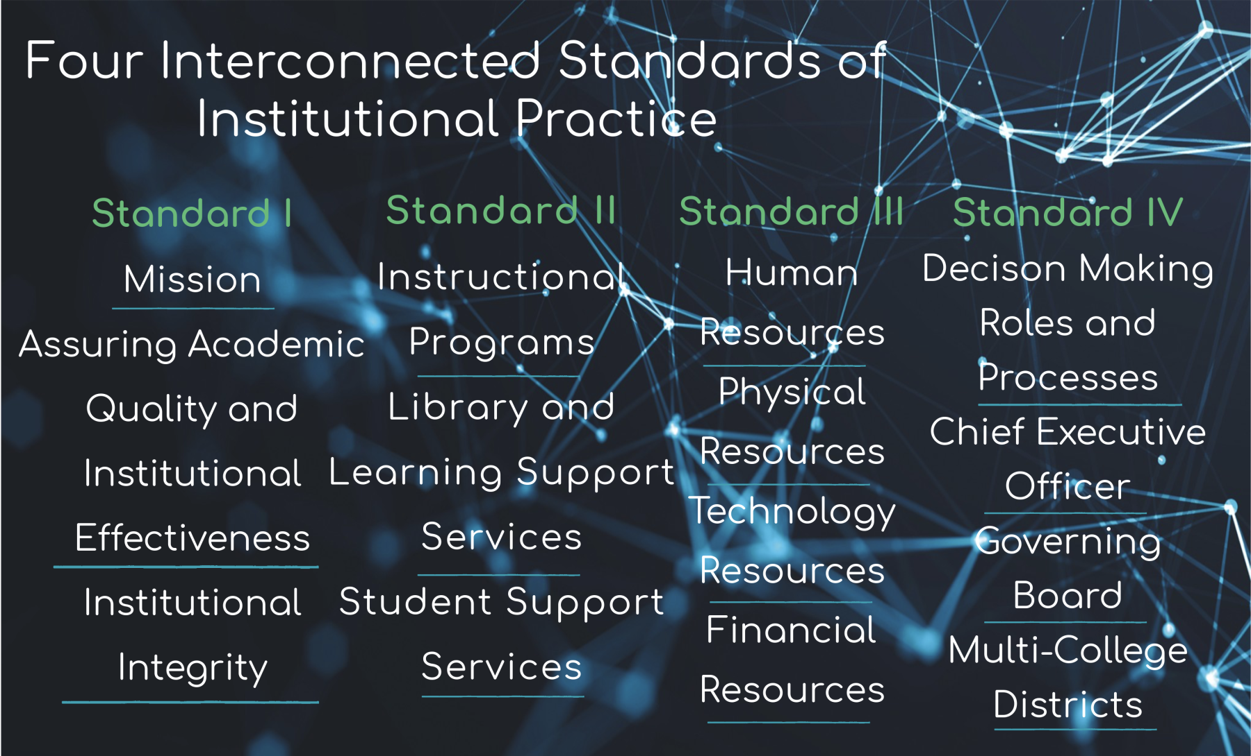
Four Interconnected Standards of Institutional Practice

Slide 8
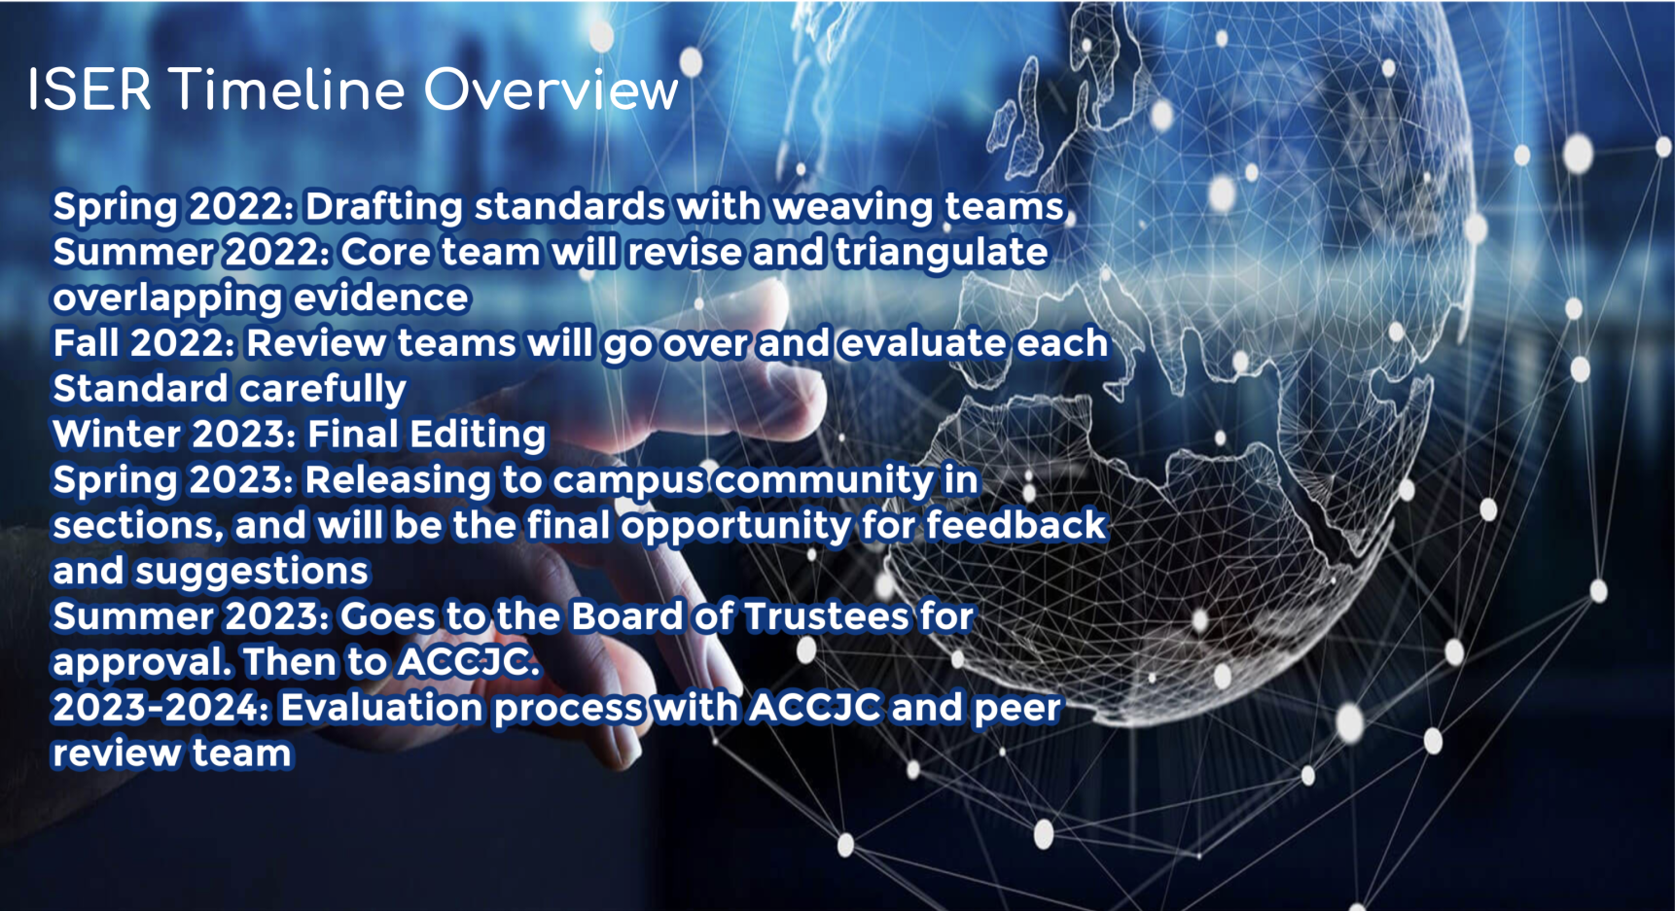
ISER Timeline Overview

Slide 9
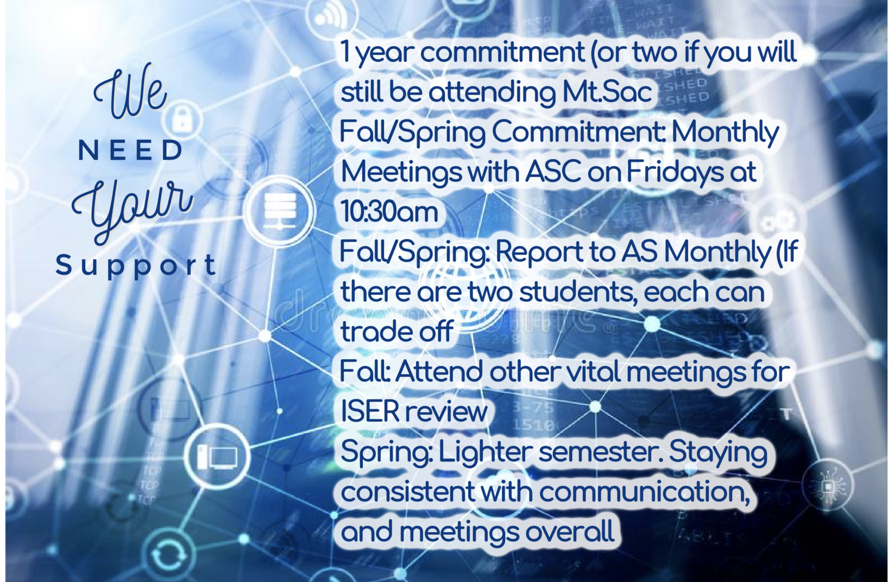
We Need Your Support

Slide 10

Questions and Comments

