Slide 1

Accreditation Update Management team
January 2024
Notes:
Kelly

Slide 2

Accreditation Core Team
Kelly Fowler | Accreditation Liaison Officer/ VP Instruction
Barbara Mezaki | Faculty Accreditation Coordinator
Allie Frickert | Faculty Accreditation Co-Coordinator
Lianne Greenlee | Assistant Dean, Accreditation and Planning
Patty Quinones | Director, Research and Institutional Effectiveness​
Michelle Sampat | Dean, Arts Division
Laura Martinez | Executive Assistant to the VP Instruction
Notes:
Kelly

Slide 3

Our Story Timeline
Fall 2023
Technical Review
& Core Inquiries
Spring 2024
Focused Site Visit
February 28-29
Summer 2024
ACCJC Commission Action
Winter 2024
Core Team and campus experts respond to core inquiries
Notes:
Allie

Slide 4

5 Core Inquiries
Identified areas in ISER requiring clarification or expansion to validate standards alignment
Mt. SAC will respond with additional evidence and brief narrative (300 words)
Used to develop recommendations and commendations
Basis for Focused Site Visit
Notes:
Lianne

Slide 5
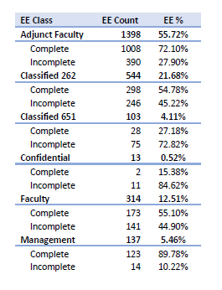
Core Inquiry 1 Human Resources Evaluation Processes
The team’s review of evaluation processes for all personnel suggests that the College has appropriate procedures in place for regular and timely evaluations but was concerned that the ISER did not identify the percentage of evaluations that were up-to-date and filed in a timely manner.
Standard III.A.5
Data indicate that formal, timely evaluations have fallen behind.
The team would like to learn more about the plan to get back on track for evaluation processes being conducted in a regular and timely manner.
Next Steps
Human Resources is conducting a manual audit of all evaluations stored within division offices and the designated data system to ensure accuracy and currency of documentation and competition records.
A plan has been established to support evaluation processes
Notes:
Patty Quinones is working with HR (Alexis Carter) to support the evaluation of data.

Slide 6
Core Inquiry 2 Process for Evaluation of the Governance Structure
The team would like to further understand the process for evaluating the college’s governance structure to assure integrity and effectiveness and how the process is used for improvement.
Standard I.B.7, IV.A.7
The team seeks to understand how the College evaluates its governance processes to assure effectiveness and how the evaluation process has been used to make changes/improvements to the governance process.
Next Steps
A PAC Workgroup has been formed to recommend content for a local Decision-Making Handbook which will include methodology and tools to be utilized for regular evaluation of the participatory governance structure
Governance leaders are attending Collegiality in Action Training on 2/14
Notes:
Tri-chairs are leading the workgroup: Rosa Asencio, Allie Frickert, Lianne Greenlee

Slide 7
Core Inquiry 3 Timely and Regular Review of Board Policies and Procedures
The team would like clarification on the timely and regular review of Board Policies and Procedures.
Standard IV.C.7
At the time of the ISER review, 15 of 36 Board policies in the 2000 series (pertaining to the Board of Trustees) were last reviewed or revised in 2016 or earlier.
The College self-identified an improvement plan to strengthen “the comprehensive review and revision process of Board Policies and Administrative Procedures.” Additional evidence was provided that depicts a recent evaluation of Board Policies, particularly a tracking spreadsheet and process with dates that allowed the Team to assess timeliness of BP and AP review.
Next Steps
A PAC Workgroup has been formed and is tasked with reviewing AP 2410 and recommending revision to the regular review cycle of BPs and APs
Notes:
Carol Nelson is leading this effort.

Slide 8
Core Inquiry 4 Regular and Substantive Interaction in DL Courses
The team would like to further understand how the College ensures regular and substantive interaction between students and instructors in distance education courses.
Policy on Distance Education and Correspondence Education
The team reviewed a random sample of Spring 2023 DL sections and found a notable number did not appear to have regular and substantive interaction (RSI) between students and instructors.
The college provided a handbook for distance education that is pending approval.
Faculty are trained with skills and pedagogy for online teaching (SPOT) certification process.
AP 4105 describes requirements for online course curriculum approval, faculty teaching certification requirements, privacy, RSI, accessibility, equity, and evaluation of faculty.
The faculty contract outlines the evaluation process for distance education courses.
Next Steps
Academic Senate and FA are encouraging faculty use of the approved RSI Self-Evaluation Rubric
A random sample of 50 Fall 2023 DL sections will be reviewed by the ACCJC Peer Team.
Notes:
Barbara Mezaki, Allie Frickert leading with support from Katie Datko & Romelia Salinas

Slide 9

Core Inquiry 5 GRASP & LEAD Success and Effectiveness
The Team was pleased to read about the Gray/Red Shirt Academic Support Program (GRASP) and Leadership Education and Development (LEAD) programs, which are aimed at strengthening student leadership, retention and involvement in pursuit of student success.
Standard II.C.4
The goals of these programs seem to significantly strengthen the College’s commitment to the educational experience of its students.
The Team is greatly interested in receiving success data pertaining to these programs, including the College’s assessment of the programs’ impact on the student body. Such information would help the team better understand their importance and impact.
Next Steps
GRASP & LEAD are collaborating with RIE to provide program success data and impact
Notes:
Donna Balduci, Andi Sims, Pule Taampilo, Lisa diDolato

Slide 10
Commission Actions on Institutions
Reaffirm Accreditation/ Follow-Up Report
In compliance with ERs, Standards, or Policies
Minor deficiencies to be addressed in a Follow-Up Report
Issue Warning
Severe noncompliance with ERs, Standards, or Policies Deficiencies must be corrected within 12-18 months
Reaffirm Accreditation
In compliance with ERs, Standards, and Policies
8 years accreditation with a Midterm Report
Reaffirm for 18 months/Follow-Up Report
Significant deficiencies with ERs, Standards, or Policies
Deficiencies to be addressed in a Follow-Up Report
Notes:
Kelly - Ask Classified who served on a Weaving or Finishing Team to stand and be recognized. Volunteers in aisles will hand out pins.

Slide 11

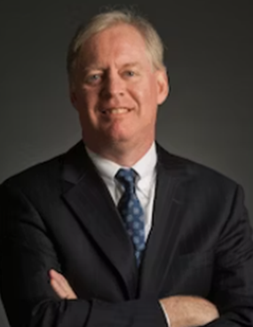
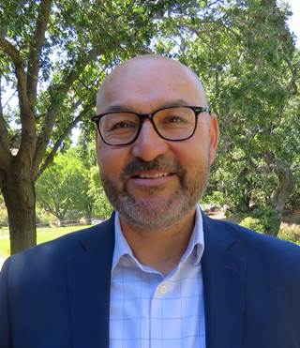
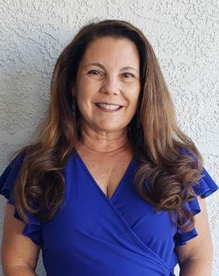
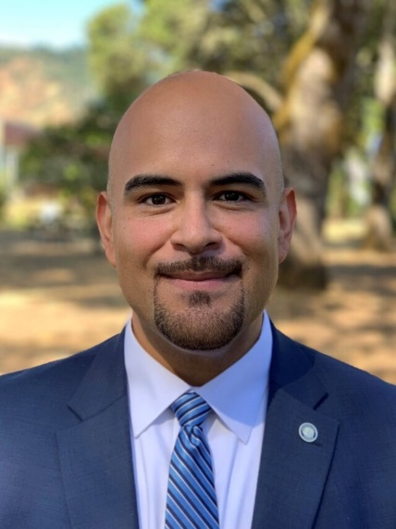
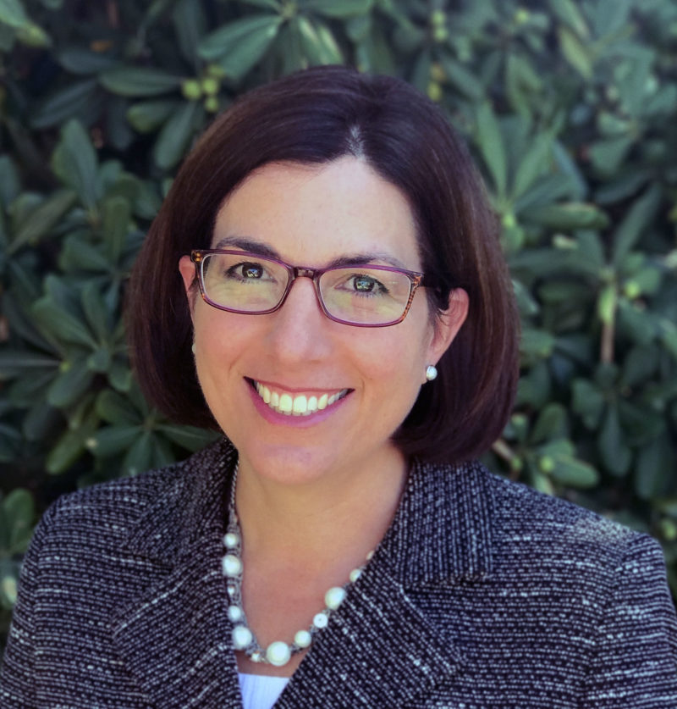
Campus Visit ACCJC Site Team - February 28-29
Open Forum *
Wednesday, February 28
4:30 - 5:30 pm
Building 13, Room 1700
*President, VPs, and Board Members do not attend
Exit Report
Thursday, February 29
12:00 - 12:30 pm
Summit Event Center
5 Core Inquiries: Interviews with Key Campus Voices
Human Resources Evaluation Processes
Process for Evaluation of Governance Structure
Timely and Regular Review of Board Policies and Procedures
Regular and Substantive Interaction in Distance Learning Courses
GRASP & LEAD Success and Effectiveness
Visiting Team Members
Dr. Matthew Wetstein, Chair
Dr. Pedro Avila, Vice Chair
Dr. Linda Carvalho Cooley
Mr. Ulises Velasco
Dr. Gohar Momjian, ACCJC
Notes:
Allie

