Slide 1
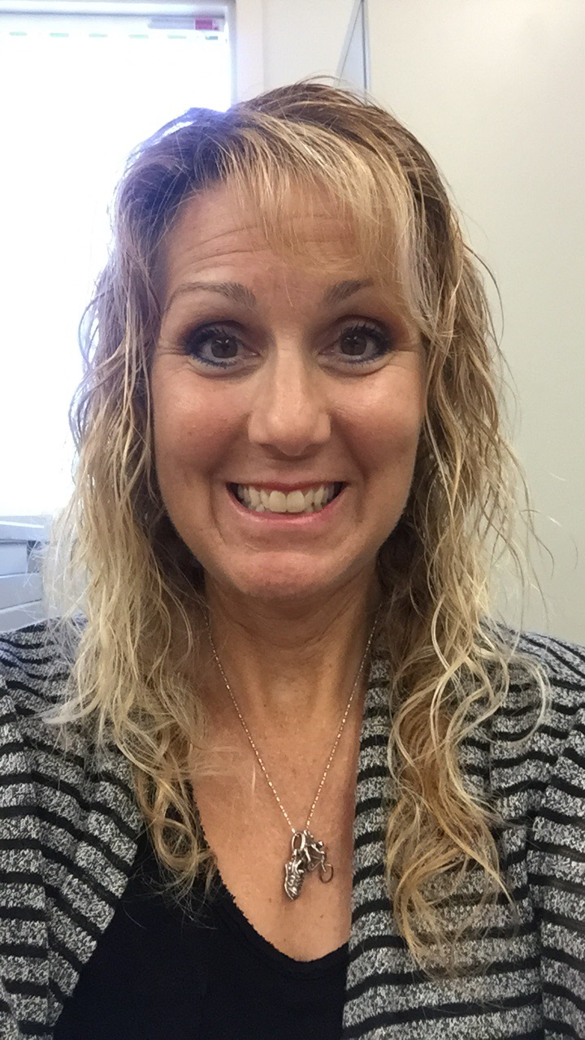
Time & Location: Mon/Wed 7:30 am - 9:35 am Bldg 66-222
Student Hours: Monday 12:20 - 1:00 pm; 5:55-7:00 pm; Tue 9:45 am -12 pm (Zoom)
Contact Info: bmezaki@mtsac.edu OR (909) 274-4586
Welcome to AmLa 1A Class | CRN: 40878
Professor Barbara Mezaki
Textbook: Born A Crime: Stories of an South African Childhood by Trevor Noah ISBN: 978-0399588198
(You may borrow this book from me; it must be returned clean and unmarked).
Attendance/Late/Drop: To make the most of your learning opportunities in this class, students must attend the class meetings each week AND show “active academic engagement” during the class. If you miss 20% of the course work, 2 consecutive classes, or 6 substantive assignments, you will be notified by email and must respond within 48 hours to avoid being dropped from the course. IF you do not respond within 48-hours, you may be dropped from the course. TC Sessions are highly recommended but not required. | Grades A = 89.5 -100% B = 79.5-89.4% C = 69.5-79.4% P = 69.5 - 100% D = 59.5 - 69.4% F = 0 - 59.4% NP = 0 - 69.4% | Participation/Teams: For each paper, you will work with a team who will help you feel supported and empowered to succeed and grow. You will change teams after each paper. Teamwork helps prepare you for future work environments, helps you be flexible and open to working with different people, and helps you complete different assignments.
My interest is to help you be successful in my class. If you have a specific need that I can address to assist you in being successful in my class, please discuss it with me.
If you are a student with a documented disability, you may apply for services through the Mt. SAC Accessibility Resource Office for Students (Access) by calling (909) 274-4290 and/or you may go to http://www.mtsac.edu/access
All requests for accommodations require appropriate advance notice to avoid a delay in services.
American Language Department Policy on Cheating and Plagiarism:
It is important that you do your own work. The following are examples of dishonesty:
Turning in work copied or done by another student/source -- including translators or AI
Copying answers from another student during a quiz, test, or for any assignment
Copying work from another source or AI without proper credit/citation given to the author or source
Permitting someone to do your work
Receiving too much help on graded writing papers
Giving someone the answers or helping somebody cheat
Translating from another language to English and/or using any translator including AI tools rather than writing your own work
Submitting work that you have submitted for this class or another class in a previous semester
Using AI tools without noting their use
Committing any actions deemed to be academic dishonesty by instructor
If you are dishonest in any of these ways, your professor is required to give you a zero for the assignment and refer you to the Dean of Students for discipline. Some of the possible consequences of cheating are a discipline contract, mandatory workshops, suspension, and even expulsion.
Resources and Basic Needs
If you need something besides help with our class, there are many resources available. Mt. SAC can provide:
basic needs, such as food and personal hygiene products
Mt. SAC Student Health Center for physical or mental health needs (You are not alone!)
Scholarships and Grants
Financial Aid at Mt. SAC
Counseling at Mt. SAC
other needs to help you succeed in this class
Please feel free to contact your professor or our TC if you have any questions about other needs you may have. Your professor may be able to help you or to direct you to someone at Mt. SAC who can.
TC = Tutor in the Class!

Slide 2
Student Learning Outcomes (SLOs): Writing/Reading/Vocabulary/Effective Communication: Listen, process, contribute, analyze, evaluate, persuade, and create new meaning for learning in the target language. Connections to self, text, world/Language use and syntax: Demonstrate sophisticated command of English language grammar, vocabulary, and syntax with critical analysis of feedback for successful editing to complete the writing process Metacognition and Self-regulation: Apply college-level metacognitive and reflective strategies to monitor learning success, address academic challenges, and implement self-regulation techniques | Course Objectives: Read, analyze and evaluate multiple text and media sources, both fiction and non-fiction, with attention to cultural touchstones to build the schema necessary for comprehension of college-level reading. Compose unified, well-organized essays integrating research evidence into body paragraphs with sentence structures to develop the relationship and coherence among ideas. Develop and employ flexible strategies for generating, drafting, and revising essays with specific attention to English language organizational patterns. Analyze stylistic choices in authentic texts as well as in peer and self-generated writing in order to elevate critical thinking and increase language sophistication. Compose timed, in-class essays demonstrating appropriate English language organizational patterns, in-depth development, acceptable coherence, and college-level mechanics. | Integrate into writing the ideas of others through paraphrasing, summarizing, and quoting, demonstrating an increasing command of vocabulary and sentence structure to avoid plagiarism. Find, evaluate, analyze, interpret, and discuss primary and secondary sources in the target language (English) incorporating them into written essays using appropriate documentation format. Proofread and edit essays to eliminate global and local English grammar, usage, and punctuation errors that impede comprehensibility with just in time instruction in troublesome areas for English language learners. Develop and refine metacognitive strategies for writing and reading success with special attention to affective factors that challenge English language learners. Develop an understanding of American college culture, including developing strategies to respond to academic challenges as well as the use of college-based success resources.
Paper 1 Building Blocks Low Stakes Writings Quizzes/Exercises Discussions/Team Activities Draft 1/Checklist TC Sessions Library Workshops Writing Center Workshops/DLAs | 5% | Research Paper Building Blocks Topic Proposal Annotated Bibliography Working Outline/Organizer Rough Draft Peer Review Poster Presentations Writing Center Tutor Session Paper Conference with Professor Works Cited (5 sources required) | 15%
Paper 1 due: Sun Mar 17 by 11:59 pm | 10% | Research Paper due: Sun May 26 by 11:59 pm | 20%
Paper 2 Building Blocks Low Stakes Writings Quizzes/Exercises Discussions/Team Activities Draft 1/Peer Review TC Sessions Library Workshops Writing Center Workshops/DLAs | 5% | Final Project Preparation Learning Summary BAC Synthesis Metacognitive analysis Other | 10%
Paper 2 due: Sun Apr 14 by 11:59 pm | 15% | Final Project due Jun 10 by 1:30 pm | 20%

