Slide 1
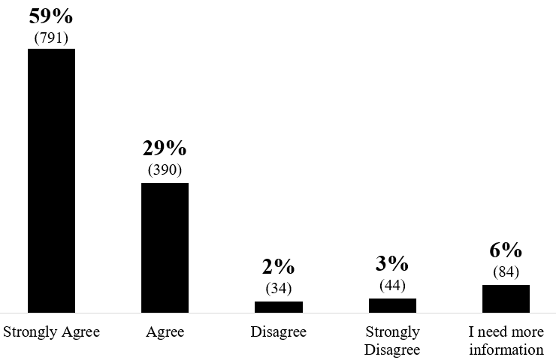
Body Worn Cameras
Equipping sworn police officers with body worn cameras for better accountability to monitor their call-handling and response to complaints.
88% AGREE
1,343 total respondents
5% DISAGREE
Notes:
Approximately 88% of respondents agree that PCS should be equipped with body-worn cameras

Slide 2
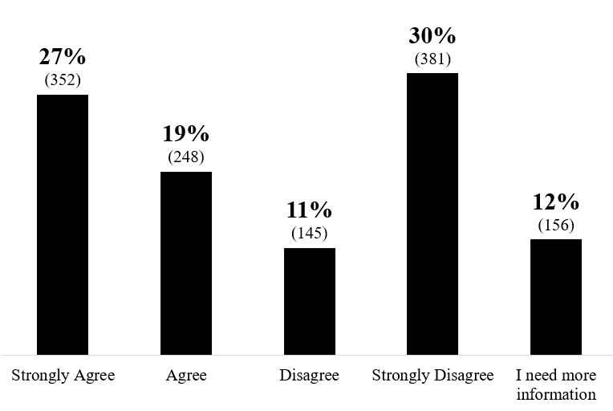
Police Rifles
Purchasing police rifles for sworn police officers to effectively respond to active shooters or armed assailants on campus.
46% AGREE
41% DISAGREE
1,282 total respondents
Notes:
Approximately 46% of respondents agree that PCS should be equipped with police rifles. 41% disagree, and 12% need more information.

Slide 3
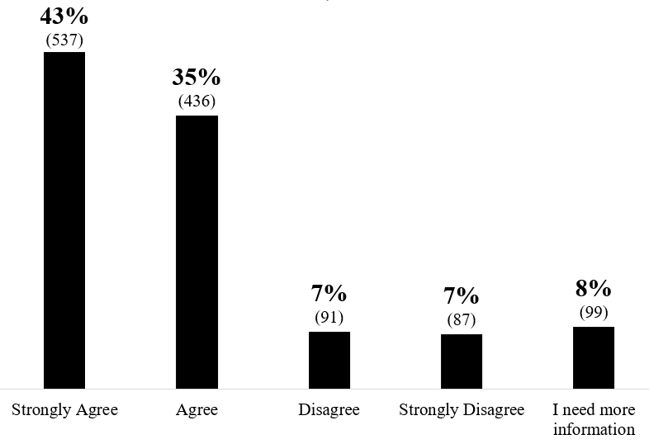
Tasers
Equipping sworn police officers with tasers to allow them to maintain a safer distance when dealing with a potentially violent subject.
78% AGREE
1,250 total respondents
14% DISAGREE
Notes:
Approximately 78% of respondents agree that PCS should be equipped with tasers.

Slide 4
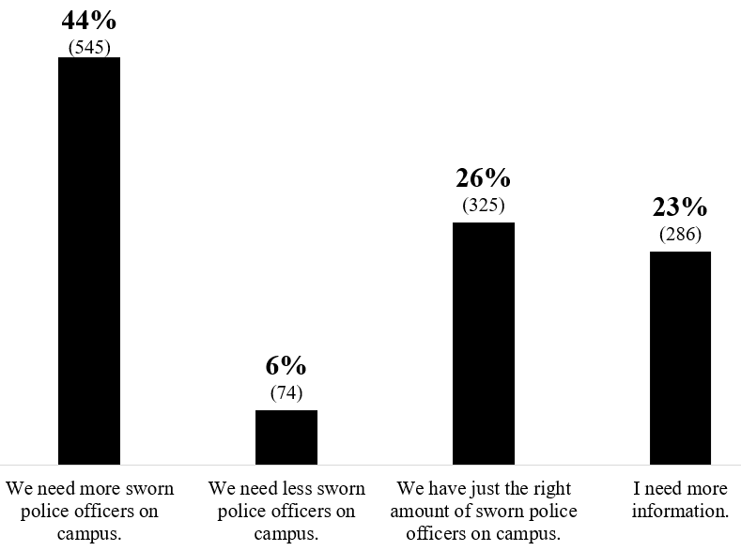
More Sworn Officers
Adding more sworn police officers who have full authority and training to respond to crimes and disturbances on campus.
44% AGREE
1,230 total respondents
32% DISAGREE
Notes:
Approximately 44% of respondents agree that we need more sworn officers on campus. 26% think we have just the right number of sworn officers, 6% think we need less sworn officers, and 23% need more information.

