Slide 1
Planning for Institutional Effectiveness
Manager PIE Planning & Resources
2023 User Guide

Slide 2
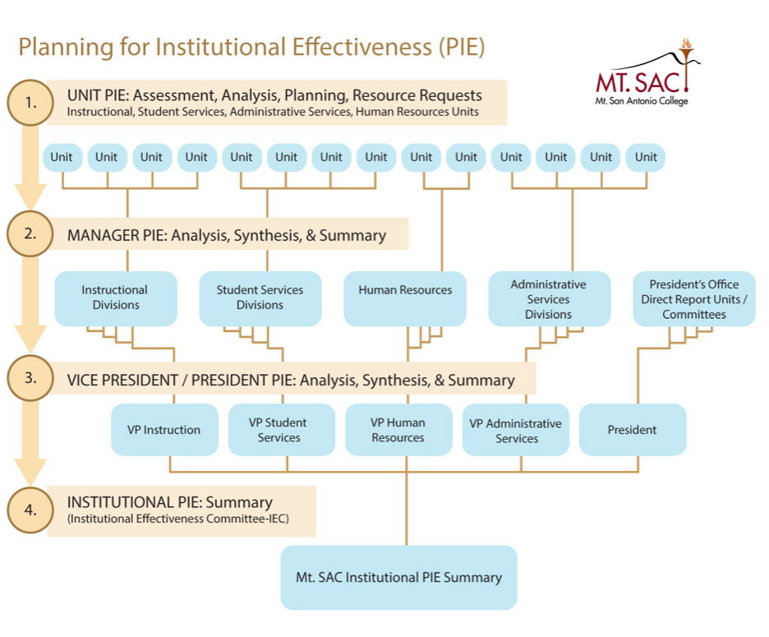

The Process

Slide 3
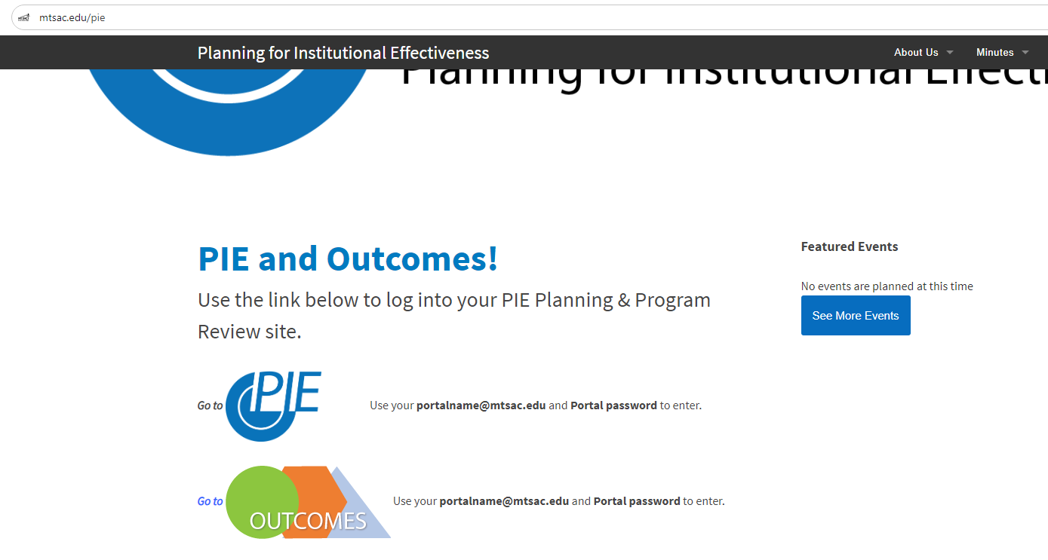
PIE - Access
1. www.mtsac.edu/pie
2. Click to access PIE

Slide 4
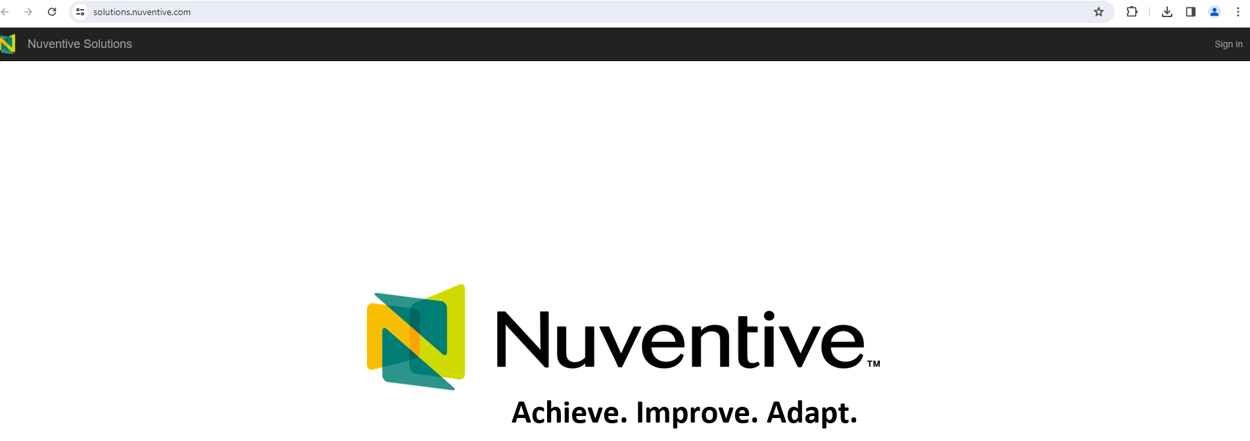
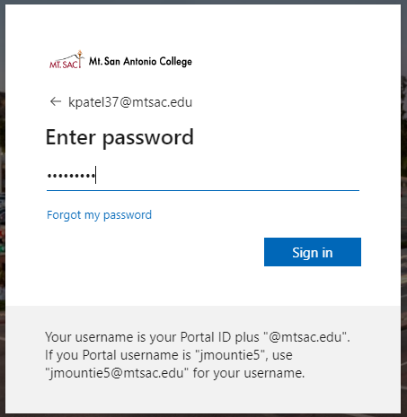
PIE - Home Screen
3. Click on the gray Sign In button
After clicking on “Go to PIE” use your Mt. SAC credentials to access the interface that houses PIE to begin the process
4. Use on-campus email ID &
password to login

Slide 5
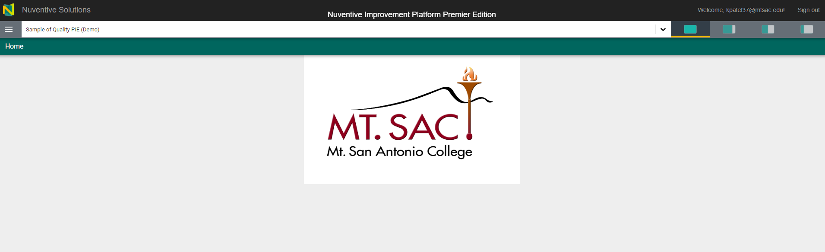
PIE – Home Screen
The home screen with the Mt. SAC logo will appear. The home screen is customizable with any information, files, or pictures.

Slide 6
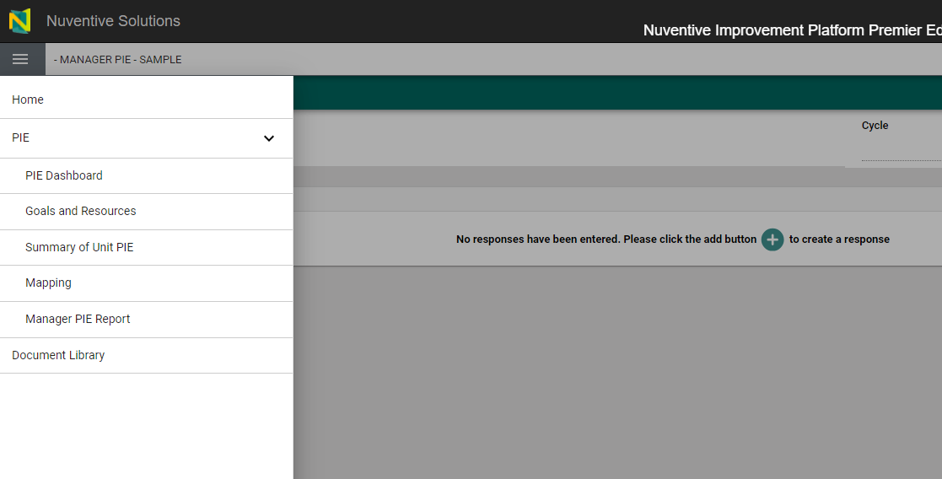
PIE – Menu
Click on the hamburger menu on the left-hand side of the screen to access the sections within the Unit PIE.
Expand the PIE caret. To access the menus.
PIE Dashboard
Unit Goals & Resources
Summary of Unit PIE
Mapping
Reporting

Slide 7
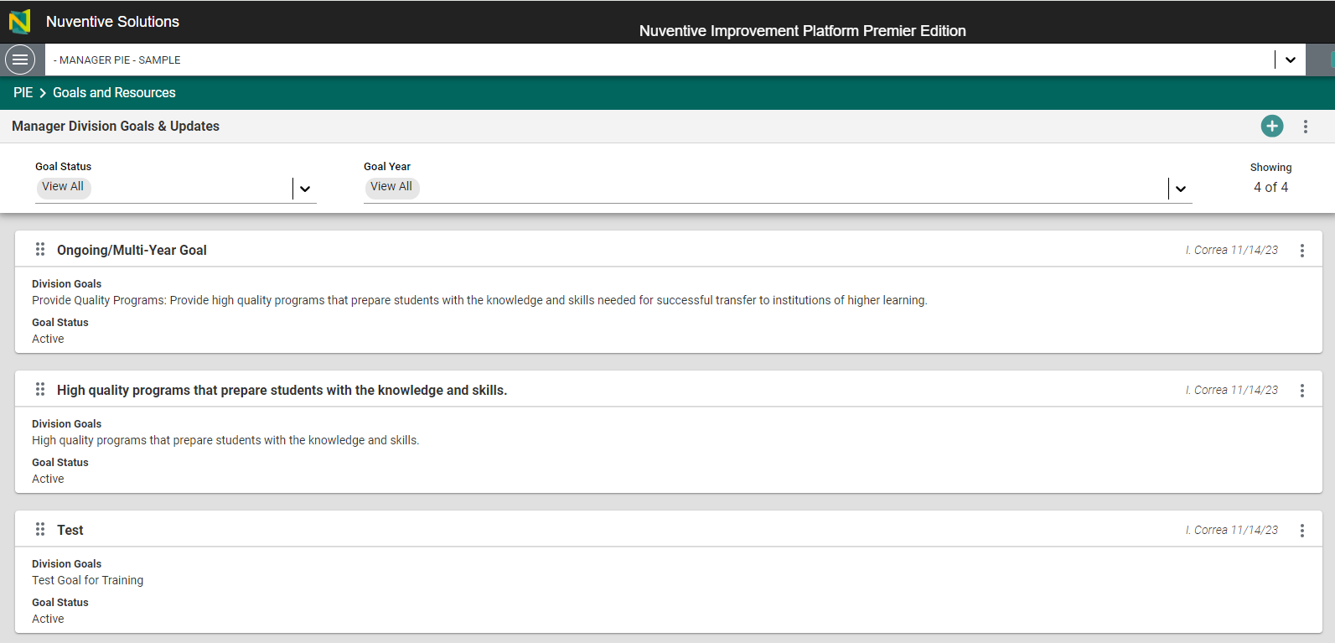
Goals and Resources
a.
Add the new goal
b.
b. Filter to view only active or inactive goals.
c. Double-click in the white rectangle (card) to open and edit or update the goal.
c.
d.
d. Click on the dots to copy or open the goal.

Slide 8
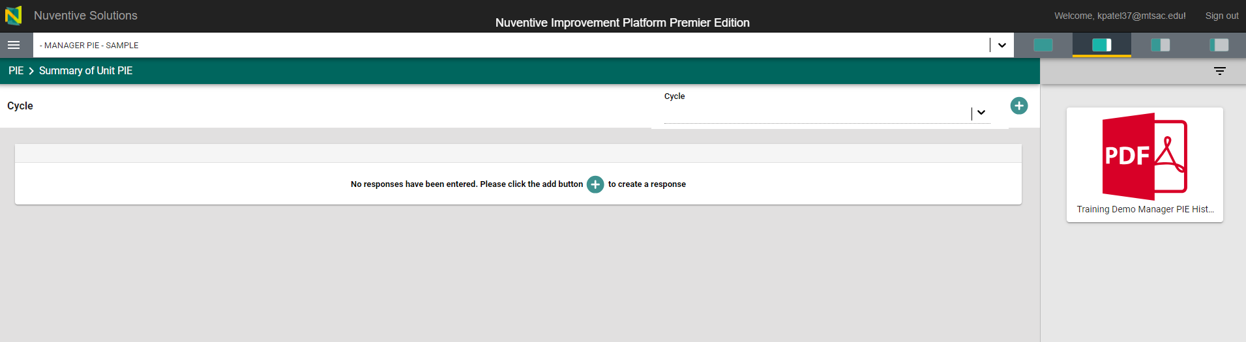
PIE – Summary of Unit PIE
Access the Summary of unit PIE for the past years.
e.
f.
f.
f. Add the summary for the reporting year
e. Open Page Filter (narrow down searches)

Slide 9
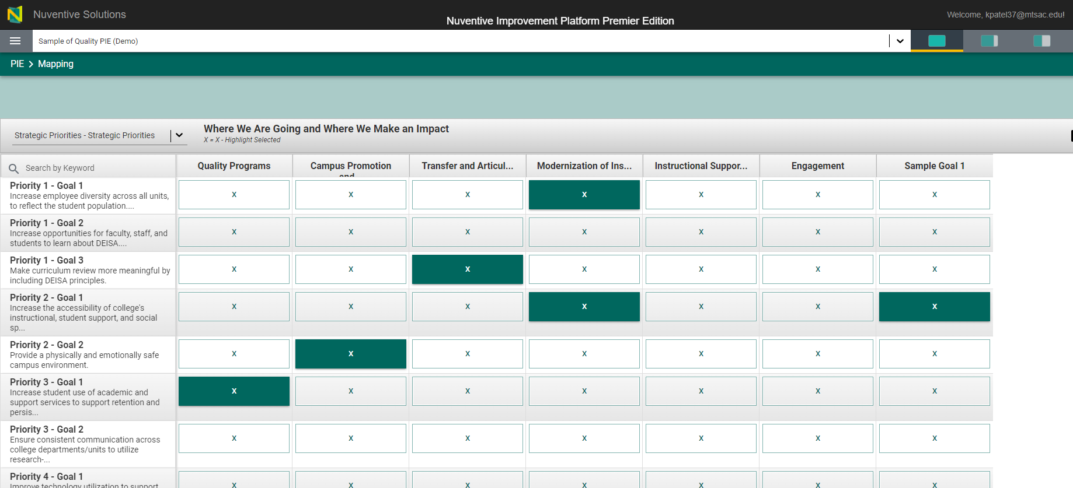
PIE - Mapping
Strategic Priorities (College Goals) are displayed vertically.
Departmental goals are displayed horizontally.
*Make color filled with ‘X’ means goal mapped.

Slide 10
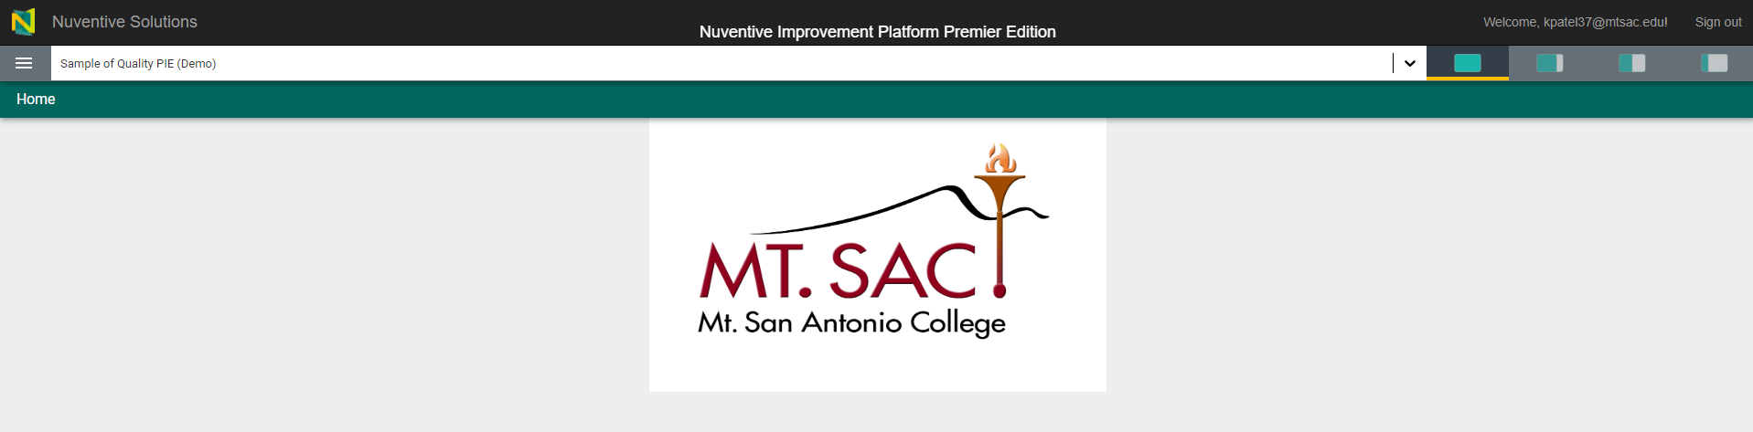
PIE – View Options
Options allow for full-screen, quarter, and half-screen size.

Slide 11


Resources
PIE Content Questions
Meghan Chen: mchen@mtsac.edu
PIE Summaries are due by July 15, 2023
Research/ Data Review Questions
Patricia Quinones:
pquinones@mtsac.edu
Technical Questions:
Krupa Patel: kpatel37@mtsac.edu
Video Training Resources:
http://www.mtsac.edu/pie

