Slide 1


Maximizing Current Technology in Guided Pathways Using DegreeWorks Templates
Session 4: Monday, February 25, 2019 9:30am-10:30am
Matt Bidart, Caron Gomes, Sara Mestas & Chuong Tran
Mt. San Antonio College

Slide 2

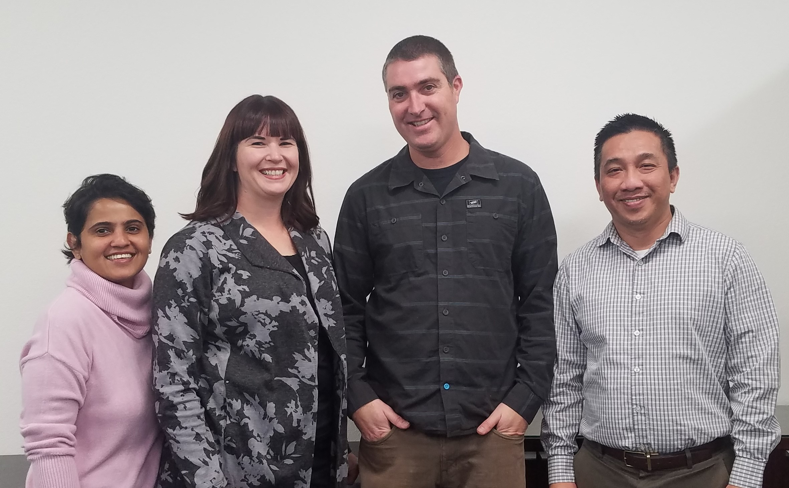
Presentation Team
Caron Gomes
Systems Analyst
Student Services | Counseling Department
Sara Mestas
Counselor
Student Services | Guided Pathways |
Matt Bidart
Web Designer/Developer
Student Services | Guided Pathways | Title V
Chuong Tran
Assistant Director, Enterprise Application Systems

Slide 3
Session Abstract
Implementation of Guided Pathways begins with program mapping. Degree Works templates provide an immediate solution for implementation without purchasing additional technology. Degree Works templates provide a functional home for program maps so that users can view real-time information of courses needed for program completion while ensuring accuracy. Presentation will cover templates for Guided Pathway, tags allowing users a meta-major filter, and data extract making it possible to uploads program maps to websites for public displays.
CISOA/3CBG/4CUG 2019 CONFERENCE, GARDEN GROVE, CA

Slide 4
Session Agenda
Introductions (Sara)
Guided Pathways (Sara)
Program Mapping & Creating Templates in Degree Works (Sara)
Programming for Guided Pathways website (Chuong)​
Web Design for Guided Pathways website (Matt)​
Corrections (Caron)
Questions? (All)
CISOA/3CBG/4CUG 2019 CONFERENCE, GARDEN GROVE, CA

Slide 5

Why This Presentation?
Many legislative efforts in a short timeframe
Lots of change
Chaotic, learning new systems adds to strain
CISOA/3CBG/4CUG 2019 CONFERENCE, GARDEN GROVE, CA

Slide 6
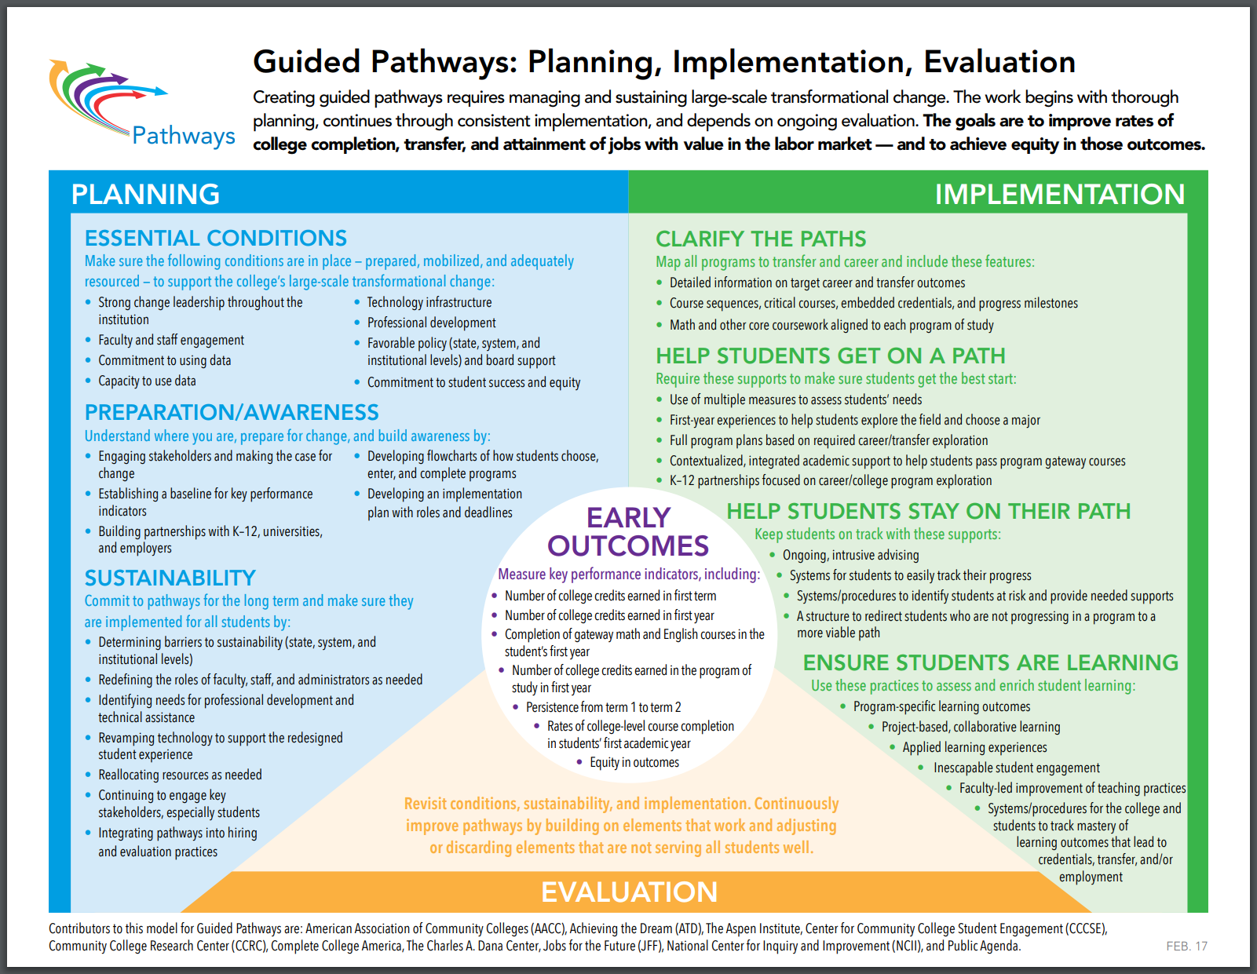
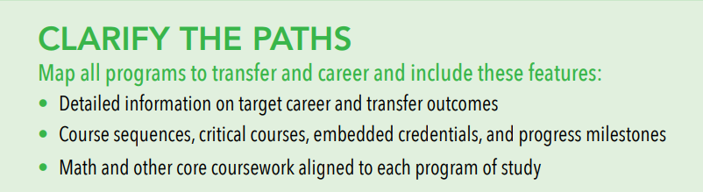
Guided Pathways
At Mt. SAC:
MAP workshops
Marketing tool
Connect programs across the College
Use for career & major clusters
CISOA/3CBG/4CUG 2019 CONFERENCE, GARDEN GROVE, CA

Slide 7
Degree Works Templates
Steps to pathways implementation:
Created a template for all pathway maps- almost 400!
Created “dummy” courses in Banner system for GE areas where a specific course is not necessary
Use choice and placeholder options to add detail
Ability to audit maps to catalog to ensure that requirements are met based on catalog, update as needed
Students can access maps through Degree Works as well as Mt. SAC Guided Pathways website
CISOA/3CBG/4CUG 2019 CONFERENCE, GARDEN GROVE, CA

Slide 8
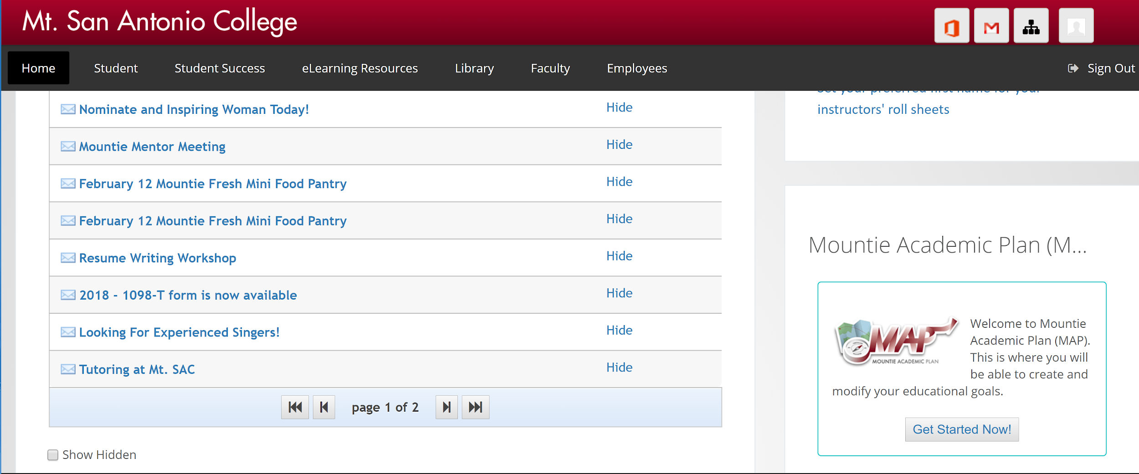
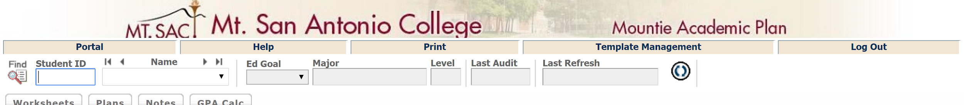
Locating Pathways MAPS
College-wide access (students, faculty, staff, administrators- anyone with Mt. SAC portal access
CISOA/3CBG/4CUG 2019 CONFERENCE, GARDEN GROVE, CA

Slide 9
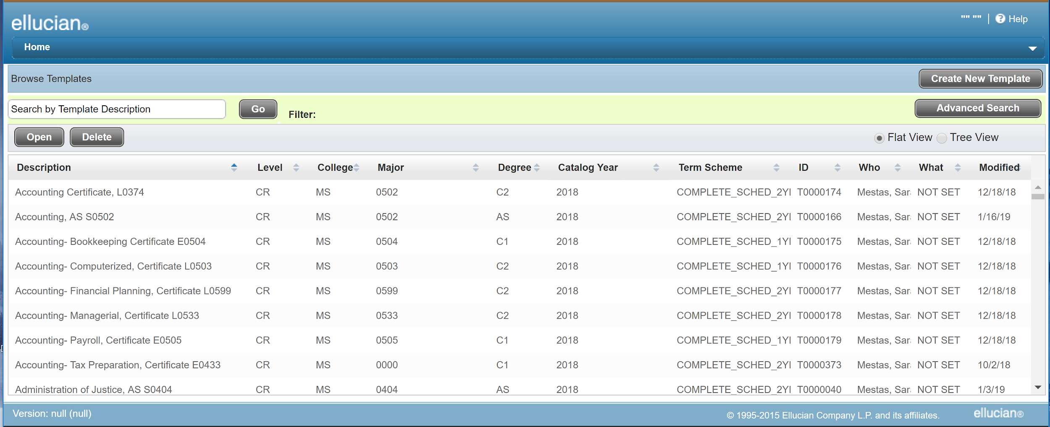
Degree Works Template Page
CISOA/3CBG 2018 CONFERENCE, ONTARIO, CA
CISOA/3CBG/4CUG 2019 CONFERENCE, GARDEN GROVE, CA

Slide 10
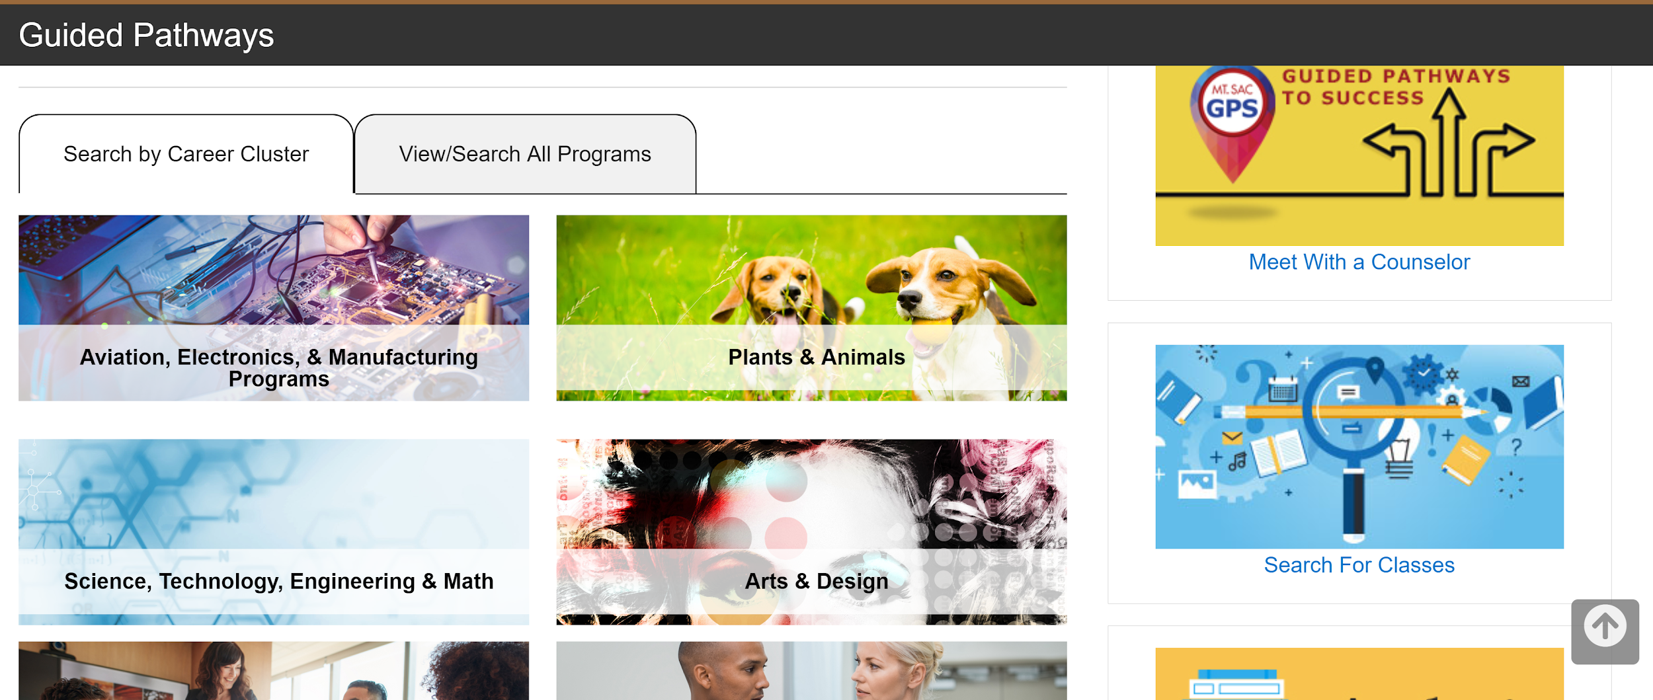
Guided Pathways Website
https://www.mtsac.edu/guided-pathways/
CISOA/3CBG/4CUG 2019 CONFERENCE, GARDEN GROVE, CA

Slide 11
How to Make Use of Existing Degree Works Templates for the Guided Pathways Project
Data extracted from Degree Works Templates must allow the mapping between student educational plan templates information and guided pathways information.
Data should be extracted in XML format so that it can be readily used by other web development tools such as PHP, Java, etc.
CISOA/3CBG/4CUG 2019 CONFERENCE, GARDEN GROVE, CA

Slide 12
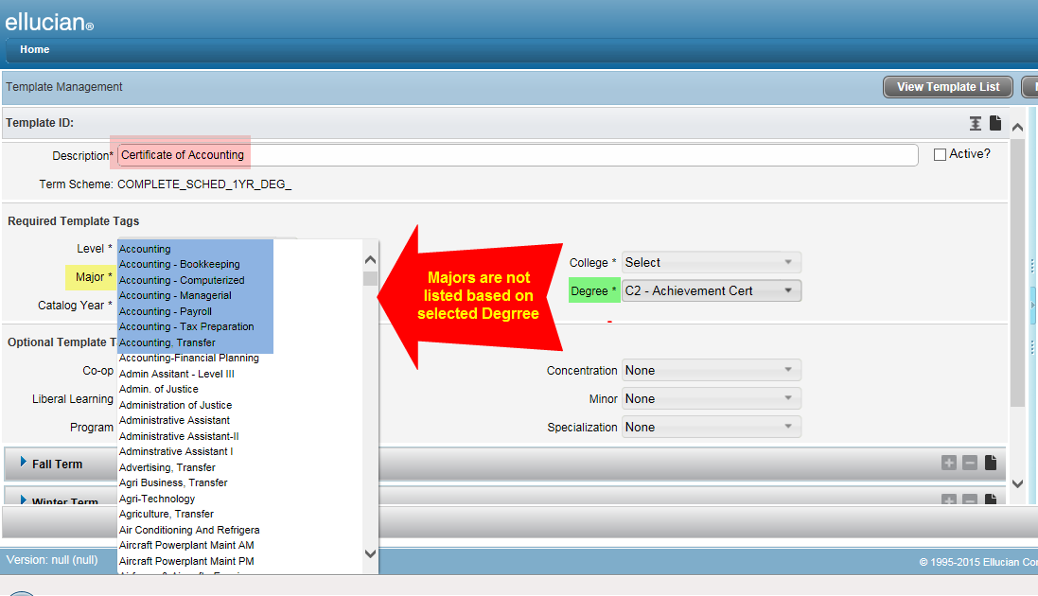
Templates Not Uniquely Identified by Banner Codes
CISOA/3CBG/4CUG 2019 CONFERENCE, GARDEN GROVE, CA

Slide 13
Solution
Using Banner Program Code in the template descriptions
Guided Pathways program then use that code to map with program requirements.
CISOA/3CBG/4CUG 2019 CONFERENCE, GARDEN GROVE, CA

Slide 14
Complex Tables Structure
SEP_TMPL_MST
SEP_TMPL_NOTE
SEP_TMPL_TAG
SEP_TMPL_TERM
SEP_TMPL_TERM_NOTE
SEP_TMPL_GROUP
CISOA/3CBG 2018 CONFERENCE, ONTARIO, CA
CISOA/3CBG/4CUG 2019 CONFERENCE, GARDEN GROVE, CA

Slide 15
Complex Tables Structure
SEP_TMPL_GROUP
SEP_TMPL_GROUP_NOTE
SEP_TMPL_TEST
SEP_TMPL_PLACEHOLDER
SEP_TMPL_NONCOURSE
SEP_TMPL_GPA
SEP_TMPL_CLASS
SEP_TMPL_TEST_NOTE
SEP_TMPL_
PLACEHOLDER_NOTE
SEP_TMPL_
NONCOURSE_NOTE
SEP_TMPL_GPA_NOTE
SEP_TMPL_
CLASS_NOTE
CISOA/3CBG/4CUG 2019 CONFERENCE, GARDEN GROVE, CA

Slide 16
Solution
Study template data structures from “Degree Works Advanced Reporting Technical Guide” document.
Get familiar with each table: how data are stored and organized
Use outer joins to get all the information needed.
CISOA/3CBG/4CUG 2019 CONFERENCE, GARDEN GROVE, CA

Slide 17
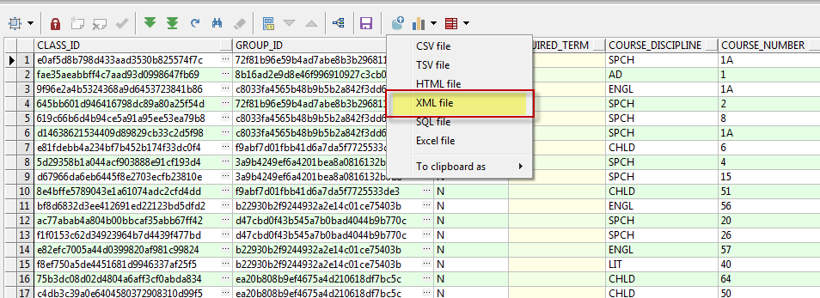
Convert Data to XML Format
Use Oracle DBMS_XMLGEN package
In PL/SQL Developer:
CISOA/3CBG/4CUG 2019 CONFERENCE, GARDEN GROVE, CA

Slide 18
Technical Challenges
Manually clean up the data
Automate the extract process
Integrate with Courseleaf
Extract comments, placeholders, requirements info
https://www.mtsac.edu/guided-pathways
CISOA/3CBG/4CUG 2019 CONFERENCE, GARDEN GROVE, CA

Slide 19
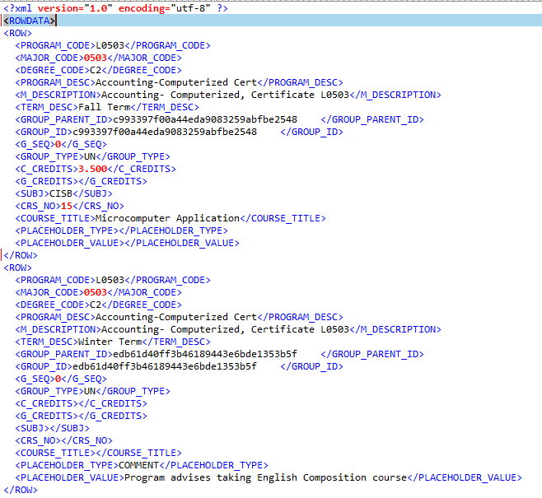
Convert Data to XML Format
CISOA/3CBG/4CUG 2019 CONFERENCE, GARDEN GROVE, CA

Slide 20
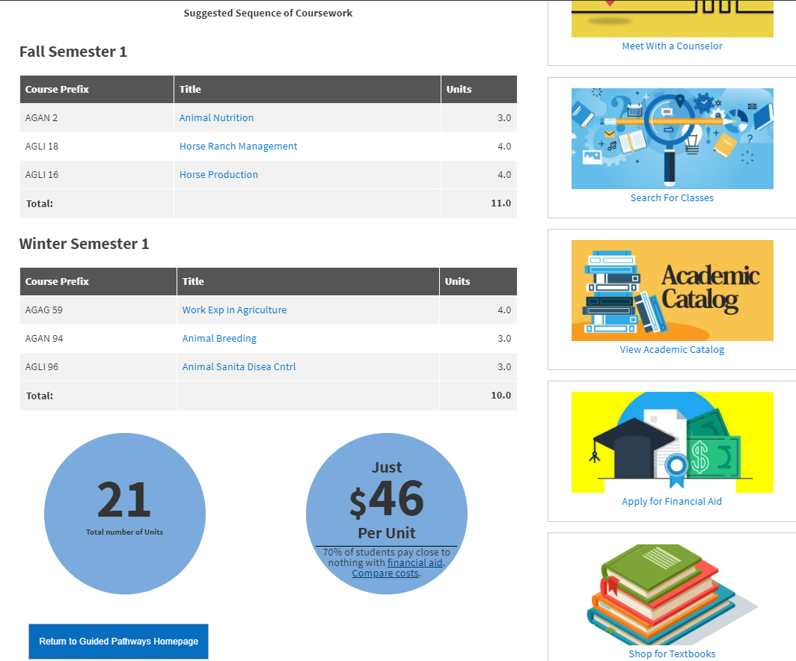
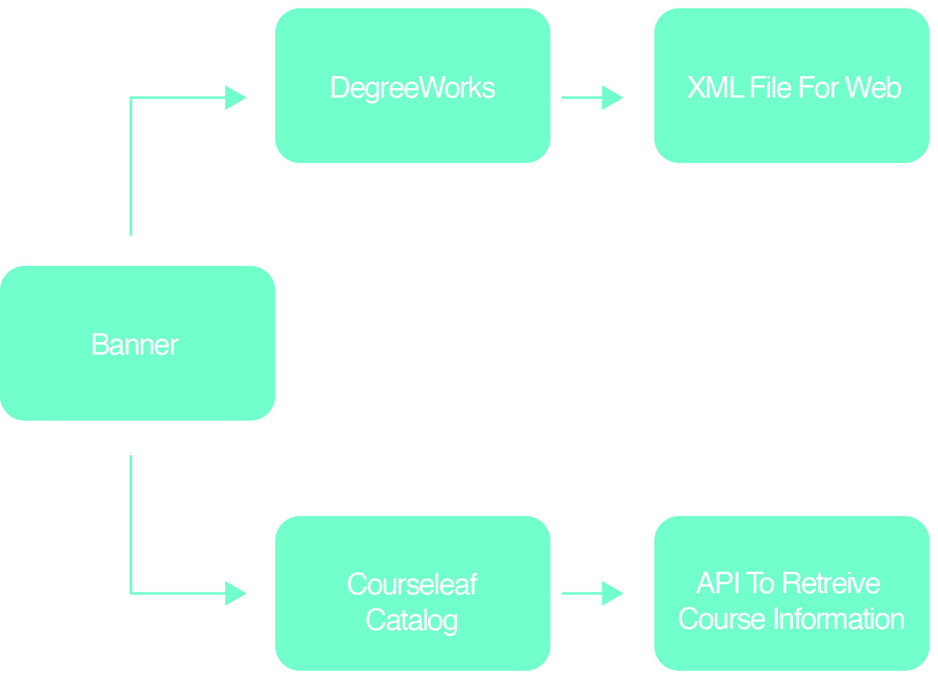
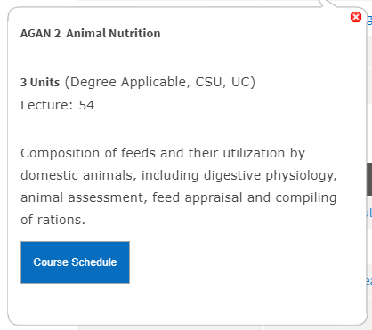
Data Overview
CISOA/3CBG/4CUG 2019 CONFERENCE, GARDEN GROVE, CA

Slide 21






Web Tools Used
OmniUpdate CMS
Foundation (Responsive Framework)
XML (Export from DegreeWorks)
PHP (To Process XML)
Jquery (Datatables/API)
Courseleaf API Calls
CISOA/3CBG/4CUG 2019 CONFERENCE, GARDEN GROVE, CA

Slide 22
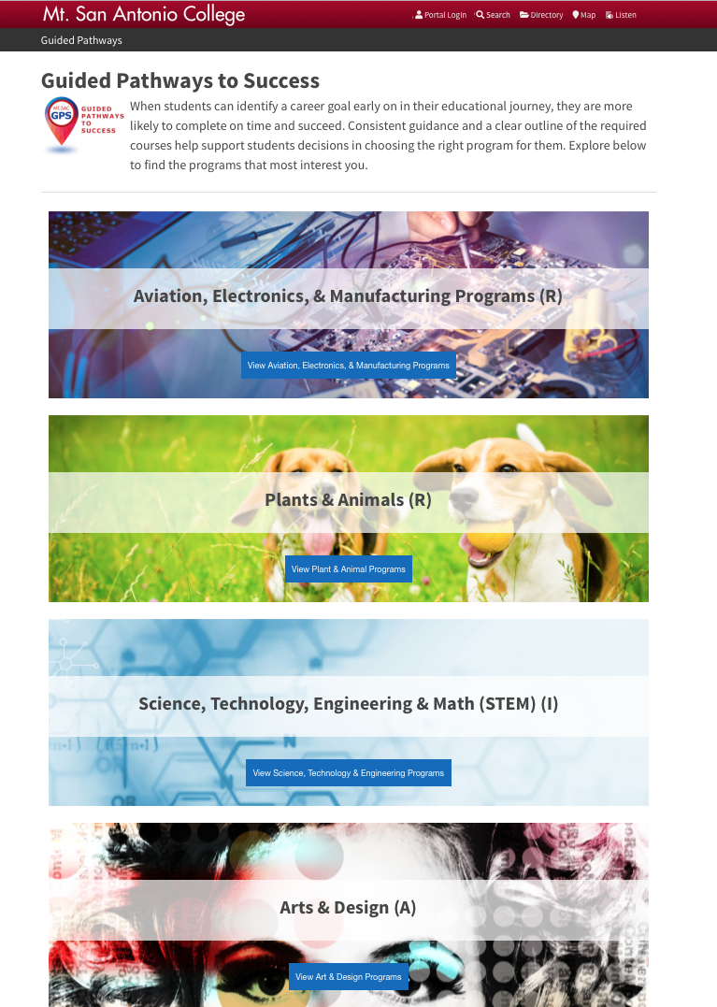

Initial Design
Began in July 2018
Programs Organized by Clusters
Single Scrolling page of Clickable Clusters that reveal applicable programs
CISOA/3CBG/4CUG 2019 CONFERENCE, GARDEN GROVE, CA

Slide 23

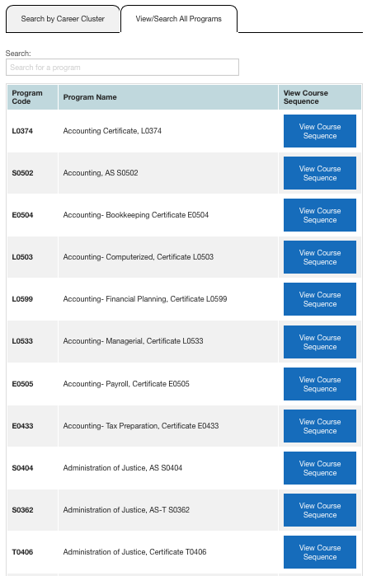
Current Design Tabbed Design
Initiated October 2018
Cluster Option or Search Option
Tabbed Format on First Page
More Efficient Use of Space
CISOA/3CBG/4CUG 2019 CONFERENCE, GARDEN GROVE, CA

Slide 24
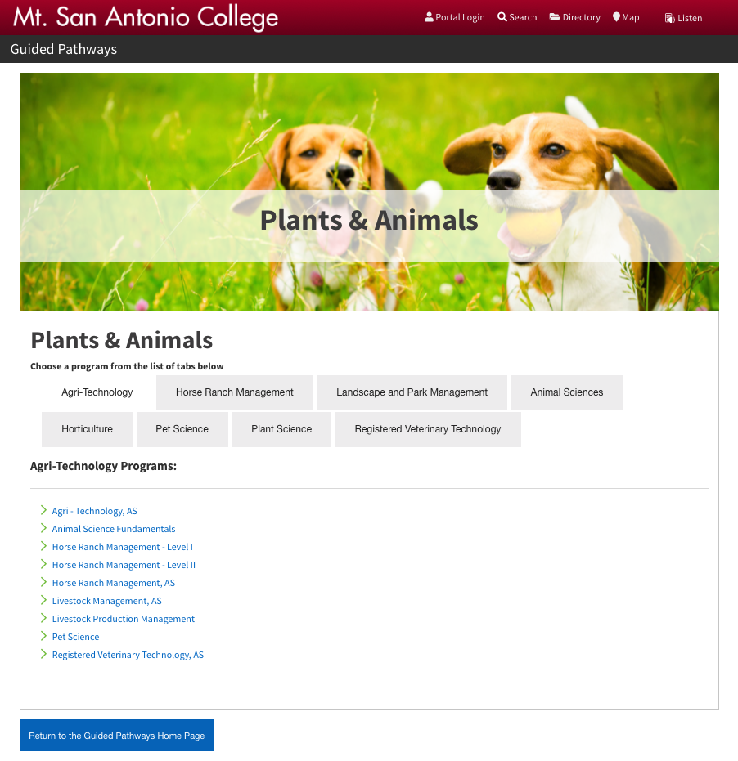
Current Design
Cluster - Secondary Page
Dedicated page for clusters
Tabbed options within the clusters to locate program
Return button to inspect other programs
CISOA/3CBG/4CUG 2019 CONFERENCE, GARDEN GROVE, CA

Slide 25
Current Design
Search Bar Option
Search Bar Limiter (Datatables Jquery App)
Good for those unsure of which cluster to search
Ability to search through all available programs from DegreeWorks
Run on PHP/Jquery DataTables
CISOA/3CBG/4CUG 2019 CONFERENCE, GARDEN GROVE, CA

Slide 26

Resource Links
Included on Search Page and Results Page
Provides Links to Course Catalog, Financial Aid and other helpful Links
An include file
CISOA/3CBG/4CUG 2019 CONFERENCE, GARDEN GROVE, CA

Slide 27
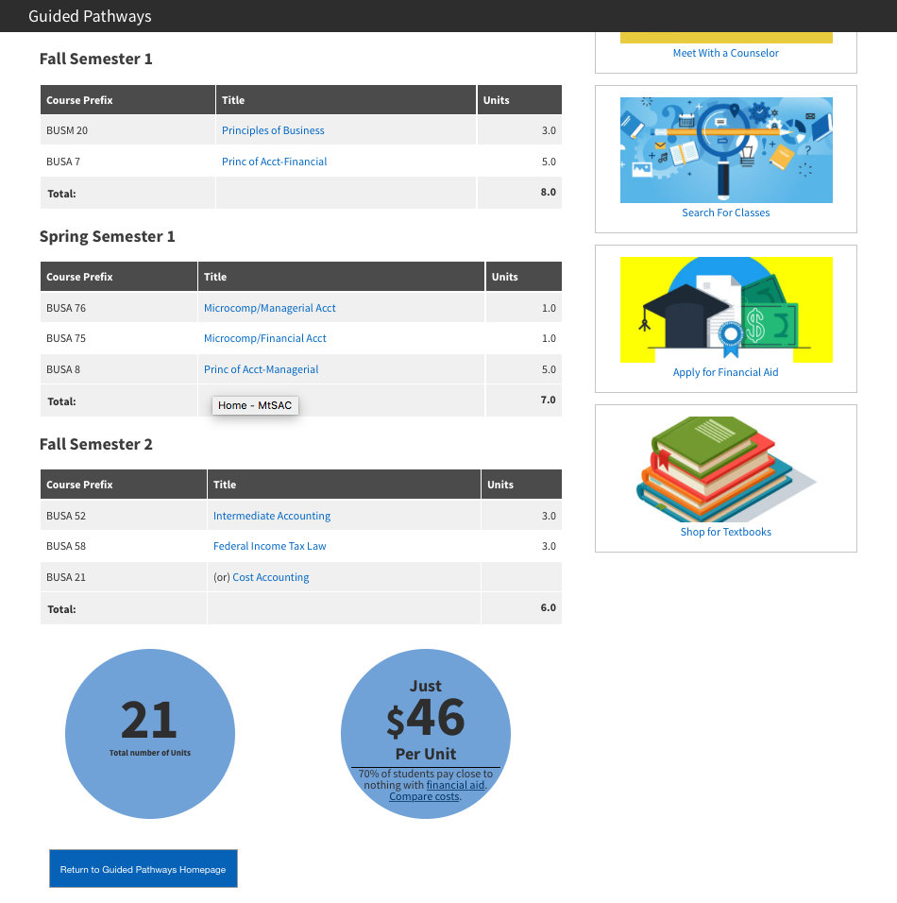
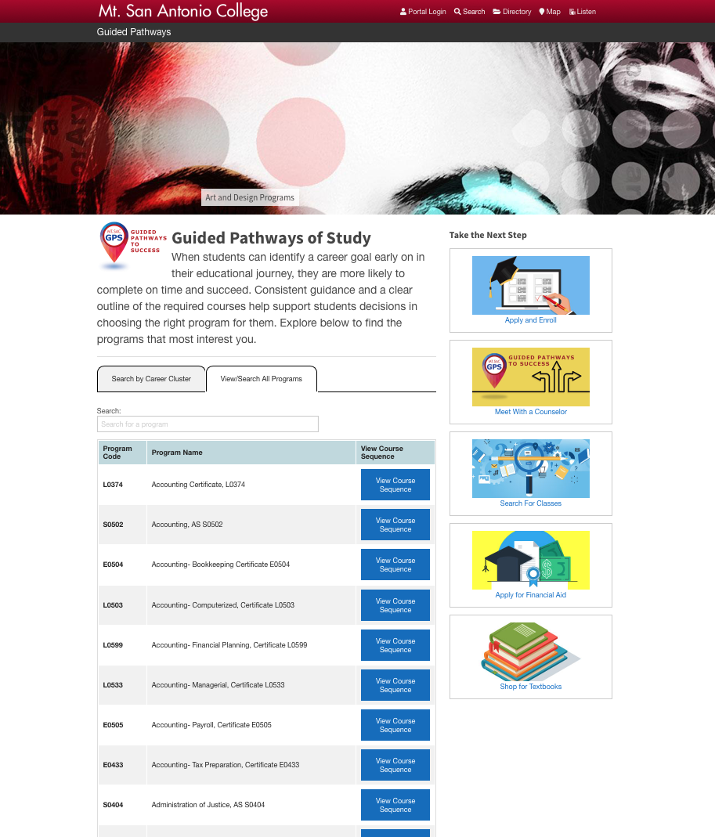
Results Page
XML DegreeWorks Data
Used to populate Search function
Used in Results Page
Coming from a periodically run job
CISOA/3CBG/4CUG 2019 CONFERENCE, GARDEN GROVE, CA

Slide 28
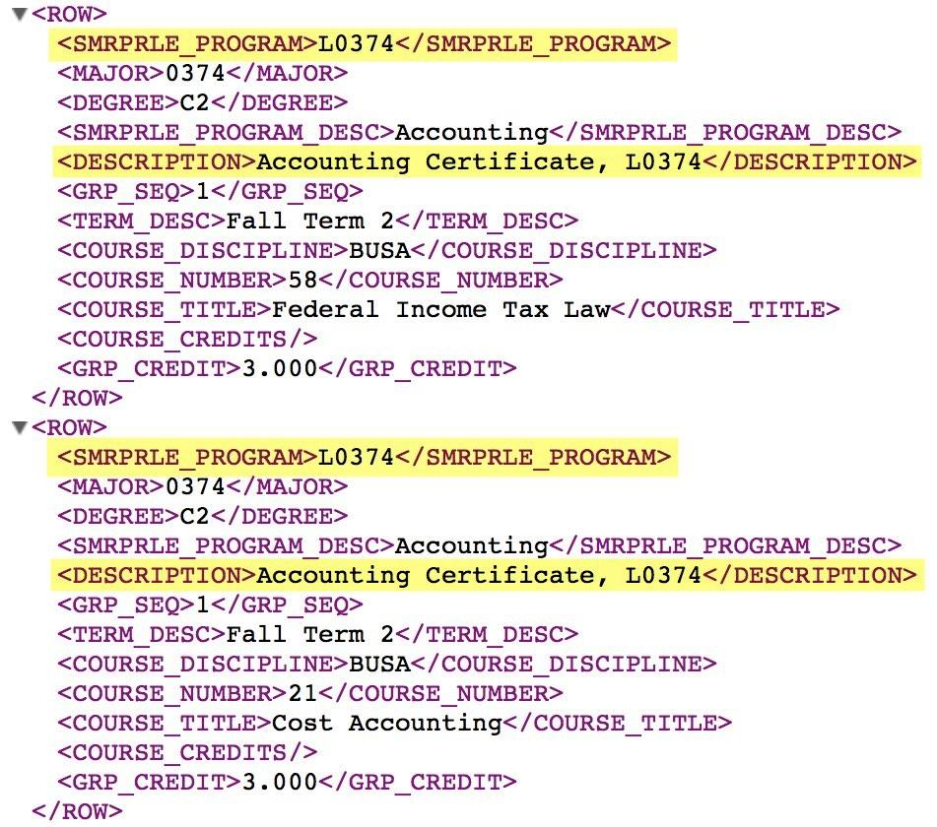
Results Page
XML DegreeWorks Data
Point 1: Match Program Code
Program Code/ Description is Primary Key that is used to pull data from catalog
First Node of XML
CISOA/3CBG/4CUG 2019 CONFERENCE, GARDEN GROVE, CA

Slide 29
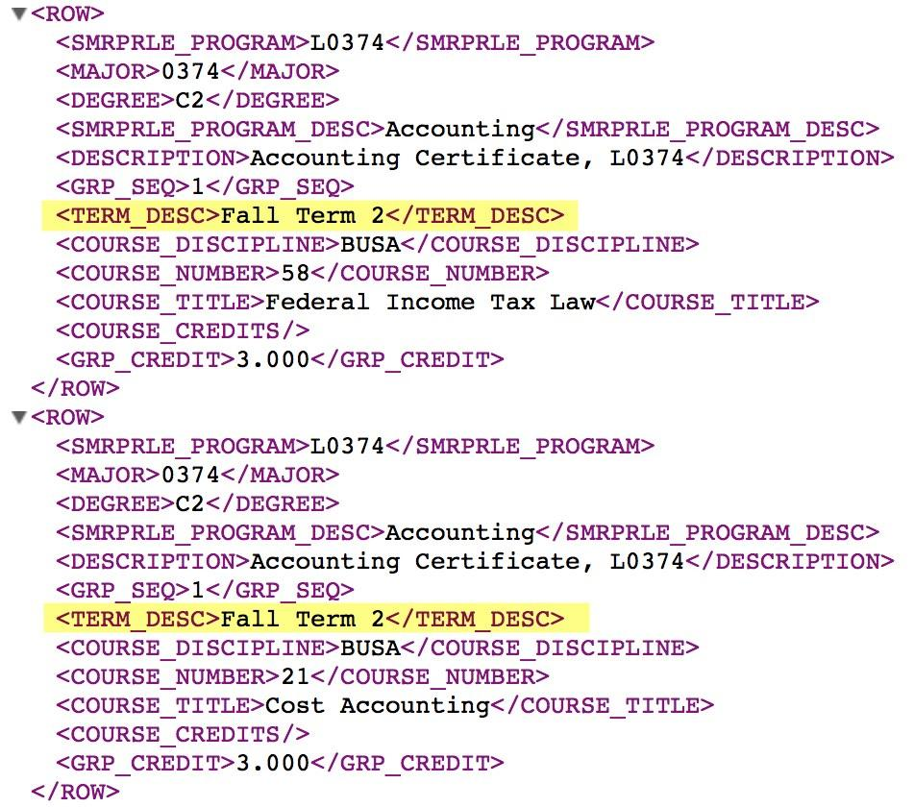
Results Page
XML DegreeWorks Data
Point 2: Match Term/Pull Nodes
Limit your results to display Fall, Winter, Spring, Summer terms
Once targeted, we are pulling Course Prefix and number, Course Title and Credits
Credits are accrued and totaled at bottom of page
CISOA/3CBG/4CUG 2019 CONFERENCE, GARDEN GROVE, CA

Slide 30
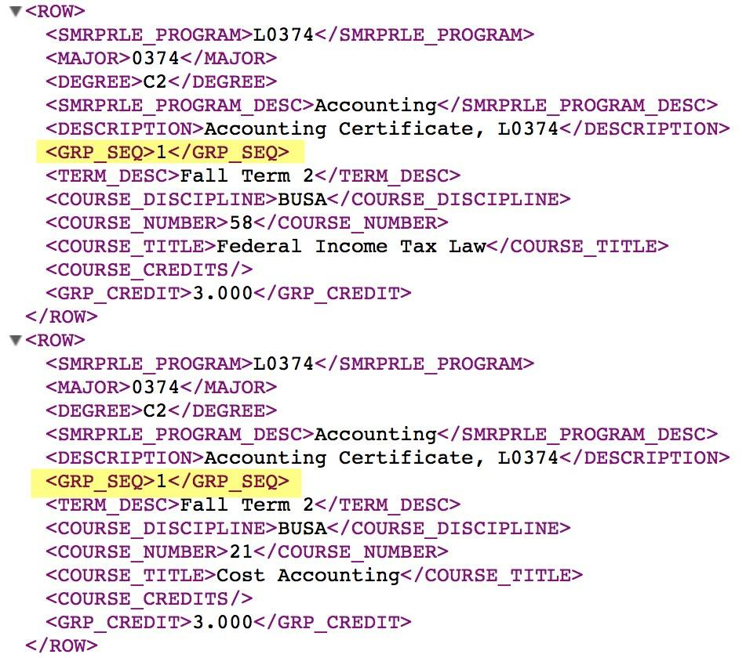
Results Page
XML DegreeWorks Data
Point 3: Identify Course Options
Any Group Sequence Node that has the same number is an option
Individual courses are indicated by a zero (0)
CISOA/3CBG/4CUG 2019 CONFERENCE, GARDEN GROVE, CA

Slide 31
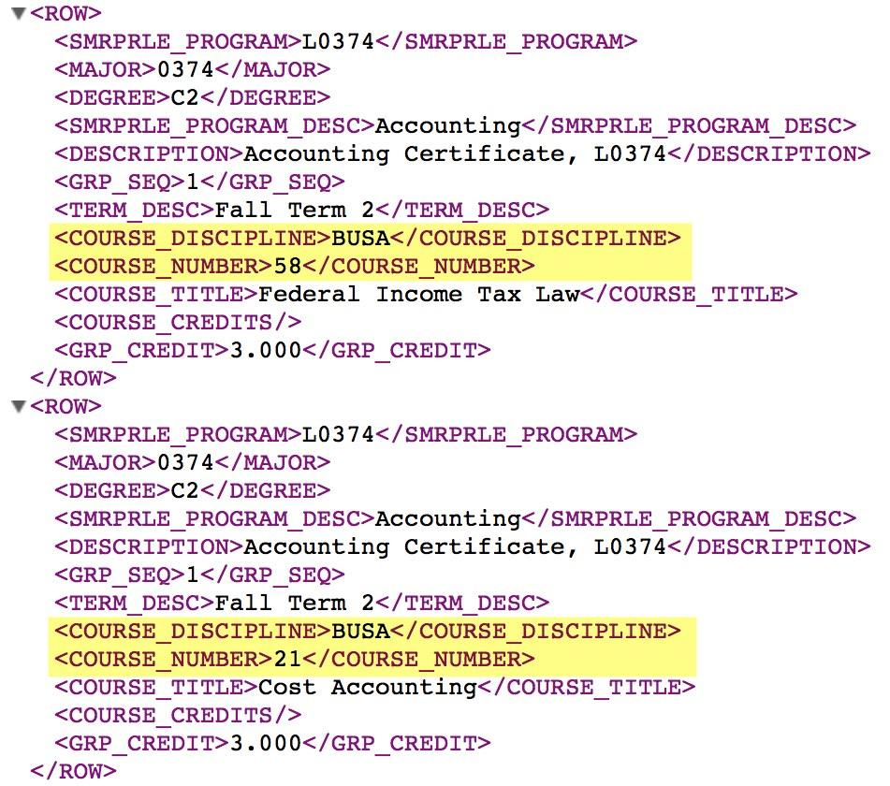
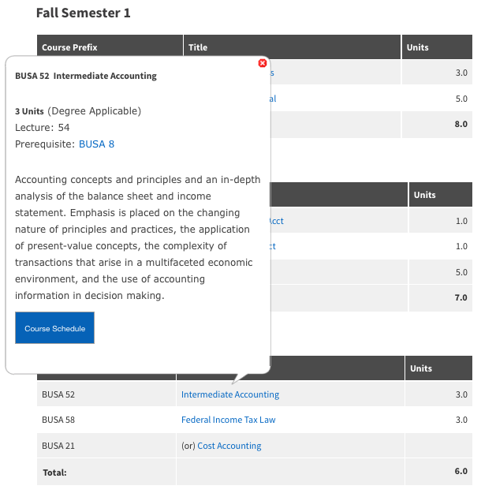
Results Page
XML DegreeWorks Data
Point 4: Marry Catalog Data
Courseleaf Catalog Offers API with Information Bubble Option
Bubbles preview course information
Courseleaf API is triggered by passing Course Number and Title.
Ajax call/Proxy function
Sample API Call - https://www.mtsac.edu/guided-pathways/search/?P=BUSA%2058
CISOA/3CBG/4CUG 2019 CONFERENCE, GARDEN GROVE, CA

Slide 32
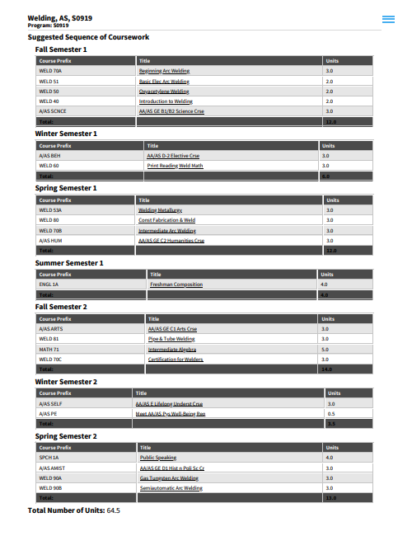
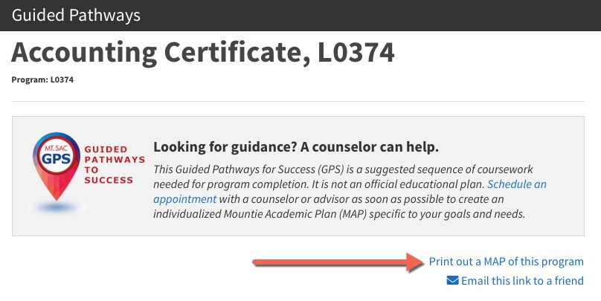
Printout Option
For Reference to take to a counselor or register for classes
Created with Print CSS Conditioning
Eliminated other elements in the page to condense information
CISOA/3CBG/4CUG 2019 CONFERENCE, GARDEN GROVE, CA

Slide 33
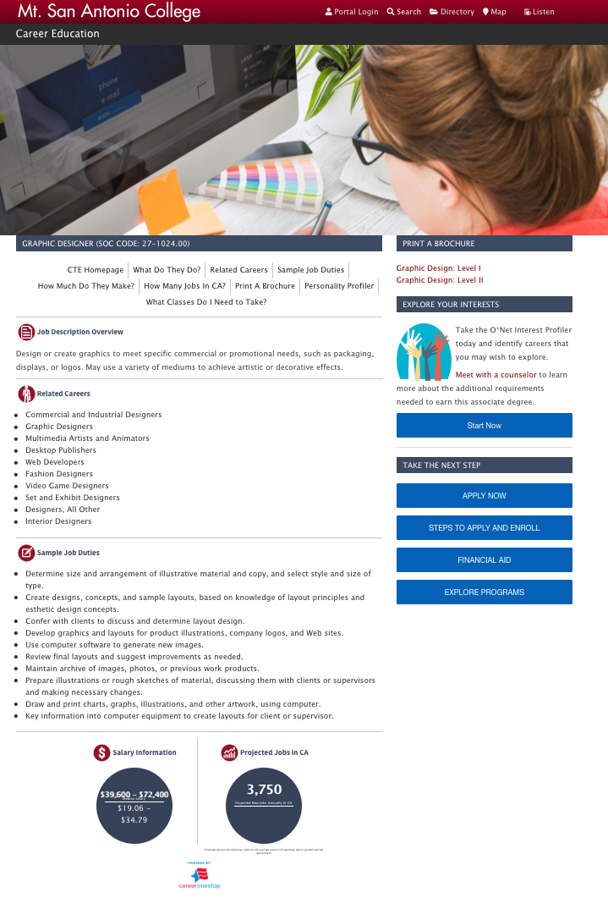
Future Plans with Site
Link to GP site from every department page
Long description of Program before MAP information
Cross Promote with our CTE Site (mtsac.edu/cte)
Salary Information (CareerOneStop/Onet Info)
Employment Information
Data comes from Onet/CareerOneStop
CISOA/3CBG/4CUG 2019 CONFERENCE, GARDEN GROVE, CA

Slide 34
Updates and Maintenance
Update the Template scheme
Clean up & Maintenance
CISOA/3CBG/4CUG 2019 CONFERENCE, GARDEN GROVE, CA

Slide 35
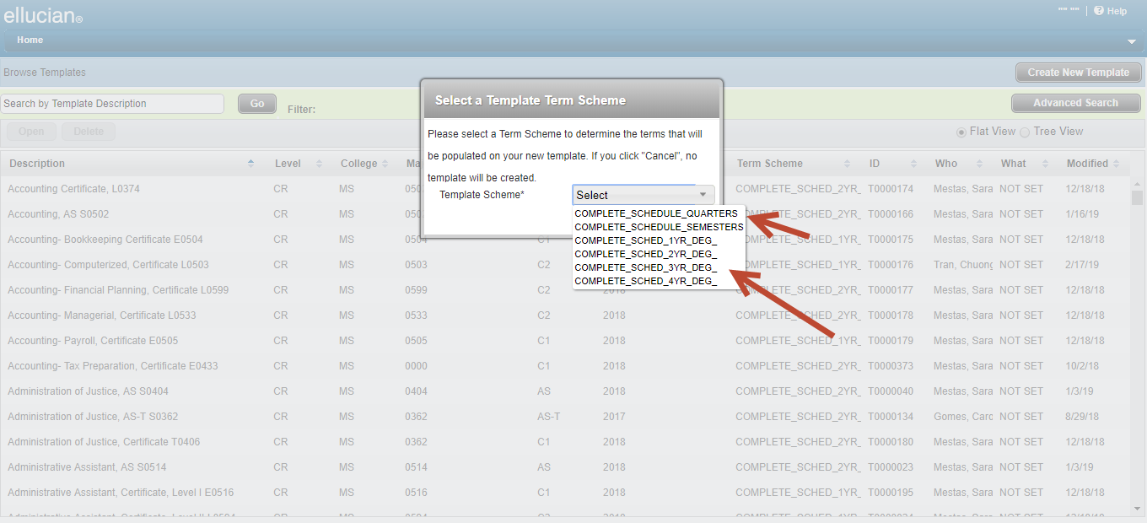
Updates to the Template Scheme
PROBLEM
The configured template scheme used the 4 year degree settings - 16 rows
Created extra empty rows that needed to be deleted
Slowed down the whole process and consumed resources
SOLUTION
Change the template terms schemes set in UCX-SEP002 - SureCode UCX Tables Technical Guide - Release 4.1.0
Provide the choice of 1/2/3 or 4-yr templates
Choice of 4 rows min to 16 rows max
CISOA/3CBG/4CUG 2019 CONFERENCE, GARDEN GROVE, CA

Slide 36
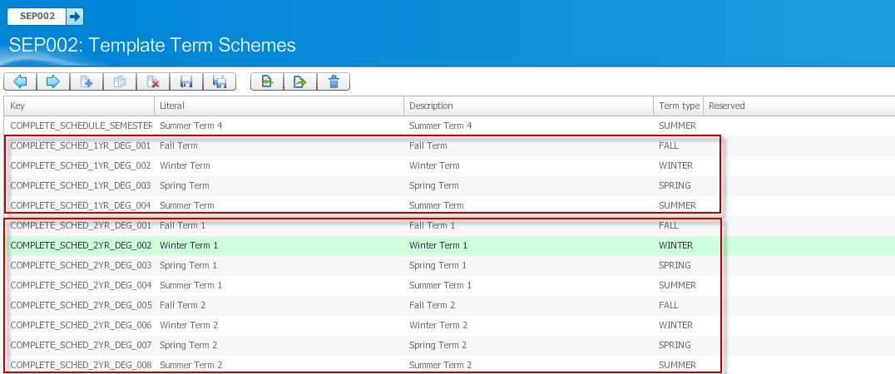
Update the Template Scheme
CISOA/3CBG/4CUG 2019 CONFERENCE, GARDEN GROVE, CA

Slide 37
Clean-up & Maintenance
Restructure all the templates based on the new template schemes available.
Verify that the major codes in Degreeworks match the catalog
Verify code extracted from Degreeworks before updates to the MAP site
CISOA/3CBG/4CUG 2019 CONFERENCE, GARDEN GROVE, CA

Slide 38
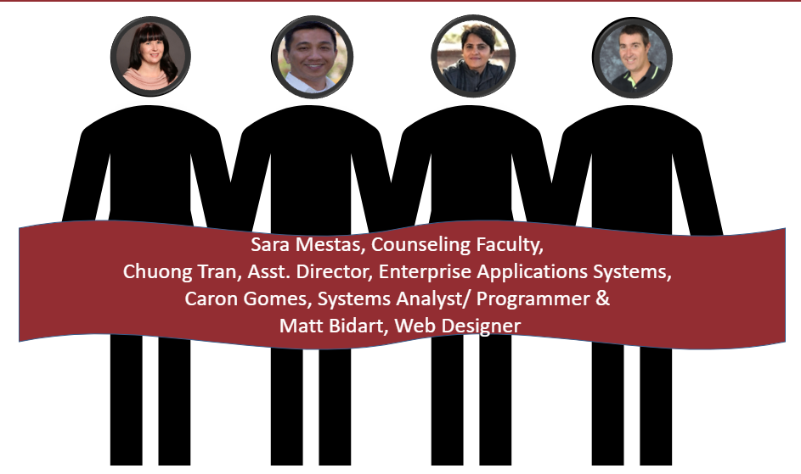
Questions?
Sara Mestas
Counselor
smestas@mtsac.edu
(909) 274-6349
Chuong Tran
Director Enterprise Application Systems
ctran@mtsac.edu
(909) 274-5569
Caron Gomes
Systems Analyst/Programmer
cgomes4@mtsac.edu
(909) 274-5840
Matt Bidart
Web Designer/Developer
Student Services | Guided Pathways | Title V
mbidart@mtsac.edu
(909) 274-6224

