Slide 1
Career Clusters at Mt. San Antonio Community College Presented by:
Dr. Joumana McGowan – Associate Vice President, Instruction
Mrs. Emily Versace – Counselor

Slide 2
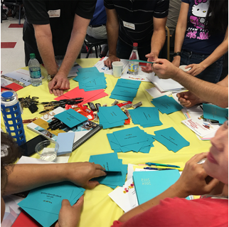
GPS at Mt. SAC
Activity Part 1: Card Sort
Take the stack of majors
Sort them into 8 piles based on what goes together
Use a sticky note to give each pile a name

Slide 3
Activity Part 2: Synthesizing Information
Copy the name of each pile in big letters on a piece of paper
Hold a paper and stand up
Find other people in the room with a similar title on their paper
Make a circle around the room

Slide 4
From a Student's Lens: Sort Programs into 8 buckets
600+ new students participating in summer programs
Students grouped into teams of six
Instructions: Sort these 200 Mt SAC programs into 8 groups and give each group a name
Students did ask for clarification on majors. For example, "What is Histology?" "What is the difference between Pet Science and Registered Veterinary Technician?"

Slide 5

Academic & Student Services Spring Master Planning Summit
Identifying Career Clusters

Slide 6
Learning Opportunities
Contextualized Learning
AB705 implementation
Challenges to modifying originally adopted meta-majors "buckets"
Changing clusters happens and is ongoing- collaboration is important

Slide 7
2016-17 Basic Skills Contextualization
English, Math, and Learning Assistance Faculty: Started contextualizing Basic Skills courses with focus on each Career Cluster
Fall 2017: Contextualized sections of ENGL 68 and MATH 51 were offered across the 8 career clusters
Students enrolled in the courses but were not necessarily majoring in that career cluster

Slide 8
Career Clusters Revisited
What makes sense for student advising by counselors?
What makes sense with career theory?
Incorporating the Holland Code: RIASEC
Adding a bucket

Slide 9
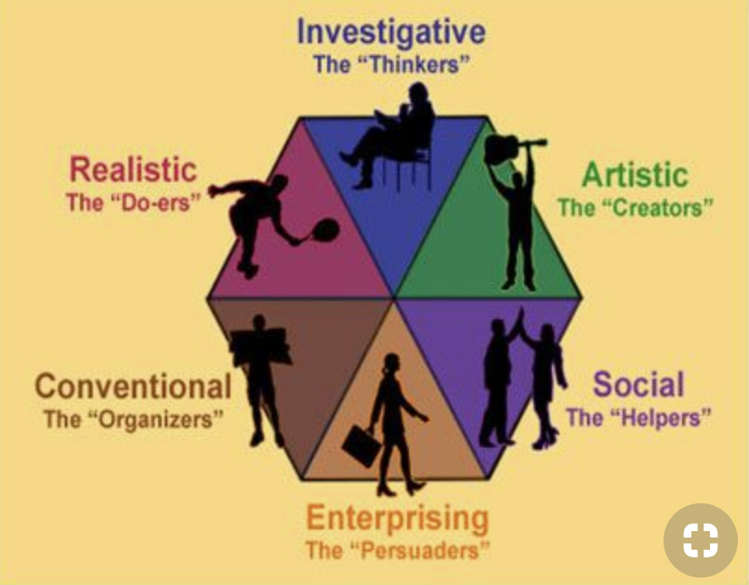
Added: Public Services and Social Science Changed: Sciences to STEM
There is no perfect way to sort:

Slide 10
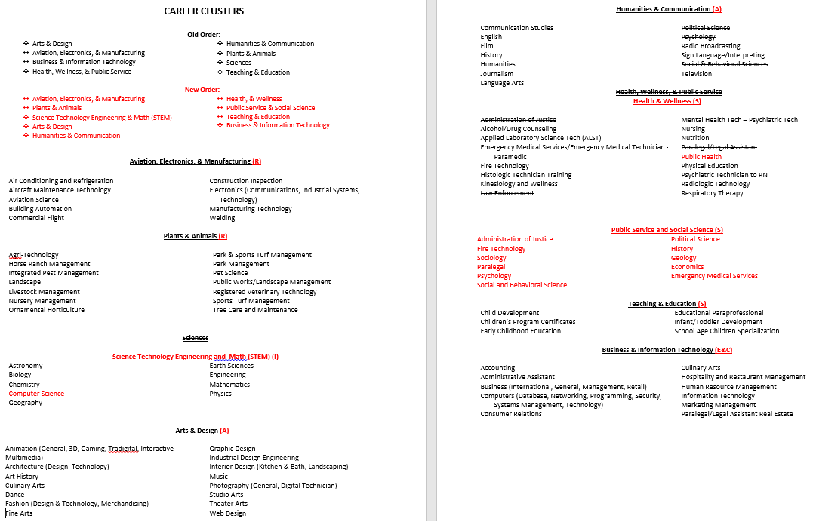

Slide 11

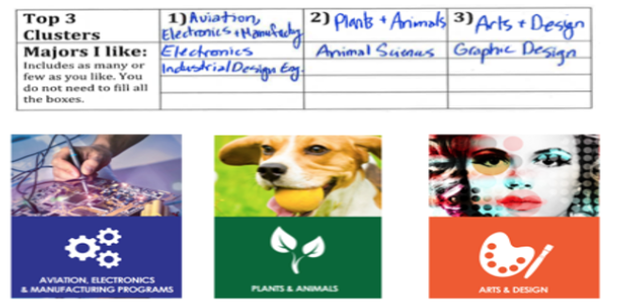
Activity: Pathways Cluster Card Sort
Explore majors at Mt. SAC with Career Cluster Cards
Choose your top three cards and write down any majors you are interested in

Slide 12
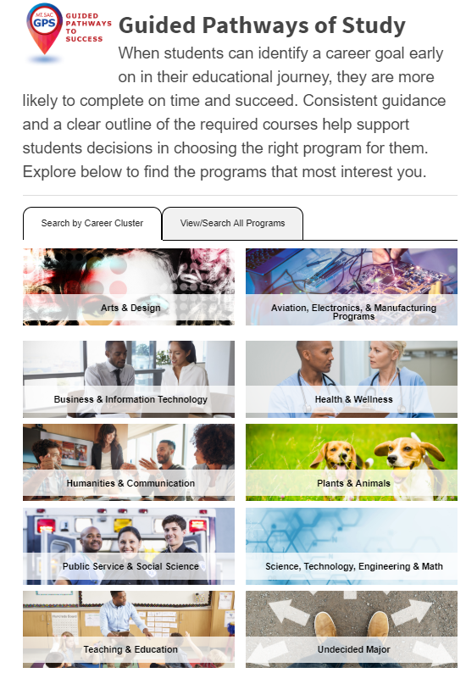
Guided Pathways Website: https://www.mtsac.edu/guided-pathways/

Slide 13


Slide 14
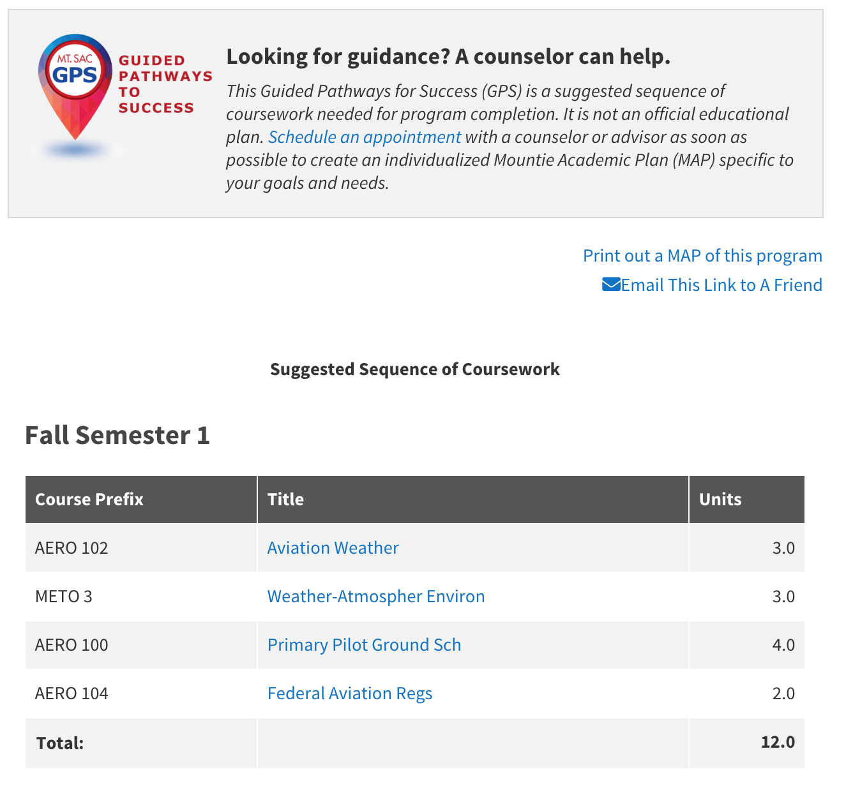

Slide 15
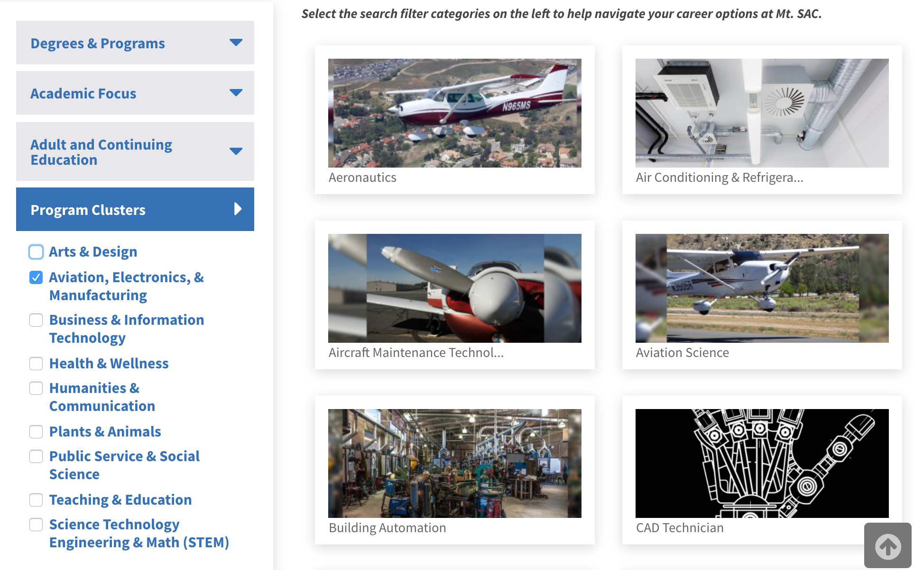
Catalog Sorted by Clusters

Slide 16
Questions? Contact Information:
Dr. Joumana McGowan - (909) 274-5140 jmcgowan@mtsac.edu
Emily Versace -(909) 274-6487 eversace@mtsac.edu

