Slide 1
Guided Pathways to Success (GPS) Funding Request Workshop
Patricia Maestro, GPS Faculty Liaison/Co-Chair Counseling Department
Michelle Sampat, Associate Dean, Instruction Services

Slide 2








“Begin With The End In Mind.” Stephen Covey
With the end in mind…

Slide 3
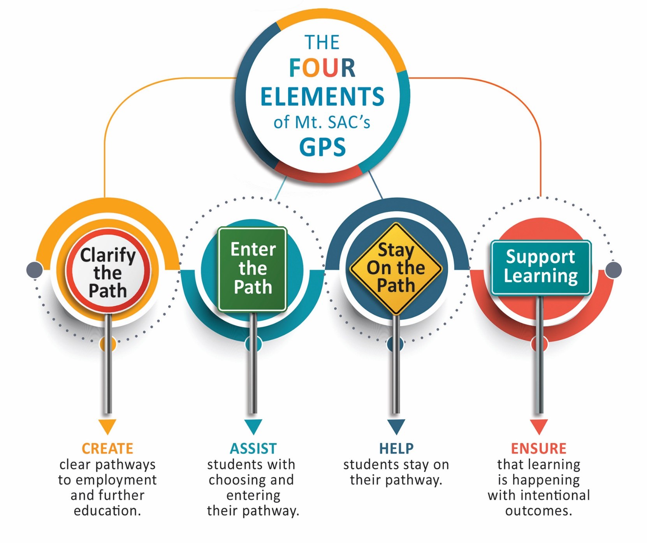
Guided Pathways at Mt.SAC
Notes:
Joumana

Slide 4
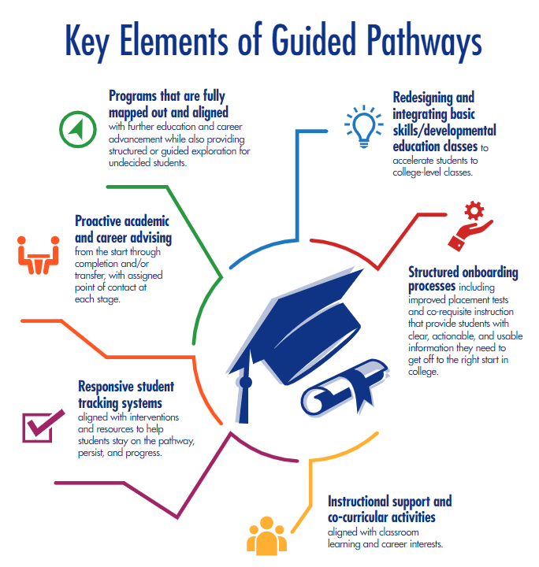

Slide 5

Signpost I
The purpose of this element is to make the pathway for students to complete their education and employment goals clear .
Faculty have been hard at work to help clarify the path by creating GPS maps that provide course sequence recommendations for students.
Counseling faculty have used these maps to create templates in Degree Works for students to use in creating academic plans or to modify these maps to fit the students’ diverse needs.

Slide 6
Signpost II
The focus of this element is to help students choose and enter their pathway of study. Counseling faculty are revising MAP Workshops and orientations to help students find the right career path and program of study.
Faculty are considering ways to engage students in their programs, including providing work experience, internship, and independent study options.

Slide 7
Signpost III
Students start academic programs and encounter many challenges along the way.
Mt. SAC has unparalleled academic and student services support programs such as tutoring centers, special programs, clubs, internships, work experience, special projects, project-based learning, clinical experiences, research opportunities, competitive teams, financial aid, and much more.
Mt. SAC’s GPS is capitalizing on this robust infrastructure to create an even more supportive environment to help students stay on the path to meet their goals.

Slide 8
Signpost IV
Changes in delivery of services, outreach, placement, course scheduling, orientations, academic support, technical resources, and so many more activities are happening with student equity in mind.
This element of Mt. SAC’s GPS centers on ensuring that learning is at the center of the work we are doing.
Researching the impact of changes and improvements, using data to drive decision-making, and developing and assessing outcomes are critical to student success.

Slide 9
Proposal to Address…
Impact on Student Success based on one, two, three, or all four Signposts
Data: Consult and include our Research team if requesting data from them prior to submitting proposals.
Budget needs that are reasonable. The workgroup may provide additional clarification as needed.

Slide 10
Submission Information:
GPS Funding Requests must be submitted by 5:00 p.m. on Monday, March 11, 2019.
For individual assistance please feel free to contact:
        Dr. Joumana McGowan Extension 5140)
        Michelle Sampat (Extension 5480)
        Patricia Maestro (Extension 6231)
        General: gps@mtsac.edu
        Guided Pathways Mapping website: https://www.mtsac.edu/guided-pathways/

