Slide 1

Mt. San Antonio College’s Horticulture Programs
Orientation
Fall, 2026

Slide 2
Introduction of Staff
Chaz Perea - Department Chair, Hort. Science, IPM, Turf, Parks, ID, Irrigation
Jennifer Hinostroza – Hort. Science, ID, Arboriculture, Interiors, etc.
Duncan McKee – Soils, Landscape Design, Cannabis, etc.
Jesus Ramirez – Horticulture Unit Supervisor
Brad Foyil – Farm Manager

Slide 3
Introduction of Staff - continued
Bill Millward - Irrigation
Gretchen Heimlich– IPM
Alicia Baugh– Nursery Management, Design
Will Harrison - Propagation
Eduardo Gutierrez– Construction
Robyn Tom – Irrigation
Edward Kardish

Slide 4
Program Declaration
Make sure to declare your goal (Certificate or Degree)!!!!
Associates Degrees
Ornamental Horticulture
Park and Sports Turf Management
Integrated Pest Management
Plant Science AS-T
Agriculture Science and Technology
Cannabis
Certificates of Achievement
Horticulture Science
Interior Landscaping
Landscape Design I
Landscape Irrigation
Landscape Construction
Landscape and Park Maintenance
Nursery Management
Tree Care and Maintenance
Sports Turf Management
Park Management
Cannabis I
Cannabis II

Slide 5
Associates Degree Programs
Students will receive an Associates of Science Degree (A.S. Degree)
Requires completion of General Education classes in addition to the core classes.

Slide 6
Certificate Programs
Only require completion of specified Core Courses
6 courses – 18 Units
Often used for job advancement within a company or to prove job skills.

Slide 7
Completion of Certificates and Degrees
You can earn Certificates and Degrees at the same time.
Double Major – You can complete a second A.S. degree with the completion of 18 additional units.
Certificates and Degrees are not automatically given to you when you have completed your required classes.
You must submit the required paperwork to request them from the Admissions and Records office.

Slide 8
Catalog Rights
You have “Catalog Rights” for the year that you started the program
  You must be a continuous student, and may not miss more than 1 semester (Fall or Spring) or your catalog rights start from when you return.
  There is an exception if you miss more than one semester because you are in the military.
Catalog rights means that if your degree or certificate requirements change while you are attending school, you are held to the original requirement.
Refer to the catalog from the year you started!

Slide 9
Applying for Certificates
You must fill out an “Application for Certificate” available in the Student Self Service part of the portal.
All transcripts from other colleges or universities must be submitted either before or at the time of filing the application.
At least half of the units for the certificate must have been completed at Mt. SAC.

Slide 10
Graduation Checks
Associates degrees are not automatically conferred. You must complete a graduation check.
It is recommended that you complete your graduation check one year before your expected finish date.
Grad Checks must be completed by the 7th week of the semester when you plan to graduate.
Application for graduation is available on the Portal - #45 under Student Self Service.

Slide 11
Associates of Science Degrees
Have a “grad check” performed by the Advising Center.
Completely fill out a Graduation Petition form and submit it by the deadline for the semester in which you plan to graduate.
If you are seeking to substitute a course completed at another school or one course for another, you need to petition for a variance with the appropriate department/division.
All transcripts from other colleges or universities must be either included with the petition or on file in the Admissions Office.
Submit the petition via the portal.

Slide 12
Course Offering Frequency

Slide 13
Educational Plans
We do not require you to create a formal education plan, but we do recommend that you have one.
Department faculty can help you with planning for core courses and basic general education information.
For transfer information, see Traci Ebue or one of the academic counselors.
  Traci Ebue, Counselor
    Extension 5304
    tebue@mtsac.edu

Slide 14
Example Education Plan
Education Plan |  | APPROVED BY:
 |  | NAME: BRIAN SCOTT
Student: _____________________________________ |  | TITLE: AGRICULTURAL SCIENCES DEPARTMENT CHAIR
Date: ________________________________________ |  | SIGNATURE:
Courses Needed for A.S. in Integrated Pest Management |  | (Major # S0311)
UNITS: | F 20___ | W 20___ | SP 20___ | SU 20___ | F 20___ | W 20___ | SP 20___ | SU 20___
Required courses:
AGOR 1 Horticulture Science 3.0
AGOR 24 Integrated Pest Management 3.0
AGOR 29 Ornamental Plants - Herbaceous 3.0
AGOR 30 Ornamental PlantsTrees&Shrub 3.0
AGOR 39 Turfgrass Production&Mgmt 3.0
AGOR 50 Soil Science and Management 3.0
AGOR 62 Landscape IrrigationDesign&Install 3.0
AGOR 63 Landscape Irrigation SystemsMgmt 3.0
AGOR 91 Work Experience in Nursery Ops3.0
PLUS-Select (6) units from following:
BIOL 1, 2, 3, 4, 4H, 6, 6L, 8, 20, 21, 34, 50; BTNY 3;
CHEM 10, 20, 40 50, 50H, 51, 60, 80, 81
PLUS
Student must take 9 units from the following list:
AGOR 2 Plant Propagation 3.0
AGOR 15 Interior Landscaping 3.0
AGOR 32 Landscaping&Nursery Mgmt 3.0
AGOR 40 Sports Turf Management 3.0
AGOR 75 Urban Arboriculture 3.0
UNITS: | 0 | 0 | 0 | 0 | 0 | 0 | 0 | 0
Total Units 42.0 |  |  |  |  |  |  | TOTAL UNITS: | 0

Slide 15
Recommendations – Courses to Begin With
Horticultural Science : AGOR 1
Soil Science: AGOR 50
Turfgrass Management: AGOR 39
Plant ID - AGOR 29, 30, and 35
Landscape Construction Fundamentals: AGOR 71
Tractor and Landscape Equipment Operations: AGOR 51
Plant Propagation: AGOR 2
Landscape and Nursery Management: AGOR 32
Irrigation Design and Installation: AGOR 62

Slide 16
Recommendations: Courses to End With
Landscape Design: AGOR 13
Integrated Pest Management: AGOR 24
Sports Turf Management: AGOR 40
Landscape Hardscape Applications: AGOR 72
Urban Arboriculture: AGOR 75

Slide 17
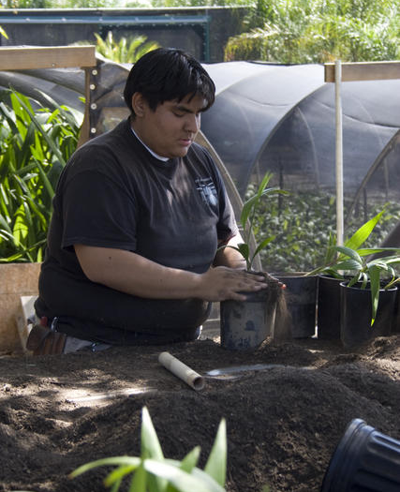
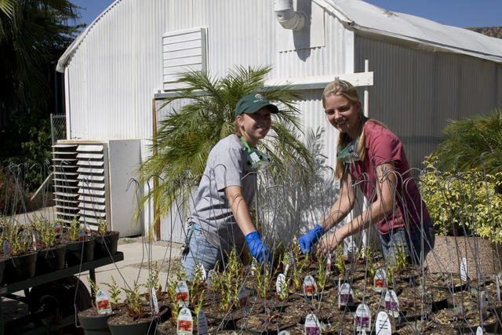
Work Experience
1-4 Units available, repeatable up to 4 times.
Possibilities:
  Work at the Horticulture Unit
  Work on special projects
  Work for an off-campus employer
No Experience Necessary. We will train you.
You Must complete 9 units of Horticulture Classes and attend an orientation before you are eligible for work experience.

Slide 18
Student Involvement Opportunities
Competitive Teams - Turf Team
Horticulture Club
Ag Ambassadors
Volunteer Opportunities
  Descanso Plant Sales
  Mother’s Day Sale
  Farm Day
  Work Days
Attend Department Events
  End of year Banquet

Slide 19
Any Questions?

