Slide 1


MT. SAC Paramedic Academy Overview
Fall and Spring Starts
Public Safety Programs

Slide 2

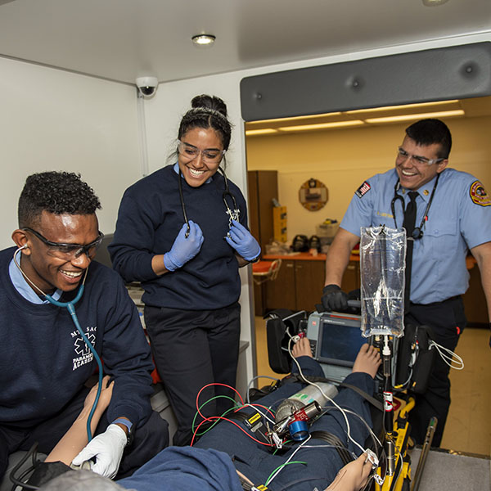
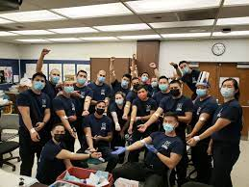
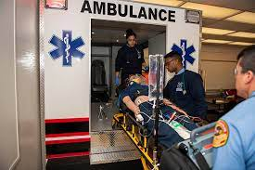
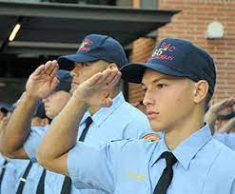
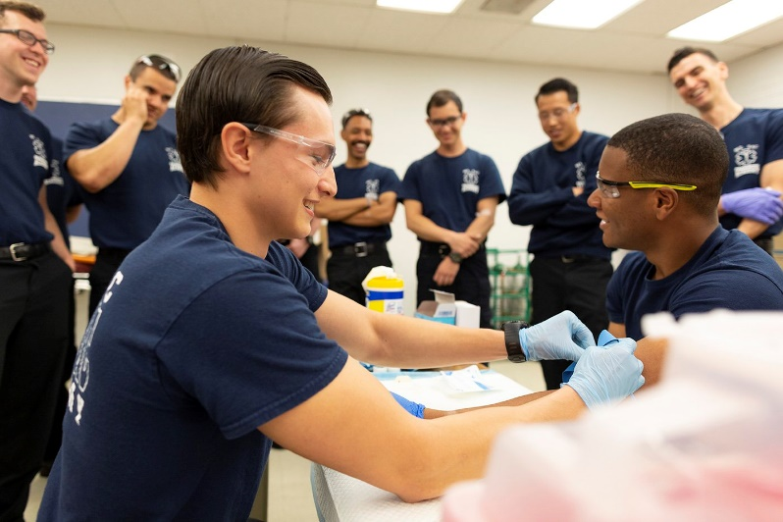
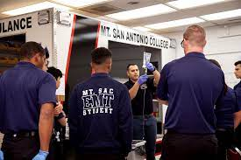
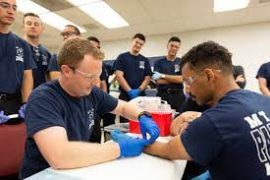
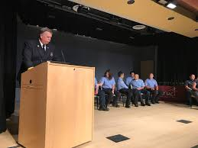
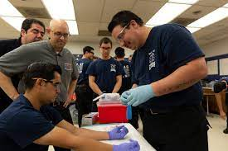
Paramedic Academy

Slide 3




Nationally and Local Accreditation

Slide 4
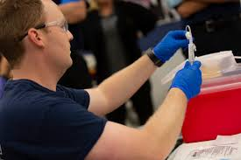
Paramedic Academy Established Goals
“To prepare competent entry-level Paramedics in the cognitive (knowledge), psychomotor (skills), and affective (behavior) learning domains with or without exit points at the Advanced Emergency Medical Technician and/or Emergency Medical Technician, and/or Emergency Medical Responder levels.”
Paramedic Academy Goals
~ Prepare the graduate to enter the EMS workforce with a pre-hospital care provider
~ Prepare the graduate to serve their community with compassion, caring, kindness, and professionalism
~ Prepare the graduate to successfully complete National Registry Cognitive and Psychomotor Examinations
~ Prepare the graduate to meet the challenges of working within the pre-hospital care provider culture

Slide 5
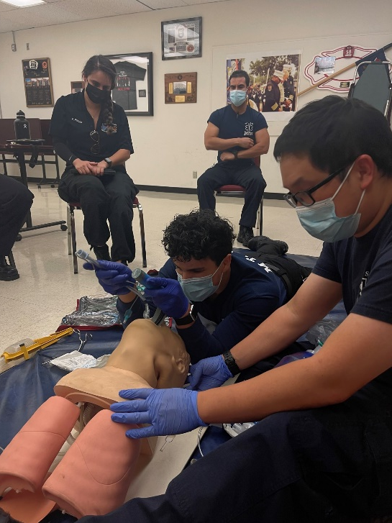

Paramedic Academy Vaccination Requirements
Clinical and Field Internships require COVID 19 vaccination and booster
MT SAC strictly follows public health guidelines and increased classroom safety

Slide 6
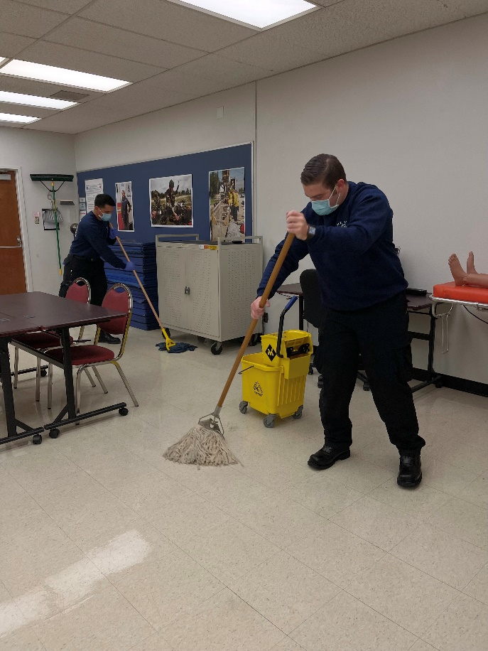
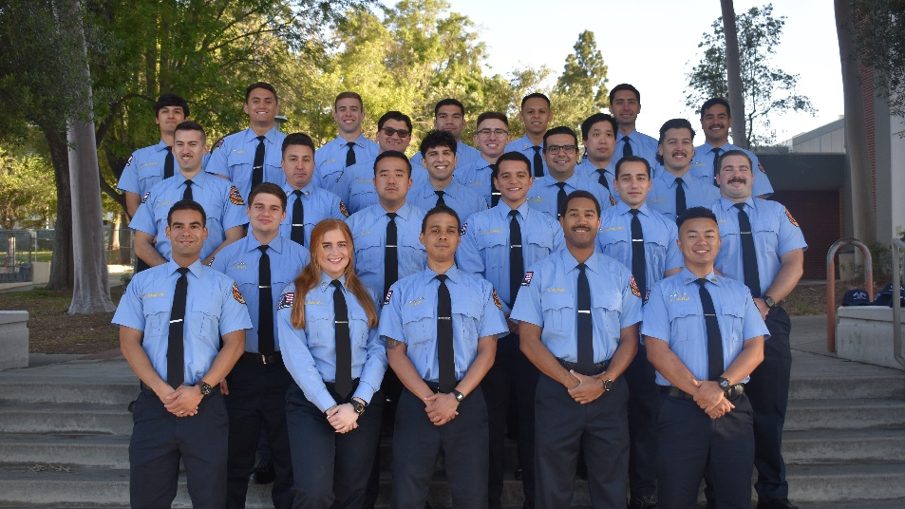
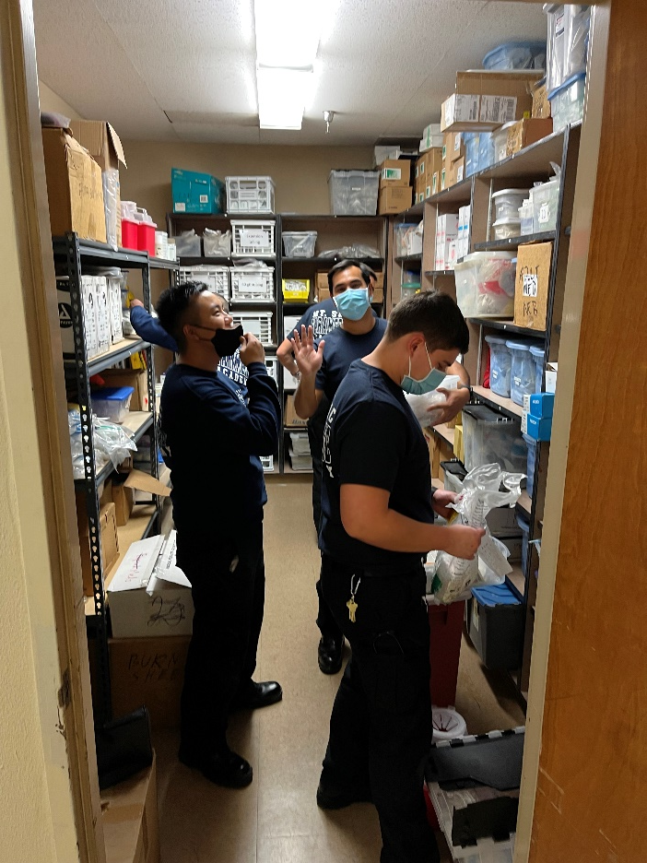
Academy Structure
25 Seats
Semi-Military Structure
Paramedic & Fire Academies
Uniforms
Leadership Opportunities – Battalion Chief, Company Captains
Weekly Inspections / Flag Presentation
Weekly Top Company
Company Responsibilities
Graduation

Slide 7
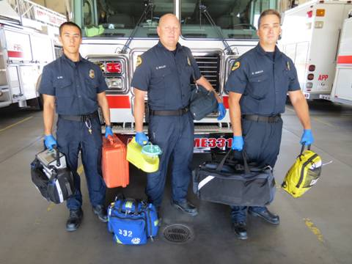



Paramedic Academy Stats
National Registry (NREMT)
100% pass rate with 88% passing first time and remaining 12% passing the second time.
Employment Rate
100% employment rate

Slide 8

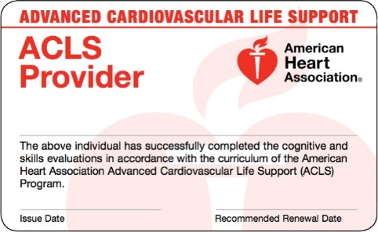


Paramedic Academy
Advanced Cardiac Life Support (ACLS) Certification
Pediatric Advanced Life Support (PALS) Certification
Los Angeles County Accreditation
Outside Counties Accreditation
Preparation for National Registry Paramedic Testing
Requirements to take the National Registry Paramedic Testing
Prepare the Student a Career in Emergency Medical or Fire Services
Completion toward an Associated Science Degree

Slide 9

Financial Aid
It your Responsibility to Investigate Potential Aid
You must Submit a FAFSA to be Eligible
Students Services Building
Board of Governor's Fee Waiver (Promise Grant)
Scholarship Opportunities

Slide 10
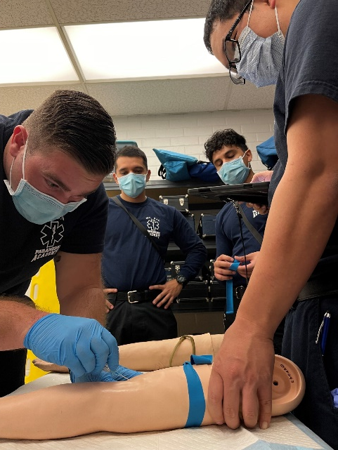
Paramedic Academy Overview
Didactic Course Schedule Example
Monday 0800 - 1230
Tuesday – Friday 0800 – 1545
Academy Structure
Fall / Spring Start
Prerequisite Course EMS 1 – Paramedic Prep
Courses EMS 10, 40, 50, 70 & 80
16 Weeks – Didactic
6 Weeks – Clinical
10/12 Weeks – Field

Slide 11

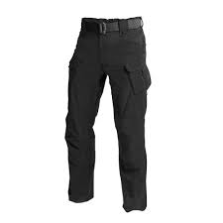
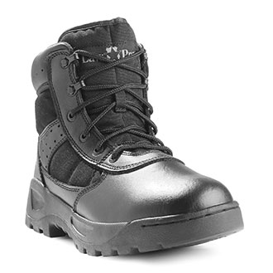
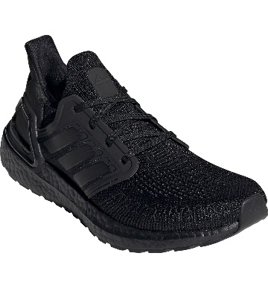
EMS 1 Paramedic Prep Course
Mandatory Course
Winter or Summer Intersession
Written & Scenario Final Exam
Uniform:
Mt. SAC Paramedic T-shirt
Black BDU Pant (Tactical)
Black Belt
Black Boots or Black Tennis Shoes (Only EMS 1)

Slide 12
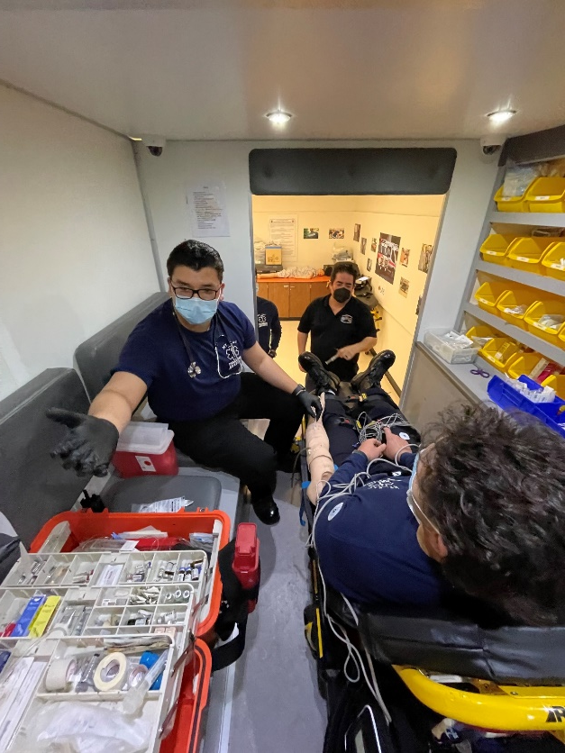
Didactic
EMS 10- Anatomy, Pathophysiology, & Pharmacology
EMS 40-Cardiology and ACLS/PALS
EMS 50-Paramedic Skills-Scenario Training
Morning Lecture
Afternoon LAB
Academy Classroom
ARE YOU PREPARED?

Slide 13
Didactic
Schedule Examples
Week 9 | 10/17 | 0800-1215 | EMS 50 | Med Math Final | Rincon
 | 10/18 | 0800-1135 | EMS 10 | Gastrointestinal System | Mah
 |  | 1225-1330 | EMS 10 LAB | Skills to Date / Prep for Practical Exam | Mah
 |  | 1340-1545 | EMS 50 LAB | Skills to Date / Prep for Practical Exam | Mah
 | 10/19 | 0800-1135 | EMS 10 | Abdominal and Gastrointestinal Emergencies | Lopez
 |  | 1225-1330 | EMS 10 LAB | Skills to Date / Prep for Practical Exam | Rincon
 |  | 1340-1545 | EMS 50 LAB | Skills to Date / Prep for Practical Exam | Rincon
 | 10/20 | 0800-1135 | EMS 10 | Reproductive System and Urinary System | Mah
 |  | 1225-1330 | EMS 10 LAB | Skills to Date / Prep for Practical Exam | Lopez
 |  | 1340-1545 | EMS 50 LAB | Skills to Date / Prep for Practical Exam | Lopez
 | 10/21 | 0800-1135 | EMS 10 | Urinary and Renal Emergencies | Mah
 |  | 1225-1330 | EMS 10 LAB | EMS 10 PRACTICAL EXAM | Lopez
 |  | 1340-1545 | EMS 50 LAB | EMS 10 PRACTICAL EXAM | Lopez
Week 11 | 10/31 | 0800-1215 | EMS 50 | Topographic Anatomy, Integumentary | Mah
 | 11/01 | 0800-1135 | EMS 10 | Muscular and Skeletal Systems | Mah
 |  | 1225-1330 | EMS 10 LAB | Auto Extrication | Mah
 |  | 1340-1545 | EMS 50 LAB | Auto Extrication | Mah
 | 11/02 | 0800-1135 | EMS 10 | EENT Systems/Trauma/Emergencies | Mah
 |  | 1225-1330 | EMS 10 LAB | Skills Lab - HCRC (Childbirth & Neo Natal resc) Comp 1&2 | Mah
 |  | 1340-1545 | EMS 50 LAB | Skills Lab - HCRC (Childbirth & Neo Natal resc) Comp 1&2 | Mah
 | 11/03 | 0800-1135 | EMS 10 | Abdominal and Genitourinary Trauma | Lopez
 |  | 1225-1330 | EMS 10 LAB | Skills Lab - HCRC (Childbirth & Neo Natal resc) Comp 3&4 | Rincon
 |  | 1340-1545 | EMS 50 LAB | Skills Lab - HCRC (Childbirth & Neo Natal resc) Comp 3&4 | Rincon
 | 11/04 | 0800-1135 | EMS 10 | Cadaver lab | Rincon
 |  | 1225-1330 | EMS 10 LAB | Skills Lab | Rincon
 |  | 1340-1545 | EMS 50 LAB | Skills Lab | Rincon

Slide 14
TEXTBOOKS
Nancy Caroline’s Emergency Care in the Streets…..
EMS 1 Books:
  AAOS Anatomy and Physiology
  ECG Workout Book
  WE WILL PROVIDE THE PURCHASE LINK……..

Slide 15
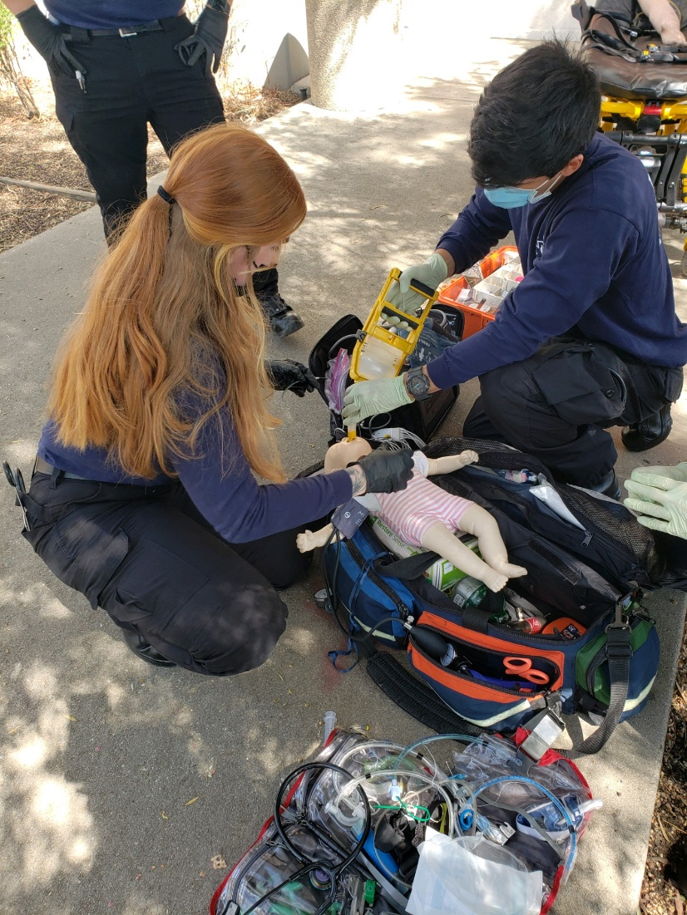
EMS 70 – Clinical (Hospital Rotation)
Pomona Valley Hospital
Beverly Hospital
Queen of the Valley Hospital
Long Beach Memorial Medical Center
Orange County Global Medical Center
St. Joseph Hospital Burbank
PIH Whittier Hospital
Arcadia Methodist Hospital
University of Irvine Medical Center
Children’s Hospital Orange County
  Assigned to Local Hospitals
  Practice Skills on Live Patients
  Administer Medications, Start IVs under Supervision
  168 hours (12 hour shifts)
  Emergency Room Rotations
  Labor and Delivery Unit Rotation
  Pediatric Emergency Room Rotation
  Burn Center Rotation

Slide 16

EMS 80
Field Internship
480 hours (24-hr shifts)
Affiliated Agencies:
LA County: LAFD, Pasadena, Alhambra, West Covina, San Gabriel, Arcadia, Monterey Park, Lynch Ambulance
Orange County: Anaheim, Orange, OCFA, Fountain Valley
San Bernardino County: Montclair, AMR, Chino Valley Fire District

Slide 17
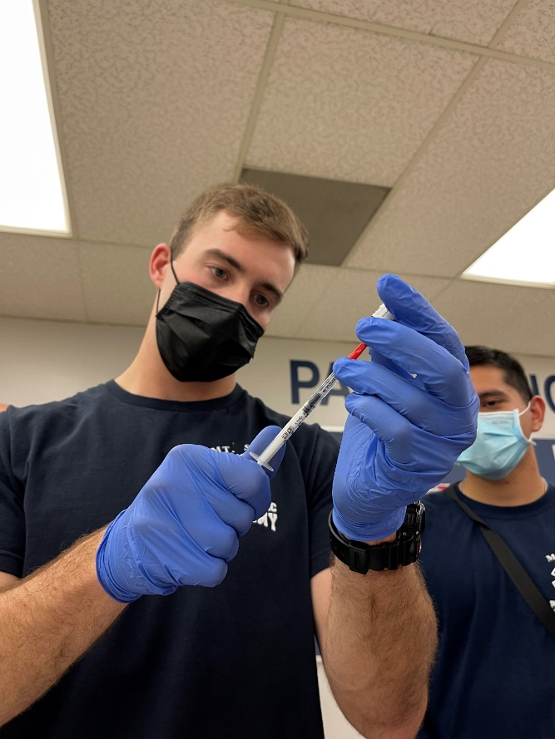
Grading
EMS 10, 40, and 50
Pop Quizzes and Activities
Quizzes
Final Written Exam
Final Psychomotor Exam
Affective Behavior Evaluations
Grading Standard for EMS 10, 40, and 50 require a minimum grade average of 80% to be maintained at all times.
Letter Grades:
A = 90 – 100%
B = 80 – 89%
**Below 80.0% constitutes courses failure
EMS 70 and 80
Pass / Fail

Slide 18
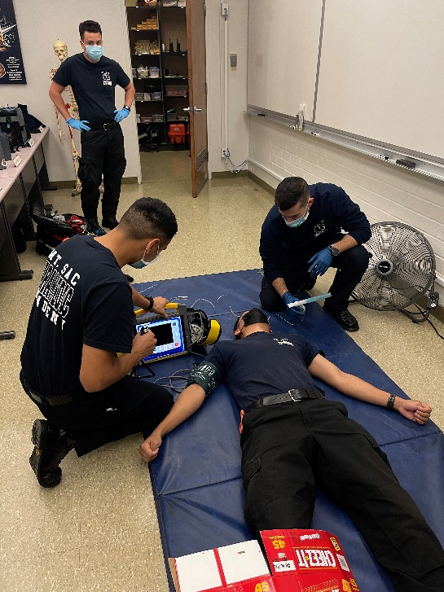
Financial Obligations
Tuition 36 Units X $46: $1,656.00
Uniforms: $337.00
Boots : $155.00
Simulated Medication Kit: $200.00
Books: $800.00
Apps and Miscellaneous Items: $200.00
Health/Parking Fees: $90.00
PALS/ACLS Books/Cards: $100.00
Total: Approximate: $4,000.00
BOG Waiver- Tuition / Scholarships

Slide 19
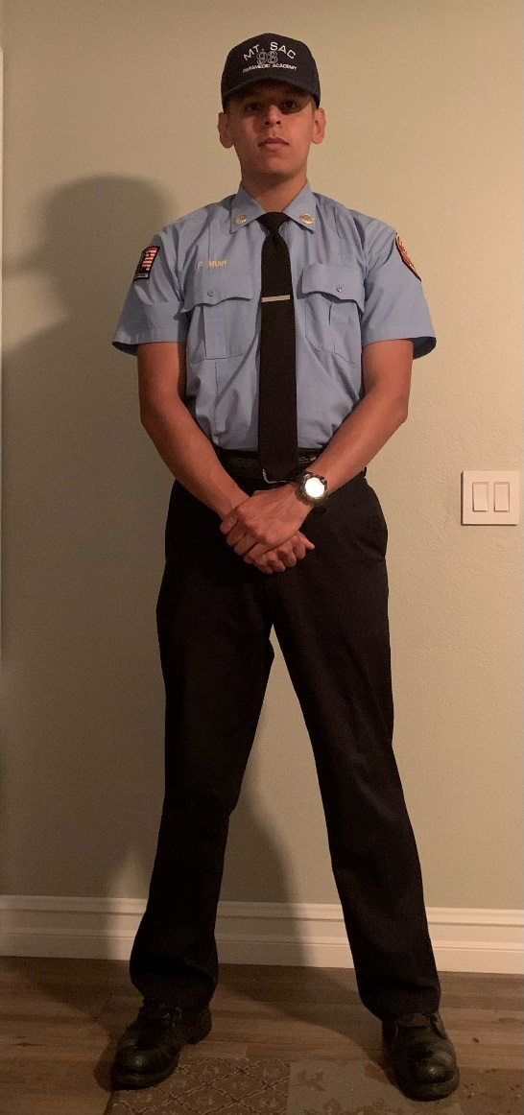
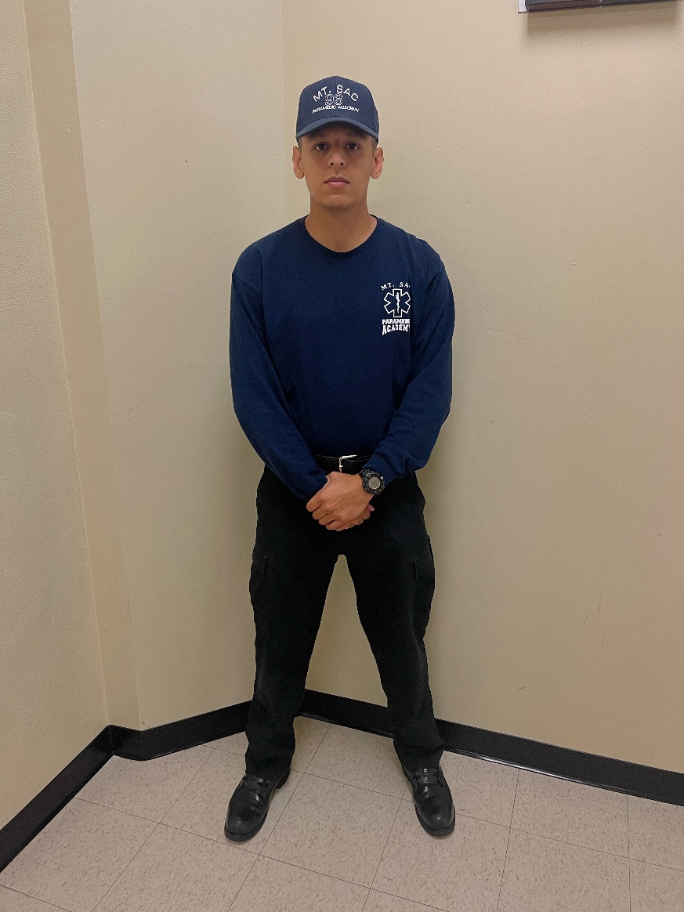
Uniforms
Academy Uniform
Shirt
Light Blue
Short and Long Sleeves (Tattoo)
Students Name Embroidered
Pants
Black Pants
Black Leather Belt
Boots
Black Safety Boot – Must Be Approved
T-Shirts
Short and Long Sleeves (Tattoo)
Skills Lab Uniform
T-Shirt
Short and Long Sleeves (Tattoo)
BDU
Black Pants
Black Leather Belt
Boots
Black Safety Boot – Must Be Approved
Cap
Navy Blue
Short and Long Sleeves (Tattoo)
Students Name Embroidered
Safety Gear
Issued

Slide 20
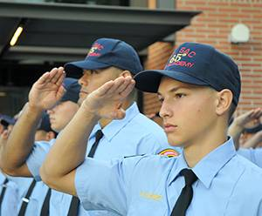
Academy Frame of Mind
Held Accountable to Signed Agreements
Be Prepared
Be on Time
Attention to Detail
Esprit De Corps
Team Player
100% Effort at all Times
Professionalism
Attitude

Slide 21
Attitude
Attitude Matters!
You Can Fail due to your Attitude……
Attitude is everything, so pick a good one….
Excellence is not a skill, it’s an attitude!
It's not what happens to you, but how you react to it that matters….
Attitude is a key component of your character and personality!

Slide 22
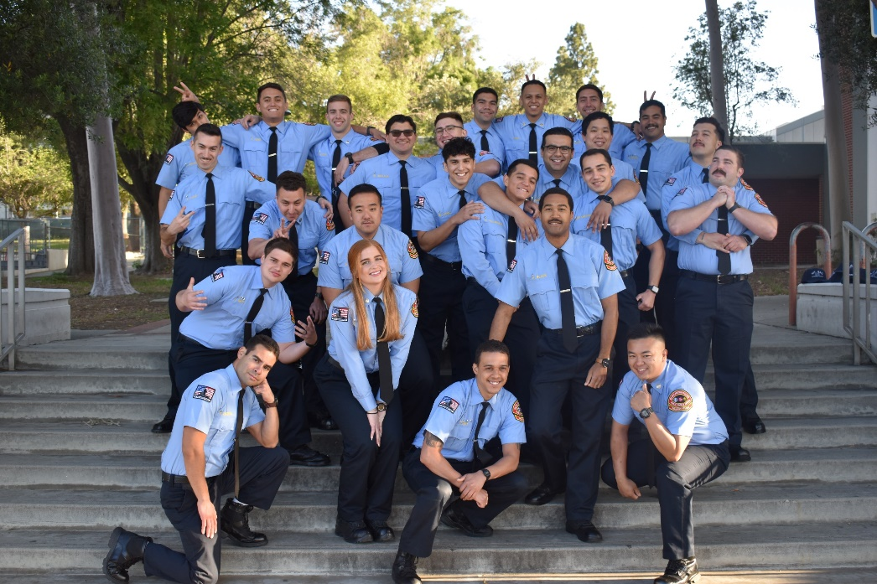
Come Join our Academy!

