Slide 1

Mt. SAC 2035
Goals, Commitments & Outcomes
Notes:
Diane

Slide 2




Mt. SAC 2035 Framework
Mt. SAC 2035 is the College’s comprehensive plan, which will guide unit goals.
Mt. SAC MISSION
CONDITIONS FOR SUCCESS
Welcoming, Inclusive, Safe, Supportive Environment
Rigorous and Relevant Learning
Clear, Easily Accessible Information
INSTITUTIONAL GOALS + COMMITMENTS
Accomplished through plans and resource allocation
VISION 2030
EQUITABLE + INNOVATIVE TEACHING
1
2
EQUITABLE ACCESS + COMPLETION
3
CULTURE OF CARE
1.1 Service to Students
1.2 Wraparound Support
1.3 Holistic Support
1.4 Clear Communication
1.5 Belonging + Community
1.6 Welcome + Safe Campus
2.1 Enhance Onboarding + First-Year Success
2.2 Support for Online Learning
2.3 Support Course Success
2.4 Support Transfer + Completion
2.5 Enhance Processes to Support Student-Centered Course Needs
3.1 A Diverse Campus Workforce
3.2 Investment in Professional Learning
3.3 Strengthen Relationships
3.4 Learning-Ready Infrastructure
3.5 Equitable + Integrated Facilities
Mt. SAC 2035 website and plan document: www.mtsac.edu/2035
Notes:
Academic Senate Slide
To ensure a common understanding of essential plan elements, the College applies the Society for College and University Planning (SCUP) definition of “a goal” as “a broad, general statement of intended outcomes or results.” To reinforce the College’s intentions to create the envisioned future with clear, measurable actions, Mt. SAC 2035 identifies its plan strategies as commitments, which more precisely conveys its institutional pledge to implement the goals that create conditions for the success of all students.

Slide 3
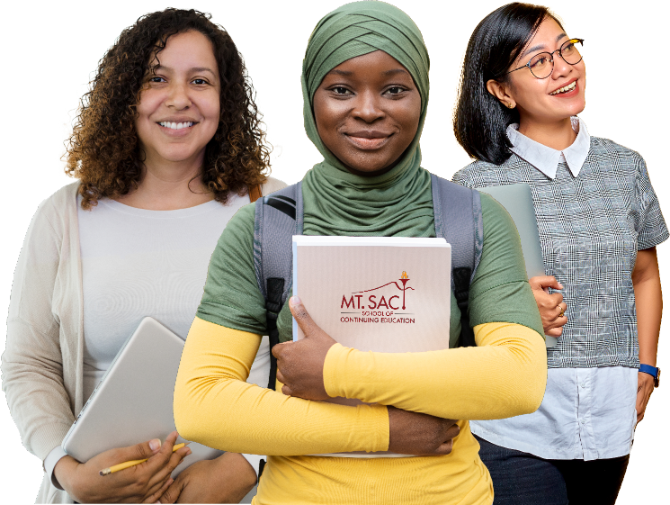
Goal 1: Culture of Care
Foster a caring campus community where individuals are valued and respected, and where students are surrounded by a network of empathy, personalized support, encouragement, and guidance.
Commitments: In support of this goal, we commit to …
1.1 Service to Students
Foster a culture of care by building employee capacity to be of service to students through knowledge of students’ lived experiences; internal and external resources; and infuse healing-centered engagement and peace education practices.
1.2 Wraparound Support
Strengthen support for student’s medical and mental health needs by leveraging community partnerships with social service agencies and community-based organizations to provide comprehensive wraparound services.
1.3 Holistic Support
Increase use of programs for disproportionately impacted and other specialized student groups to provide students with supports such as mentoring, cultural enrichment, and spaces to cultivate belonging.
1.4 Clear Communication
Prioritize the timely creation and delivery of clear, consistent, and readily available information in multiple formats and languages to ensure accessibility.
1.5 Belonging and Community
Build sustainable indoor and outdoor spaces that are inclusive, accessible, promote engagement, encourage collaboration, foster connection, and
create community.
1.6 Welcome and Safe Campus
Provide a welcoming, safe, and secure campus with organizational clarity through functional zoning, a network of accessible pathways, improved campus navigation, and clear wayfinding.

Slide 4

Goal 1: Culture of Care
Foster a caring campus community where individuals are valued and respected, and where students are surrounded by a network of empathy, personalized support, encouragement, and guidance.
Employee knowledge of student support services
Engagement of employees in learning opportunities that support a healing-centered culture of caring and peace
Outcomes
5 Year Outcome: 25% of employees will participate in learning opportunities that support a healing-centered culture of care
5 Year Outcome: 10% increase over baseline in employee knowledge of student support services
Commitment 1.1
Service to Students
Foster a culture of care by building employee capacity to be of service to students through knowledge of students’ lived experiences; internal and external resources; and infuse healing-centered engagement and peace education practices.
Notes:
Academic Senate Slide

Slide 5

Goal 1: Culture of Care
Foster a caring campus community where individuals are valued and respected, and where students are surrounded by a network of empathy, personalized support, encouragement, and guidance.
Student wellness infrastructure
Outcomes
Student utilization of wraparound support services
Student awareness of available wraparound support programs and wellness services
5 Year Outcome: Formal partnerships established with 5+ local social service and health agencies.
5 Year Outcome: 10% increase in credit student utilization of wraparound support programs and wellness services
5 Year Outcome: Provide health and mental health services and a referral process to noncredit students, with at least 200 noncredit students accessing services per year.
5 Year Outcome: 60% of students report awareness of available wraparound support programs and wellness services.
Commitment 1.2
Wraparound Support
Strengthen support for student’s medical and mental health needs by leveraging community partnerships with social service agencies and community-based organizations to provide comprehensive wraparound services.
Notes:
Academic Senate Slide

Slide 6

Goal 1: Culture of Care
Foster a caring campus community where individuals are valued and respected, and where students are surrounded by a network of empathy, personalized support, encouragement, and guidance.
Student utilization of affinity centers
First-to-second year retention for credit students (Aspen)
Outcomes
5 Year Outcome: 68%
5 Year Outcome: Increase student utilization of affinity centers by 10% over baseline.
Commitment 1.3
Holistic Support
Increase use of programs for disproportionately impacted and other specialized student groups to provide students with supports such as mentoring, cultural enrichment, and spaces to cultivate belonging.
Notes:
Academic Senate Slide

Slide 7

Goal 1: Culture of Care
Foster a caring campus community where individuals are valued and respected, and where students are surrounded by a network of empathy, personalized support, encouragement, and guidance.
Students report satisfaction with the clarity, accessibility, and timeliness of student communications
Communications meet established guidelines coordinated through the Student Communication Calendar, timelines, and multilingual/multiformat elements
Outcomes
5 Year Outcome: 60% of communications will meet the established guidelines for communication.
5 Year Outcome: 5% increase in credit and noncredit students, including Community Education, neurodiverse, and disabled populations report of satisfaction with the clarity, accessibility, and timeliness of student communications from the established baseline.
Commitment 1.4
Clear Communication
Prioritize the timely delivery of clear, consistent, and readily available information in multiple formats and languages to ensure accessibility.
Notes:
Academic Senate Slide

Slide 8

Goal 1: Culture of Care
Foster a caring campus community where individuals are valued and respected, and where students are surrounded by a network of empathy, personalized support, encouragement, and guidance.
Students report a sense of belonging tied to shared campus spaces, through satisfaction with the availability, accessibility, and useability of shared spaces
Inclusive and sustainable campus space utilization and engagement
Outcomes
5 Year Outcome: 30% of renovated or new spaces meet green building and universal accessibility standards.
5 Year Outcome: 5% increase in use of collaborative spaces as measured by event bookings
5 Year Outcome: 20% increase in students reporting satisfaction with the availability, accessibility, and usability of shared spaces from established baseline.
Commitment 1.5
Belonging and Community
Build sustainable indoor and outdoor spaces that are inclusive, accessible, promote engagement, encourage collaboration, foster connection, and create community.
Notes:
Academic Senate Slide

Slide 9

Goal 1: Culture of Care
Foster a caring campus community where individuals are valued and respected, and where students are surrounded by a network of empathy, personalized support, encouragement, and guidance.
Standardized wayfinding across the campus
Students and employees report the campus as welcoming, easy to navigate, and safe
Outcomes
5 Year Outcome: 15% increase in the students reporting the campus as welcoming from established baseline.
5 Year Outcome: Standardized wayfinding signage installed across 30% of campus.
Commitment 1.6
Welcome and Safe Campus
Provide a welcoming, safe, and secure campus with organizational clarity through functional zoning, a network of accessible pathways, improved campus navigation, and clear wayfinding.
Notes:
Academic Senate Slide

Slide 10
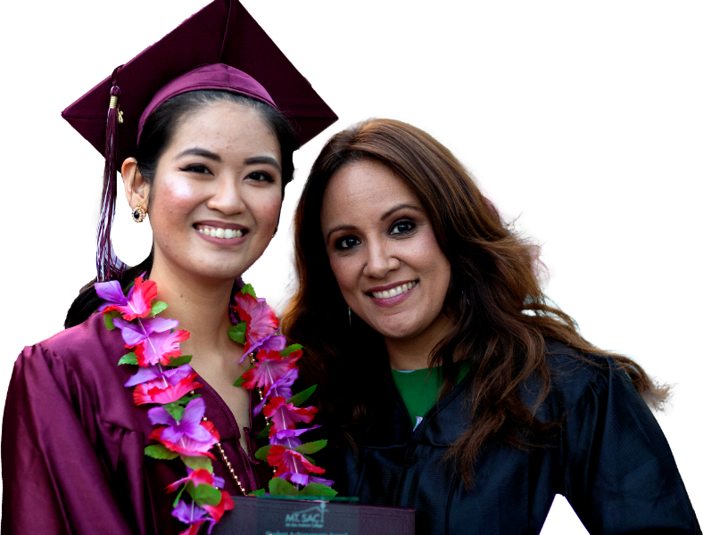
Mt. SAC 2035 Framework
Institutional Goals and Commitments
Institutional Goal 2: Equitable Access & Completion
Expand equitable access to and participation in instructional and support programs, services, and resources to enhance student success.
Commitments: In support of this goal, we commit to …
2.1 Enhance Onboarding and First-Year Success
Enhance the onboarding experience via a student-centered process for enrollment, and services that welcome students and promote first year success.
[Rigorous and Relevant Teaching and Learning]
2.2 Support for Online Learning
Increase students’ online access to academic support, counseling, opportunities to participate in campus life, and expand easily accessible technology training and support for students in both synchronous and asynchronous learning environments.
[Welcoming, Inclusive, Safe, Supportive Environment]
2.3 Support Course Success
Assess access and increase participation in tutoring services and resources that support student course success. Streamline tutoring services to maximize efficiency of specialized areas of support, increase visibility of focused services and student usage, ensure multi-modal access, use embedded tutors, and train all tutors in subject matter as well as methods to meet different learning needs.
[Rigorous and Relevant Teaching and Learning]
2.4 Support Transfer and Completion
Enhance access and participation to programs services and resources that increase student success in transfer and completion.
[Welcoming, Inclusive, Safe, Supportive Environment]
2.5 Enhance Processes to Support Student-Centered Course Needs
Assess and improve student-centered processes to strengthen transfer and completion outcomes through data-informed degree mapping, course offerings, scheduling, and facility needs.
[Rigorous and Relevant Teaching and Learning]

Slide 11

Goal 2: Equitable Access & Completion
Expand equitable access to and participation in instructional and support programs, services, and resources to enhance student success.
Percentage of first-time students completing credit thresholds in their first year (12 credits for part-time and 24 credits for full-time)
First-to-second year retention for credit students (Aspen)
Outcomes
5 Year Outcome: All Students 68%
5 Year Outcome: Part-time students 36%. Full-time students 49%.
Commitment 2.1
Enhance Onboarding and First-Year Success
Enhance the onboarding experience via a student-centered process for enrollment, and services that welcome students and promote first year success.
Notes:
Academic Senate Slide

Slide 12

Goal 2: Equitable Access & Completion
Expand equitable access to and participation in instructional and support programs, services, and resources to enhance student success.
Increase online credit course success overall and for student of color (Aspen) **
Outcome
5 Year Outcome: All students 72%. Black or African American students 62%. Hispanic, Latino students 69%. Native Hawaiian or Other Pacific Islander 62%.
Commitment 2.2
Support for Online Learning
Increase students’ online access to academic support, counseling, opportunities to participate in campus life, and expand easily accessible technology training and support for students in both synchronous and asynchronous learning environments.
** students of color are defined in the context of the Aspen Prize for Community College Excellence and include all students who do not identify as non-Hispanic White
Notes:
Academic Senate Slide

Slide 13

Goal 2: Equitable Access & Completion
Expand equitable access to and participation in instructional and support programs, services, and resources to enhance student success.
For students attending tutoring, increase the frequency of attendance
Increase student usage of tutoring services in courses that are currently served, including gateway English and math courses
Outcomes
For students who attend gateway English and math tutoring, increase gateway English and math course success by one percentage point each year (Aspen)
Successful student course completion
(ACCJC Institution-Set Standard)
5 Year Outcome: 10% of students will use tutoring services
5 Year Outcome: Students who attend tutoring average 3 hours.
5 Year Outcome: Math tutoring students 42%. English tutoring students 68%. All math students 28%. All English students 50%.
Five Year Outcome: Credit students 74%
Commitment 2.3
Support Course Success
Assess access and increase participation in tutoring services and resources that support student course success. Streamline tutoring services to maximize efficiency of specialized areas of support, increase visibility of focused services and student usage, ensure multi-modal access, use embedded tutors, and train all tutors in subject matter as well as methods to meet different learning needs.
Notes:
Academic Senate Slide

Slide 14

Goal 2: Equitable Access & Completion
Expand equitable access to and participation in instructional and support programs, services, and resources to enhance student success.
Number of Degrees and Certificates
(Student Equity Plan, ACCJC Institution-Set Standard, SCFF)
3-Year Graduation & Transfer Rate (Aspen)
Outcomes
Cohort Transfer to a Four-Year
(Student Equity Plan)
Participation in Career, Transfer, or Completion Services
5 Year Outcome: All students 47%. Students of color 41%.
5 Year Outcome: Credit degrees 3932. Credit certificates 1058. Noncredit certificates 2705.
Five Year Outcome: All students 2197. Students of color requires further analysis by RIE.
5 Year Outcome: All students & students of color requires further analysis by RIE
Commitment 2.4
Support Transfer & Completion
Enhance access and participation to programs services and resources that increase student success in transfer and completion.
Notes:
Academic Senate Slide

Slide 15

Goal 2: Equitable Access & Completion
Expand equitable access to and participation in instructional and support programs, services, and resources to enhance student success.
Reduced time to degree completion
Educational Plans, Preliminary and Comprehensive
Outcomes
Reduced time to transfer
5 Year Outcome: Requires further analysis by RIE
5 Year Outcome: Requires further analysis by RIE
5 Year Outcome: Requires further analysis by RIE
Commitment 2.5
Enhance Processes to Support Student-Centered Course Needs
Assess and improve student-centered processes to strengthen transfer and completion outcomes through data-informed degree mapping, course offerings, scheduling, and facility needs
Notes:
Academic Senate Slide

Slide 16

Mt. SAC 2035 Framework
Institutional Goals and Commitments
Institutional Goal 3: Equitable and Innovative Teaching
Advance inclusive, equitable, and innovative teaching to increase student success and completion.
Commitments: In support of this goal, we commit to …
3.1 A Diverse Campus Workforce
Hire and retain faculty and staff who are sensitive to, and knowledgeable of, the value of diversity, equity, inclusion, social justice, anti-racism, and accessibility (DEISA+) in the workplace by engaging in and promoting practices that increase proficiency in locally-developed DEISA+ competencies and advance diversity principles in employment.
[Welcoming, Inclusive, Safe, and Supportive Environment]
3.2 Investment in Professional Learning
Invest in the professional learning of all instructional employees to meet the learning needs of students through inclusive teaching methods that leverage students’ strengths, course content that reflect students’ life experiences and cultural identities, and opportunities for practical application of knowledge in students’ lives.
[Rigorous and Relevant Teaching and Learning]
3.3 Strengthen Relationships
Strengthen collaboration between noncredit and credit programs and relationships with educational partners, community organizations, and industries to expand access and support students in their academic and career pathways to employment that earns a living wage.
[Rigorous and Relevant Teaching and Learning]
3.4 Learning-Ready Infrastructure
Create learning-ready infrastructure with flexible and inclusive spaces
that support multiple modes of learning and optimize accessibility through physical or virtual participation.
[Rigorous and Relevant Teaching and Learning]
[Welcoming, Inclusive, Safe, and Supportive Environment]
3.5 Equitable and Integrated Facilities
Invest in campus development to address existing inequities, integrate programs to remove existing barriers, and support students to study, socialize, and reflect.
[Welcoming, Inclusive, Safe, and Supportive Environment]

Slide 17

Goal 3: Equitable & Innovative Teaching
Advance inclusive, equitable, and innovative teaching to increase student success and completion.
Retention rates by classification
Outcome
5 Year Outcome: Requires further analysis by RIE
Commitment 3.1
Diverse Campus Workforce
Hire and retain faculty and staff who are sensitive to, and knowledgeable of, the value of diversity, equity, inclusion, social justice, anti-racism, and accessibility (DEISA+) in the workplace by engaging in and promoting practices that increase proficiency in locally-developed DEISA+ competencies and advance diversity principles in employment.
Notes:
Academic Senate Slide

Slide 18

Goal 3: Equitable & Innovative Teaching
Advance inclusive, equitable, and innovative teaching to increase student success and completion.
Engagement of instructional employees in learning opportunities to enhance their knowledge of equitable outcomes and inclusive practices
Outcome
5 Year Outcome: 25% of instructional employees will participate in learning opportunities focused on equitable outcomes and inclusive practices.
Commitment 3.2
Investment in Professional Learning
Invest in the professional learning of all instructional employees to meet the learning needs of students through inclusive teaching methods that leverage students’ strengths, course content that reflect students’ life experiences and cultural identities, and opportunities for practical application of knowledge in students’ lives.
Notes:
Academic Senate Slide

Slide 19

Goal 3: Equitable & Innovative Teaching
Advance inclusive, equitable, and innovative teaching to increase student success and completion.
Articulation for noncredit students
Outcomes
Noncredit students transitioning for the first time to credit
Student completion of 9 CTE units (SCFF)
5 Year Outcome: Increase the number of articulations for noncredit students enrolled in mirrored courses by 10%.
5 Year Outcome Increase the number of noncredit students transitioning for the first time to credit by 10%.
5 Year Outcome: 3% increase in the number of students completing 9 CTE units.
Commitment 3.3
Strengthen Relationships
Strengthen collaboration between noncredit and credit programs and relationships with educational partners, community organizations, and industries to expand access and support students in their academic and career pathways to employment that earns a living wage.
Notes:
Academic Senate Slide

Slide 20

Goal 3: Equitable & Innovative Teaching
Advance inclusive, equitable, and innovative teaching to increase student success and completion.
Mt. SAC learning spaces enhanced with updated technology
Outcome
5 Year Outcome Network infrastructure: Network infrastructure refreshed at 20% of total. Classroom computers and labs: Classroom computers and labs refreshed at 20% of total. Complete and implement IT Infrastructure Replacement Forecast: 20% of all classroom A/V systems are refreshed
Commitment 3.4
Learning-Ready Infrastructure
Create learning-ready infrastructure with flexible and inclusive spaces that support multiple modes of learning and optimize accessibility through physical or virtual participation.
Notes:
Academic Senate Slide

Slide 21

Goal 3: Equitable & Innovative Teaching
Advance inclusive, equitable, and innovative teaching to increase student success and completion.
Mt. SAC student survey responses will indicate adequate spaces for studying, socializing, and/or reflection
Outcomes
Square footage dedicated to student-centered spaces (study, reflection, social)
Utilization rates of student support spaces
Five Year Outcome: 20% increase in students report they have adequate spaces for studying, socializing, and/or reflection.
5 Year Outcome: Requires further analysis by Facilities Planning Management
5 Year Outcome: Requires further analysis by Facilities Planning Management
Commitment 3.5
Equitable and Integrated Facilities
Invest in Campus development to address existing inequities, integrate programs to remove existing barriers, and support students to study, socialize, and reflect.
Notes:
Academic Senate Slide

