Slide 1
Navigating Program Review
User Guide

Slide 2
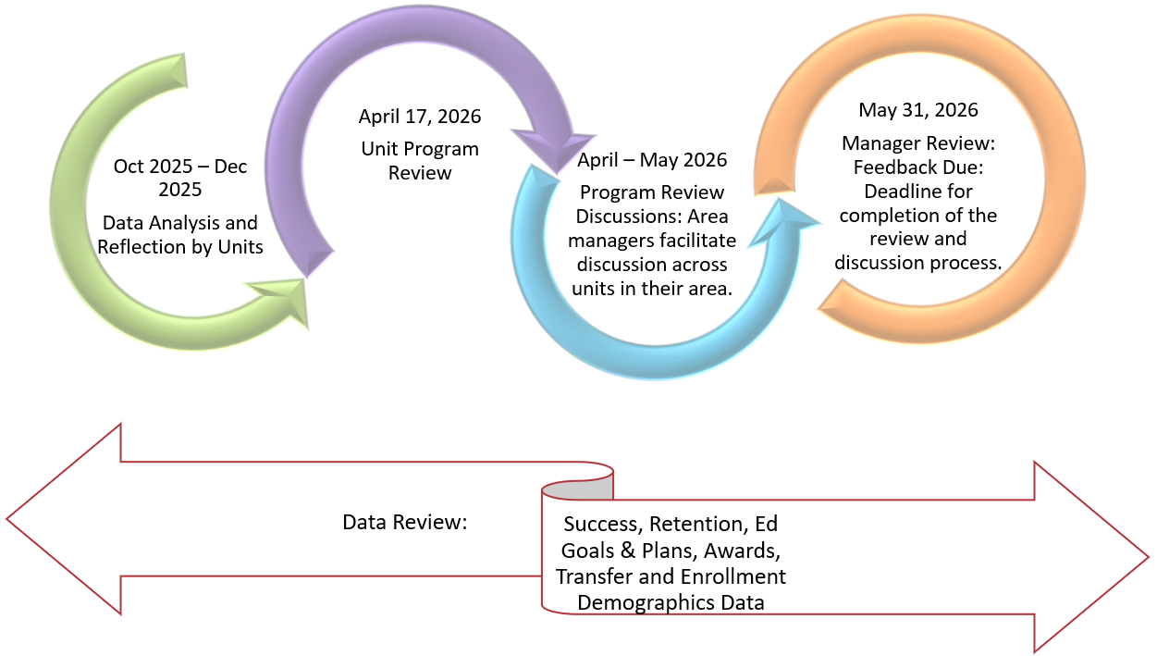
Program Review - Timeline

Slide 3
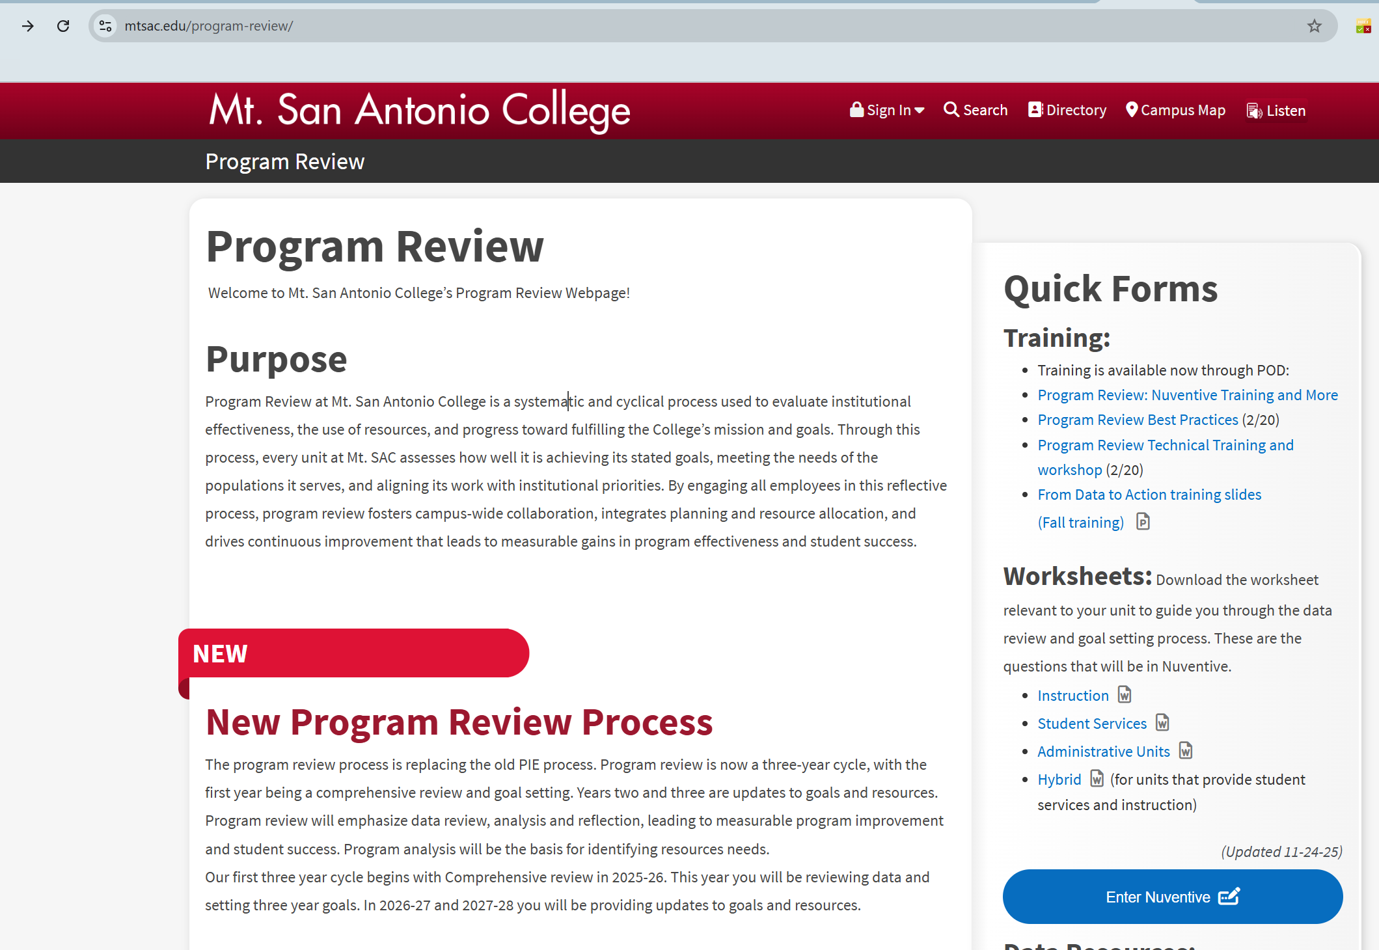
Program Review - Access
1. www.mtsac.edu/program-review
2. Click to enter Program Review

Slide 4
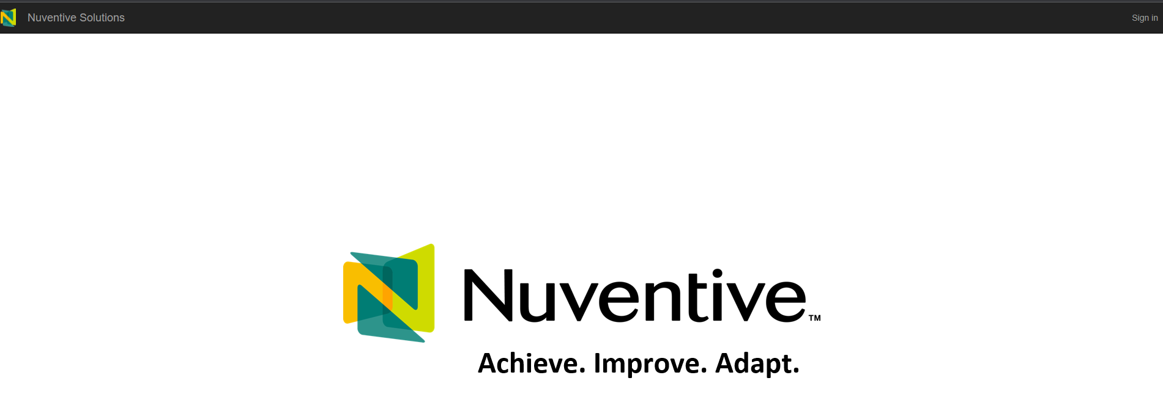
Program Review – Sign in
3. Click on Sign in on the top right corner.

Slide 5
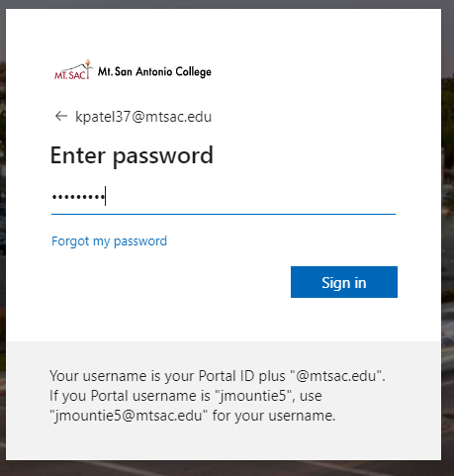
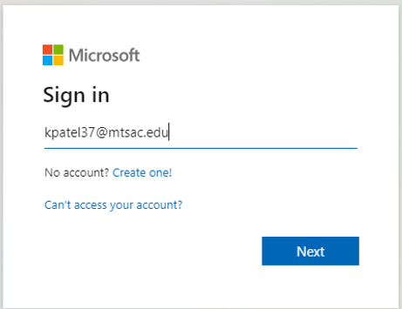
Program Review – Single Sign On
4. Use portal username &
password to login.

Slide 6
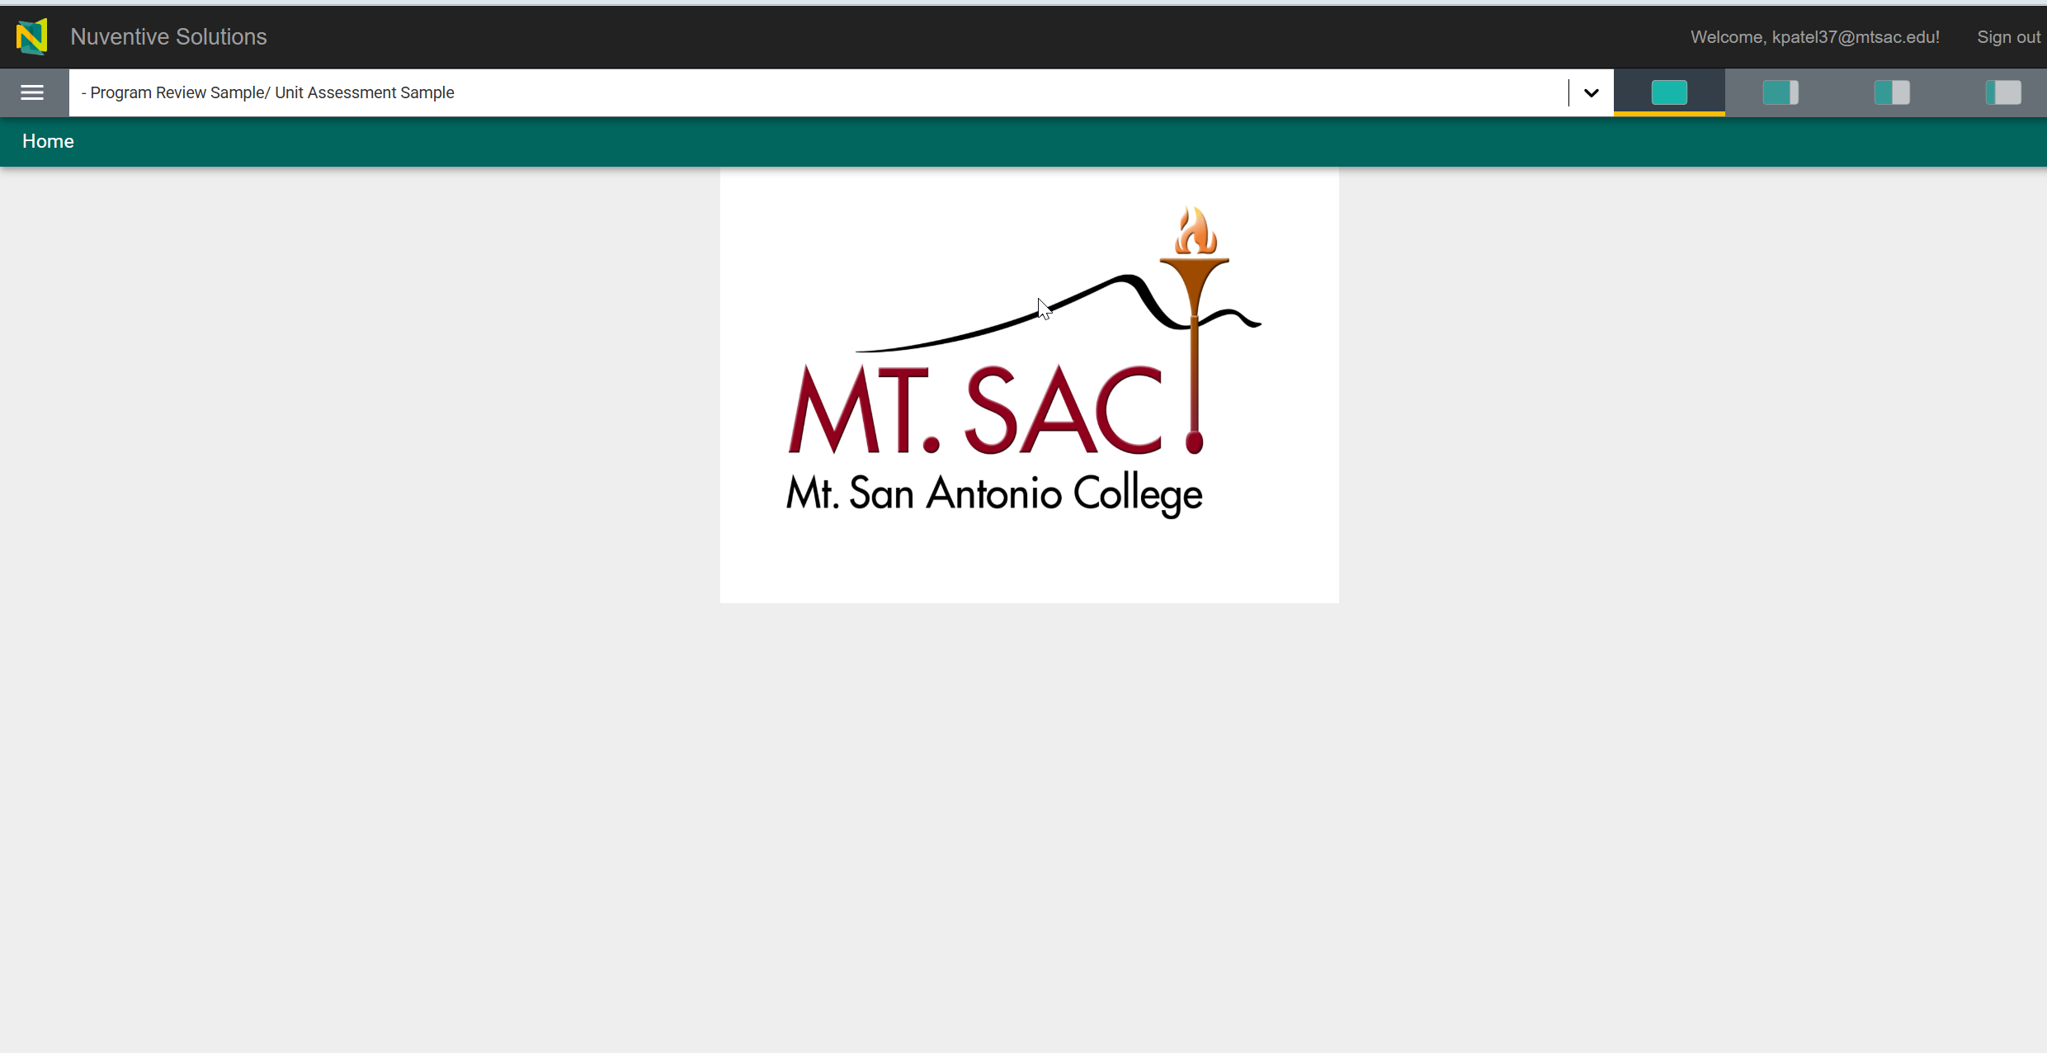
Program Review – Home Screen
The home screen with the Mt. SAC logo will appear. The home screen is customizable with any information, files, or pictures.
Select the unit for which you would like to report the program review from the drop-down menu.

Slide 7
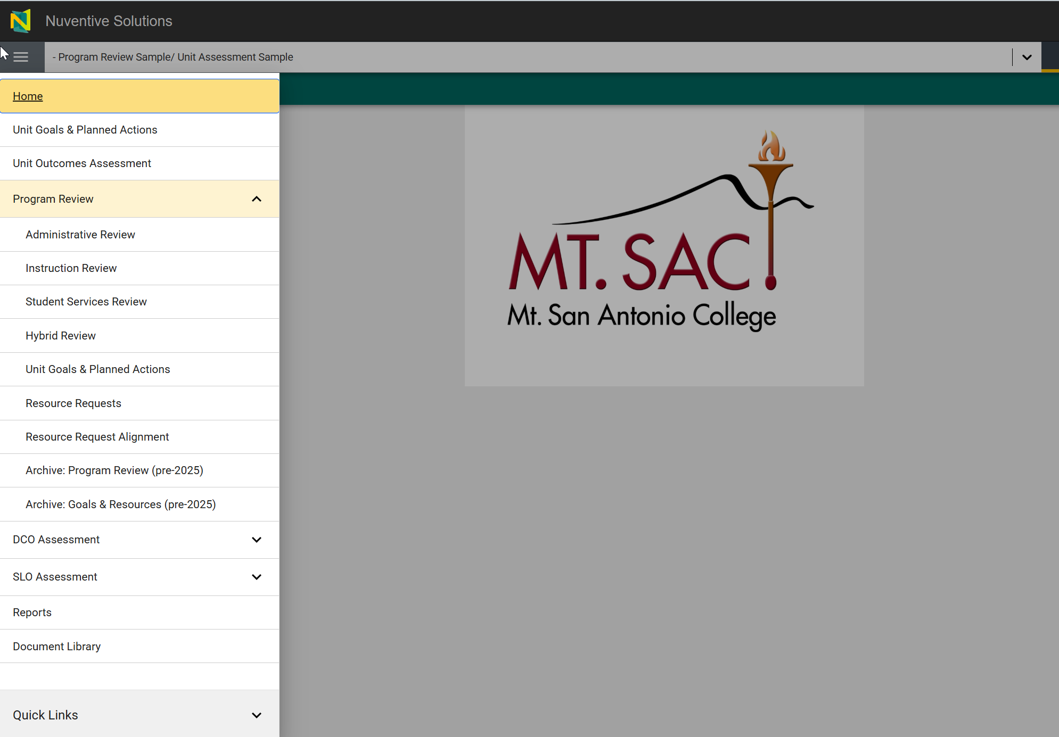
Program Review – Menu
Click on the hamburger menu on the left-hand side of the screen to access the sections within the Unit Program Review.
Expand the Program Review caret. To access the menus.
Depending on your unit, one of the four templates will be displayed.
Enter unit Goals and Planned action
Enter Resource Requests
Map the resources with the unit goals
Access reporting or reports on the previously entered data

Slide 8
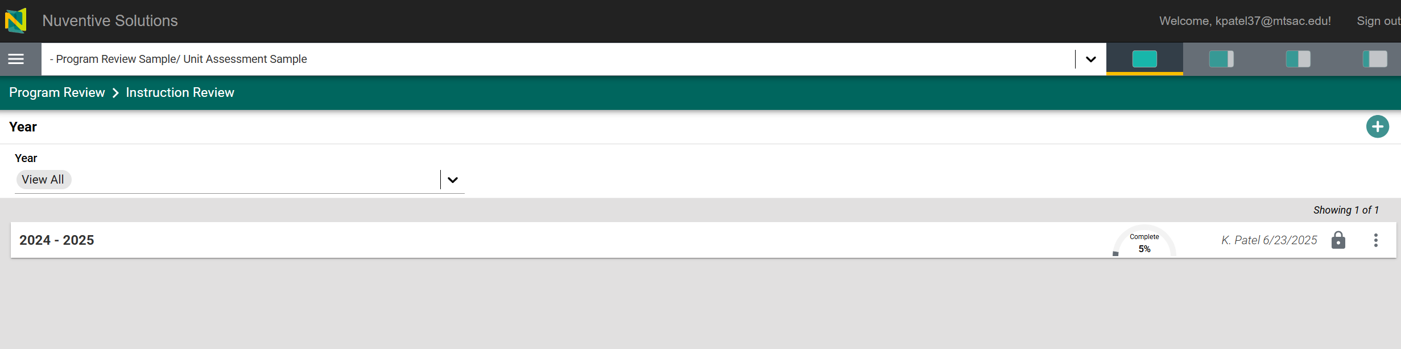
Program Review – Template
a. Add the new year for the review
b. Filter through the year
c. Edit the existing program review

Slide 9
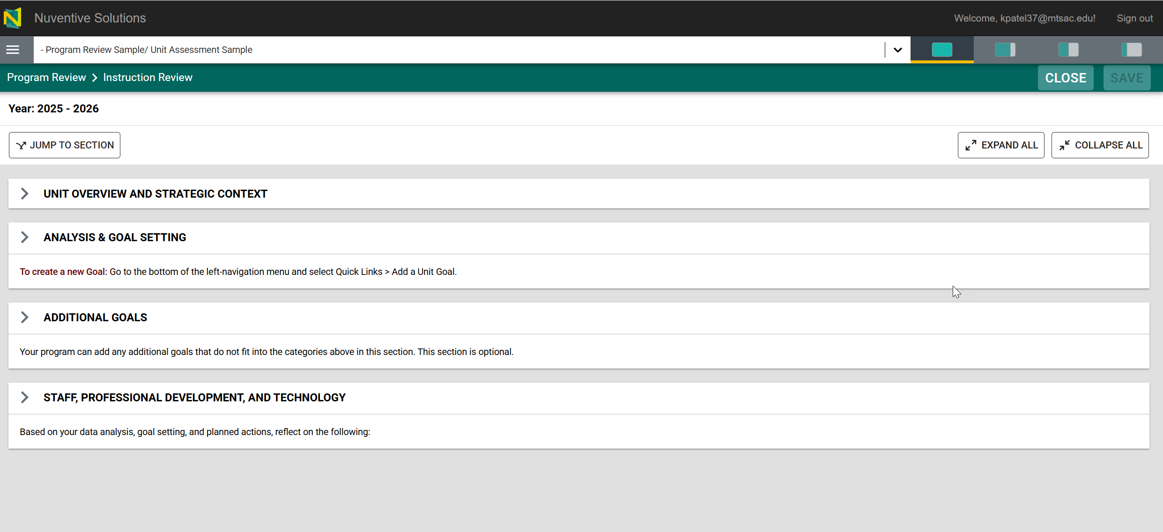
Program Review – Template
a. Add Unit Overview and Strategic Context
b. Add Analysis & Goal Setting
c. Add Additional Goals
d. Add Staff, Professional Development, and Technology

Slide 10
Data Review

Slide 11

Key Dashboards include:
Data for the last five academic years
How are our courses doing? Course success and retention, enrollment and fill rates
How are our students doing? Success and retention rates by demographics
How many students are completing our programs? Number of degrees and certificates awarded by Division and Program (ethnicity and gender).
How are students in specific student programs doing? (formerly SEAP Dashboards)

Slide 12
Helpful Definitions
Enrollment-A student is enrolled in a course if they received an end of term notation that is displayed on their official transcript.
Success (Data)-The percentage of students who received a passing/satisfactory grade. Success rates includes grades of A, B, C, P, IA, IB, IC, and IPP by the total number of enrollments.
Course Retention– The percentage of students who do not withdraw from class and who receive a valid grade.
Fall to Spring Retention- The percentage of students enrolled in both fall & spring at Mt. SAC in the selected year, excluding students who completed an award or transferred to a four-year institution.
Awards – The number of degree/certificates given to a student upon the successful completion of a program at Mt. SAC. This includes all Associates, certificates and noncredit awards.
Transfer (Data) – The number of students enrolling in either the University of California (UC) California State University (CSU) system, or private institutions.

Slide 13
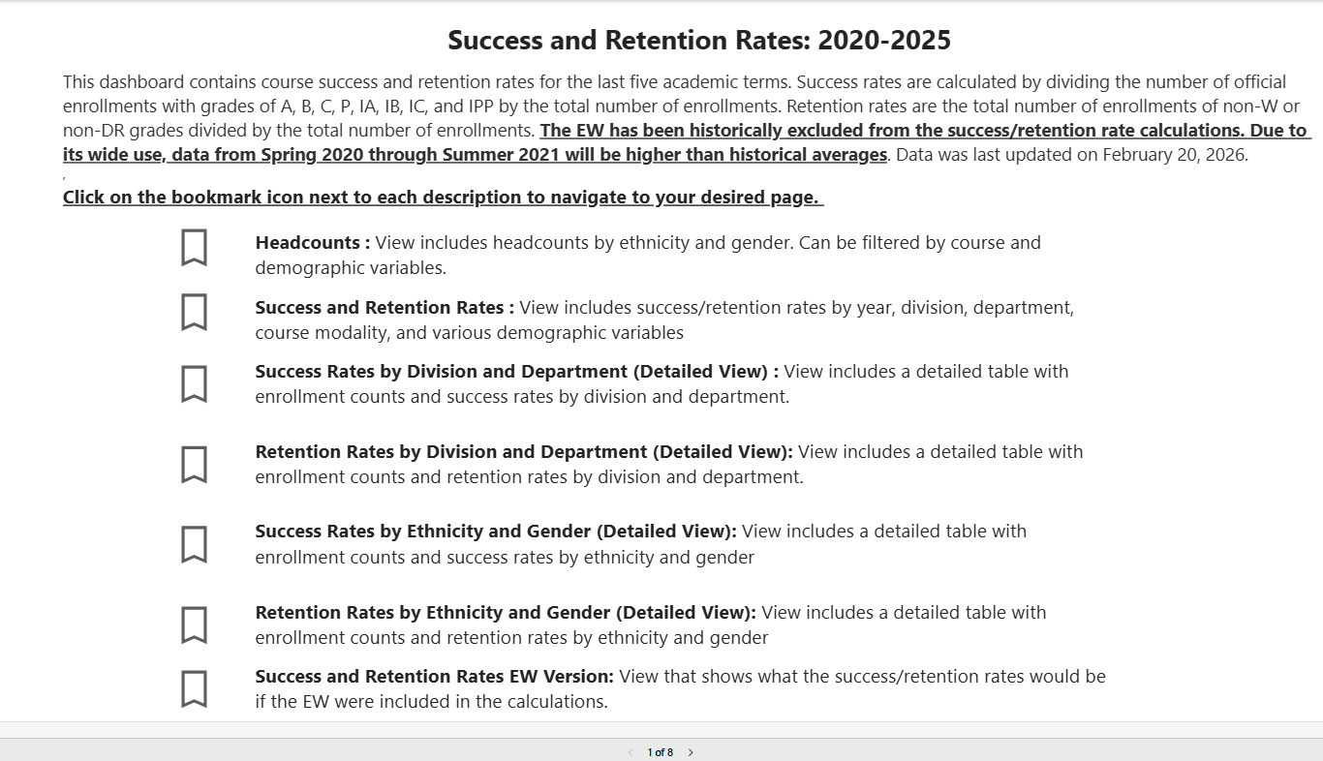
Using Data for Unit Goals and Resources: Sample of Dashboards
Select any of these Bookmark icons/pages
Each icon has different information from headcounts, rates, division, department, etc.

Slide 14
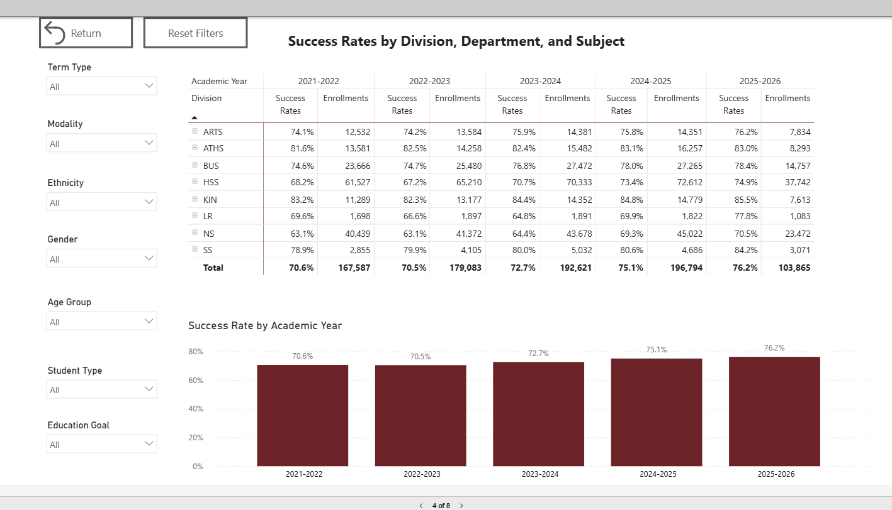
Success Rates by Division, Department, & Subject
Select Return to go back to the main menu
Select Term
Select 'Reset Filters’ to clear any items
Clear selections by Using the Eraser Button

Slide 15
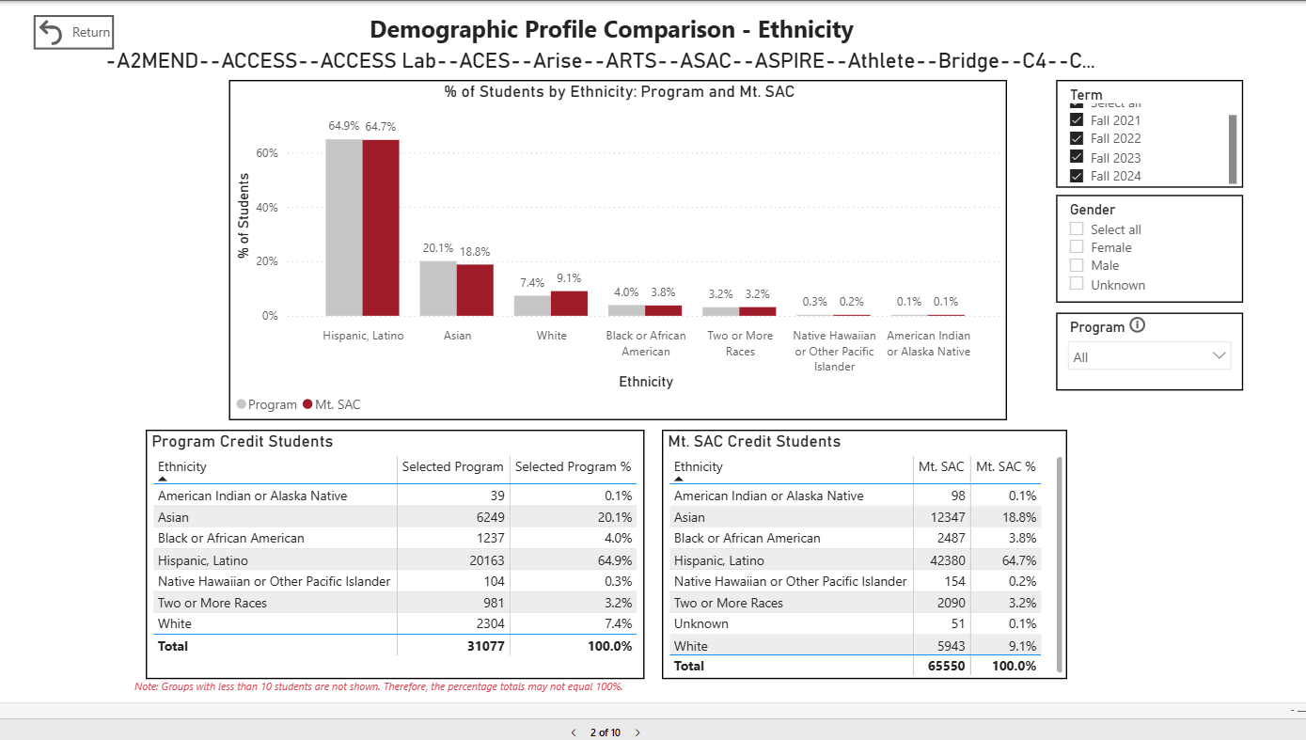
Student Programs Demographic Profile Ethnicity Example
Select Term
Select Program

Slide 16
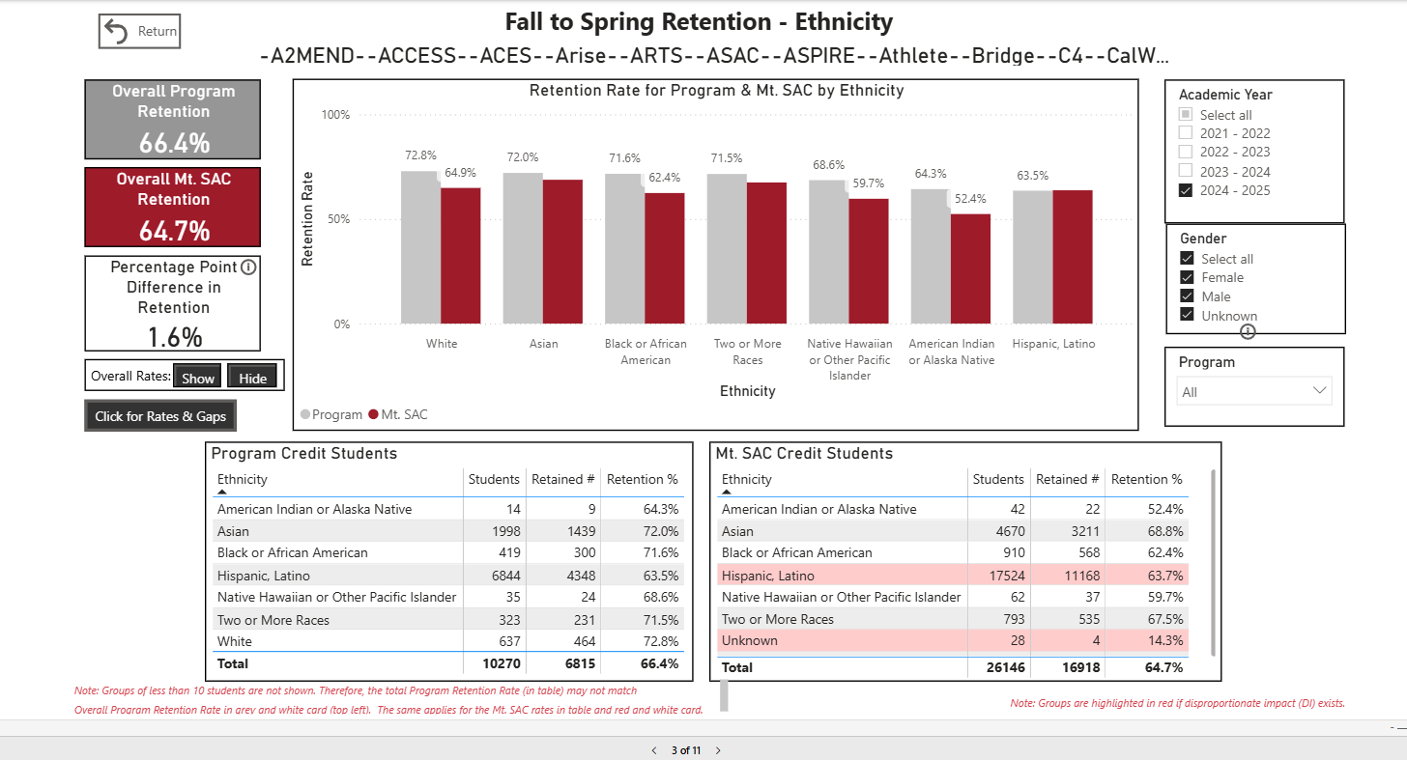
Student Programs Fall to Spring Retention Example (Fall 24 to Spring 25 & EOPS)
Select AY
Select Program & All Mt. SAC

Slide 17
Data Exercise: Success, Challenges, and Lessons Learned
What are your initial thoughts on the data?
What might be contributing to student success in your program?
What might be detracting student success in your program?

Slide 18
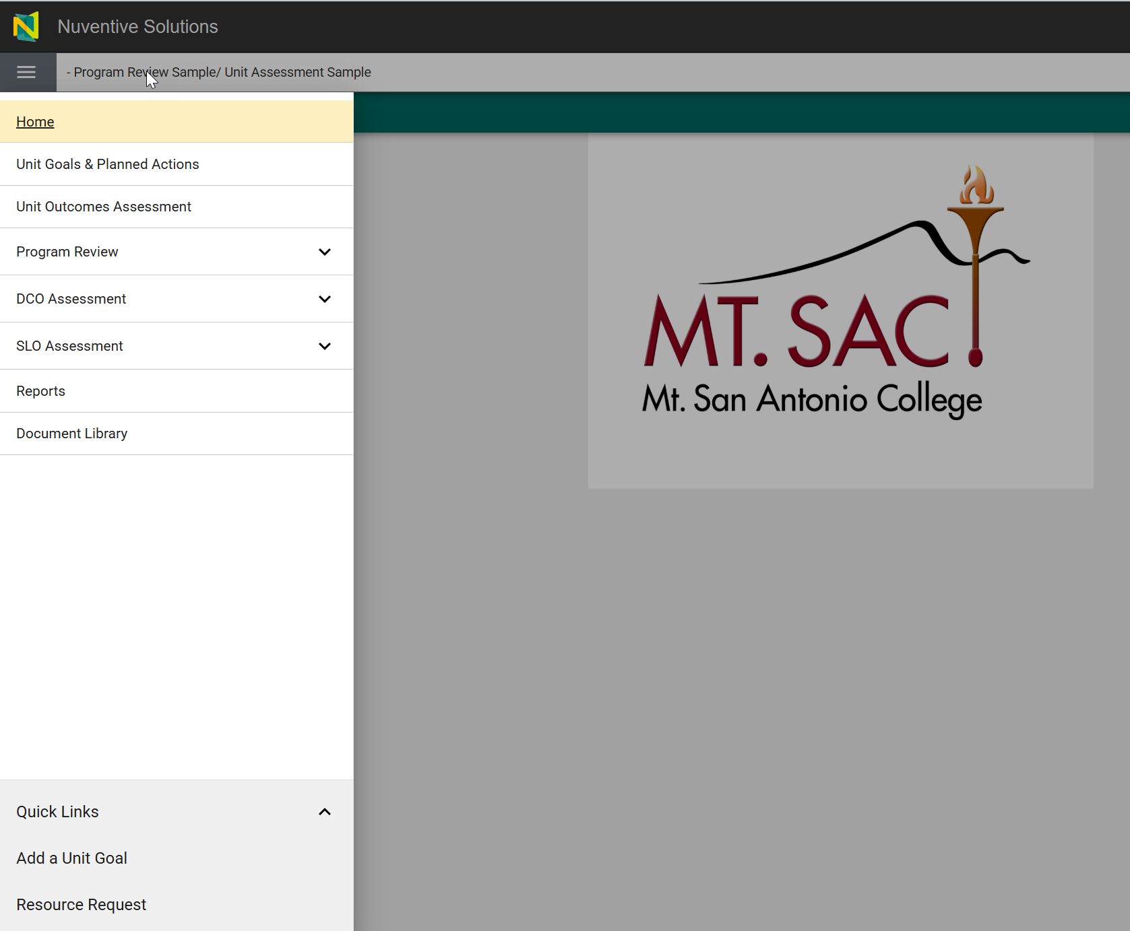
Program Review – Templates
Click on the hamburger menu on the left-hand side of the screen to access the sections within the Unit Program Review.
Expand the Program Review caret. To access the menus.
DCO assessment
SLO assessment
Reporting
Quick Links to add goals and resource requests
Add unit goal
Add Resource Request

Slide 19
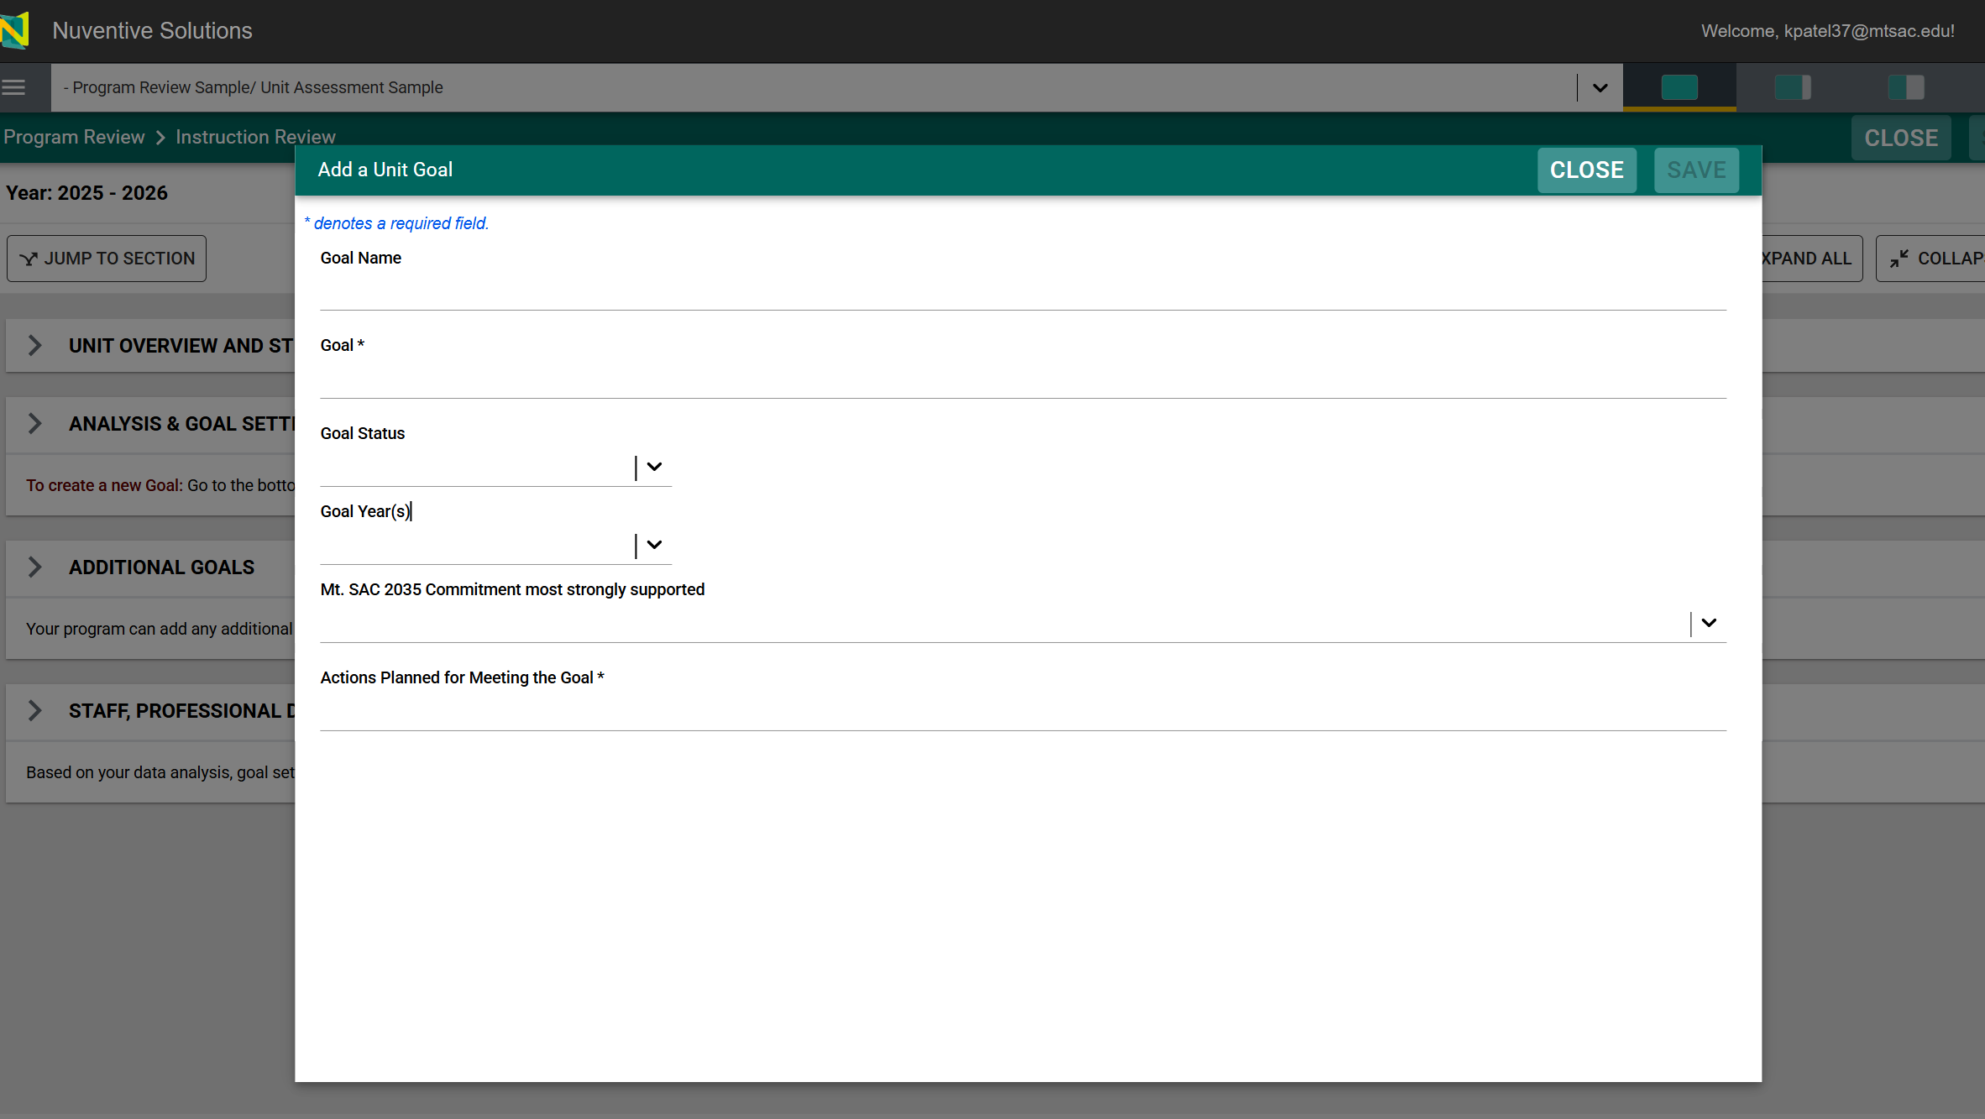
Program Review – Goals
Enter Unit Goal(s)

Slide 20
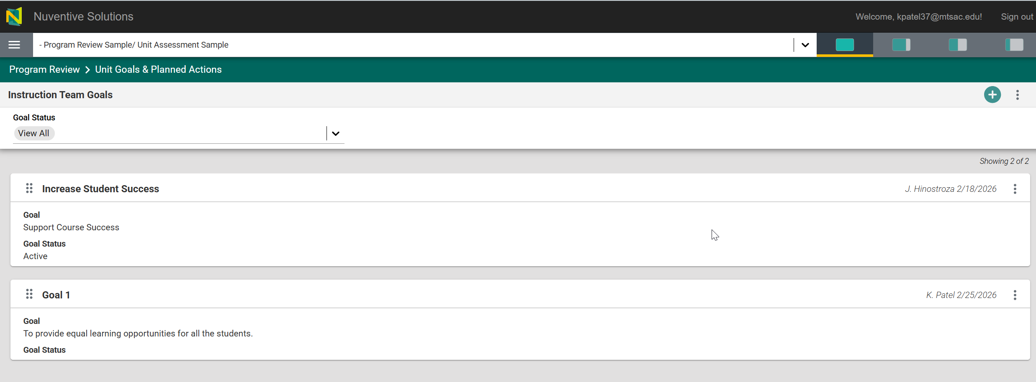
Program Review – Goals
To add a new goal, click on the ‘+.’
Click on three dots to open or copy the existing goal

Slide 21
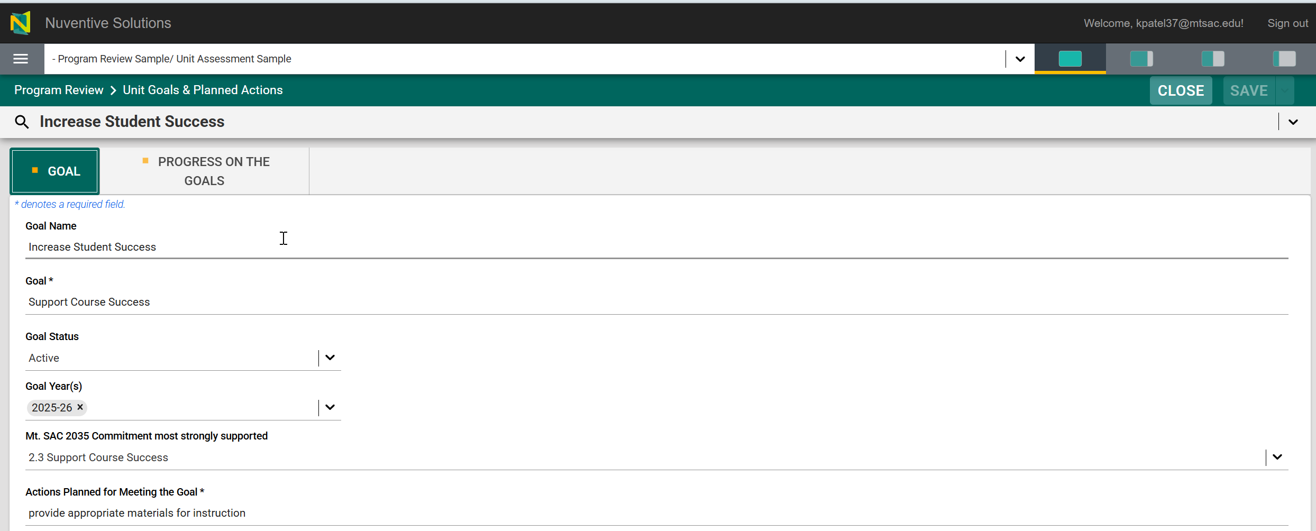
Program Review – Goals
Update existing goal information

Slide 22
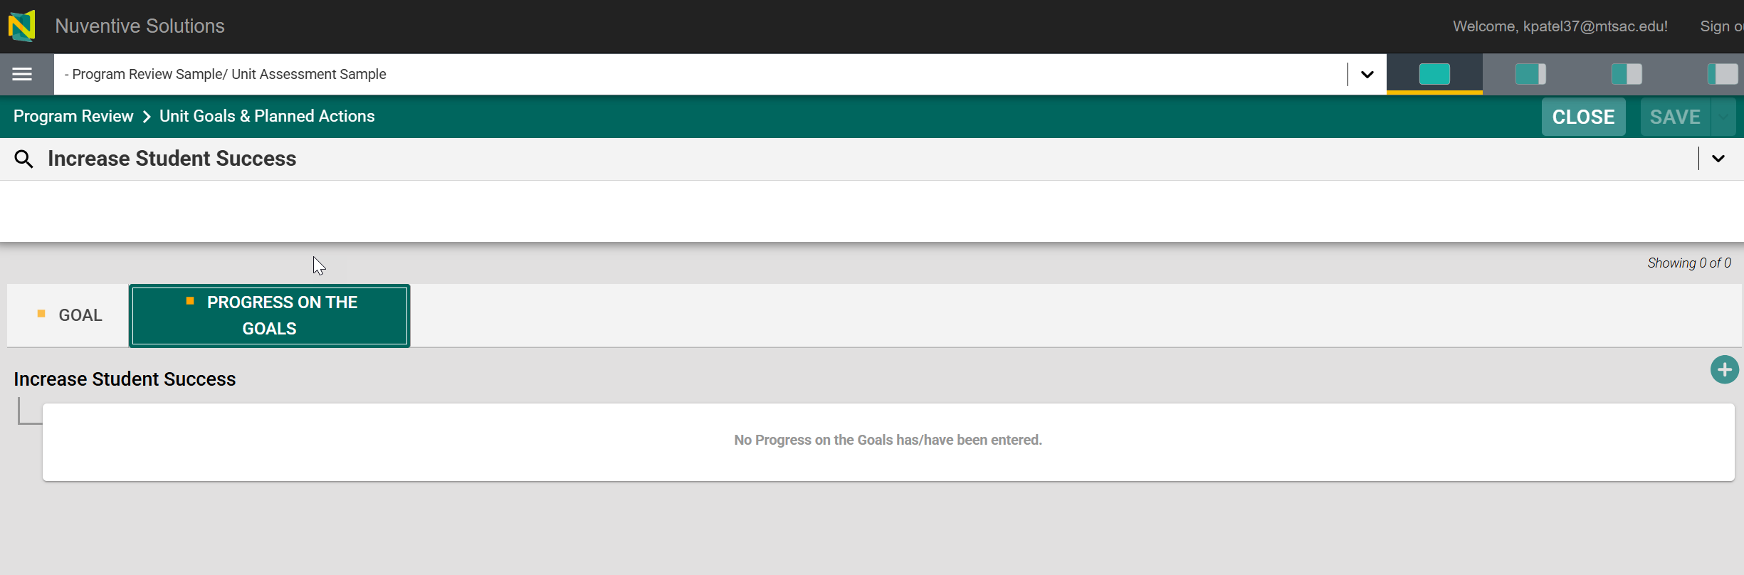
Program Review – Goals
Enter progress on the goal by clicking on the ‘+’

Slide 23
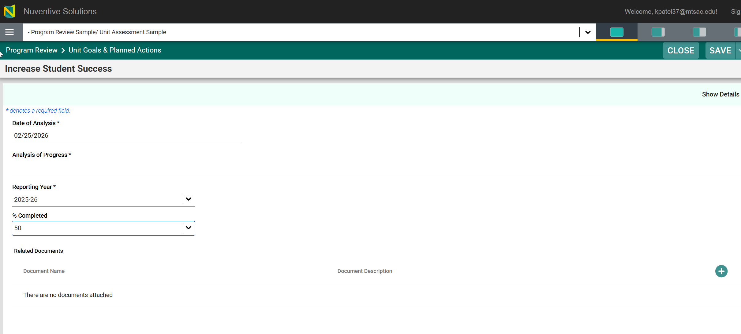
Program Review – Goals
Enter analysis of progress on the goal and click on save

Slide 24
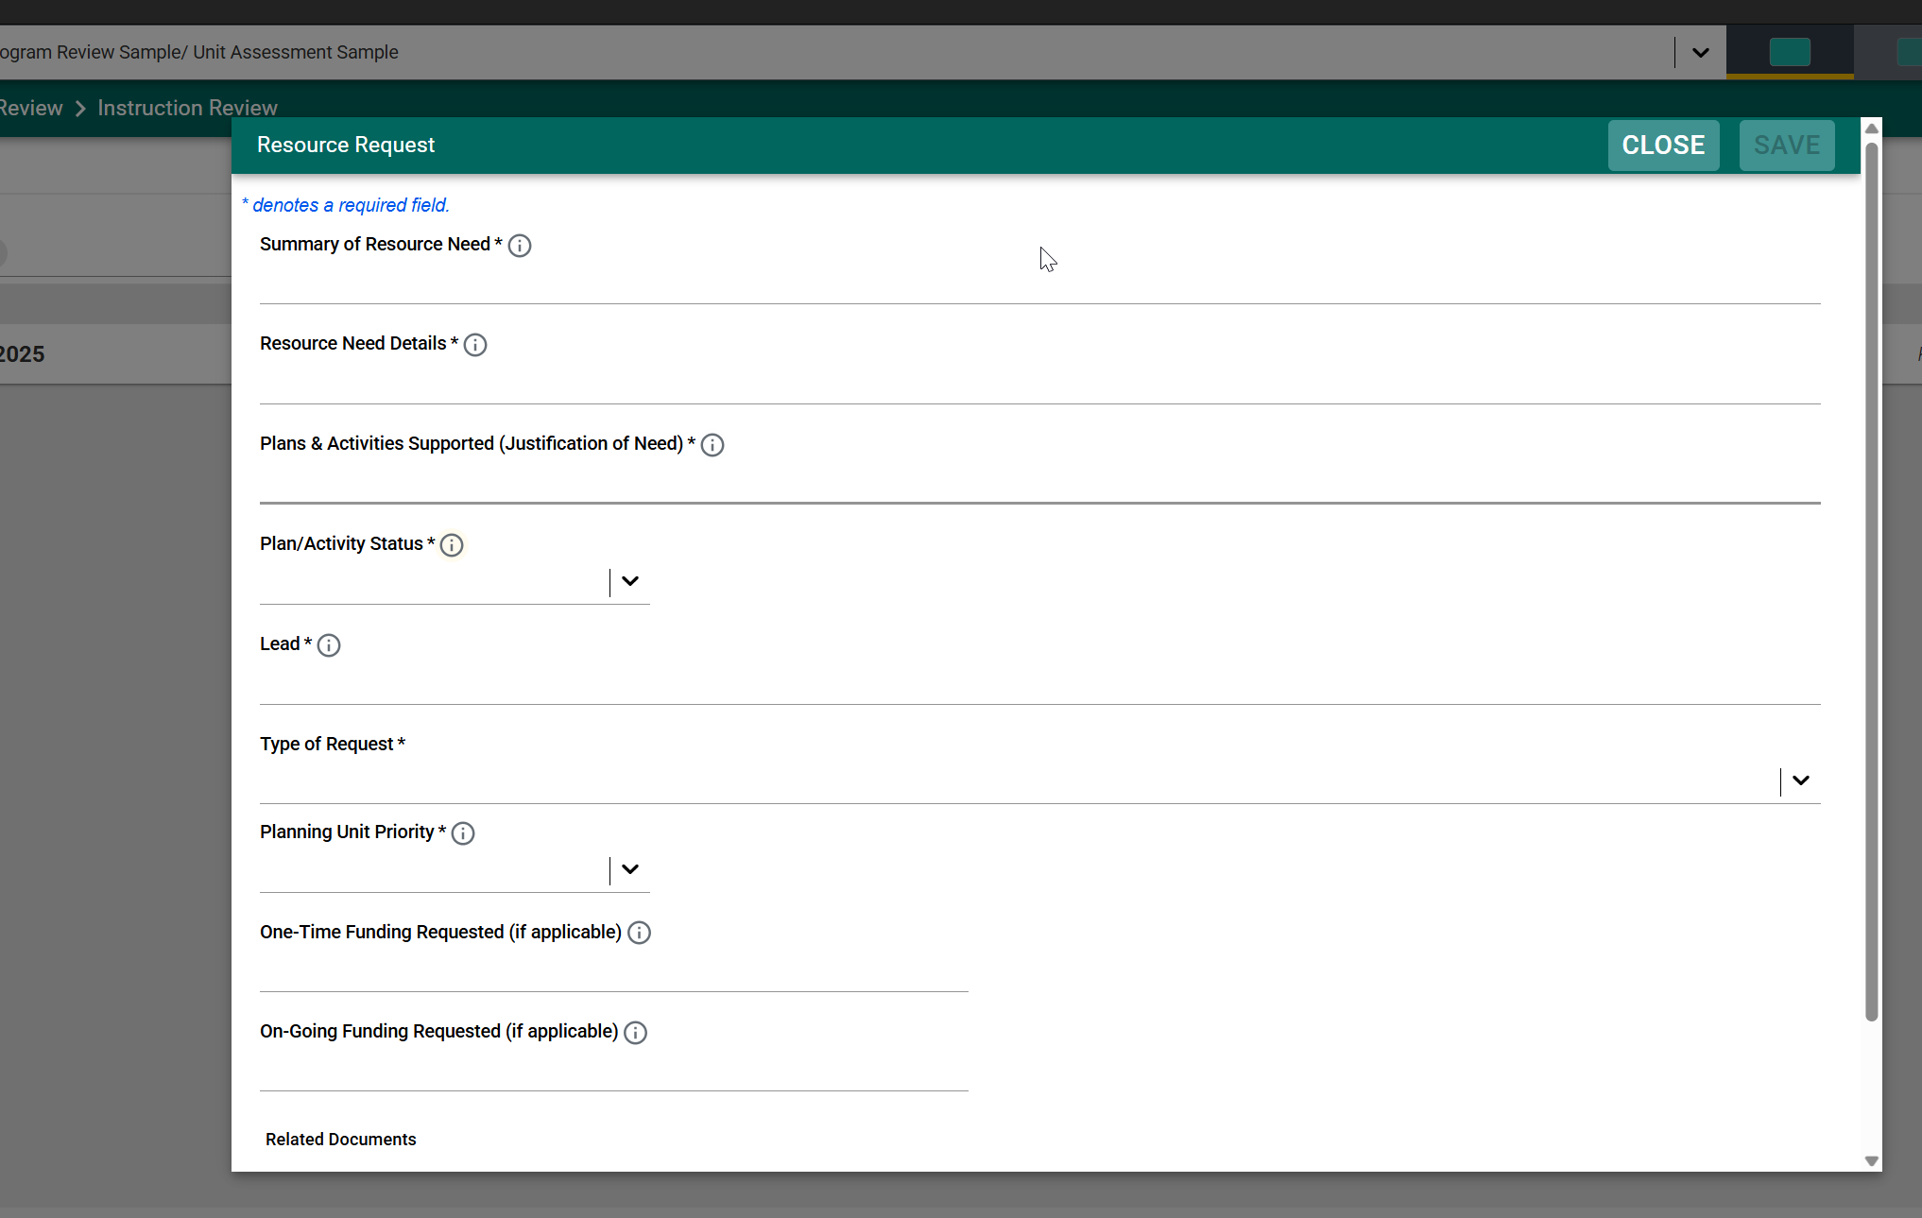
Program Review – Resource Request
Enter Resource Request

Slide 25
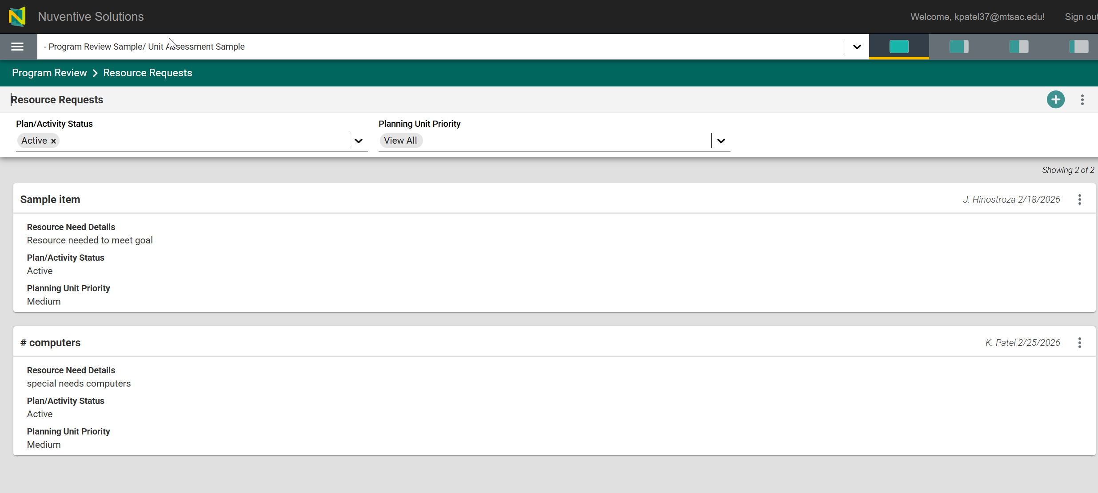
Program Review – Resource Request
To add a new resource request, click on the ‘+’
Click on the three dots to open or copy the existing resource request

Slide 26
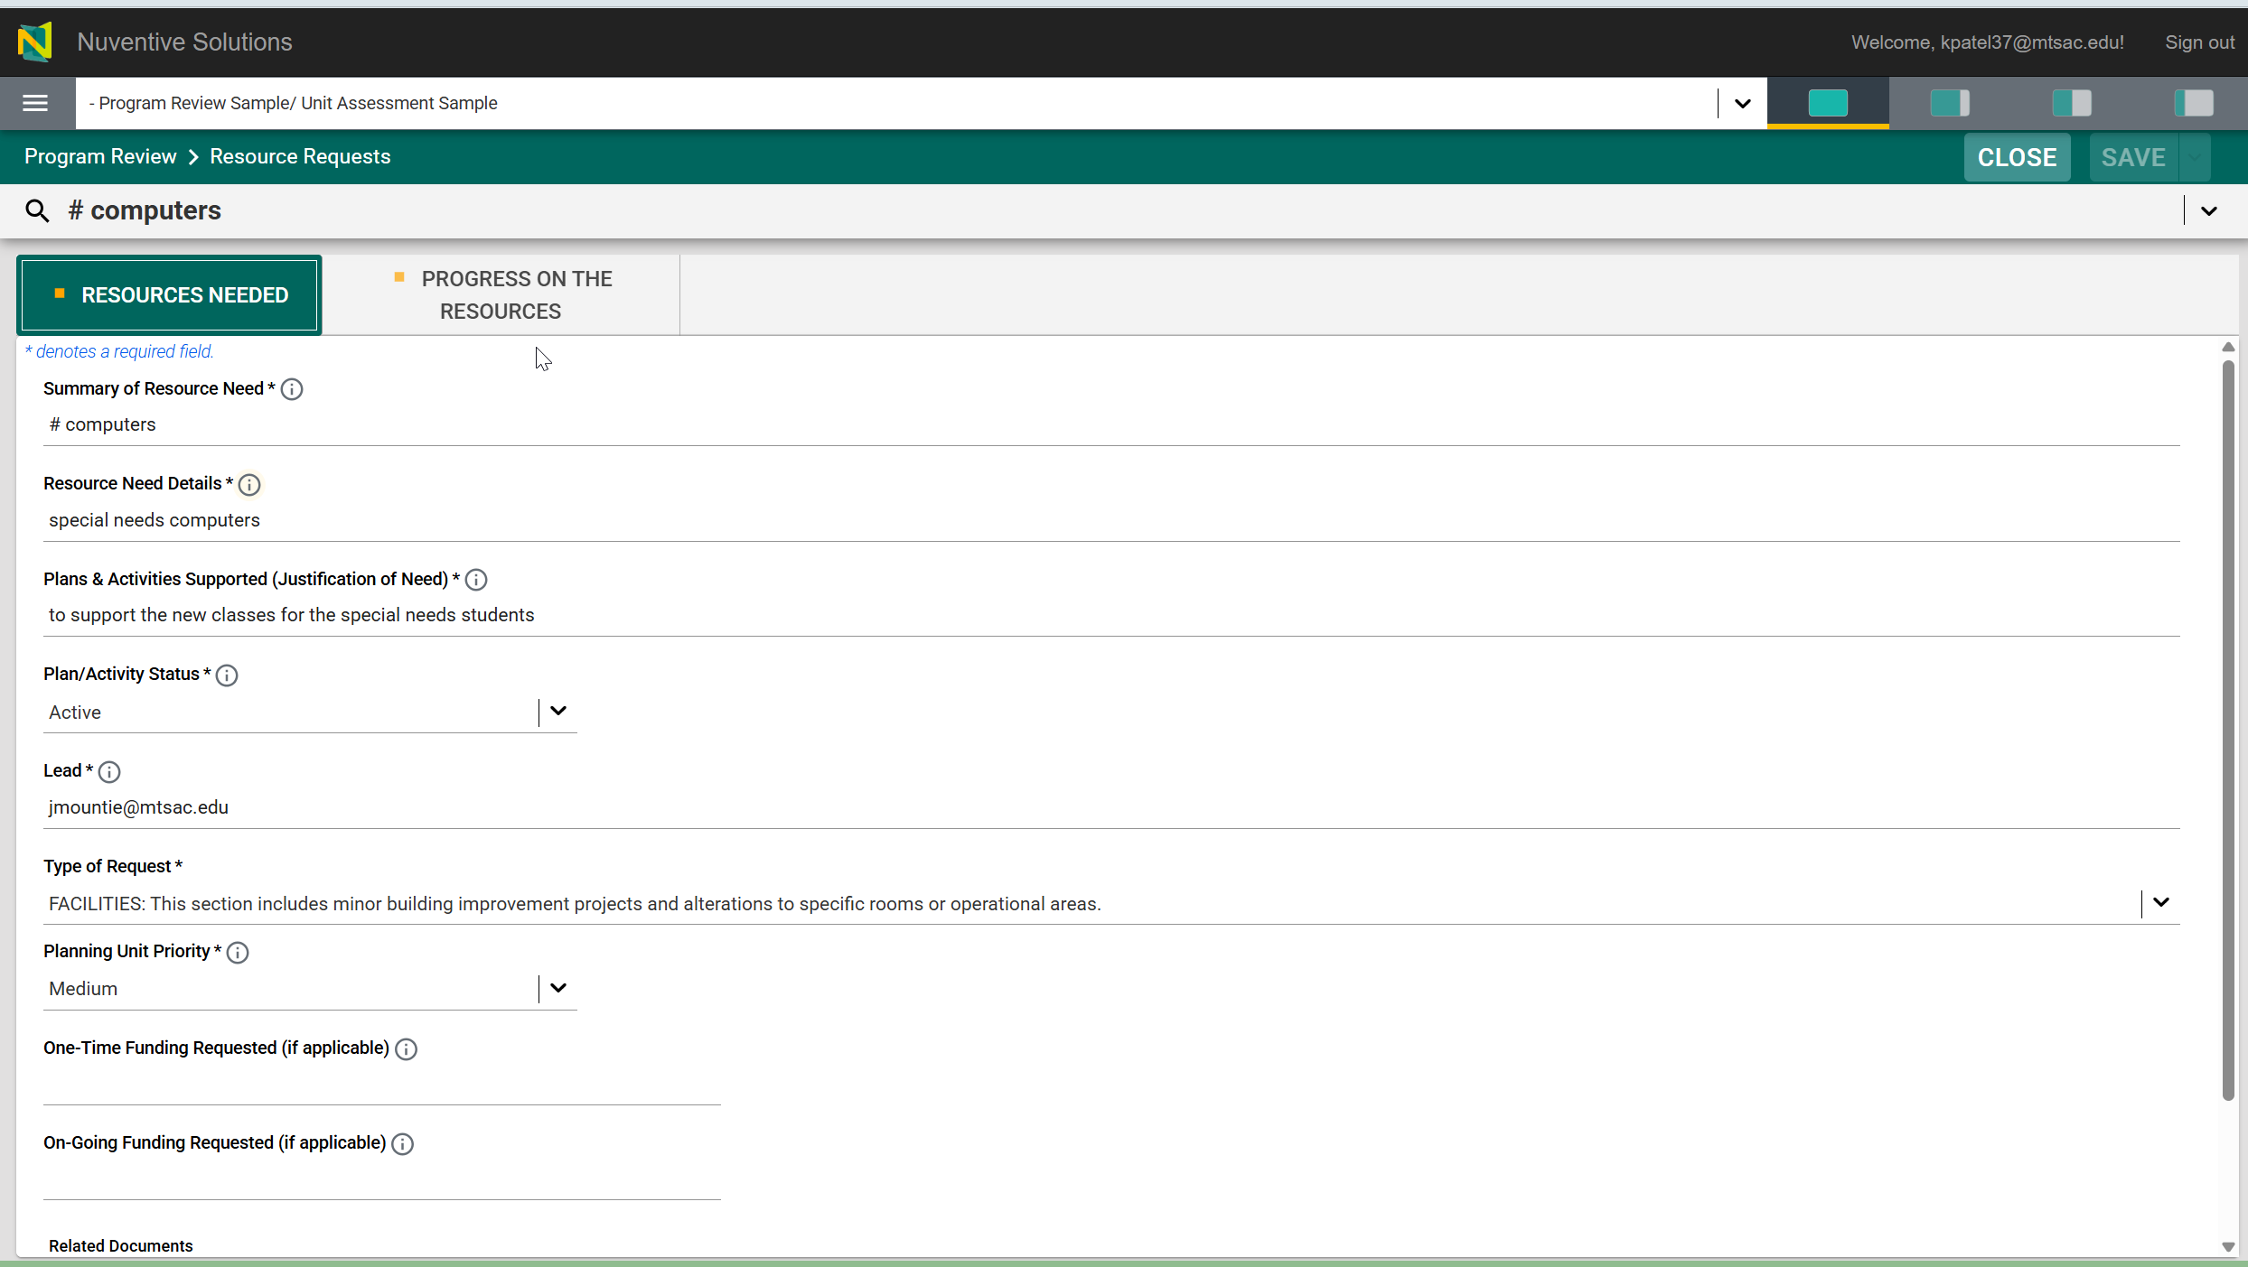
Program Review – Resource Request
Update existing resources request information

Slide 27
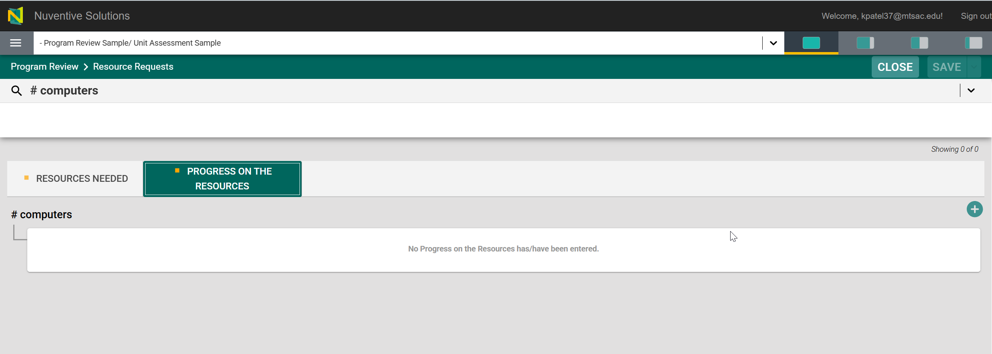
Program Review – Resource Request
Enter progress on the goal by clicking on the ‘+’

Slide 28
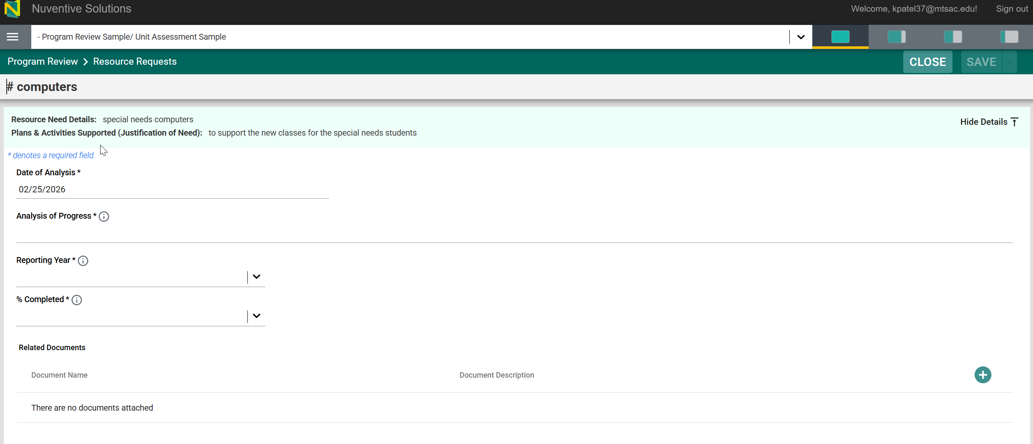
Program Review – Resource Request
Enter analysis of progress on the resources and click on save

Slide 29
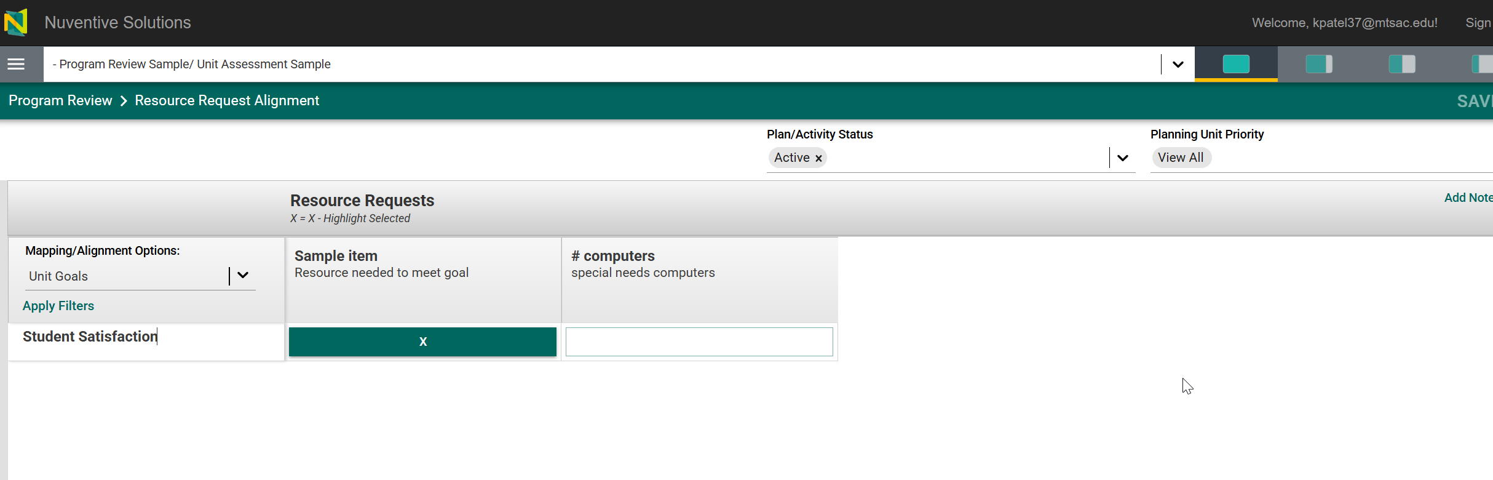
Program Review – Resource Request Alignment
Resource request is displayed as column headers
Unit goals are displayed as rows
*Make color filled with ‘X’ means goals and resources are mapped
Mapping/Alignment Options filter set to Unit Goals

Slide 30
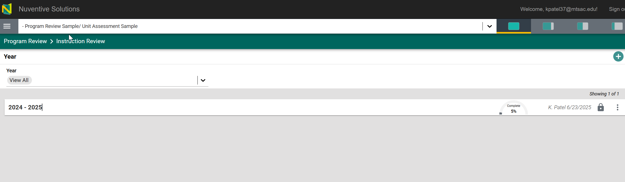
Program Review – View Options
Options allow for full-screen, quarter, and half screen size.

Slide 31
Resources
Program Review Content Questions
Patricia Quinones: pquinones@mtsac.edu Jennifer Hinostroza: jhinostroza@mtsac.edu
Research/ Data Review Questions
Patricia Quinones:
pquinones@mtsac.edu
Technical Questions:
Krupa Patel: kpatel37@mtsac.edu
Video Training Resources:
Coming soon..

