Slide 1



Slide 2
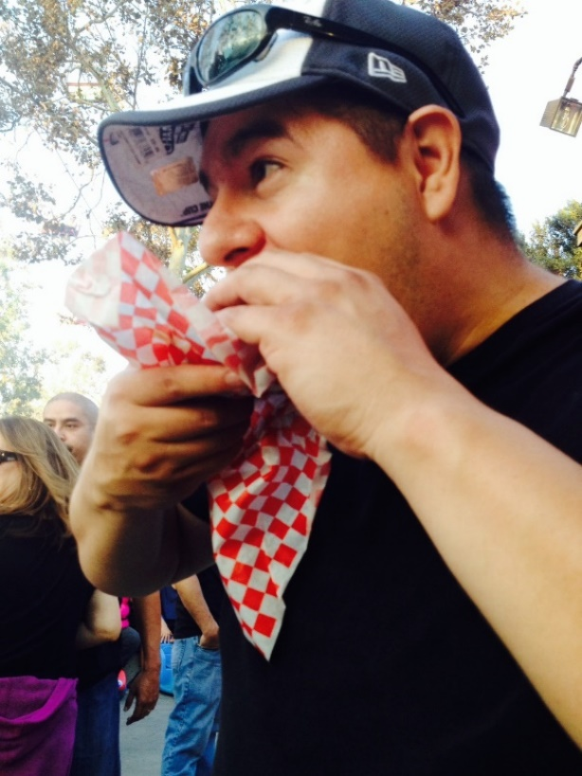
Steven Valdes, CPA,CFE, PFS, CGMA, MBT
Certified Public Accountant (AICPA, California Board of Accountancy)
Certified Fraud Examiner(ACFE)
Personal Financial Specialist ( AICPA){CPA Financial Planner}
Chartered Global Management Accountant (AICPA)
Graduated from CSULA with B.S. Degrees from CSULA ( Accounting and Management)
Graduated from the University of Southern California, Marshall School of Business , Leventhal School of Accounting with a Masters Degree in Business Taxation

Slide 3
Subject Matter Expert
Named to the California Board of Accountancy (CBA) under the California Department of Consumer Affairs Office of Professional Examination Services (OPES) to assist with defining California specific aspects of CPA practice and reviewing content of the Uniform CPA exam and PETH exams.
A subject-matter expert (SME) is a person who has accumulated great knowledge in a particular field or topic and this level of knowledge is demonstrated by the person's degree, licensure, and/or through years of professional experience with the subject.
The term is used when developing materials about a topic (a book, an examination, a manual, etc.), and expertise on the topic is needed by the personnel developing the material.

Slide 4
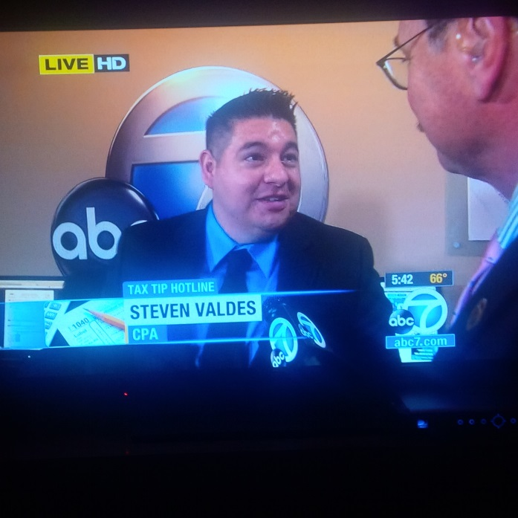
Steven Valdes, CPA,CFE, PFS, CGMA,MBT
2010-2014 CalCPA Los Angeles Board of Directors
2015 CalCPA Vice President & State Council Representative
2010-2015 State Financial Committee for CalCPA
Teach at Rio Hondo & Mt. SAC
BUSA 7
BUSA 75 & BUSA 76
ACCT 097
ACCT 101
ACCT 105
ACCT 203
ACCT 290
2 VITA Programs
Grad School –Tax Ethics Class
Managed or Reviewed over 600 tax returns
Featured on KABC Ch.7 Tax Tip Hotline

Slide 5
Professional Work Experience
High Net Worth, Middle Class Individual 1040 Tax Returns, with applicable Sch A, Sch, C, D Sch E forms and K-1 forms
Business returns including General Partnerships, Limited Partnerships S Corporations C-Corporations , Limited Liability Companies, Single Member LLC’s
ProsystemsFX(TurboTax), Lacerte, TaxAct, H& R Block, Taxwise, Taxslayer, Intuit Pro Connect
Federal & State Non Profit 990 Tax-Exempt Returns
Managed over 400 individual tax return ( book of business) as well as corresponding quality control, employee training and e-filing procedures
Audit and Review of SEC developmental Stage companies
Prepared Payroll, 1099, Sales tax, 571-L filings, IRS & FTB Tax Controversy
Experience with Board of Directors Governance and Leadership
Have my own consulting/tax practice with about 80+ clients,
11 years as a VITA Site Coordinator

Slide 6
Contact information
Steven Valdes, CPA, CFE, PFS, CGMA, MBT
svaldes3@mtsac.edu
Business Email : valdescpa@aol.com
Cell Phone 323-646-0132

Slide 7
New Certificate in Tax Preparation
Accounting - Tax Preparation
Business Division E0433 Skills Certificate
This certificate is designed for individuals desiring to enter the tax preparation field with a minimum of 3 course requirements. Upon successful completion of this certificate, students will possess the knowledge and practical experience necessary to prepare individual income taxes effectively. Additionally, students will earn the qualifying education required by the California Tax Education Council to become a California Registered Tax Preparer.

Slide 8
New Certificate in Tax Preparation
Required Courses
Course List
Course Prefix | Course Name | Units
BUSA 58 | Federal Income Tax Law | 4
BUSA 59 | Volunteer Income Tax Assistance I | 1
BUSA 60 | VITA II | 1
Total Units |  | 6
http://catalog.mtsac.edu/programs/programsaz/accounting/accounting-tax-preparation/

Slide 9
Welcome
Thank you for attending!
The IRS VITA Program offers free e-file tax preparation for individuals and families earning less than $67,000 and senior citizens 65+ by IRS Certified Volunteers.
Who benefits from VITA?
The following taxpayers who file forms 1040, 1040A and 1040EZ:
Students
Low-to-moderate income families
Persons with disabilities
Limited English speaking taxpayers
Older taxpayers

Slide 10
CSU 5 VITA Clinic
Cal State Universities
Community Colleges
CSU Dominguez Hills
CSU Los Angeles
CSU Long Beach
CSU Northridge
Cal Poly Pomona
College of the Canyons
Los Angeles Mission College
Mt. San Antonio College
Rio Hondo College
Pasadena City College

Slide 11
2025 Highlights
70 Volunteers
653 total Returns (+102, 18% increase)
Total Refunds $740,521
Total Federal Refund $522,624 ( +66,027)
Total State Refunds $217,897(+$41,247)
Federal EITC $156,891 (+$38,675)
State EIC $54,979+$31,708)

Slide 12
2024 Highlights
70 Volunteers
551 total Returns
Total Refunds $633,247
Total Federal Refund $456,597 ( +128,242)
Total State Refunds $176,650(+$41,204)
Federal EITC $156,891 (+49,240)
State EIC $23,271

Slide 13
2023 VITA Highlights
47 Volunteers
472 Returns prepared
$463,802 total Refunds
$328,355 in Federal Refunds
$ 135,447 in State Refunds
Saved over $60,000 in fees for the Community

Slide 14
2022 VITA Highlights
25 Volunteers ( 18 Certified Advanced)
305 Returns Prepared
$ 345, 242 in Federal Refunds
$ 62,059 in State Refunds
$ 53,838 in Federal EIC and $7,402 in CA EIC
Saved over $60,000 in fees for the Community

Slide 15
Our challenge in 2025
We have a tremendous amount of volunteers, we have 72 compared to 47 the year before
Because of the costs, economy and with moth families trying to save money, many will look towards VITA.
We want to increase the number of returns we prepare
We want to improve our marketing to get the word out
Attention to detail, listening, putting our ego aside, developing our students as emerging professionals

Slide 16
Your challenge
Being professional
Being on time
Start off on the right foot, with the right momentum
Take this course and the program seriously, not like your other classes
Working with a new software and process and working in income taxes
Prepare as a if you were a professional
Have patience, positive attitude
Be willing to work and work with others
Be willing to accept feedback and criticism

Slide 17
Following schedule of dates 8:00Am-3:00pm For 2026 every Saturday
Feb 28th
March 7th
March 14th
March 21st
March 28th
April 4th
April 11t^{h}
* Note These dates are subject to Change

Slide 18
What can I get out of this
Resume
Active in College
Community Service/ Leadership
Learn how to prepare individual income taxes
Experience Accounting / Tax Students
Running a business
Opportunity
Intangible Skills

Slide 19
Intangible Assets
Writing
Speaking
Communication
Organization
Preparation
Work Ethic
Grit
Listening
Confidence
Tenacity
Turn around time
Resiliency
Practice
14. Leadership
15. Drive
16. Honesty
17. Having Goals
18. “Dig your self out of a hole”
19. Making good decisions
20. Negotiations
21. Time Management
22. Motivation
23. Intrinsic Motivation
24. Emotional Intelligence
25. Faith
26. Test Taking

Slide 20
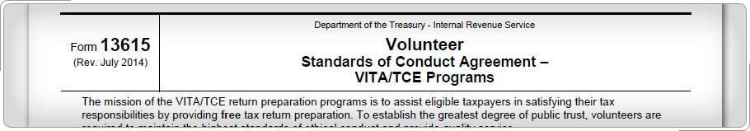
Certification
Steps to Certification:
Complete training session in January-February 2025
Complete Volunteer Standards of Conduct (VSC) Training, pass the test, complete and sign and date Form 13615
Complete the Intake/ Interview and Quality Review Training (Pub 5101)
Pass at least Basic certification test (80%) if preparing tax returns
Notes:
Review sequence of certification steps for volunteers.
Remind Volunteers are not required to certify in Basic before taking the Advanced test.

Slide 21
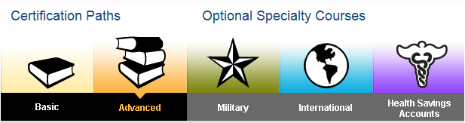
Student Certification Paths
Certification Paths:
Basic
Advanced
Optional specialty courses:
Military
International
Health Savings Accounts (HSA)
Notes:
Share link to article that explains the Link & Learn Taxes modules: http://www.irs.gov/Individuals/Link-&-Learn-Taxes--
Inform Students there is a new course on The Affordable Care Act and that COD lesson is no longer available.
Inform Students that they don’t need to go through each path, they only select the path that best fits their volunteer requirements
Basic Course: This course covers the completion of wage earner type returns. Social security income and penalty on early withdrawal of savings is part of the Basic course. The Basic certification path is intended for the volunteer who will assist working taxpayers with individual and family tax concerns. It is recommended for, but not limited to, volunteers with 0-1 years experience.
Advanced: This course covers return preparation needs across the full VITA/TCE spectrum. It covers all tax topics in the Basic course plus pension topics and issues related to stock and sale of home for individuals and families. The Advanced certification path is recommended for, but not limited to, volunteers with 2 or more years experience.
Optional specialty courses:
Military: This optional specialty course is intended for volunteers with Advanced certification who will prepare tax returns for members of the U.S. Armed Forces. The Military course addresses tax issues that affect armed forces members and their families, such as combat pay, moving expenses, etc.
International: This optional specialty course is intended for volunteers with Advanced certification. The International course emphasizes international tax law for military and nonmilitary U.S. residents living outside the U.S., especially those served by U.S. Embassies and Consulates or other areas within the scope of VITA/TCE.
Health Savings Accounts (HSA) is for volunteers with Basic or Advanced certification.

Slide 22
Why should I file return ?
You might be eligible for the following
Federal and State Refund
Earned Income Credit
Education Credits
Future Stimulus payments
Financial Aid
Peace of Mind

Slide 23
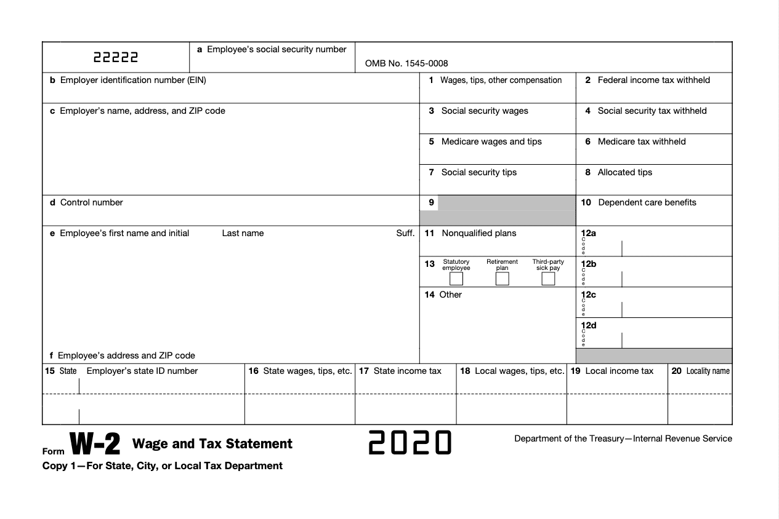
W2

Slide 24
Mt. sac student workers – w2 form
Instructions for viewing and printing your W-2 online (student employees only): 1) Log into the Mt. SAC Portal (https://inside.mtsac.edu/) 2) Click on the "Student" tab. 3) In the Student Self Service channel, click on #32 "View Addresses and Phones." 4) Click on the "Employee" tab. 5) Click on "Tax Forms." 6) Click on "W-2 Wage and Tax Statement." 7) Change the Tax Year to "2023" and click "Display." 8) In the lower left corner of the screen, click "Printable W-2." 9) You will be prompted to enter your PIN which can be found by clicking on the Personal Information tab, then clicking on the Display PIN link, or by clicking on #40 "Display PIN" in the Student Self Service channel. 10) A printable version of your W-2 will appear. Use your browser's print button to print the W-2 (you may need to adjust the print settings such as printing in landscape mode). If you are having difficulty printing your W-2, you may need to change your browser's print settings by printing in landscape mode instead of portrait or by changing the margins.

