Slide 1
Navigating
WebCMS 10.0

Slide 2
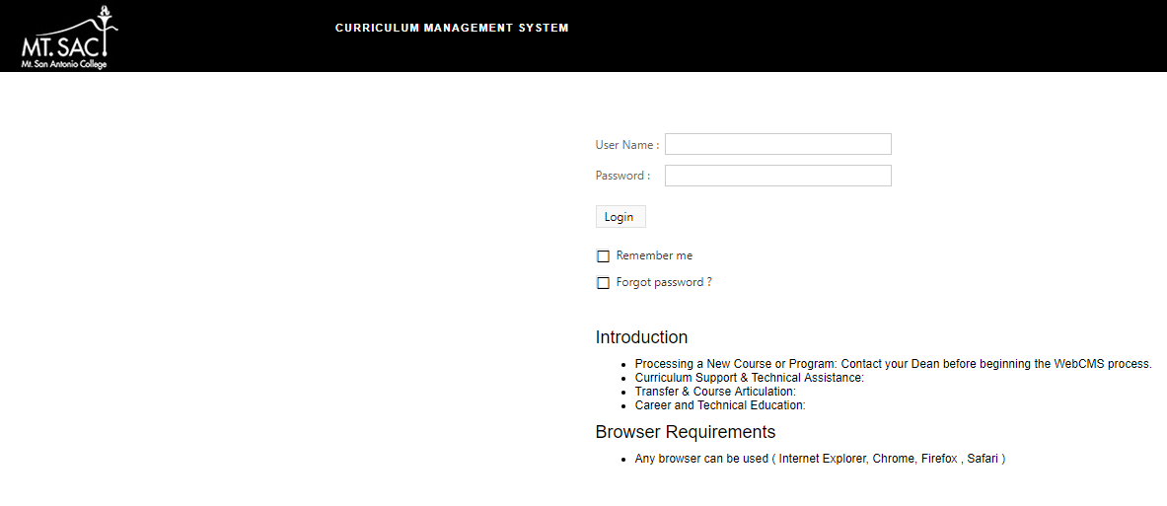
Access WebCMS 10.0
WebCMS 10.0 Link or www.mtsac.edu/curriculum
Username: Mt. SAC Credentials
Password: test
Recommended Browser: Google Chrome

Slide 3
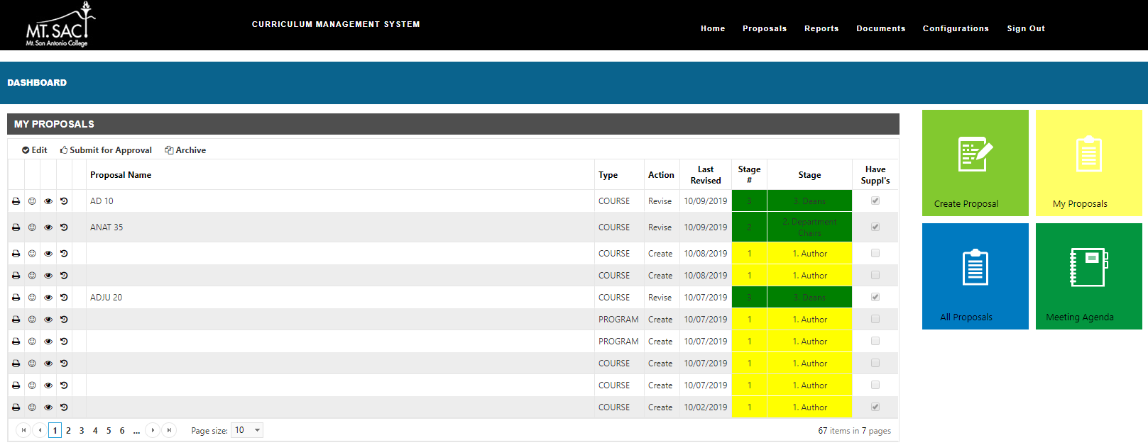
The Dashboard
Ribbon Menu
Dashboard will appear.
My Proposals summary displays.

Slide 4
The Dashboard
Can also be viewed by selecting
My Proposals.
Quick Links to make Edits, Submit for Approval and Archive.
All of your proposals will display with an indicator of the current stage.

Slide 5
The Dashboard
Create Proposal – Create a new program or course.
My Proposals – View your current program and course proposals.
All Proposals - View all current program and course proposals.
Meeting Agenda – View minutes/ documents.
1
2
3
4

Slide 6
The Dashboard – 1. Create Proposals
1. Create Proposal – Create a new program or course.
1

Slide 7
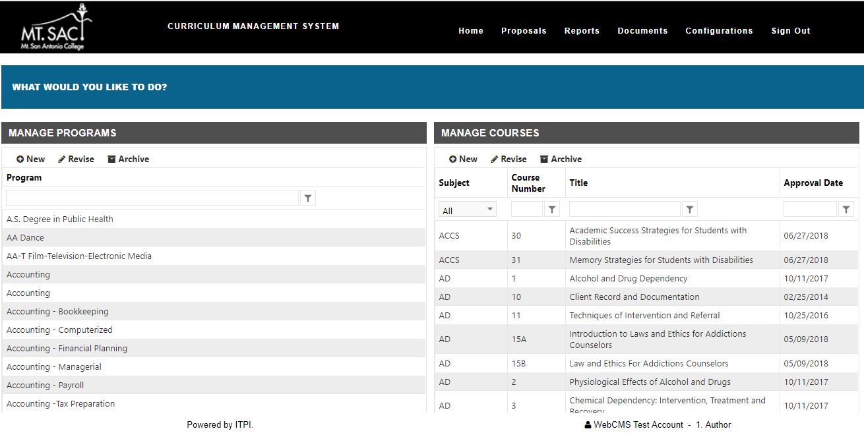
1. Create Proposals
Add New Program
Add New Course
Modify a Program
Modify a Course
Filter by Course Name
*Filter by course prefix, title, and number.

Slide 8
The Dashboard – 2. My Proposals
2. My Proposals – View your current program and course proposals.
2

Slide 9
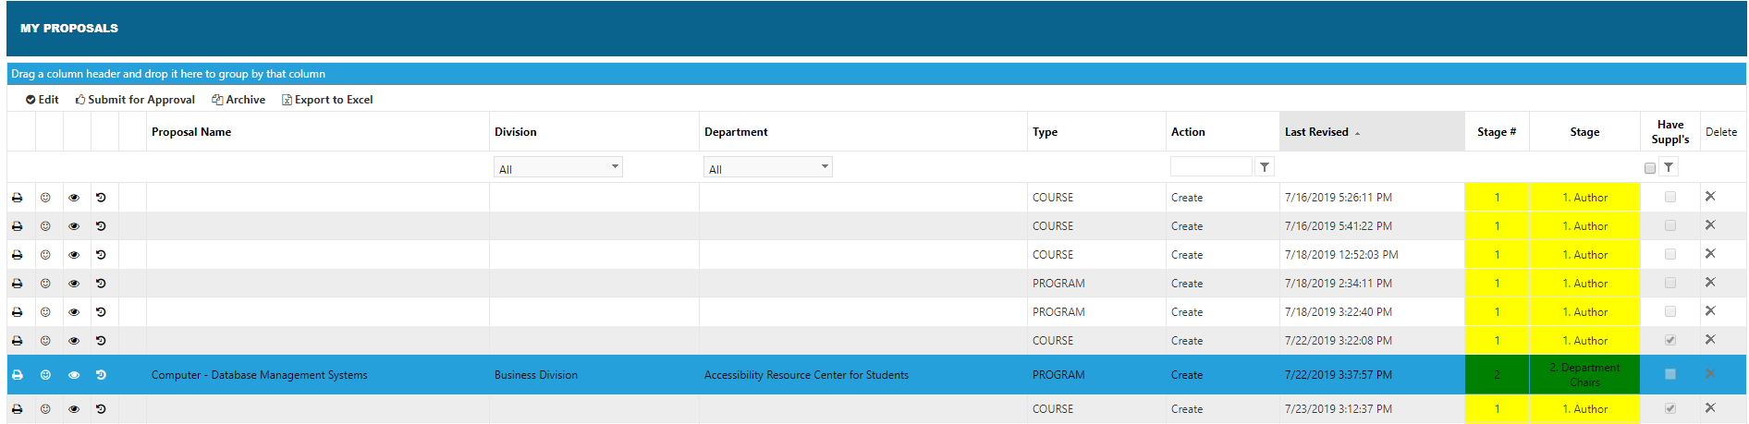
2. My Proposals
Full menu displays with detailed information for your proposals (both Programs & Courses)

Slide 10
2. My Proposals
Quick Links to make Edits, Submit for Approval, Archive and Export to Excel for only your proposals.

Slide 11
The Dashboard – 3. All Proposals
3. All Proposals - View all current program and course proposals.
3

Slide 12
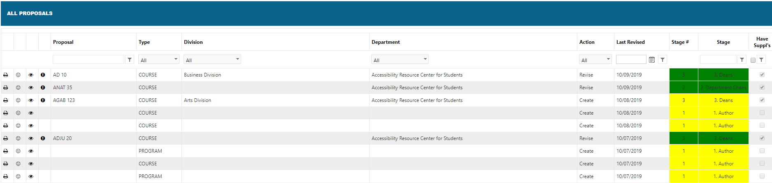
3. All Proposals
Full menu displays with detailed information for all Proposals (both Programs & Courses)
Filters can be applied.
*Read only access has been applied to all users to be able to only view proposals and not make edits.

Slide 13
Submitting for Approval
2. Submit for Approval
1. Locate Proposal on Dashboard

Slide 14
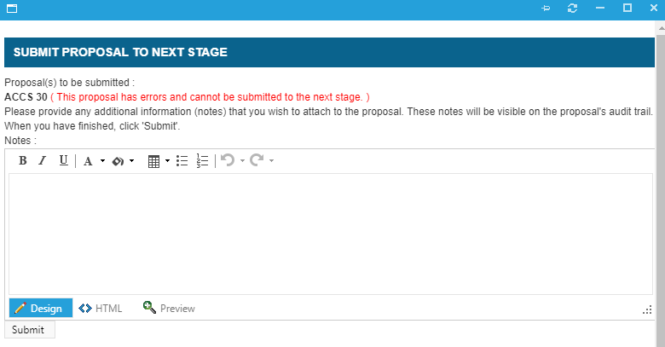
Submitting for Approval
3. New Window will populate. If any issues are found, the proposal cannot be submitted to next Stage.
4. Ability to add comments.
5. Select Submit

Slide 15
Stages in WebCMS 10.0

Slide 16
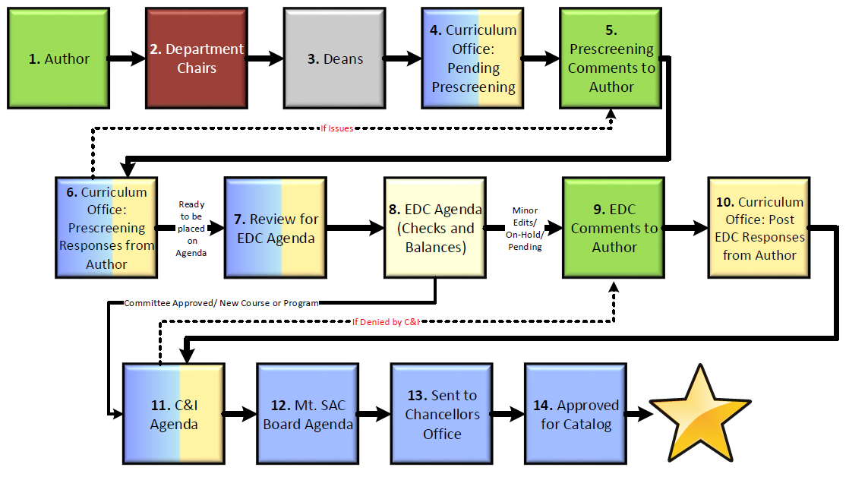
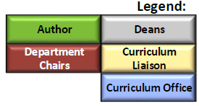
WebCMS 10.0 Stages

Slide 17
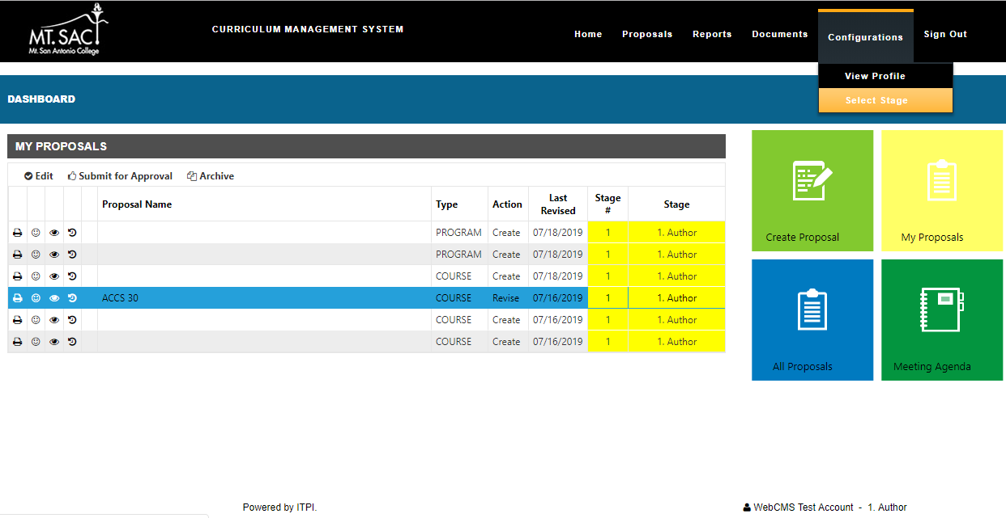
Select Stages - Author
1. Select Configurations
*Authors will have access to Stages 1, 5 and 9 in the WebCMS process.
2. Select Stage
3. Bottom of Page will identify what Stage you are currently in.

Slide 18
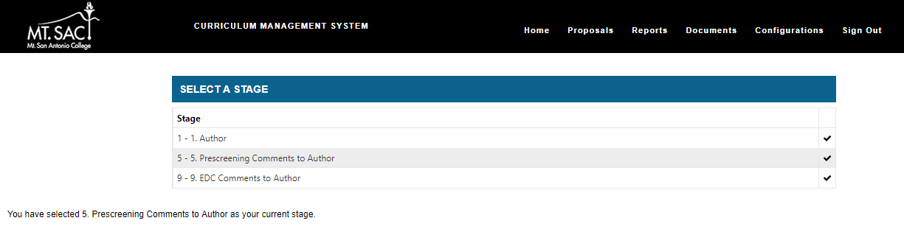
Select Stages - Author
4. Select the checkmark to be able to work in that stage.
5. Bottom of page will update the new stage you selected.

Slide 19

FAQ’s
Where can I find more curriculum resources/forms, what happens if I forget to save a section before clicking on the next section?
Does my course or program need Chancellor's Office approval?
How long does it take for a new course/program to be created and offered in the catalog?
What happens if I don't attach meeting minutes but still submit my course or program?
What if my course or program overlaps with another area?
What if I need more help?

