Slide 1

Winning the Accessibility Challenge
Gaeir Dietrich • HTCTU Director
www.htctu.net • www.toolsthatinspire.com
Notes:
www.htctu.net * Access to IT
1
1

Slide 2
Accessibility Process
Buy and create the most accessible ICT that you can
Accommodate what is not fully accessible
If equally effective accommodations not feasible, do not require the technology

Slide 3
Rehabilitation Act of 1973
Section 504 is about accommodation.
  Making it work for individuals
  Disability service offices created to serve students’ needs.
Section 508 is about access.
  Create accessible software, Web sites, videos, and documents.
  Purchase accessible products.
  Campuswide responsibility
Notes:
www.htctu.net * Access to IT
3
3
3

Slide 4
United We Stand
Access and accommodation work together
  It’s a continuum
Not fully accessible? Accommodate.
But beware…
  Some technology cannot be accommodated! Technology that cannot be accommodated cannot be required.
Notes:
www.htctu.net * Access to IT
4
4

Slide 5
How will you accommodate?
Can still use materials that are not fully accessible, as long as you can accommodate individual needs in an equally effective manner
Make accommodation planning part of the design strategy and buying decisions!

Slide 6
Complying with the Section 508 Standards
Information and Communication Technology (ICT)
Electronic & Information Technology (E&IT)

Slide 7
Section 508 Refresh
Final Rule became effective in March, 2017
For Web content, Non-Web Documents, and Software – this means WCAG 2.0, Level A and Level AA
  Web Content Accessibility Guidelines

Slide 8
When Do Standards Apply?
Section 508 standards apply to the California community colleges
  As purchasers of ICT
  As creators of ICT
Standards are not enforceable on the vendors!
Compliance is up to us

Slide 9
Exactly What IS the Standard?
The standard is WCAG 2.0 Level AA
  Web Content Accessibility Guidelines
  From W3C (World Wide Web Consortium)
Guidance on Applying WCAG 2.0 to Non-Web Information and Communications Technologies
  https://www.w3.org/TR/wcag2ict/

Slide 10
ICT Standards Apply
Two ways Section 508 applies
1. Creating ICT
  Web pages
  Online documents & courses
  Software & apps
2. Purchasing ICT
  Choose the most accessible product that meets your needs
Notes:
www.htctu.net * Access to IT
10

Slide 11
Section 508 Standards: Creation
In the beginning was the Web…

Slide 12
What Needs to Be Accessible
Anything on the Web
  Webpages
  Websites
  Online forms
  Online courses
  Videos
If it’s on the Web, it must be accessible!

Slide 13
External or Internal
ALL public facing content (documents, webpages, videos, etc.) must be accessible under the new standards
Non-public documents must be accessible in eight categories of official communications

Slide 14
Eight Categories
(1) Emergency Notifications
(2) Decisions adjudicating administrative claim or proceeding;
(3) Program or policy announcements
(4) Notices of benefits, program eligibility, employment opportunity, or personnel action

Slide 15
Categories cont.
(5) Formal acknowledgements of receipt
(6) Survey questionnaires
(7) Templates and forms
(8) Educational and training materials

Slide 16
What Does Accessible Mean?
Documents
  Must be readable with assistive technology
  Follow the LIST
    Links named logically
    Images described (alt text)
    Styles and structure consistent and logical
    Table header cells marked
For best access
  Post a PDF and the original DOC or RTF

Slide 17
Multimedia
Videos
  Captioned
  Plan for audio description—text description, for instance
  Campus-created videos, verbalize process so audio description is already there
  If you have a transcript, post that as well
Audio-only podcasts
  Transcripts

Slide 18
What about Software?
Learning software/apps
  Either have accessibility built-in or work with assistive technology
Learning objects
  Either accessible from the vendor or can be made accessible

Slide 19
And if it’s not accessible?!?
Work with DSPS to determine if an equally effective alternative exists
If an equally effective alternative does not exist, you cannot require the material / software / learning object, etc.

Slide 20
Content vs. Container
Academic freedom is about the content.
Section 508 is about the container.
Conforming to Section 508 simply allows equal access to the content.
www.htctu.net
20
Notes:
20
20
www.htctu.net * Access to IT
20
20

Slide 21
Commitment to an Accessible Web
How do we ensure access?

Slide 22
Many Recent OCR Web Cases
Requirements for access have been consistent
Conduct accessibility audit of website
Make web pages accessible
  WCAG 2.0 Level AA held as benchmark—same for DOJ
Set up system of testing and accountability (including quality assurance)

Slide 23
Requirements cont.
Verify vendor’s claims of accessibility for third party materials
Content must be made accessible or removed from site
Include a process on the website to allow the reporting of inaccessible content
Train all appropriate personnel on web accessibility

Slide 24
Bottom Line
Websites must be accessible
  Including materials posted to the website (videos, PDFs, etc.)
  Third party materials from vendors must be accessible or be removed
    The campus is responsible to verify vendor’s claims of accessibility
On-going accessibility testing of the site is required

Slide 25
Accountability
A system of accountability must be in place
OCR says sufficient resources must be provided to ensure accessibility
  “The Plan for New Content must include sufficient quality assurance procedures, backed by adequate personnel and financial resources, for full implementation.”

Slide 26
Make It Easy!
Train “accessibility experts” to support staff
Develop an accessibility “help desk”
  Questions need to be answered quickly!
One model: Each department has one person who becomes an expert in accessible documents

Slide 27
WCAG 2.0
Web Content Accessibility Guidelines

Slide 28
Organization of WCAG 2.0
4 Principles
12 Guidelines
  Not testable, but provides generalized framework
38 Success Criteria (for Level A/AA)
  Success Criteria are Yes / No statements
  Supported by detailed documentation (including How to Meet, Understanding the Success Criteria, Sufficient and Advisory techniques, etc.)

Slide 29
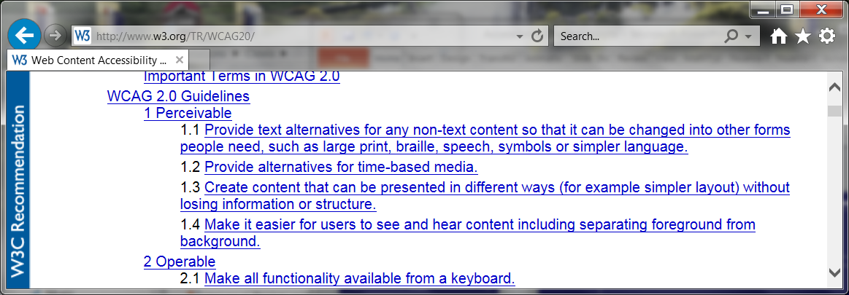
Perceivable Guidelines

Slide 30
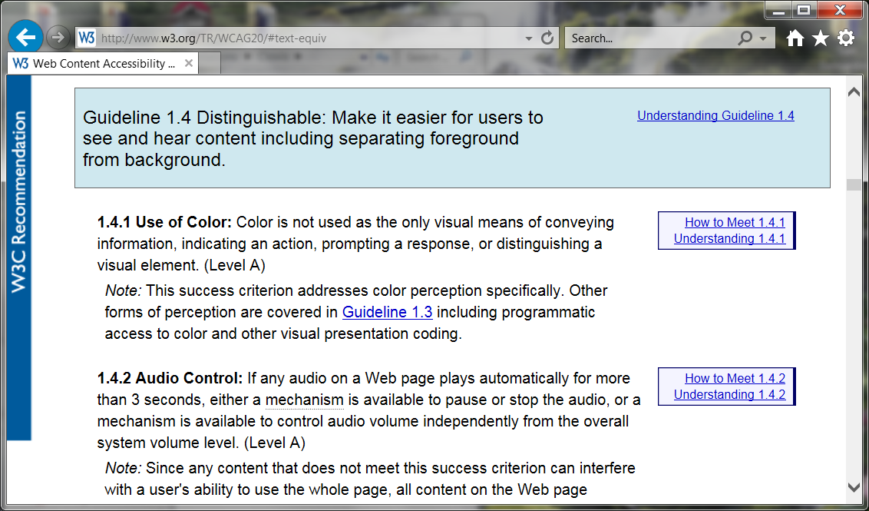
Guideline 1.4 Criteria

Slide 31
Accessible checklist?
Web Content Accessibility Guidelines (WCAG) 2.0 checklist from the W3C (World Wide Web Consortium)
  www.w3.org/TR/2006/WD-WCAG20-20060427/appendixB.html

Slide 32
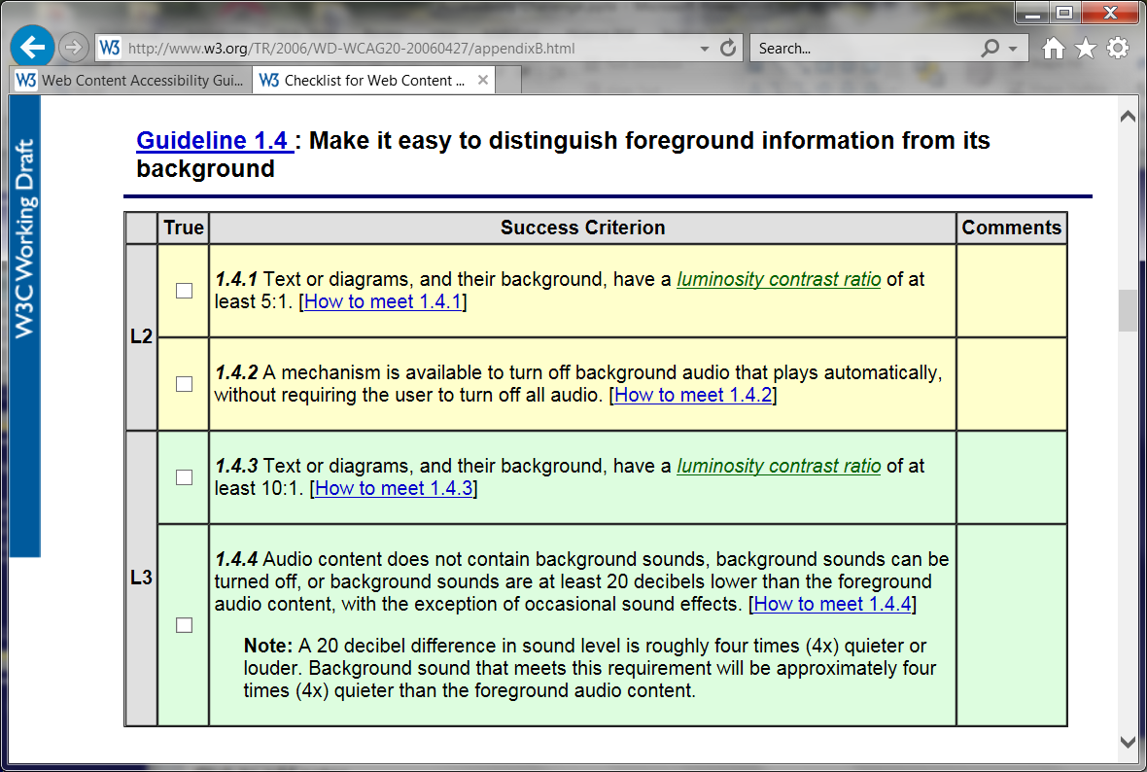
Checklist for 1.4

Slide 33
In a Nutshell: Four Guidelines
Perceivable
Operable
Understandable
Robust
Let’s see how POUR applies to forms!

Slide 34
Perceivable
Provide text for non-text elements
  Alt text for graphics
  Labels for form fields
Use structure
  Be aware of how instructions and buttons associate with the text
Use good contrast
  Make sure that text can be distinguished easily from the background

Slide 35
Operable
Make sure everything works from the keyboard
  Make sure the tab order is logical
  Do not require a mouse
Make content easy to find and navigate
  Use logical headings
  Use logical link names
  Make sure header rows in tables are clearly marked

Slide 36
Understandable
Write clearly
Define terms
Spell out acronyms
  Always write out the first time used
Use tooltips for clarity on fields
Use the language setting

Slide 37
Robust
Use good design to ensure that the document will work with all assistive technology
  Not just JAWS

Slide 38
In Summary
Perceivable
Operable
Understandable
Robust
So POUR yourself into your forms! ;-)

Slide 39
Follow the LIST
Practical Accessibility for Documents

Slide 40
Helpful Acronym
Use this “colored” LIST for access!
Links
Images
Structure
Table
And watch your color contrast!

Slide 41
Use Color Carefully!
Do not represent information ONLY with color
  Use a combination of color and text/ symbols
Color contrast must be clear; foreground and background clearly differentiated
  Black on white—good
  Yellow on white—not good

Slide 42
Color Contrast Help
Color Contrast Analyzer (CCA)
  http://www.paciellogroup.com/resources/contrastanalyser/
http://colorsafe.co
  Shows colors you can use together
Color Simulators
  http://www.color-blindness.com/coblis-color-blindness-simulator/
  http://colororacle.org/

Slide 43
L is for Links
Instead of …
  Click here for document X
Use the name or description as the hyperlink
  Document X has the information you need

Slide 44
Links
Link names should make sense out of context
Do not use underlining for anything other than hyperlinks

Slide 45
Links Benefits
Benefit for you
  You don’t lose connection with your materials when you make edits
  Linking to documents and learning objects by their names allows you to keep track of them easily!
Benefit for others
  What you get when you click is clear
  Screen reader users can use a “links list”

Slide 46
I is for Images
Add very brief text description
If graphic is simply decoration
    Provide a super brief description (e.g., “ivy border”)
  OR make it “background” in PDF
  OR use a null tag on the web “_”
If graphic is informative
  Describe as succinctly as possible

Slide 47
Images
Add alt text
If graphic copied from the internet, remove any attached hyperlinks
Place images “inline”
  Do not wrap text around them
  Can get same effect using columns, and that is fine
If images have text, include in alt text as needed

Slide 48
Describing Graphics
First figure out the purpose (intent) of the graphic.
  Is it decoration or information?
If information, what does the graphic convey?
  What is it?
Does the student need to do something with the graphic (part of an exercise)?

Slide 49
Informational Graphics
Keep descriptions short
  12 words or fewer is usually best
Do not repeat caption or information already in text
In some cases where more is needed, DSPS can create tactile graphics
  Tactile graphics are raised line interpretations of the graphic

Slide 50
No One Right Way
There is no single best way to describe graphics.
Just remember…
  Keep context in mind
  Ask yourself: Is this something the person really needs to hear?

Slide 51

Exercise 1
In a book about health, this full-page photo appears at the beginning of a chapter on nutrition:

Slide 52
Possible Alt Text Exercise 1
The photo is decorative.
  It is simply illustrating the theme of the book.
Keep the description simple:
  People biking
  Cyclists
If you really want more…
  3 people cycling along a river

Slide 53

Logo Example
Kansas City Kansas Community College
Presents an Evening of Jazz
Come join us for two hours of wonderful jazz by the lake. …

Slide 54
Possible Alt Text Logo
The logo is mostly decorative, somewhat informational.
Logo is branding, but is essentially decorative from the user’s viewpoint.
Keep it simple; first time include all text.
  Kansas City Kansas Community College logo, Making Life Better
  KCKCC logo

Slide 55
Images Benefits
Benefits for you
  Requires “out of the box” thinking
  Text becomes searchable online
Benefits for others
  Text appears on mouse-over (PDF or HTML), clarifying purpose of graphic
  Reinforces vocabulary
  Higher “hit” on Google

Slide 56
S is for Structure (& Styles)
Use styles
  Headings
    Use in order (heading 1, then 2, etc.); do not skip numbers
  Lists / bulleted lists / numbered lists
  Index (for stairstep indents, outlines)
DO NOT use text boxes
*Note: headings provide navigation points—both for screen reader users and for anyone using the “navigation pane.”

Slide 57
In General
Font size and readability
  12 point is good
  Avoid fonts that will be difficult to read online (use sans serif fonts)
Avoid using enter key for spacing
  Use spacing in the styles or on individual paragraphs as needed
Avoid using space bar for multiple spaces

Slide 58
Styles Benefits
Benefits for you
  Allows easy changing and editing
  Improves document navigation
  Can use “outline” view to rearrange sections
  Automatic table of contents
Benefits for others
  Improves document navigation for all—headings useable with screen readers

Slide 59
T is for Table
Mark the header row* in your tables
Word calls this “Repeat as header row at top of every page”
  *If first column has headers, those header cells will need to be marked in Adobe Acrobat Pro.
Use columns instead of tabs
  If absolutely necessary, use decimal tabs

Slide 60
Tables
Mark headers (rows and columns)
Do not break rows across page
Best not to merge cells
Put table title before the table
Use columns, not tables, just for layout
For boxed text, use columns and add a decorative border
Add a table summary (alt text)

Slide 61
Table Benefits
Benefits for you
  Always see header row, even across multiple pages
  Lessens reformatting/editing issues
Benefits to others
  Screen reader users will be able to hear the header text repeated as needed
  Users of large print will still see header row when enlarging text

Slide 62
Check Your “LIST”
MS Word has a very good built-in accessibility checker
File > Check for Issues

Slide 63
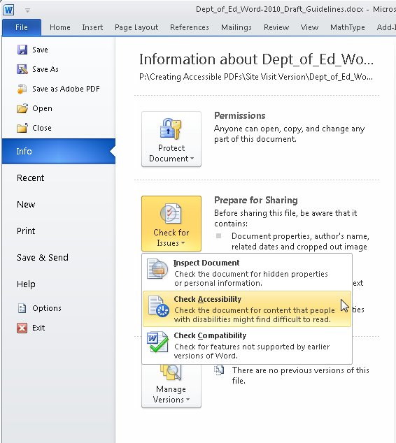
MS Word Built-in Checker

Slide 64
PowerPoint

Slide 65
Accessible PowerPoint
Themes
  Use built-in themes (under design tab)
  Allows user to adjust contrast as needed
  Styles are applied automatically
Make sure the first slide uses the “title slide” layout
  Use other layouts as appropriate
Give each slide a unique name

Slide 66
LIST in PPT
√ Links
Use logical link names
√ Images
Briefly describe graphics with alt text
√ Structure
Use built-in themes
Use “title” slide first
Give each slide a different title

Slide 67
LIST Continued
√ Structure
  Watch out for blank boxes in the footer
√ Tables
  Mark header row
  Add a table summary (alt text)
  Best not to merge cells

Slide 68
PPT Accessibility
Run the built-in accessibility checker
  File > Info > Check for issues

Slide 69
Resources
Others can help!

Slide 70
Accessible Canvas
Canvas tutorials available on the OEI website:
  https://ccconlineed.instructure.com/courses/98
Canvas Rich Media Editor
  Allows styles, alt text for images
Videos
  Create transcript and upload as “subtitles”
  https://guides.instructure.com/m/4152/l/719744

Slide 71
Accessible Web
W3C Guidelines
  WCAG (Web Content Accessibility Guidelines) 2.0
  http://www.w3.org/TR/WCAG20/
  www.w3.org/WAI/WCAG20/quickref/
Web Accessibility Initiative (WAI)
  www.w3.org/WAI/

Slide 72
Helpful Sites
WebAIM
  http://webaim.org/
  http://webaim.org/techniques/acrobat/forms#other
DO-IT (University of Washington)
  http://www.washington.edu/doit/

Slide 73
Digital Media
DCMP Captioning Key
  http://www.dcmp.org/captioningkey/
NCAM – STEM
  http://ncam.wgbh.org/experience_learn/educational_media/stemdx/guidelines
WGBH – Web Media
  http://ncam.wgbh.org/invent_build/web_multimedia/accessible-digital-media-guide/guideline-h-multimedia

Slide 74
Online Learning
@ONE four-week course
  Accessible DE
  http://www.onefortraining.com/
Professional Learning Network
  Hosts trainings from Lynda.com
  Prolearningnetwork.cccco.edu./creating-accessible-documents
  Free for CCCs

Slide 75
Accessibility Help Desk
CCC Accessibility Center
  www.ccctechnology.info
Create an account so that staff can respond to queries

Slide 76
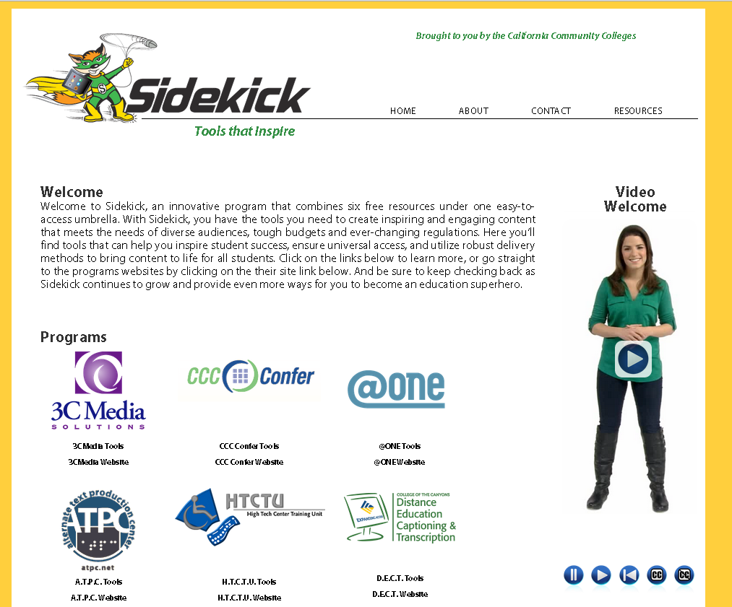
Your Sidekick!
  @ONE: Course
  on accessibility
  for online ed
  DECT Grant
Sidekick
  www.toolsthatinspire.com

Slide 77
Thank you!
Gaeir (rhymes with “fire”) Dietrich
  gdietrich@htctu.net
  408-996-6047
To schedule visits, please contact our admin assistant, Erika Owens
  eowens@htctu.net
  408-996-4636

