Slide 1
Employee Profile Showcase
Campus Directory
presented to ITAC
Facilitated by
Eric Turner
March 6, 2017
Notes:
Eric welcomes

Slide 2

Have You Had Any of These Challenges?
How do I get a hold of my manager?
What is the email address of my colleague?
Where is building 10?
How do I see someone’s profile?

Slide 3
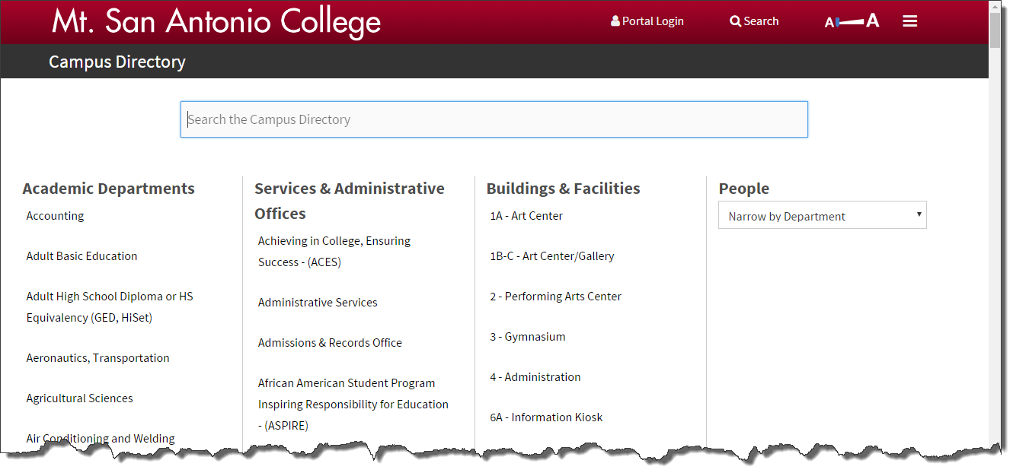
www.mtsac.edu/directory

Slide 4
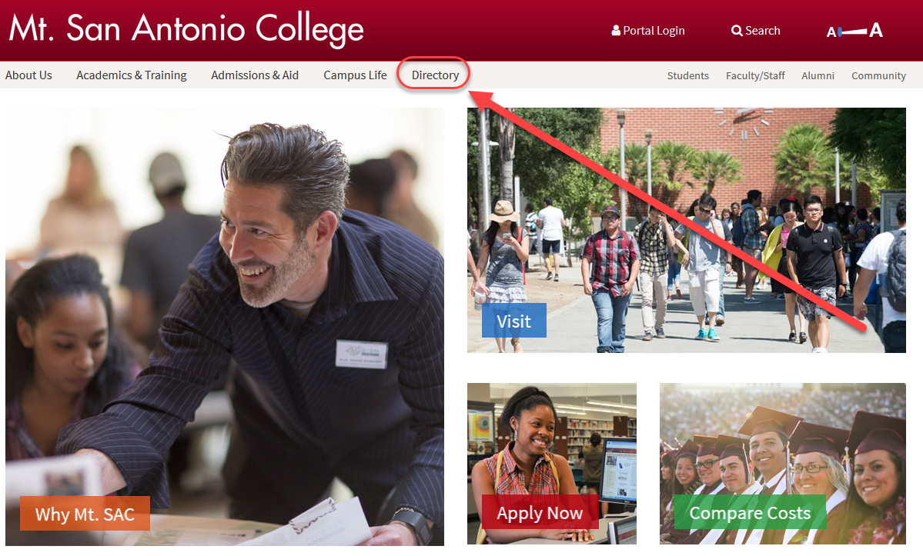
Homepage Link

Slide 5
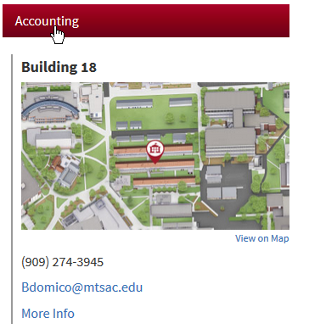
Academic Departments

Slide 6
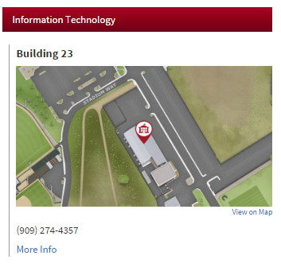
Services & Administrative Offices

Slide 7
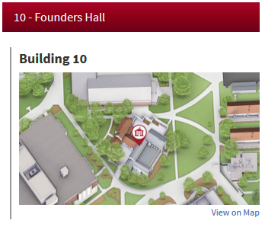
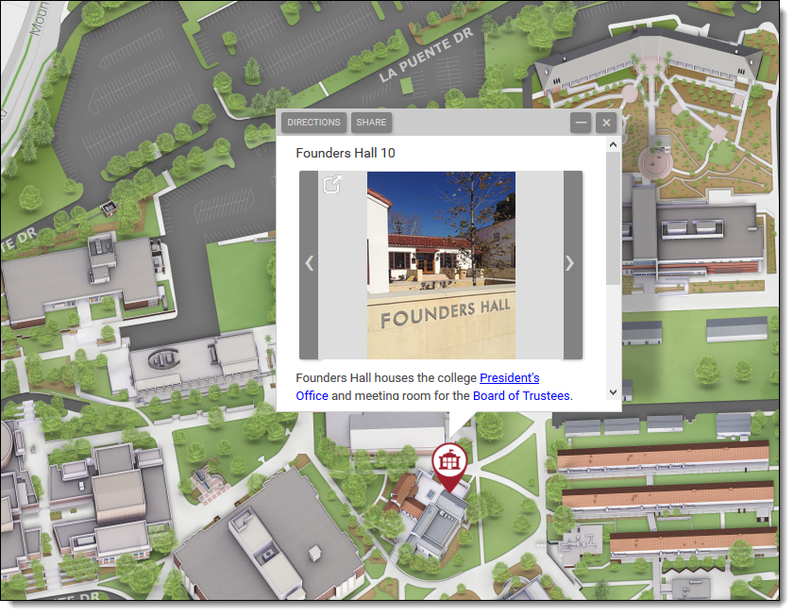
Buildings & Facilities

Slide 8
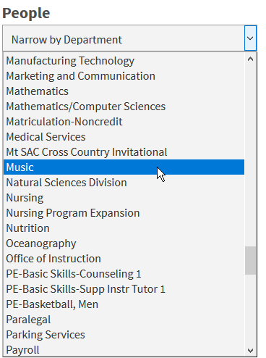
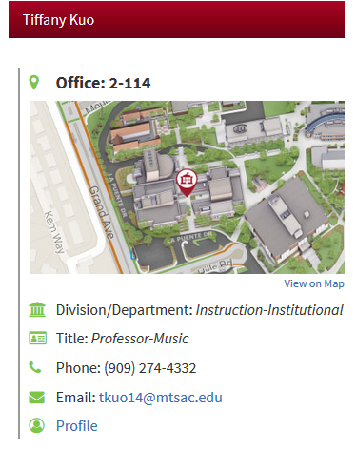
People Search

Slide 9
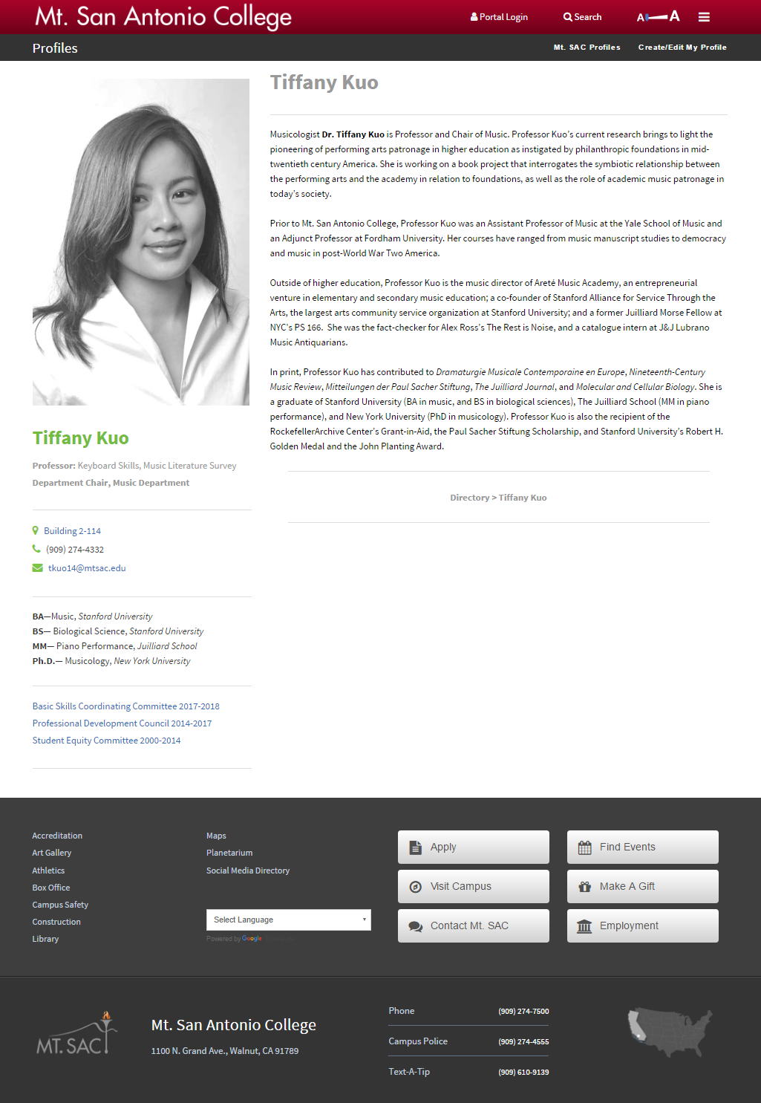
What is a Profile?
A “mini website” that offers biographical and areas of interest information to your readers

Slide 10
Profiles are Optional
Some people do not want their pictures on the Web
You must “Opt In” for your profile to be listed in
the directory
www.mtsac.edu/profiles/start

Slide 11
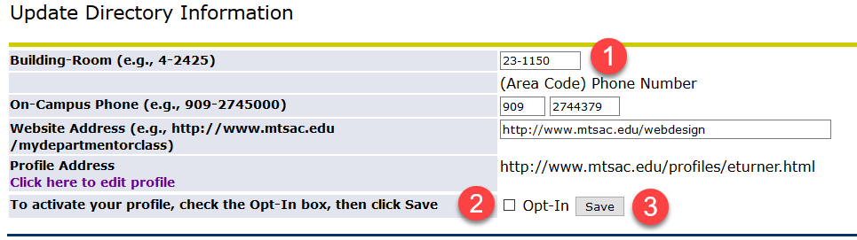
Login to Banner
Correct Contact Information
Click “Opt In”
Click Save

Slide 12
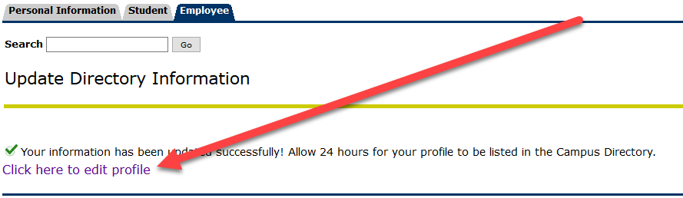
Click Link to Edit Your Profile

Slide 13
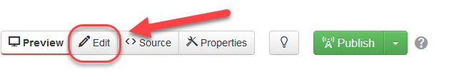
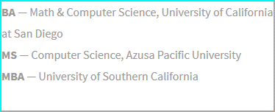
Edit Your Profile
Click the Edit button
Click the green button next to an editable region
Clear out sample text and enter your own

Slide 14
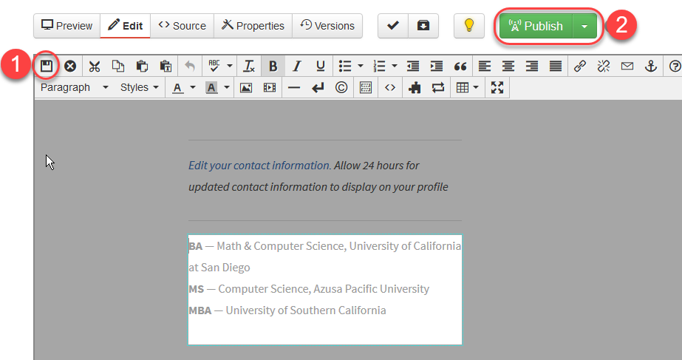
Save & Publish

Slide 15
Adding Photos
Click the Profile Image button
Click the Insert Picture Button icon in the toolbar
Click the Browse button
Click Photos Folder button
Click Upload
Click the Add button or drag your photo from your computer
Click Start Upload
Click Insert
Click the Save icon
Publish your photo or let IT know your photo is ready

Slide 16
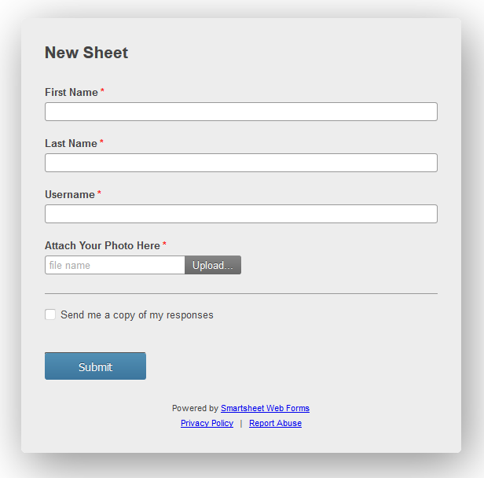
Request a Photo Publish
www.mtsac.edu/profiles/request

Slide 17
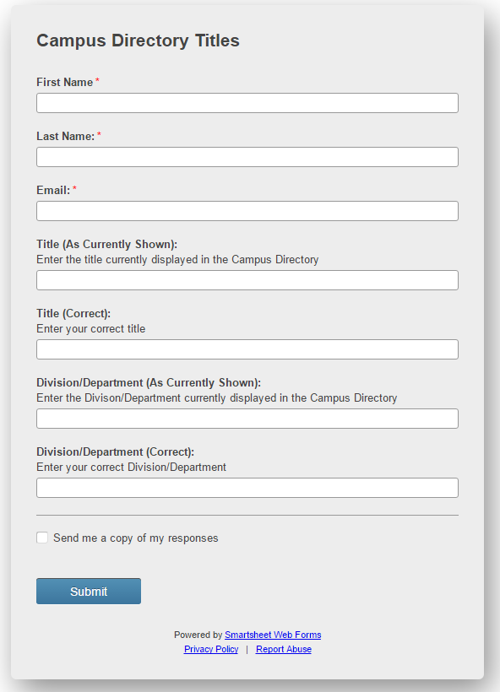
To Request Title or Department Changes
www.mtsac.edu/directory/request

Slide 18
Let’s See IT…
http://www.mtsac.edu/directory
http://www.mtsac.edu/profiles

