Slide 1
How to Scan Documents and Email for Accessibility Compliance – Classified Professionals Day
August 13, 2021
Eric Turner | eturner@mtsac.edu | (909) 274-4379

Slide 2
Preview
Know what the Law says…
Whenever possible, delete documents with errors
Whenever possible, use a webpage instead of a PDF document
Keep original copies made from Microsoft Word, Excel, PowerPoint…
Documents are more accessible in their native form
Documents can be made to be read-only in their native form
Live Demonstration
Questions

Slide 3

Accessibility
What does “accessibility” mean to you?
Website accessibility is actively designing, developing, and creating content in such a way that it does not hinder any person from interacting with the website. - Web Access Initiative (WAI)

Slide 4
Accessibility--Non-Technical Definition
A document is accessible when everyone, regardless of ability or disability, can use it and get the information they need.
Usable by someone who…
Cannot use a mouse
Cannot hear
Cannot see
Cannot easily distinguish color differences
Uses assistive technology (adaptive hardware and software) to access the system
Used with permission from the High-Tech Center Training Unit (www.htctu.net)

Slide 5
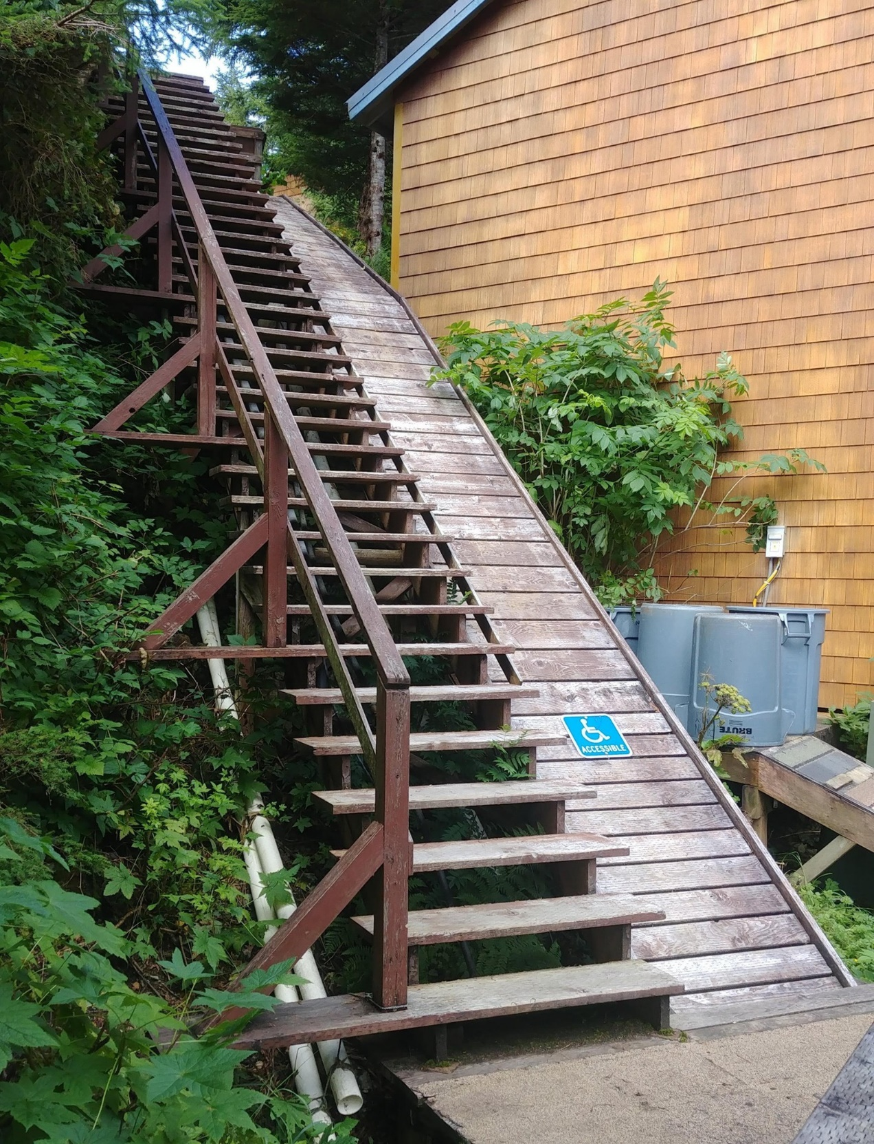
Non-accessible stairway
Accessibility Compliant?

Slide 6
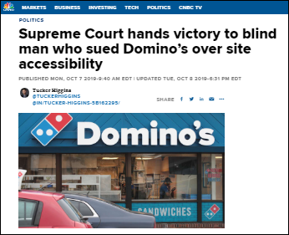
Know What the Law Says Regarding Accessibility
Section 508 of the Rehabilitation Act of 1973 has been refreshed. As of January 18, 2018 institutions (anyone who receives federal funding) must ensure websites, emails and MORE are accessible or face possible litigation!
1,700 cases pending with the Office of Civil Rights (OCR)
The OCR tasked College of the Siskiyous to make their online courses/websites accessible by the next term or take them down
Essentially, you must follow Web Content Accessibility Guidelines (WCAG) to comply!
Notes:
Organized around 4 Principles and 12 Guidelines
• Perceivable: Information and user interface components must be presentable to users in ways they can perceive.
• Operable
• Understandable
• Robust

Slide 7
What Information Must be Accessible?
Emergency Notifications
Decisions adjudicating administrative claim or proceeding
Program or policy announcements
Notices of benefits, program eligibility, employment opportunity, or personnel action
Formal acknowledgements of receipt
Survey questionnaires
Templates and forms
Educational and training materials
Used with permission from the High-Tech Center Training Unit (www.htctu.net)

Slide 8


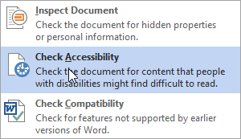
Scanning Can Be As Easy as 1-2-3
Office Documents (Word, Excel, PowerPoint, etc.) are scanned as follows:
2. Click Check for Issues
1. Open the File menu
3. Click Check Accessibility

Slide 9
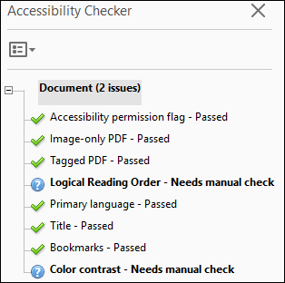
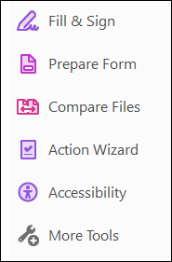
Scan PDF Documents
To scan PDF Documents:
Click Accessibility
Click Full Check
Click Start Checking
Tip
Always scan a desktop copy of your document.
If you do not see the PDF tools, be sure to open a document that has been downloaded to your desktop.

Slide 10
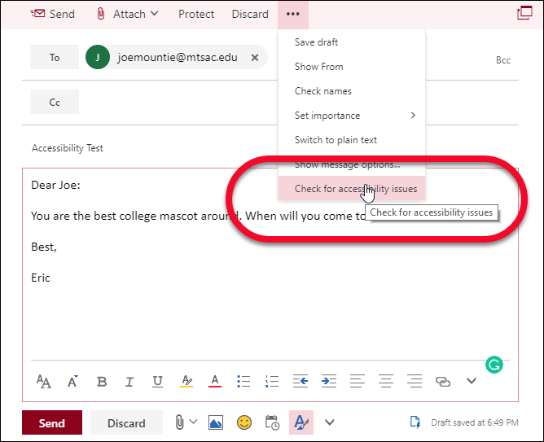
Scan Your Email (Office 365)
Open Outlook - (Use the Office 365 version at office.com)
Click New Message and compose an email
Click Check for Accessibility Issues from the … menu
Note: Check Accessibility works in Office 365, but not in all versions of Outlook

Slide 11

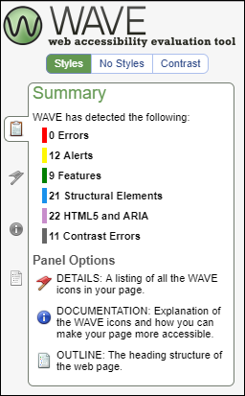
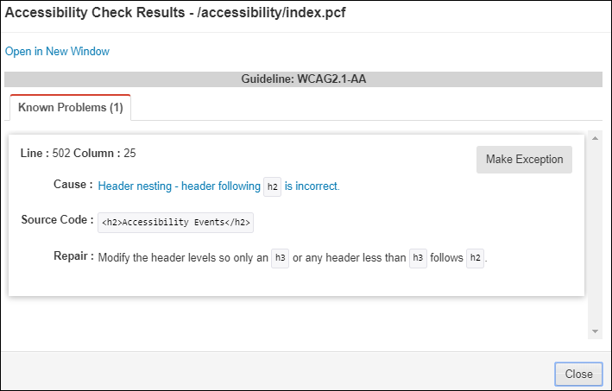
Scan Webpages
To scan Webpages:
WAVE (WAVE Webpage Scanning)
Omni CMS

Slide 12
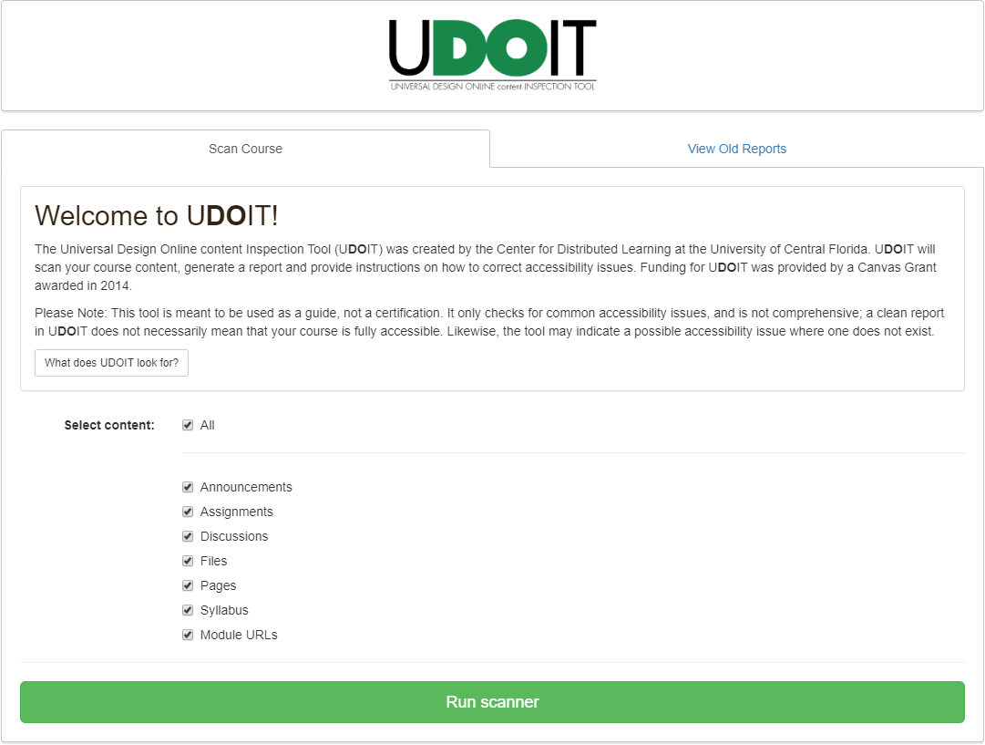
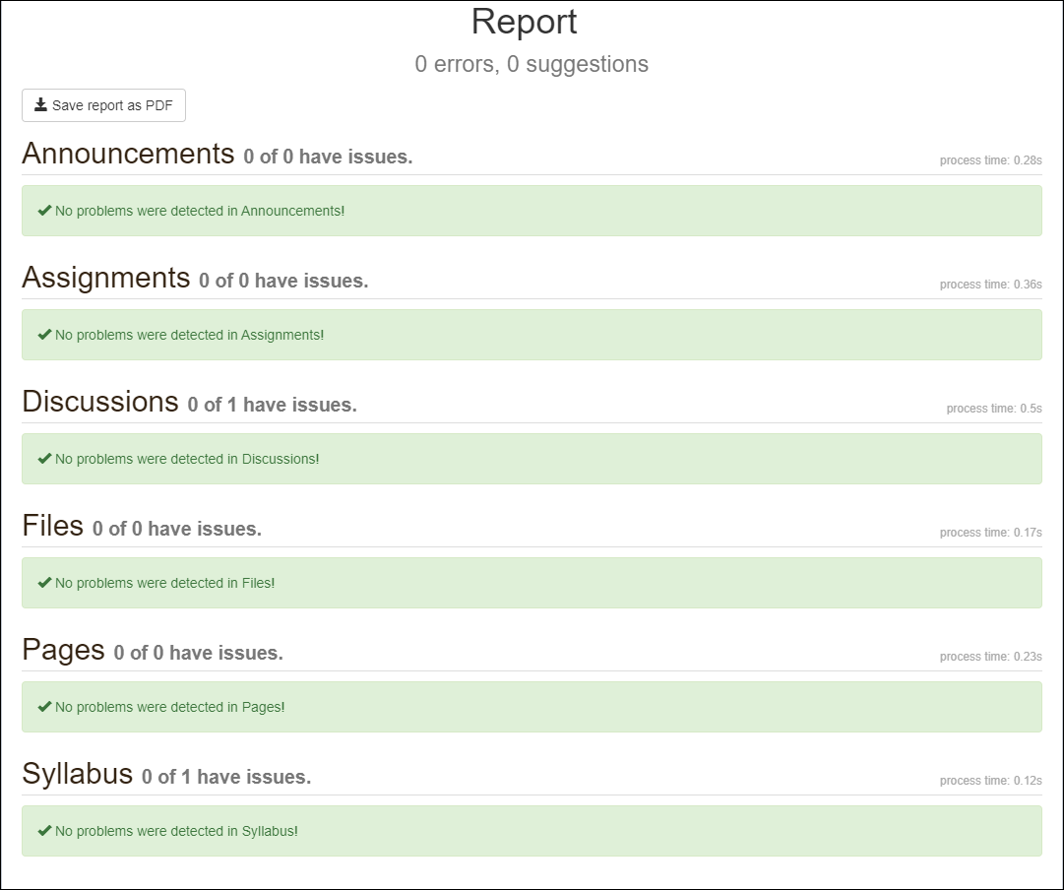
Scan Your Documents in Canvas
UDOIT scans your Canvas course, generates a report of accessibility issues, and provides resources for addressing these issues.
To Run UDOIT in Canvas:
Click Accessibility Checker
Click Run Scanner
Review the Report and fix any errors

Slide 13
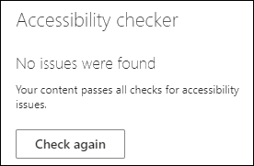
Need help making an accessible document?
Get training and fix it yourself
Send it to us
Accessibility Help www.mtsac.edu/accessibilityhelp

Slide 14
Creating Accessible Documents from Scratch
Microsoft Office (Word, PowerPoint, etc.)
Links
Images
Structure & Styles
Tables
Used with permission from the High-Tech Center Training Unit (www.htctu.net)

Slide 15
Links
Links should clearly show where the user will be taken when clicked.
Example:
To apply for FAFSA, click here.
Becomes:
Use the FAFSA application to apply.

Slide 16

Images: Which is the best alternative text for this image?
“Image”
“Two girls and a boy leaning over”
“Three smiling students”
“Image of three smiling students”
“Girl with blue shirt and shell necklace, next to girl with black shirt and hoop earrings, boy with plaid shirt in second row.”

Slide 17
Tag Your Documents
What are Tags and when do I need them?
Tags allow people to navigate a document in a similar way visual users navigate
Apply Tags to make your document accessible to screen readers
Documents without Tags have:
No clear navigation
No understanding of pictures or links
No organization for screen readers
Documents with Tags:
Are easy to navigate
Have descriptions for pictures and links
Have an organized layout

Slide 18
Tags (Continued)
Types of Tags
• Heading Tags
• Image Alt. Tags
• Table Alt. Tags
• Table Heading Tags
Other Considerations
• Color
• Lists
• Metadata

Slide 19
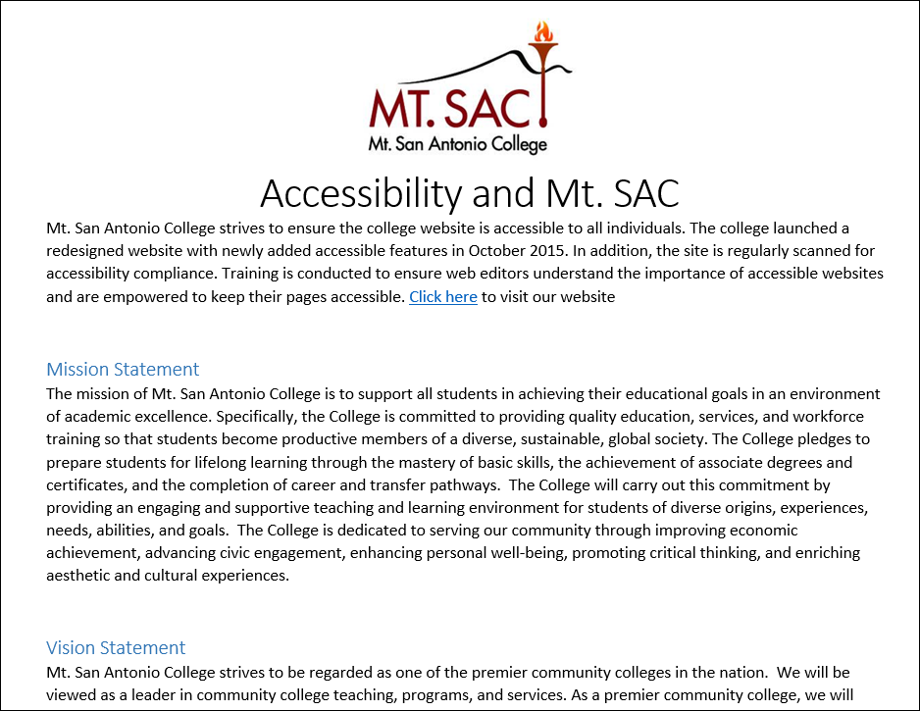
Can you tell the difference between these two documents?
Has Tags
No Tags
To those who use their eyes to read documents: there is no difference
To a screen reader: One document is organized, one is not.

Slide 20
Style/Structure
Headings communicate the organization and structure of the content.
Assistive technologies use headings to provide in-page navigation.
Make sure headings and sub-headings are in logical sequential order
Example Code:
<h1>Plant Foods that Humans Eat</h1>
<h2>Fruit</h2>
<h3>Apple</h3>
<h3>Orange</h3>
<h3>Banana</h3>
<h2>Vegetables</h2>
<h3>Broccoli</h3>
<h3>Brussels sprouts</h3>
<h3>Green beans</h3>
<h1>Plant Foods that Humans Eat</h1>
<h2>Fruit</h2>
<h3>Apple</h3>
<h3>Orange</h3>
<h3>Banana</h3>
<h2>Vegetables</h2>
<h3>Broccoli</h3>
<h3>Brussels sprouts</h3>
<h3>Green beans</h3>

Slide 21
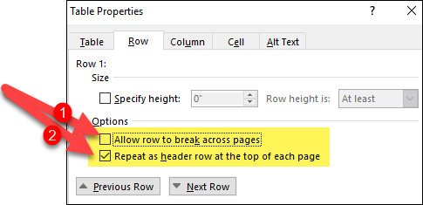

Tables – Making Tables Accessible
Split nested tables into multiple tables
Remove merged cells
Set row headers in your tables using Table Properties
Uncheck the Allow row to break across pages check box in the Options section.
Check the Repeat as header row at the top of each page
Note: Do not forget to add Alt-text to your tables

Slide 22
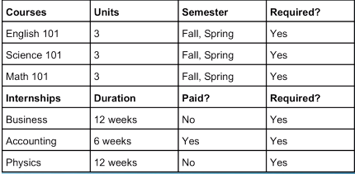

Tables
Is this table Okay?

Slide 23
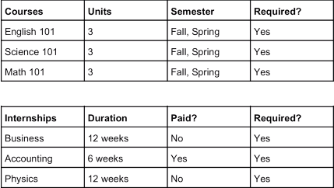


Tables (Split)
Is this table Okay?
Keep Each Table to one page if possible
Do not use tables for formatting only
Do not use nested tables or columns

Slide 24
Other Considerations: Color
Colors should not be used to communicate information
If you were to use red text to communicate bad information and green text to communicate good information
Those who use screen readers would not get that information
Those who are color blind would not get that information
Use bold or italics to communicate information
If you use color, it must be high contrast (i.e., dark text on light background or vice-versa)
Color Test (http://www.mtsac.edu/accessibility/colortest)

Slide 25
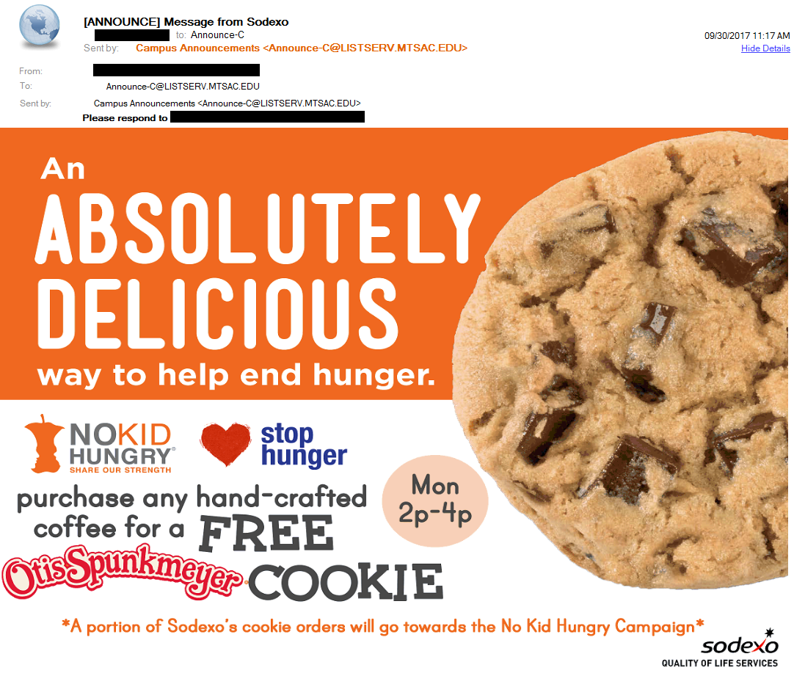
Is this a good email?
Yes
No
Maybe

Slide 26
My Email is Required to be Accessible if
I am sending to all employees
I am only sending to a small group, all of whom I know
I am only sending to one other person
My email contains a survey
My email contains educational or training material

Slide 27
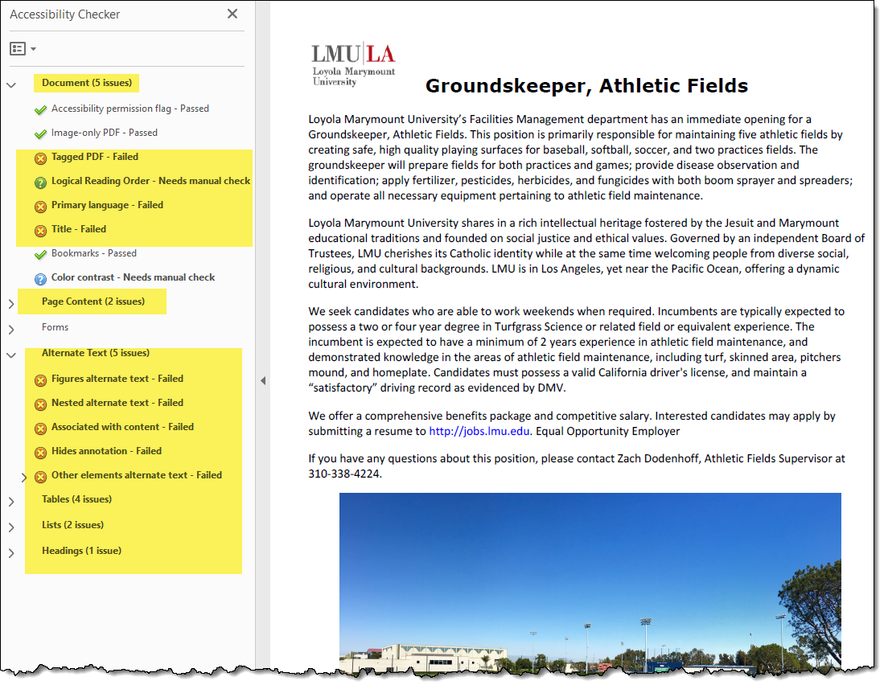
My PDF Doesn't Pass. Now What?

Slide 28

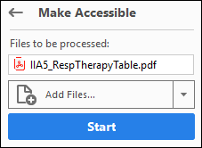
Use the Adobe Acrobat Action Wizard

Slide 29
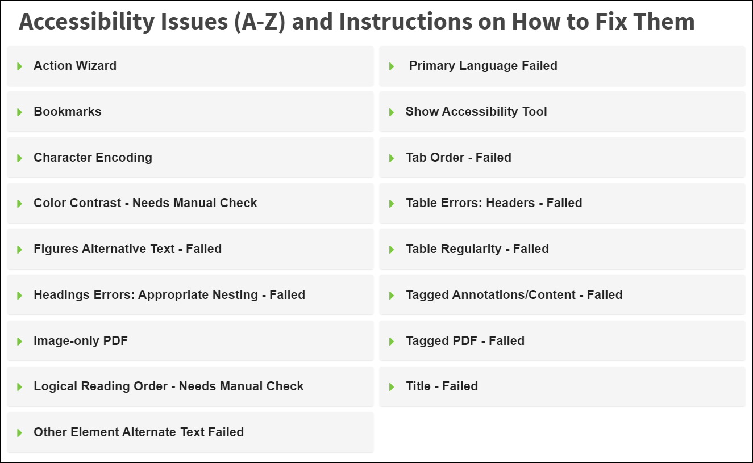
Accessibility Fixes
Wouldn’t It Be Nice If There Was One Central Place for Accessibility Help?
Accessibility Help: www.mtsac.edu/accessibility

Slide 30
Resources
Need help making an accessible document?
Check out the Mt. SAC Accessibility webpage for common errors and fixes.
Other Resources:
WCAG Guidelines
Alexander Skogberg’s blog that explains the new additions to WCAG 2.1
UDOIT Scanning for Canvas
WAVE (Web Page Scanning)
Omni CMS (Formerly OmniUpdate) Accessibility Checker
Siteimprove (Website Scanning, PDF Scanning, and Quality Assurance)
Color Test using Color Oracle

Slide 31
Accessibility Videos
Email Scanning
Reading Order & Color Contrast in PDF Documents

Slide 32

Questions

